Slide 1

Analysis and Requirements Design
Intro
Hook
Explore
Explain
Apply
Share
Evaluate
Expand

Slide 2
I. Description of problem requirements
Requires building a management system for the purchase and sale of electronic goods.
The accountant holds the company's revenue, the sales statistics incoming goods (balance of imports and exports), best-selling items, monthly revenue.
When the goods are imported, the accountant will create a goods receipt with full information about the import of that goods. When goods are sold directly to dealers or goods are raised in doubt, the accountant will create a delivery note.
Accountants directly contact manufacturers to import goods into supermarkets, as well as contact agents to sell goods out.
Agents are buyers. When purchasing, agents need to log in to the system. After logging in, the agent enters to buy, after the purchase is complete, the agent is taken to the payment place, the agent can pay by cash, transfer, momo,... The agent can pay online and view order status.
When receiving goods at warehouse, warehouse staff will scan barcodes, RIFDs to perform the goods warehousing process

Slide 3
II. Identifies the ACTOR
1. Agent
- As the person who directly buys from the system, gets paid, receives the invoice he has purchased from the system, and views the status of the order.
2. Accounting
- Is the person responsible for creating receipts when goods are imported, creating delivery notes when sending goods to agents, updating order status, updating payment status, inventory statistics.
3. Warehouse staff
- When receiving and exporting goods, they will scan barcodes, RIFDs to perform the process of importing and exporting goods.
4. Management
- Being the person who understands the business situation and revenue of the supermarket, manages the staff. The statistics are done monthly, quarterly or sometimes and hoc.

Slide 4
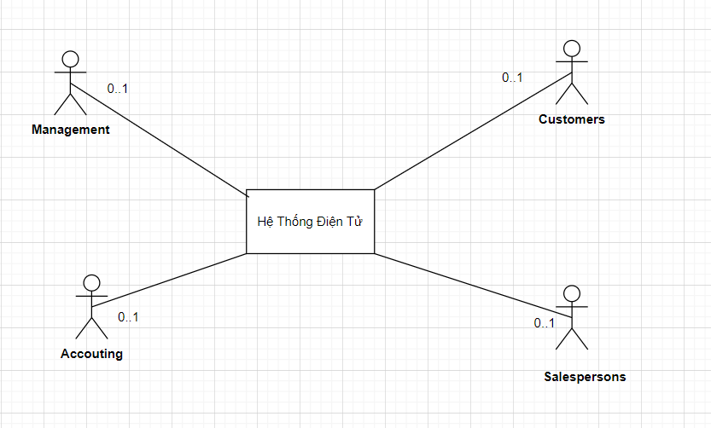

Slide 5
III. Identify use case
Customers: None
Salespersons:
Invoicing
Login
Accounting:
Create a receipt
Create delivery note
Product inventory
Create a pay slip
Management:
Import management
Shipment management
Friendly customer management
Statistical

Slide 6
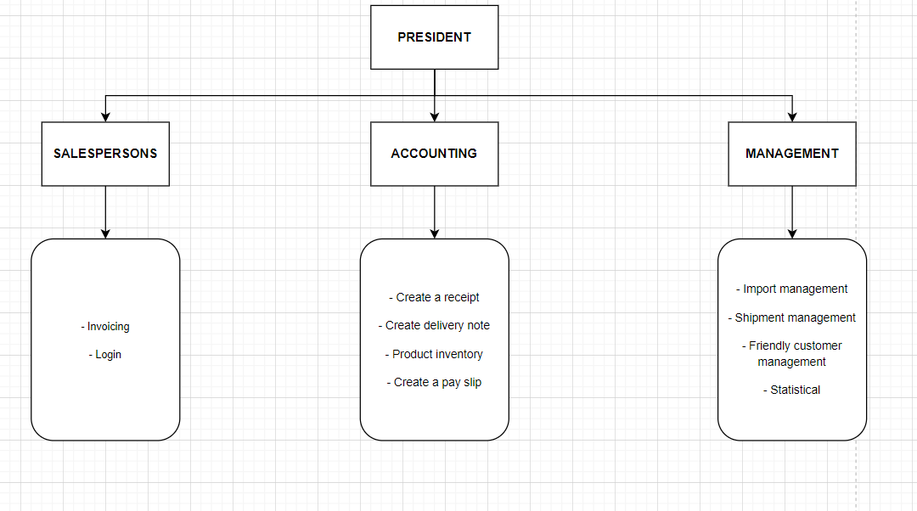
Organization Chart

Slide 7
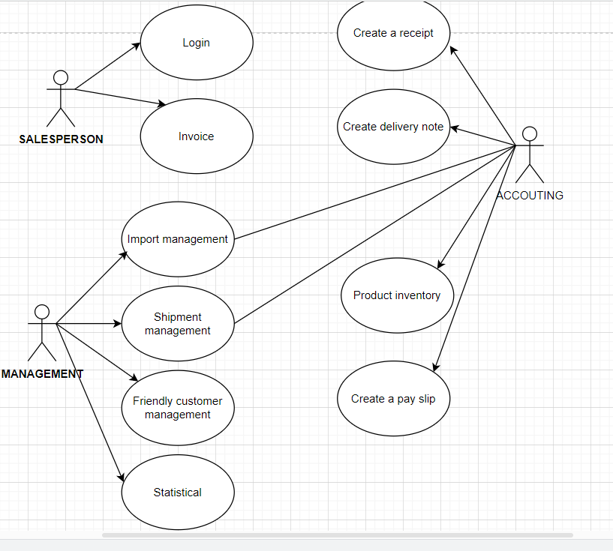
IV. Build use case diagram

Slide 8
V. Description of use cases
LOGIN
1. Identifier Summary
Title: Login to the system.
Summary: This use case allows accountants and agents to log in to the system
Actor: Salesman
2. Scenario Description
a) Prerequisites:
- Employee profile has been updated on the system.
- Employees must have an employee card
b) Normal scenario:
- The salesperson holds the employee card close to the scanner.
- Employee Barcode Validation Check System
- Login successfully.
c) Alternative scenarios
- The barcode on the card is invalid
- The system allows to rescan the employee's barcode or choose to end.

Slide 9
b) Normal scenario:
- Staff scans the barcode of each item
- The system automatically calculates the total amount that the customer has to pay based on the unit price of the item, the quantity purchased by the customer, and the value added tax that has been saved in the system
- Customer gives a friendly loyalty card
- The salesperson will scan the barcode of the card
- The system checks the validity of the card.
- The system will accumulate points for customers
- Staff will print invoices for customers
c) Alternative scenarios
- Customers who do not have a loyalty card
Starting from step 3 of the normal scenario, the system will skip step 4,5,6
MONEY BILLING
1. Identifier Summary
Title: Invoice
Summary: This use case starts when the employee chooses the invoicing function to calculate money and issue invoices to customers
Actor: Salesman
2. Scenario Description
a) Prerequisites:
- Customers have a need to buy goods and have a need to pay money
- The item codes, unit prices have been updated on the system
- Invalid loyalty card barcode
Starting from step 4 of the normal scenario, the system allows to rescan the code or choose to end.

Slide 10
IMPORT MANAGEMENT
1. Identifier Summary:
Title: Management of imported goods.
Summary: This use case allows the manager to import goods. When the goods are out of stock or there is a need to import more goods, the manager will enter the goods to be imported, this information will serve as the basis for the accountant to import the goods into the warehouse.
Actor: Manager.

Slide 11
2. Scenario Description
a) Decision conditions:
- Item code and manufacturer information have been updated in the system.
b) Normal version:
- The manager chooses the input management function of the system.
- The system asks for the item code to be entered.
- The manager of the input code.
- The system checks the validity of the product code.
- The system asks to enter the quantity.
- The manager enters the quantity of goods to be imported.
- Quantity recording system.
- The system asks to enter the manufacturer code.
- The manager enters the manufacturer code.
- The system checks the validity of the manufacturer's code.
- The system transfers the entered information to the accountant.

Slide 12
c) Options:
Al - Manager entered invalid item code:
Sequence A1 starts from step 4 of the normal scenario.
- The system asks the manager if he wants to add this item to the system.
- The manager selects more rows.
- The system asks to enter the item name.
- The manager enters the name of the item.
- The system saves item codes and goods names.
Go back to step 5 of the normal scenario.
Al.1 − The manager did not select additional rows.
The sequence A1.1 starts from step 5 of the alternative scenario A1.
- The manager did not select more rows.
Return to step 2 of the normal scenario.
A2 - The manager entered the wrong manufacturer code:
The A2 series starts from step 10 of the normal scenario.
The system asks the manager if he wants to add this manufacturer code to the system.
- The manager chooses to add the manufacturer code.
- The system asks to enter the manufacturer's name.
- The manager enters the manufacturer.
- System to save manufacturer code and production name. Go back to step 10 of the normal scenario.
A2.1 – The manager did not select more rows.
The A2.1 series starts from step 11 of the A2 replacement scenario.
- The manager did not choose to add the manufacturer code. Go back to step 8 of the normal scenario.

Slide 13
EXPORT MANAGEMENT
1. Identifier Summary
Title: Export management.
Summary: This use case allows the manager to manage the delivery of goods from the warehouse to the counter. When the goods on the counter are sold out, the manager tells us the information of the items that need to be displayed on the counter, this information will serve as the basis for the accountant to ship the goods to the counter.
Actor: The manager.

Slide 14
2. Scenario Description
a) Prerequisites:
- Goods to be exported to the counter are already in stock.
b) Normal scenario:
- The manager selects the System's Export Management function.
- The system asks to enter the product code to be exported to the counter.
- The manager enters the item code.
- The system checks the validity of the product code.
- The system asks to enter the quantity.
- The manager enters the quantity of goods to be exported.
- The system checks whether the quantity meets the quantity of goods in stock.
- The system transfers the entered information to the accountant.
c) Alternative scenarios:
Al - Manager entered invalid item code:
A1 string started from the step 4 of the normal script.
- The system notifies the item code that is not in the system.
Return to step 2 of the normal scenario.
A2 - The manager imported invalid goods to be exported:
A2 string started from the step 7 of the normal script.
- The system notices that the quantity that has just been imported exceeds the number of goods currently in stock.
- Return to the 5 of the normal script.

Slide 15
FRIENDLY CUSTOMER MANAGEMENT
1. List definition summary
Title: Friendly customer management.
Summary: This use case allows the manager to add Customer Friendly information.
Actor: Manager.

Slide 16
2. Scenario Description
a) Prerequisites:
- Customers want to make Customer Friendly card.
- Customers with invoices greater than 50000
b) Normal scenario:
- The manager chooses the system's function of adding Friendly Customers.
- The system asks the manager to enter the customer's name.
- The manager enters the customer's name.
- The system asks to enter the customer's name.
- The manager enters the customer's name.
- The system checks the validity of the customer's name and asks to enter the address.
- The manager enters the address.
- The system checks all information entered.
- The system automatically updates the card creation date, issues customer codes and saves information.
c) Alternative scenarios:
A1 - Invalid date of birth:
Sequence A1 starts from step 6 of the normal scenario.
- Invalid date entered. Go back to step 4 of the normal scenario.
A2 - The customer information just entered is already in the system:
Sequence A2 starts from step 8 of the normal scenario.
- Notice that this customer already exists in the Customer Friendly system.
- The system cancels all entered information.
The use case end.

Slide 17
STATISTICAL
1. List definition summary
Title: Revenue statistics.
Summary: This use case allows the manager to statistics the system's revenue at the present time
Actor: Manager.

Slide 18
2. Scenario Description
a) Decision conditions:
- Do not have.
b) Normal version:
- The manager chooses the system function.
- The system asks to select the statistical configuration.
- The manager chooses the statistical expression (month, quarter, current time)
- The system displays statistics and revenue tables.
- The system asks the manager if he wants to be included in the statistics table.
- The manager requests in the statistics table.
- The system in the statistics table for the manager.
c) Alternative scenarios:
A1 - Manager is not in the statistics table:
- Sequence A1 starts from step 5 of the normal scenario.
- The manager does not ask in the statistics table
The use case end.

Slide 19
CREATE IMPORT COLLECTIONS
1. Identifier Summary
- Title: Create entry slip.
- Summary: This use case allows the accountant to create a receipt for goods entering the warehouse.
- Actor: Accountant

Slide 20
2. Scenario Description
a) Prerequisites:
- There are imported goods.
- There is management information to import goods from the manager.
b) Normal scenario:
- The accountant chooses the system's Create Invoice function.
- The system requires the accountant to fill in the goods' information in the Goods Entry slip.
- The accountant fills in the goods import slip.
- System to issue goods receipt code and save information
- The system asks the storekeeper if he has printed the Import Voucher.
- The accountant chooses to print the Goods Entry slip.
- The system prints the goods import slip for accountants.
c) Alternative scenarios:
A1 - The accountant does not print the Goods Receipt:
- Sequence A1 starts from step 5 of the normal scenario.
- Accountants do not require printing receipts.
- Use case end.

Slide 21
CREATE SHIPPING COLLECTIONS
1. Summary of title definition:
- Create purchase order.
Summary: This use case allows the accountant to make a note to release goods from the warehouse.
Actor: Accountant.

Slide 22
2. Scenario Description
a) Decision conditions:
- There is information on management of shipments from the manager.
b) Normal version:
- The accountant chooses the system's Create Warehouse and Export function.
- The system asks the Accountant to fill in invoice information in the Goods Release Note.
- The accountant fills in the information on the Goods Release.
- The system issues the delivery slip code and saves the information.
- The system asks the accountant whether to print the Export Voucher.
- The accountant chooses to print the Delivery Note.
- The system to print the Goods Release for the accountant.
c) Alternative scenarios:
A1 - The accountant does not print the Goods Release:
Sequence A1 starts from step 5 of the normal scenario.
- Accountants do not require printing of delivery notes.
- The use case end.

Slide 23
INVENTORY
1. Identifier Summary
Title: Inventory of goods in stock.
Summary: This use case allows accountants to inventory goods in stock, quantity of each type of goods, expiry date of each item.
Actor: Accountant

Slide 24
2. Scenario Description
a) Prerequisites:
- Do not have.
b) Normal scenario:
- The accountant chooses the Inventory function.
- The system asks to choose the form of inventory (by item code, all).
- Accountants choose the form of inventory.
- The system displays the item code, the number of corresponding items.
- The system asks the accountant if he wants to print the inventory.
- The accountant chooses to print the Inventory sheet.
- Inventory printing system for accountants.
c) Alternative scenarios:
A1 - Accounting does not require printing of the Inventory: Series A1 starts from step 5 of the normal scenario.
- Accounting does not require printing of statistical tables
The use case ends.

Slide 25
CREATE PAYMENTS
1. List definition summary
Title: Create payment slip.
Summary: This use case allows accountants to prepare Returns to manufacturers.
Actor: Accountant

Slide 26
2. Scenario Description
a) Prerequisites:
- The item you want to pay must be in the system.
b) Normal scenario:
- The accountant chooses the system's Create Return Voucher function.
- The system asks to enter the item code to be paid.
- The accountant enters the code of goods to be paid.
- The system checks the validity of the product code.
- The system asks to choose a reason for returning goods (defective goods, expired goods).
- The accountant chooses the reason for the payment.
- The system automatically assigns the order number of the Order Creation Voucher, saves information.
- The system asks the accountant whether to print the Return Voucher.
- The accountant chooses to print the Return Voucher.
- The system prints Return Vouchers for accountants.
c) Alternative scenarios:
A1 - The accountant entered the wrong item code to pay: The A1 series starts from step 4 of the normal scenario.
- The system notifies the wrong product code.
Return to step 2 of the normal scenario.
A2 - Accounting does not require printing of Return Voucher: Series A2 starts from step 8 of the normal scenario.
- Accounting does not require printing of statistical table.
- Use case end.

Slide 27
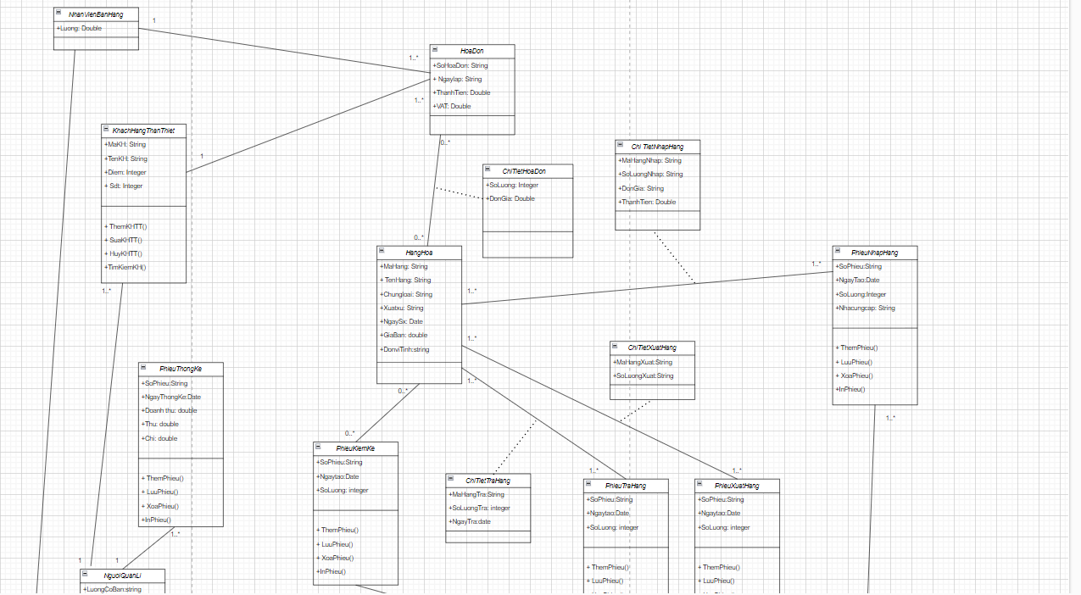
VI. Class Diagram

Slide 28
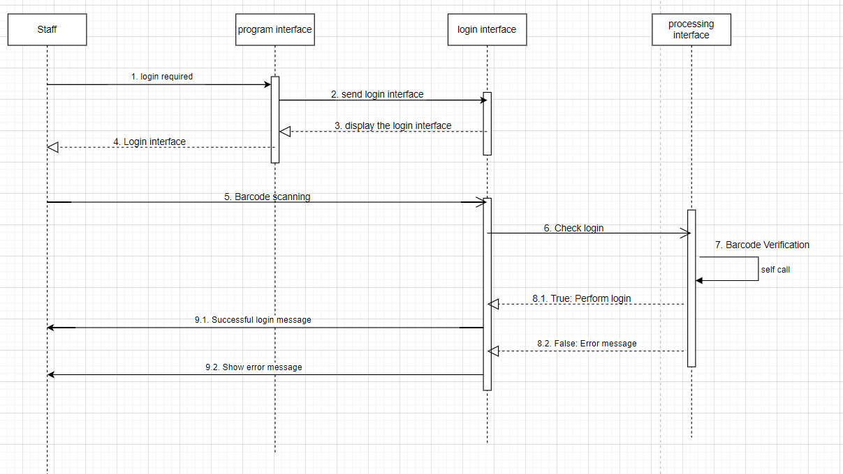
VII. Sequence Diagram
Login behavior specification:
Salesperson chooses the login function
Login interface and barcode scanning request
Bar code scanning staff
Barcode validity checking system
If yes, then login successfully
If wrong error message

Slide 29
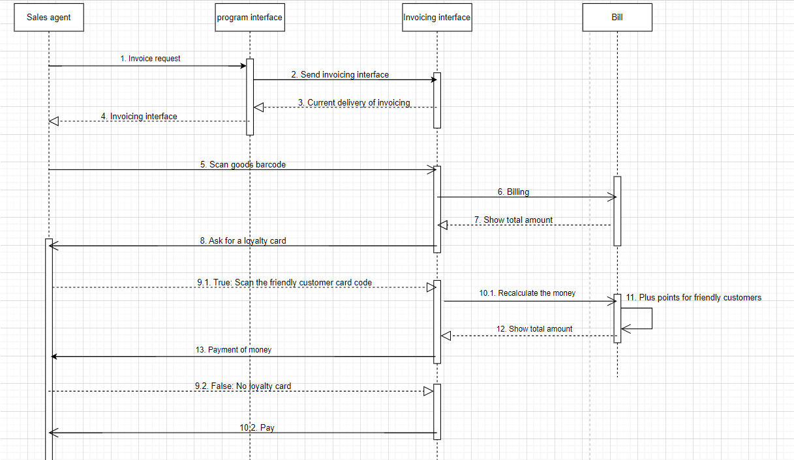
1. Employees scan the barcode of each item.
2. The system automatically calculates the total amount to be paid by the customer based on the unit price of the item, the quantity of goods purchased by the customer, and the added value of VAT that has been saved in the system.
3. Customer gives Customer Friendly card.
4. The salesperson scans the barcode of the Customer Friendly card. 5. The system checks the validity of the barcode.
6. System of accumulating points for customers.
7. The salesperson in the invoice to the customer.

Slide 30
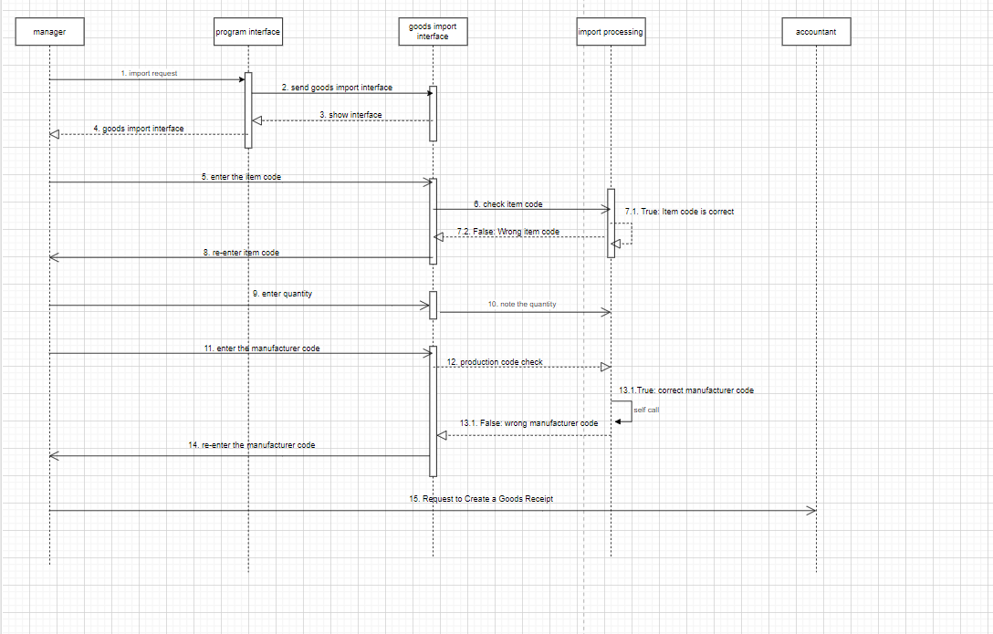
Behavioral specification “Incoming management”
- The manager selects the system's Import Management function.
- The system asks for the item code to be entered.
- The manager enters the item code.
- The system checks the validity of the product code.
- The system asks to enter the quantity.
- The manager enters the quantity of goods to be imported.
- Quantity recording system.
- The system asks to enter the manufacturer code.
- The manager enters the manufacturer code
- Manufacturer's validity check system
- The system transfers the information just entered to the accountant

Slide 31
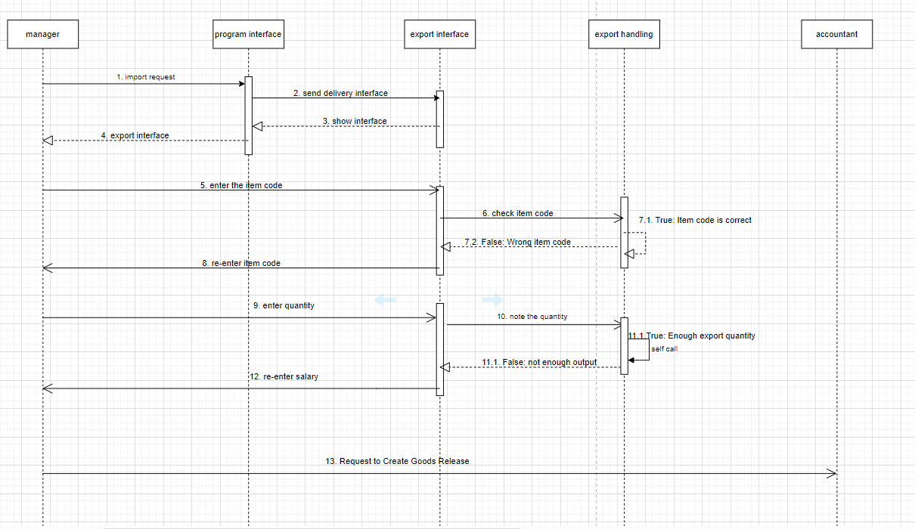
Behavioral specification “Shipment management”
- The manager selects the System's Export Management function.
- The system asks to enter the product code to be exported.
- The manager enters the item code.
- The system checks the validity of the product code.
- The system asks to enter the quantity.
- The manager enters the quantity of goods to be exported
- The system checks whether the quantity meets the inventory quantity or not.
- The system transfers the entered information to the accountant

Slide 32
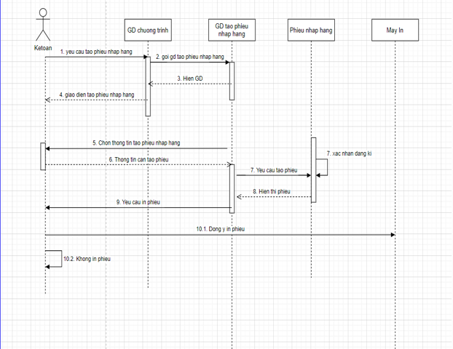
Behavioral specification “Create a Goods Receipt”
1. The accountant chooses the system's Create Order Entry function.
2. The system requires the accountant to fill in the goods' information in the Goods Import Note.
3. The accountant fills in the goods import slip.
4. System for issuing goods receipt code and saving information
5. The system asks the accountant whether to print the Air Entry Voucher.
6. The accountant chooses to print the Goods Entry slip.
7. The system prints the Goods Entry slip for accountants.

Slide 33
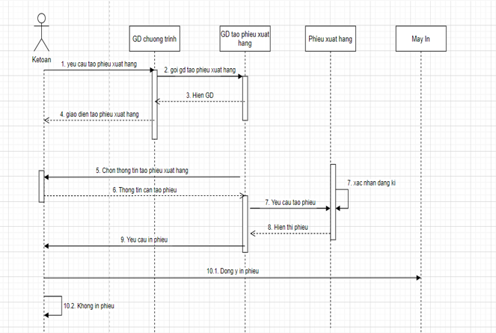
Behavioral specification “Create delivery note”
1. The accountant chooses the system's Create Export Voucher function.
2. The system requires the accountant to fill in the goods' information in the Good Release.
3. The accountant fills in the Goods Release slip.
4. The system issues the delivery slip code and saves the information.
5. The system asks the accountant whether to print the Export Voucher.
6. The accountant chooses to print the Delivery Note.
7. The system prints the Goods Release for accountants.

Slide 34
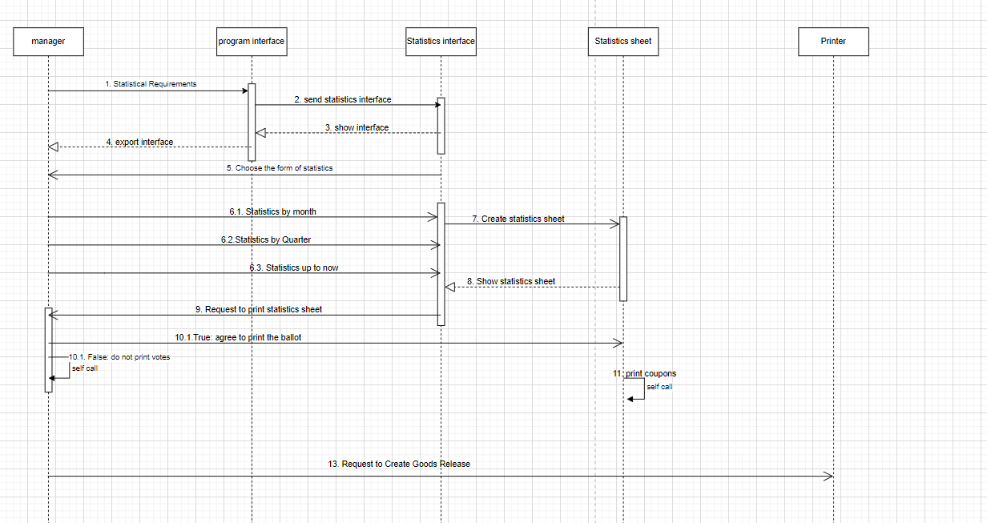
"Statistics" Behavior Specification
1. The manager chooses the statistical function
2. The system asks to choose the form of statistics
3. The manager chooses the form of statistics
4. The system displays the statistics table

Slide 35
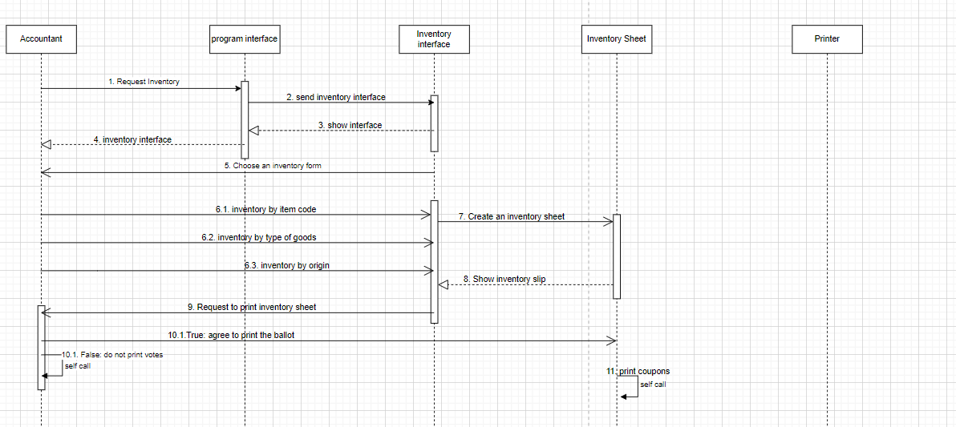
Behavioral specification “Inventory of Goods”
1. The accountant selects the Inventory function.
2. The system asks to choose the form of inventory (by item code, all).
3. Accountants choose the form of inventory.
4. The system displays the item code and the corresponding item quantity.
5. The system asks the accountant if he wants to print the Inventory sheet.
6. The accountant chooses to print the Inventory sheet.
7. Inventory printing system for accountants.

Slide 36
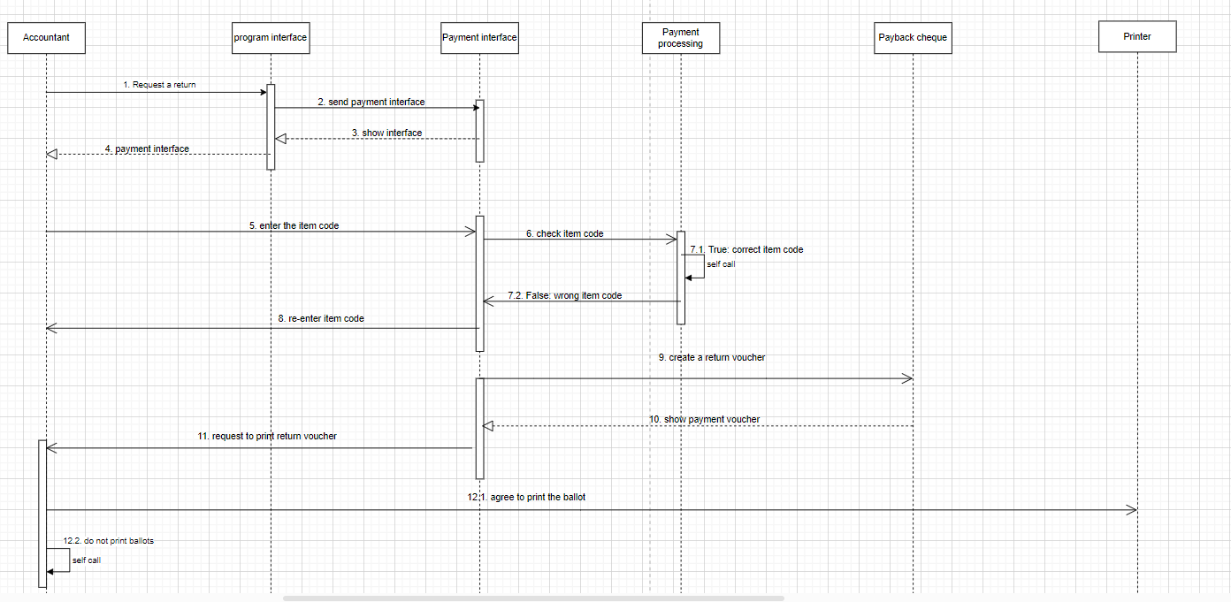
Behavioral specification “Create return slip”
1. The accountant chooses the system's Create Return Voucher function.
2. The system asks to enter the item code to be paid.
3. The accountant enters the code of goods to be returned.
4. The system checks the validity of the item code.
5. The system asks the reason for the return.
6. The accountant chooses the reason for the return.
7. Automatic numbering system Create rows, save information.
8. The system asks the accountant whether to include the return slip.
9. The accountant chooses in the Return Voucher.
10. The system enters the Return Voucher for the accountant.

Slide 37
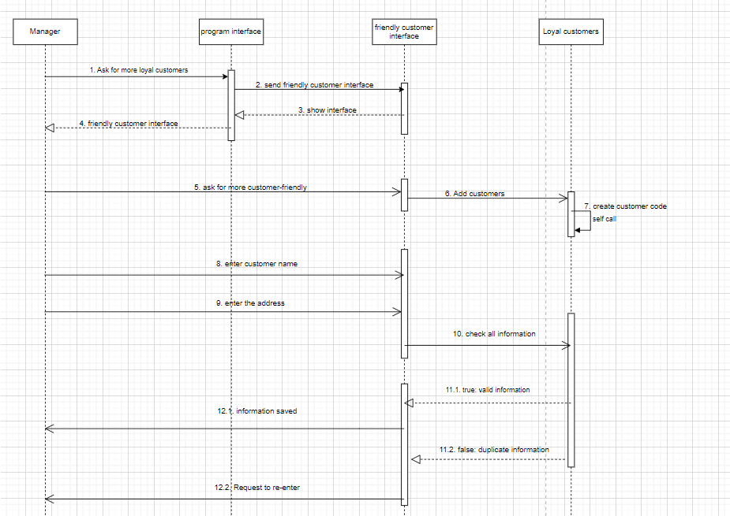
Behavioral specification “Loyalty customer”
1. The manager selects the system's additional Customer Friendly function.
2. The system asks the manager to enter the customer's name.
3. The manager enters the customer's name.
5. The system asks to enter the address.

Slide 38
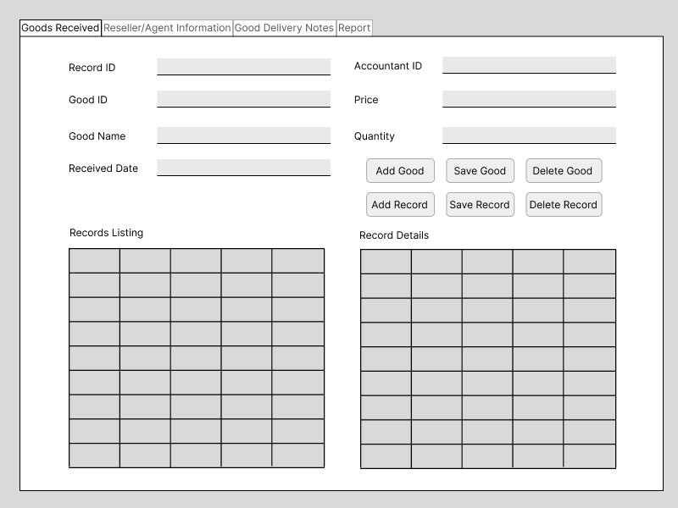
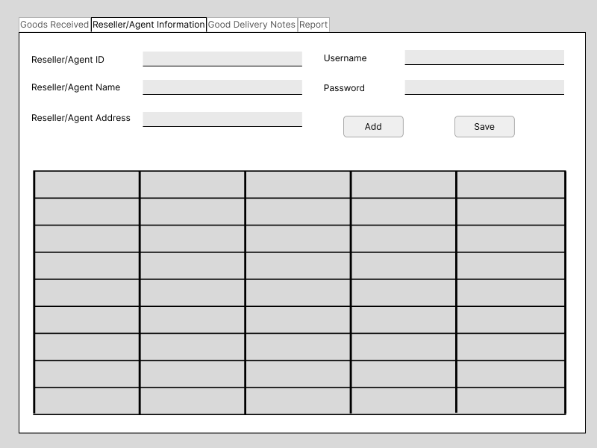
VIII. UI/UX Design

Slide 39
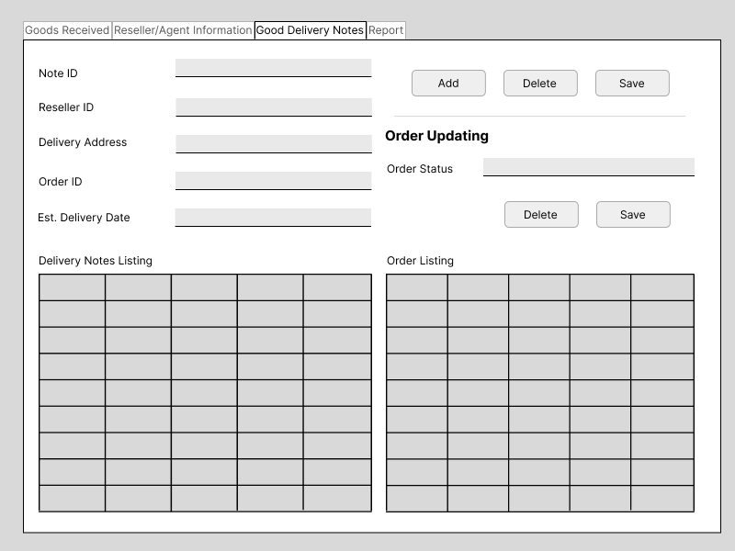
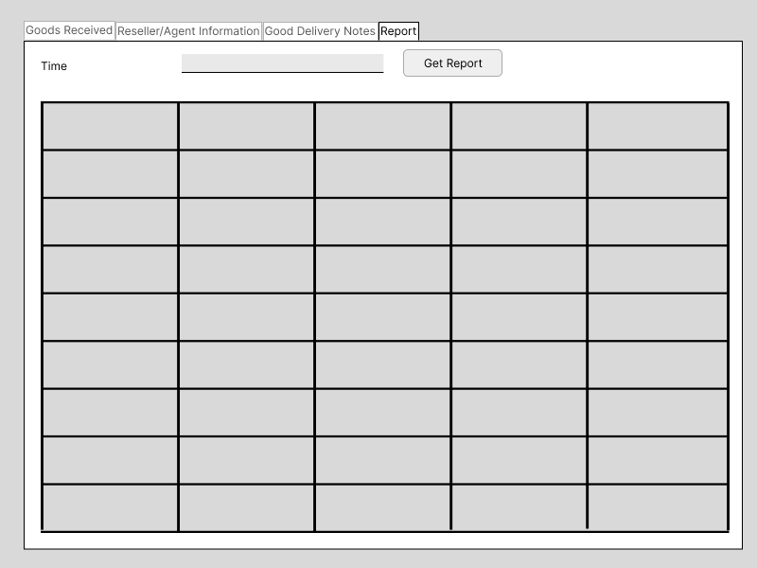
VIII. UI/UX Design

Slide 40
#Thanks!
Do you have any questions?
Contact: 519H0231@student.tdtu.edu.vn
521H0477@student.tdtu.edu.vn

