Slide 1







KERRIGAN COMMUNITY LEARNING CENTER
Design & Analyze Algorithms
CLASS ORIENTATION
TEACHER
NGUYỄN CHÍ THIỆN

Slide 2


Group Work
Projects that will be completed by teams
There will be two group projects for this class. We will use the necessary apps and platforms for group discussions and meetings, and you will be given enough time to complete each project. The instructions and materials will be sent out within the week.

Slide 3



General Mathematics Curriculum
We will study basic the frequent itemset mining (FIM).
We will cover some popular FIM algorithms.

Slide 4




Apriori
Outline
Eclat
FP-Growth

Slide 5
Frequent Itemset Mining
An aspect of Data Mining
Technique for predicting the future of understand the past
FIM algorithms can be described in both of BFS and DFS

Slide 6
Frequent Itemset Mining
TID | Transaction
T1 | a, c, d
T2 | b, c, e
T3 | a, b, c, e
T4 | b, e
T5 | b. e
I: Set of items (I = {i1, i2, . . . im}).
D: Set of transactions(D = {T1, T2 . . . Tn}).
Tq: Transaction q-th (with 1 ≤ q ≤ m).
q: each Transaction has a unique TID (Transaction Identifier).
|X|: X is a set of items (X ⊆ I.), |X| means the number of items in itemset X (length k).
sup(X): the number of transactions containing X in D.
(sup(X) = |{T|X ⊆ T ∧ T ∈ D}|).
relSup(X): is relative support, relSup(X) = sup(X)/|D|.

Slide 7
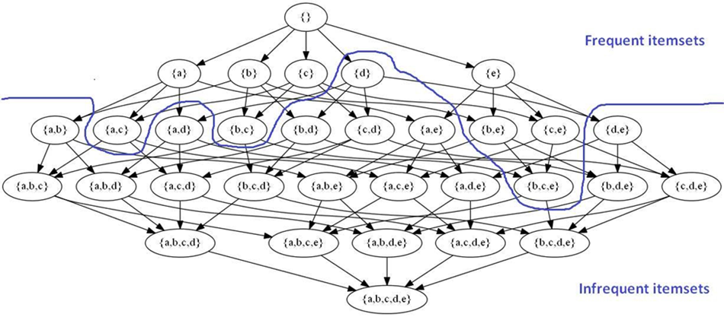
BFS & DFS searchs

Slide 8
Apriori
TID | Transaction
T1 | a, c, d
T2 | b, c, e
T3 | a, b, c, e
T4 | b, e
T5 | b. e
Apriori is the BFS search algorithm. Requiring two inputs which are standard database and minsup threshold.
Key idea: Apriori property "All subsets of a frequent itemset must be frequent(Apriori property).
If an itemset is infrequent, all its supersets will be infrequent".

Slide 9
minsup = 3, k = 1
Items | sup_count
a | 3
b | 4
c | 4
d | 1
e | 4
Items | sup_count
a | 3
b | 4
c | 4
e | 4
C1
F1

Slide 10
k = 2
Itemset | sup_count
a, b | 2
a, c | 3
a, e | 2
b, c | 3
b, e | 4
c, e | 3
Itemset | sup_count
a, c | 3
b, c | 3
b, e | 4
c, e | 3
C2
F2

Slide 11
k = 3
Itemset | sup_count
a, b, c | 2
a, b, e | 3
a, c, e | 2
b, c, e | 3
Itemset | sup_count
b, c, e | 3
F3
C3

Slide 12
TID | Transaction
T1 | a, c, d
T2 | b, c, e
T3 | a, b, c, e
T4 | b, e
T5 | b. e
Itemset | sup_count
a | 3
b | 4
c | 4
e | 4
a, c | 3
b, c | 3
b, e | 4
c, e | 3
b, c, e | 3

Slide 13
Apriori - Improved ver
Item | TID_set
a | T1, T2, T3
b | T2, T3, T4, T5
c | T1, T2, T3, T5
d | T1
e | T2, T3, T4, T5
Apriori has importan limitations:
Generating large number of candiates which do not exist in the database, because it creates without looking at db.
Repeatedly scan the database to count the sup of each candidate.

Slide 14
Eclat
Item | TID_set
a | T1, T2, T3
b | T2, T3, T4, T5
c | T1, T2, T3, T5
d | T1
e | T2, T3, T4, T5
Equivalence Class Clustering and bottom-up Lattice Traversal.
Inherited from Apriori:
Using vertical database
Avoid generating candidates which not exist in db.
tid(X ∪ Y) = tid(X) ∩ tid(Y )

Slide 15
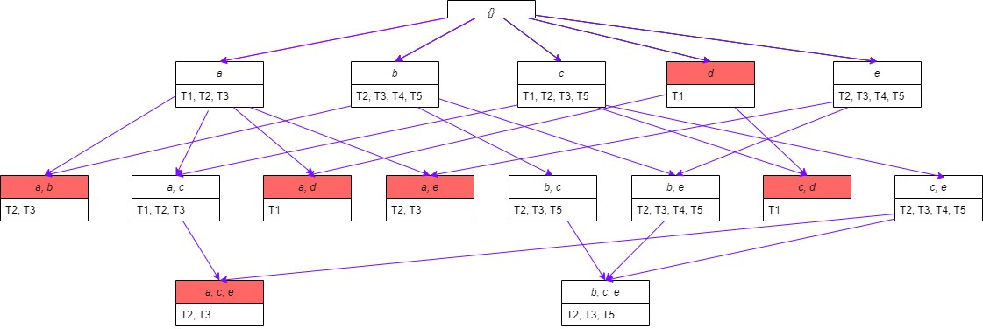

Slide 16
An improvement to the Apriori method.
Condensed (key information) but still enough to mine frequent sets
Avoid having to browse database many times
Divide and Conque method
Avoid the step of generating candidate sets
Frequent Pattern-growth

Slide 17
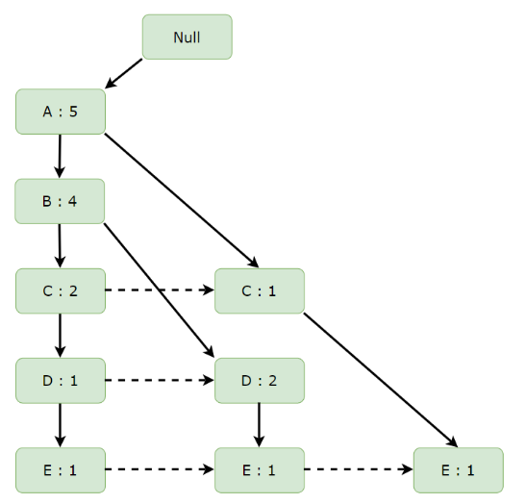
Idea
Compress the database into an FP-tree , retaining only the association information of the items.
Divide the compressed database into conditional databases, each of which is divided into a common category, and we will mine these databases independently.

Slide 18


Item | Frequency
a | 5
b | 4
c | 3
d | 3
e | 3
f | 2
g | 2
h | 1
i | 2
minsup = 3
TID | Items
T1 | {a, b, c, d, e, f}
T2 | {i, h, a, c, b}
T3 | {a, i, g, b, d}
T4 | {f, e, a, d, b}
T5 | {a, e, g, c}
L = {A : 5, B : 4, C : 3, D : 3, E : 3}

Slide 19
Database is sorted in alphabetical order
TID | Items | Ordered-item Set
T1 | {a, b, c, d, e, f} | {a, b, c, d, e}
T2 | {i, h, a, c, b} | {a, b, c}
T3 | {a, i, g, b, d} | {a, b, d}
T4 | {f, e, a, d, b} | {a, b, d, e}
T5 | {a, e, g, c} | {a, c, e}

Slide 20
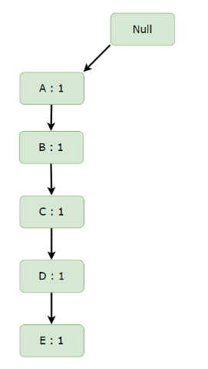
Build FP tree
Inserting the set {a, b, c, d, e}

Slide 21
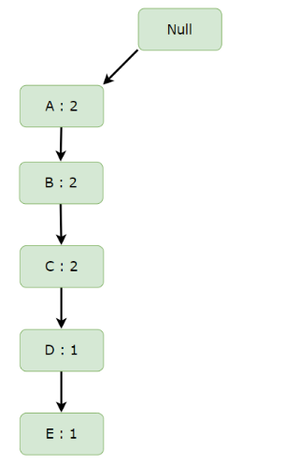
Build FP tree
Inserting the set {a, b, c}

Slide 22
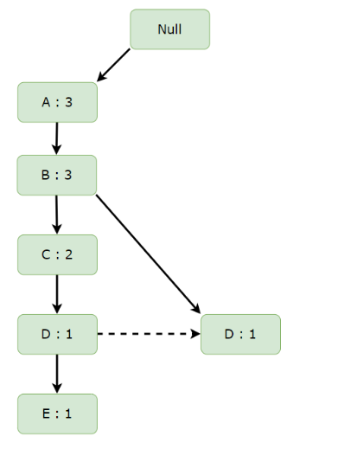
Build FP tree
Inserting the set {a, b, d}

Slide 23
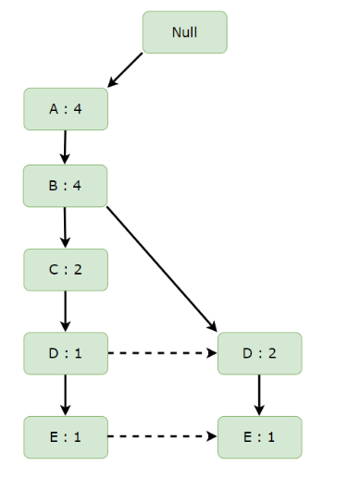
Build FP tree
Inserting the set {a, b, d, e}

Slide 24
Build FP tree
Inserting the set {a, c, e}

Slide 25
Items | Conditional Pattern Base
E | {{A,B,C,D : 1}, {A,B,D : 1}, {A,C : 1}
D | {{A,B,C : 1}, {A,B : 2}}
C | {{A,B : 2}, {A : 1}}
B | {A : 4}
A

Slide 26
Items | Conditional Pattern Base | Conditional Frequent Pattern Tree
E | {{A,B,C,D : 1}, {A,B,D : 1}, {A,C : 1} | {A : 3}
D | {{A,B,C : 1}, {A,B : 2}} | {A,B : 3}
C | {{A,B : 2}, {A : 1}} | {A : 3}
B | {A : 4} | {A : 4}
A

Slide 27
Items | Frequent Pattern Generated
E | {<A,E : 3>}
D | {<A,D : 3>, <B,D : 3>, <B,A,D : 3>}
C | {<A,C : 3>}
B | {<B,A : 4>}
A

