Slide 1
Slide Notes — Sprint 4

Slide 2
Session 1 — System Architecture & Theory
Mục tiêu slide: giải thích lý do chọn PoT + sandboxed execution + majority voting.
Slide 1: Title + team
Slide 2: Problem statement — challenges of using LLM for math
Slide 3: Key limitations of LLM for precise math
Slide 4: PoT concept (diagram + bullet points)
Slide 5: Pipeline architecture (use `pipeline_diagram.mmd`)
Slide 6: Safety & sandboxing
Slide 7: KV Cache & vLLM — why it helps
Slide 8: Metrics & evaluation plan (Pass@1, Pass@k, error taxonomy)

Slide 3
Session 2 — Error Analytics & Metrics
Slide 1: Summary statistics (total, accuracy, missing predictions)
Slide 2: Pie chart: error distribution (error_pie.png)
Slide 3: Bar chart: Pass@1 vs Pass@15 (accuracy_comparison.png)
Slide 4: Case studies (2-3 examples) with annotations
Slide 5: Actionable recommendations (prompting, parser robustness, ensemble)
Notes:
Keep text bilingual (VN/EN) if audience includes non-Vietnamese.
Use exported PNGs from `scripts/sprint4_analysis.py`.

Slide 4
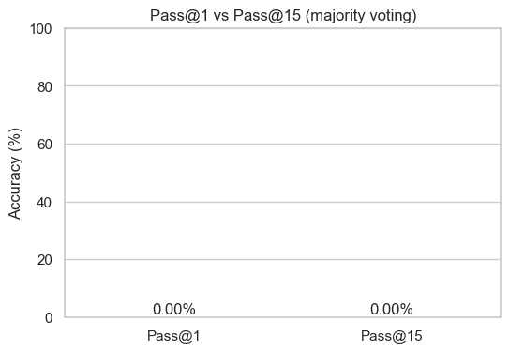

Slide 5
