Slide 1
Sneaker Store
Class Name: PF1121
Group Name: H&T Sneaker Team
Member: Nguyễn Ngọc trường
Vũ Huy Hưởng

Slide 2
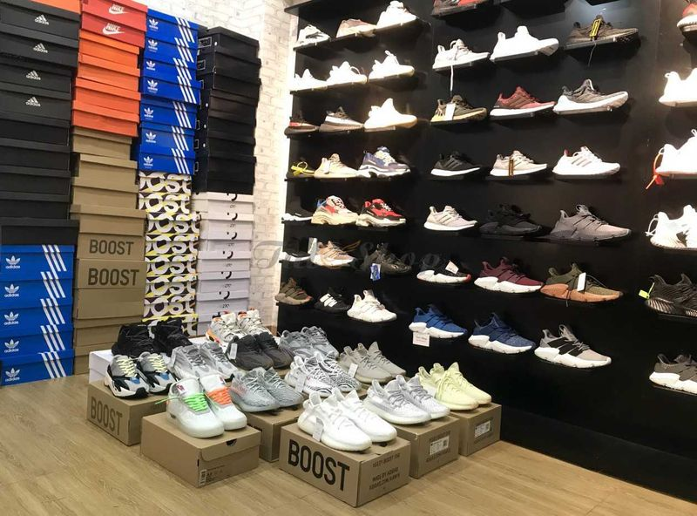
Objectives
The system is built to assist shoe stores in managing invoices more easily. It enables the seller to access additional information about store products, such as product names, colors, sizes, and brands. Sellers can create invoices by adding multiple requested products simultaneously and input customer information into the order. If customer details are already in the system, only a phone number input is necessary, and the system will automatically display the previous information. The system aids cashiers in processing invoices, whether it's for completing payments or canceling orders. When a cashier accesses the system, it displays orders created on the same day, organized chronologically, showing pending orders. Additionally, after completing a transaction, the system will display an invoice detailing the products purchased by that customer.

Slide 3
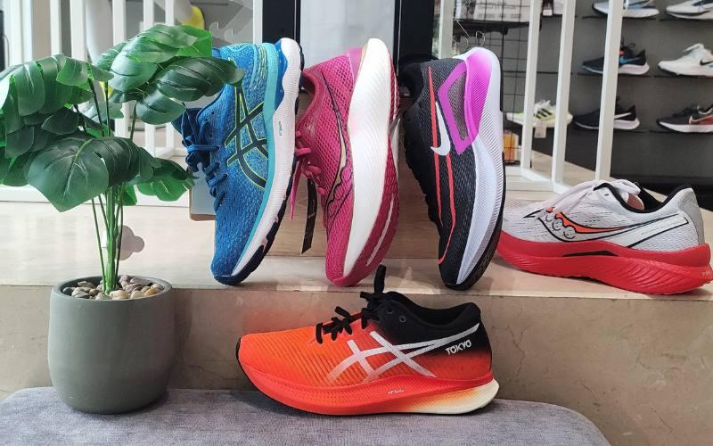
Introduction to Project
The sales system will have the following basic functions:
Login: Enhances the security of the system and facilitates dual account entry for Seller and Cashier roles.
Seller: Staff can create orders, process customer-placed orders, view and manage information, quantities, and statuses within the system.
Cashier: Staff can process orders in the system, enabling customers to make purchases or cancel orders.

Slide 4
Customer Requirements
Here are the key customer requirements for the Sneaker Sales System:
1. Seller and Cashier Logins: Secure login for sellers and cashiers to manage orders and payments.
2. Sneaker Display: Display available sneaker products for customers.
3. Detailed Sneaker Info: Customers can view images, descriptions, sizes, colors, and prices.
4. Order Creation: Sellers can add items, adjust quantities, and choose options for customers' orders.
5. Order Management: Display a list of created orders.
6. Order Details: Customers can see product lists and total prices of their orders.
7. Confirmation/Cancellation: Customers can confirm or cancel orders after reviewing details.
These features ensure a user-friendly and secure shopping experience for both customers and staff.

Slide 5
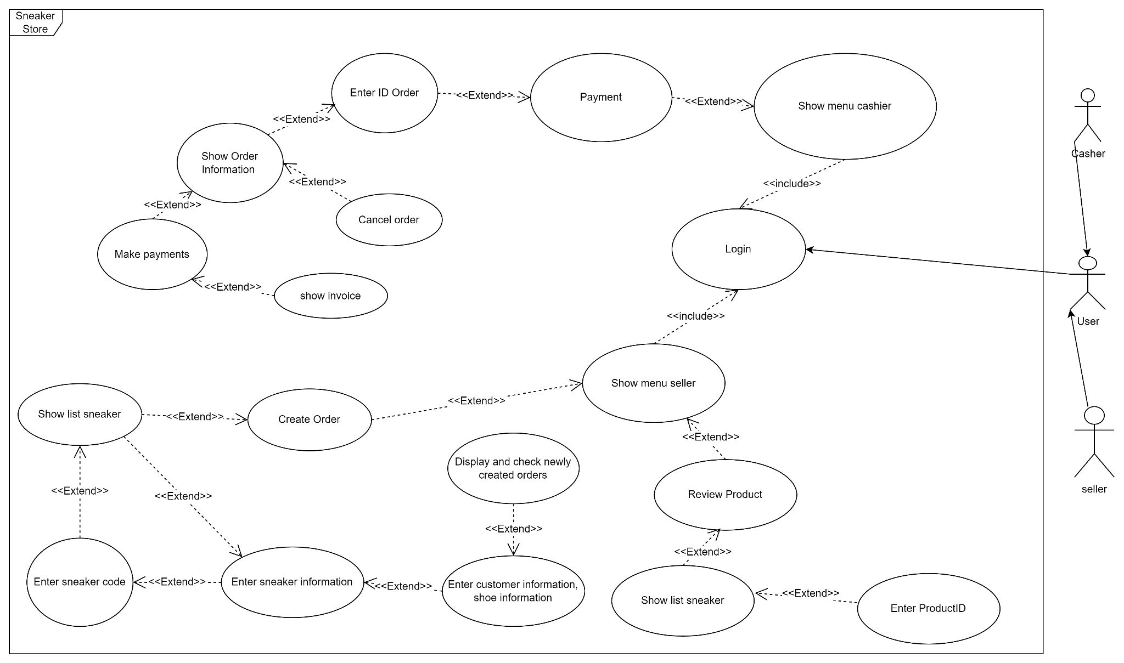
Use Case

Slide 6
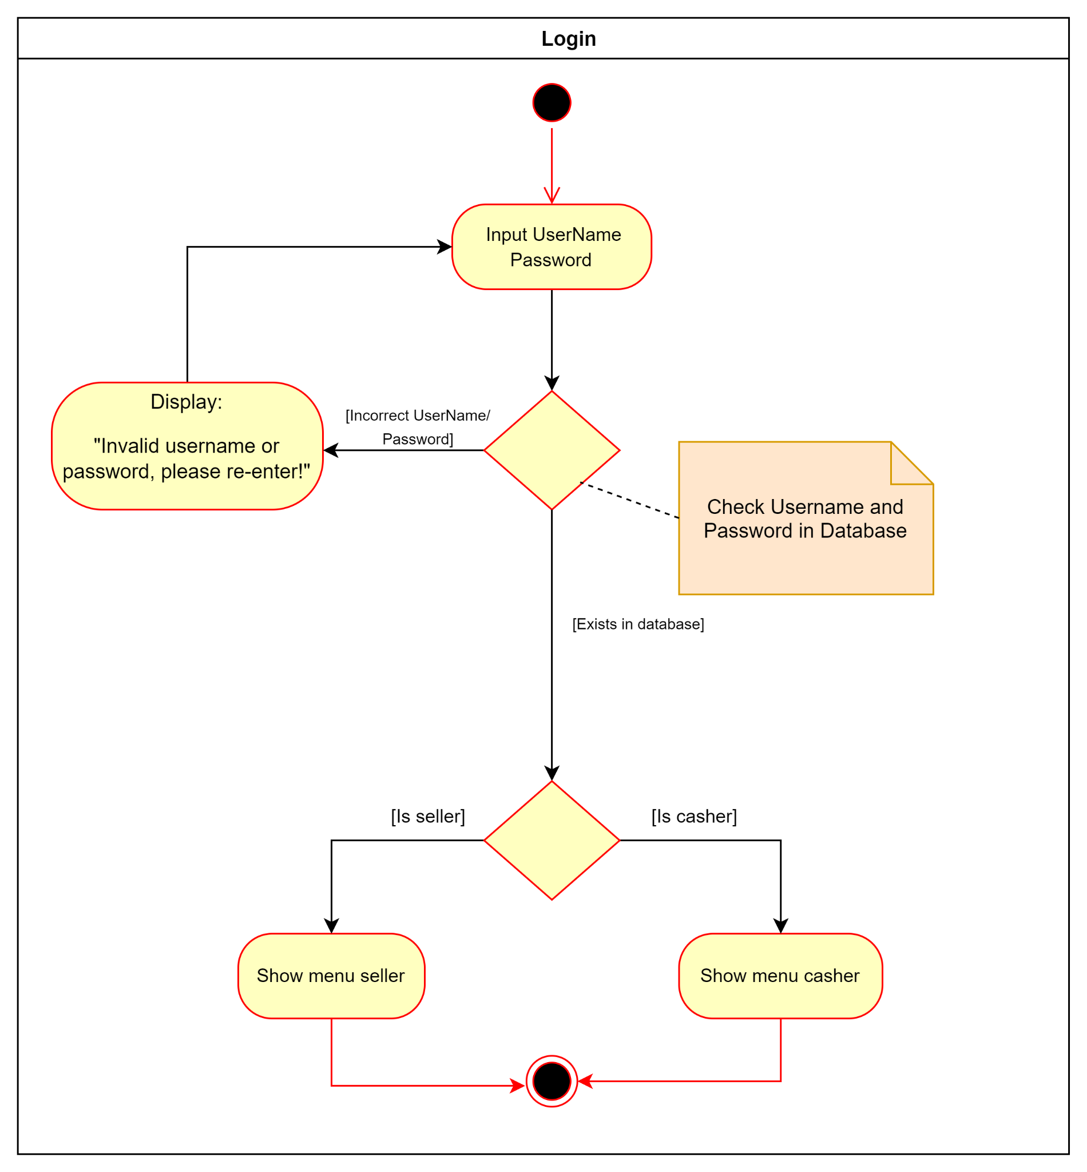
Activity Diagram
1. Login:

Slide 7
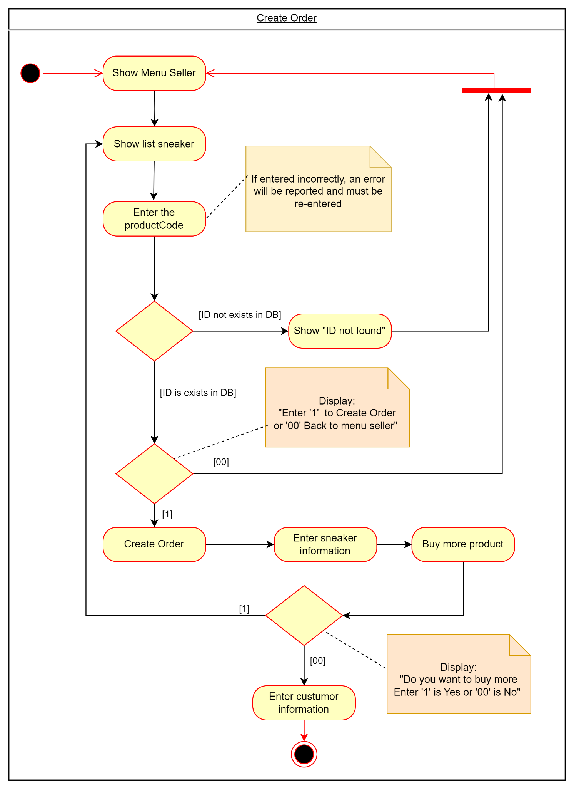
Activity Diagram
2. Create Order:

Slide 8
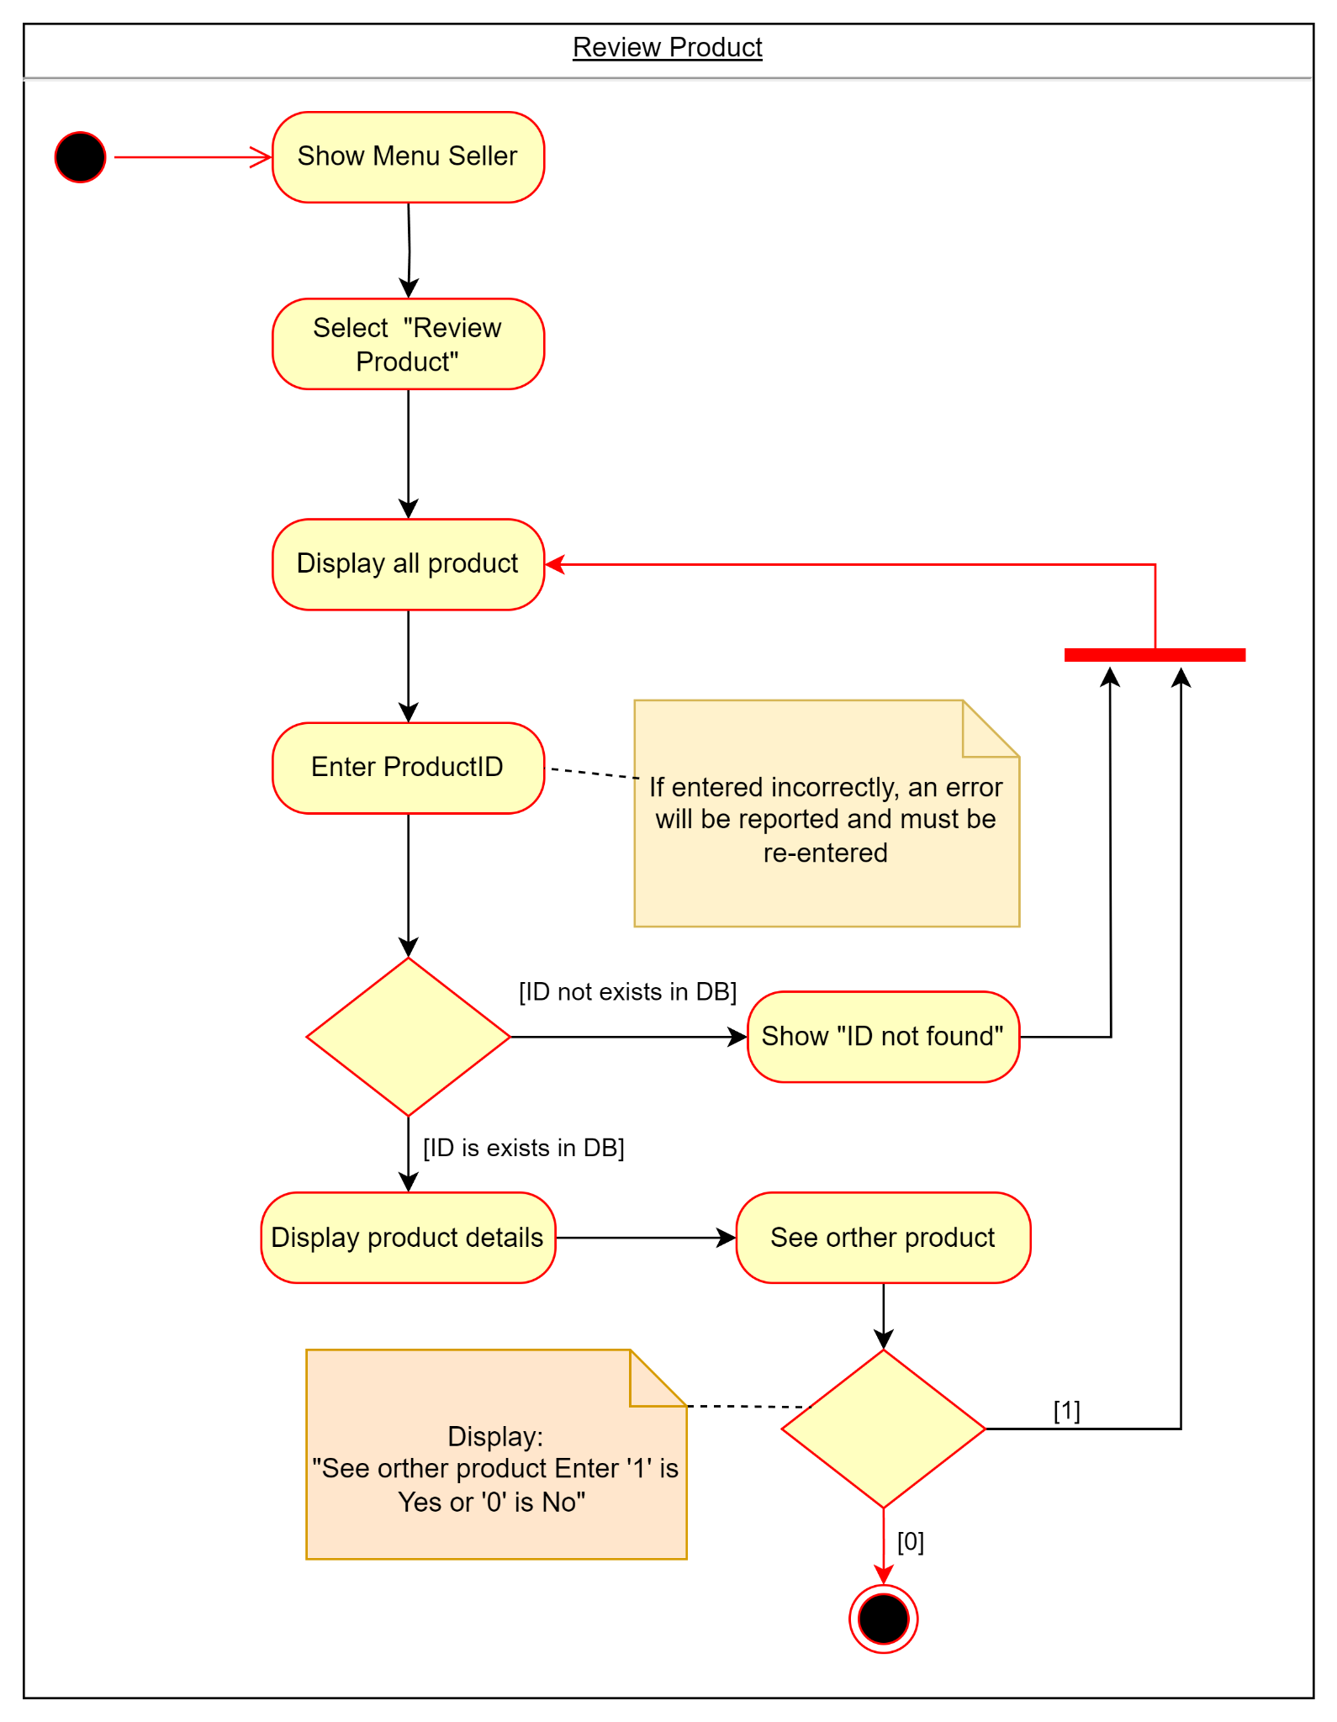
Activity Diagram:
3. Review product:

Slide 9
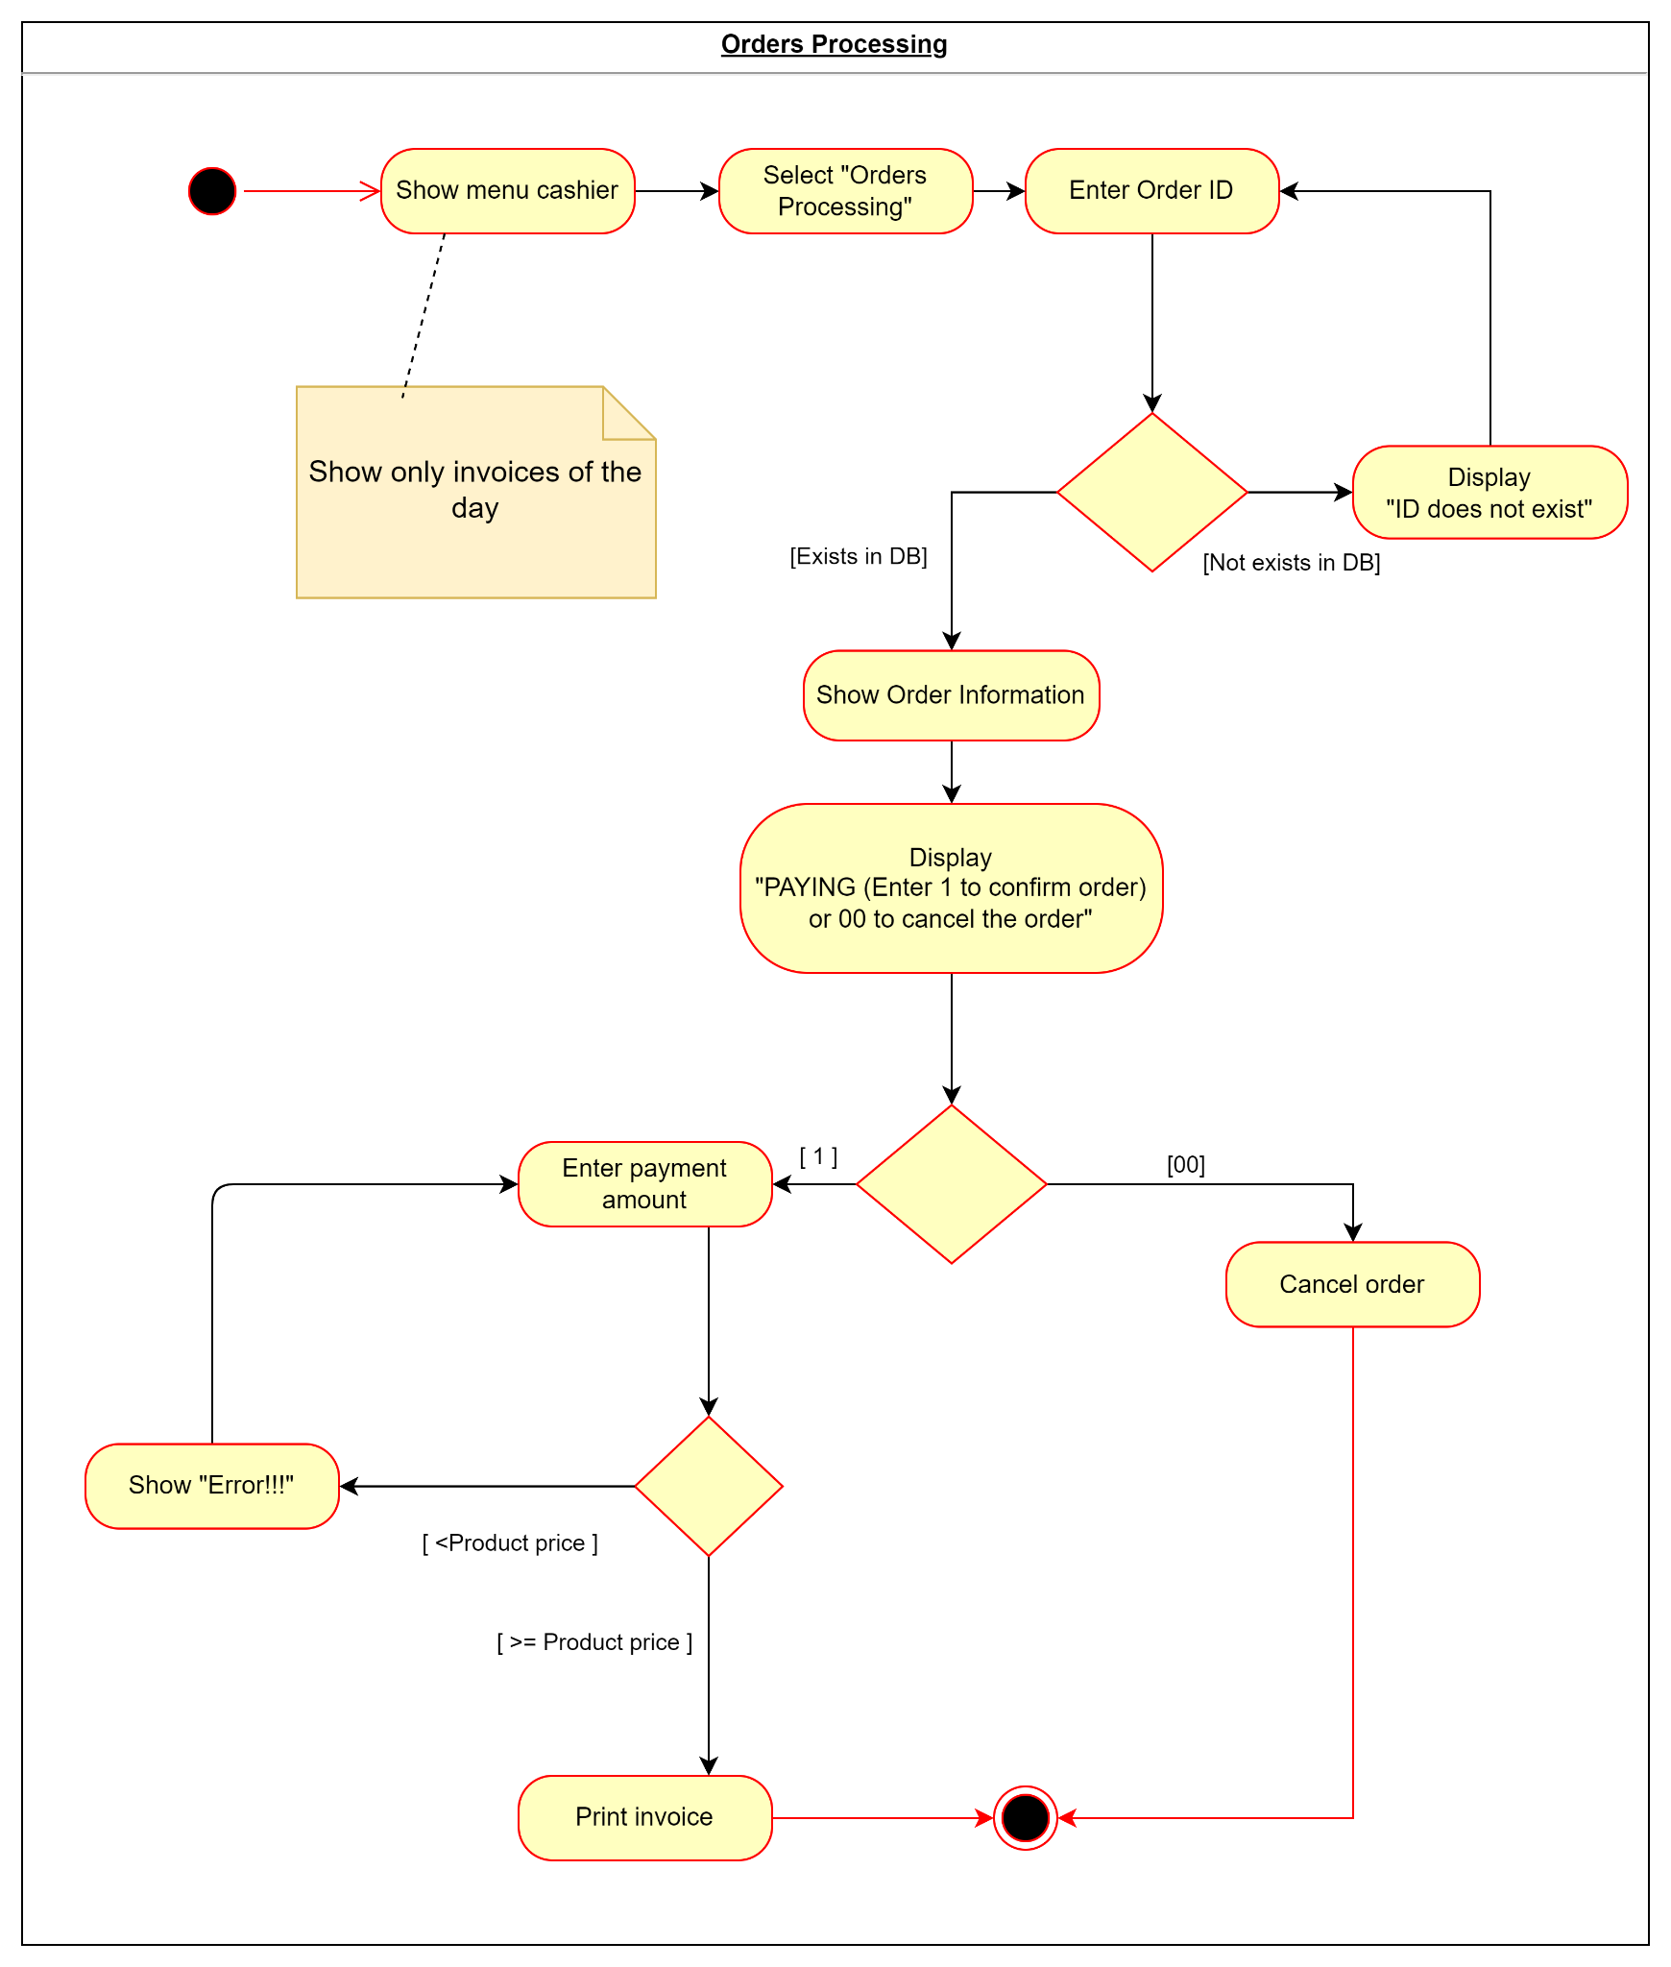
Activity Diagram:
4. Orders Processing:

Slide 10
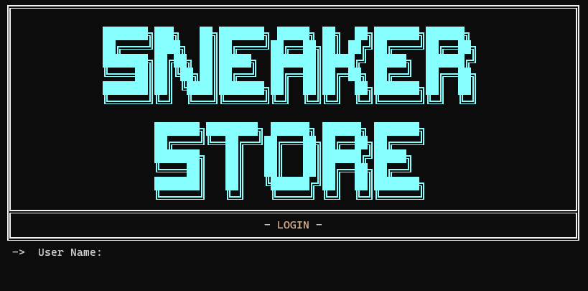
UI Design
1. Main menu:

Slide 11
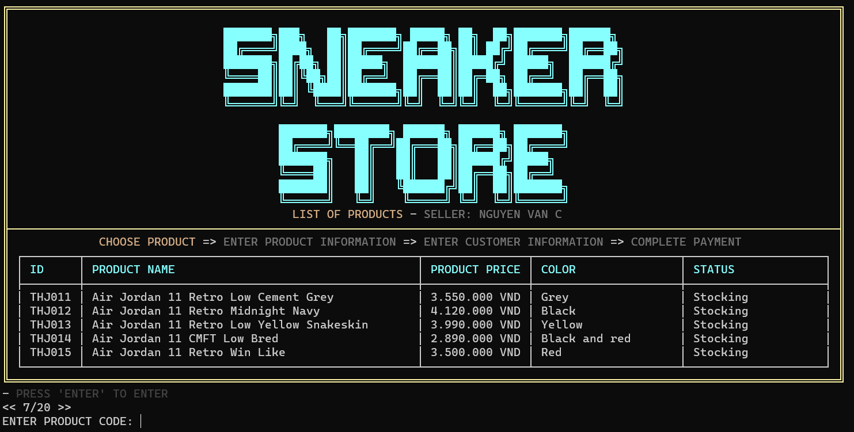
UI Design
2 Create Order:

Slide 12
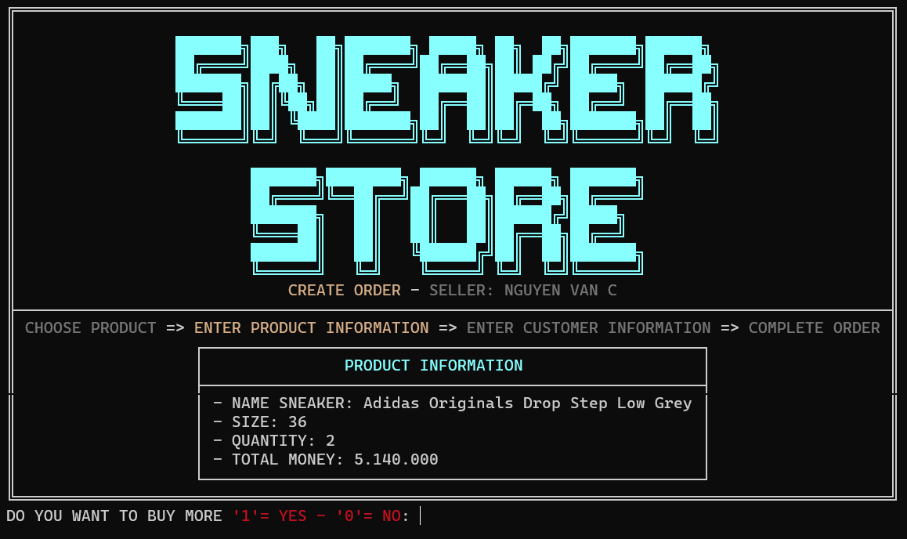
UI Design

Slide 13
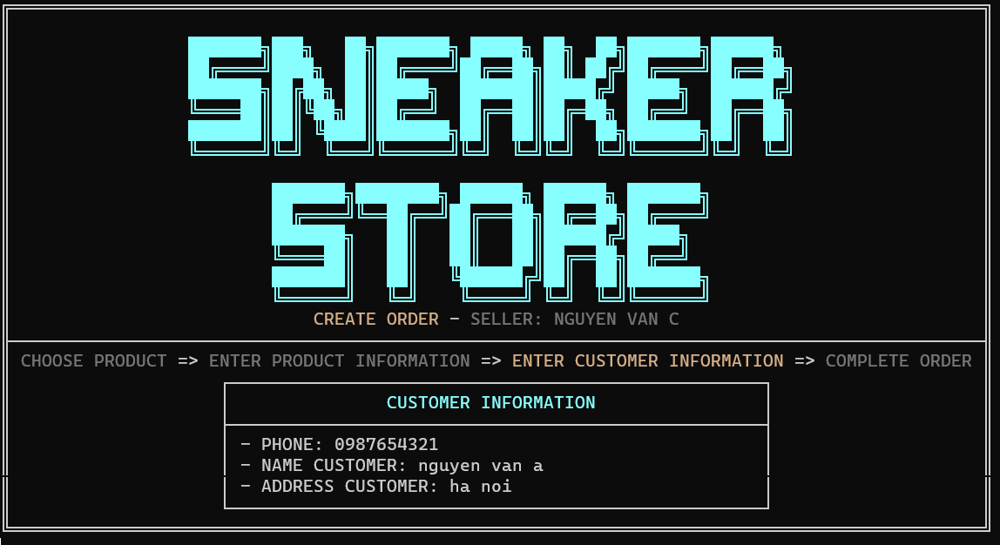
UI Design

Slide 14
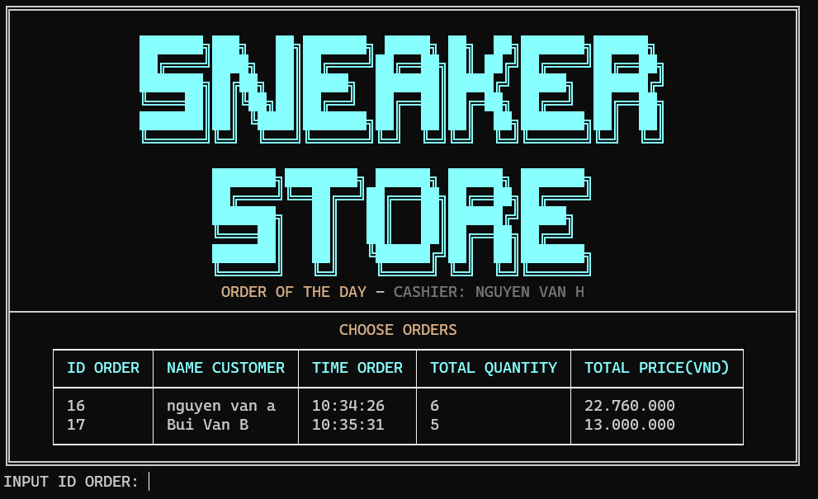
UI Design
3 Order processing

Slide 15
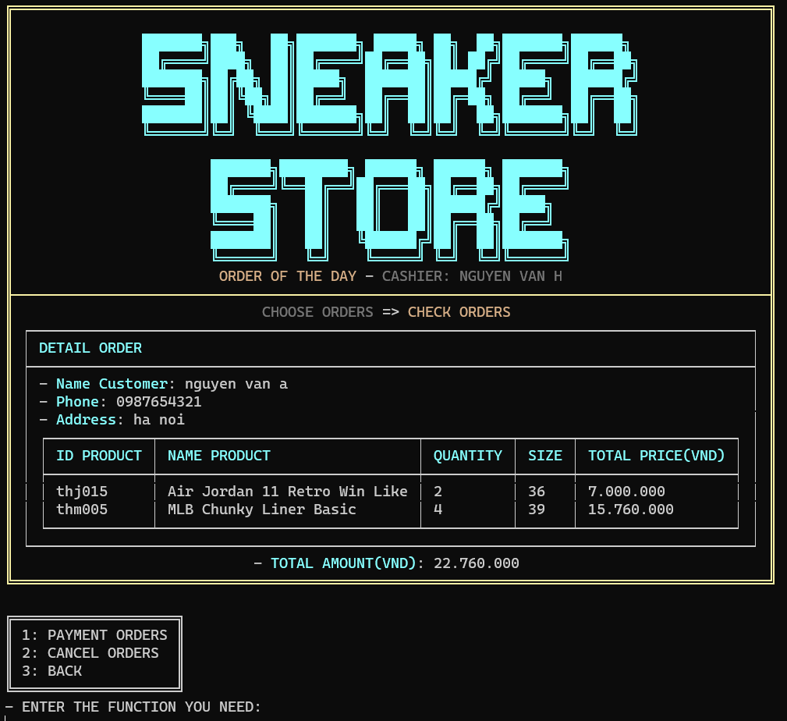
UI Design

Slide 16
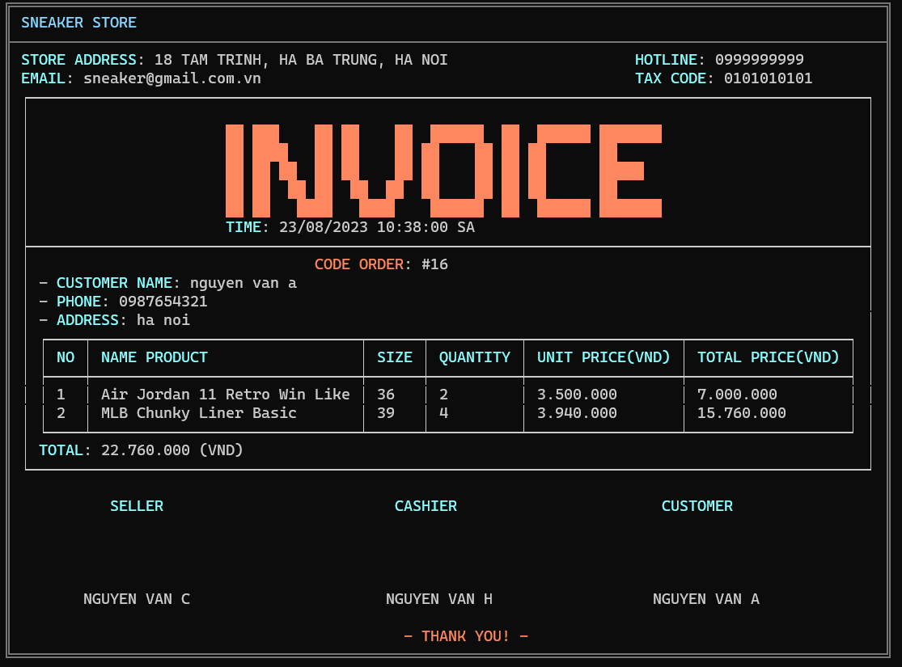
UI Design

Slide 17
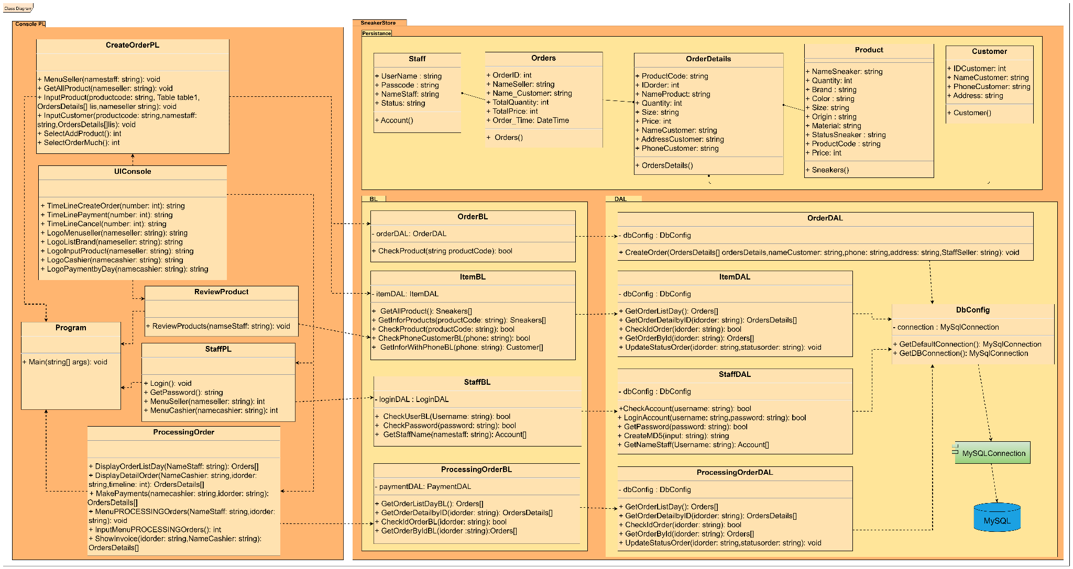
Class Diagram

Slide 18
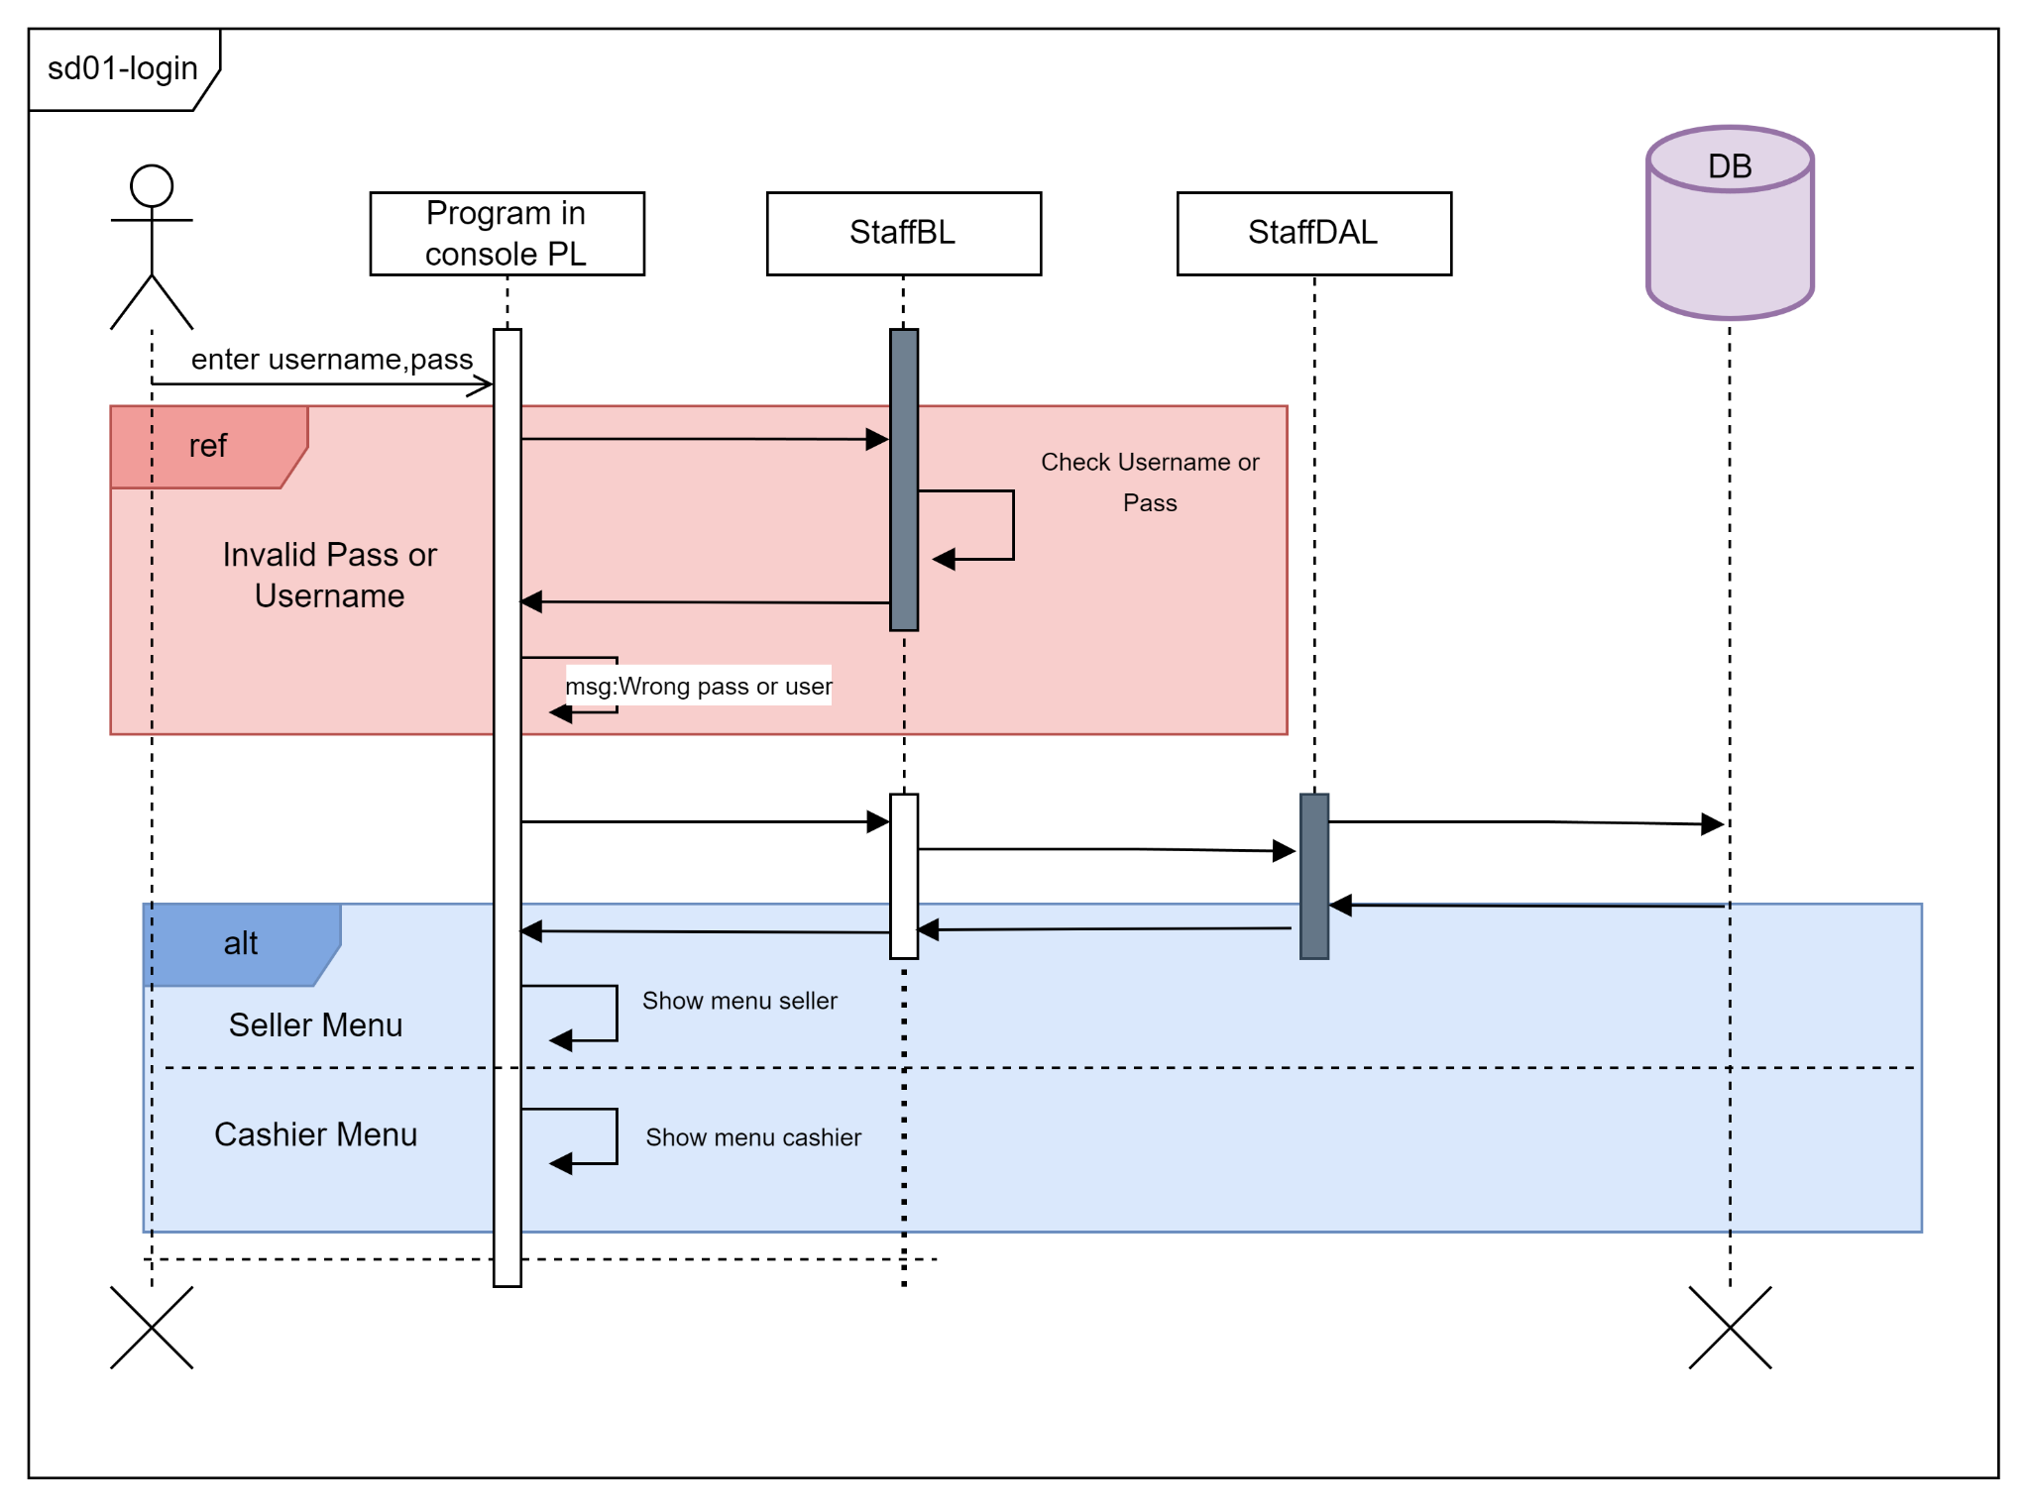
Sequence Diagram
1. Login:

Slide 19
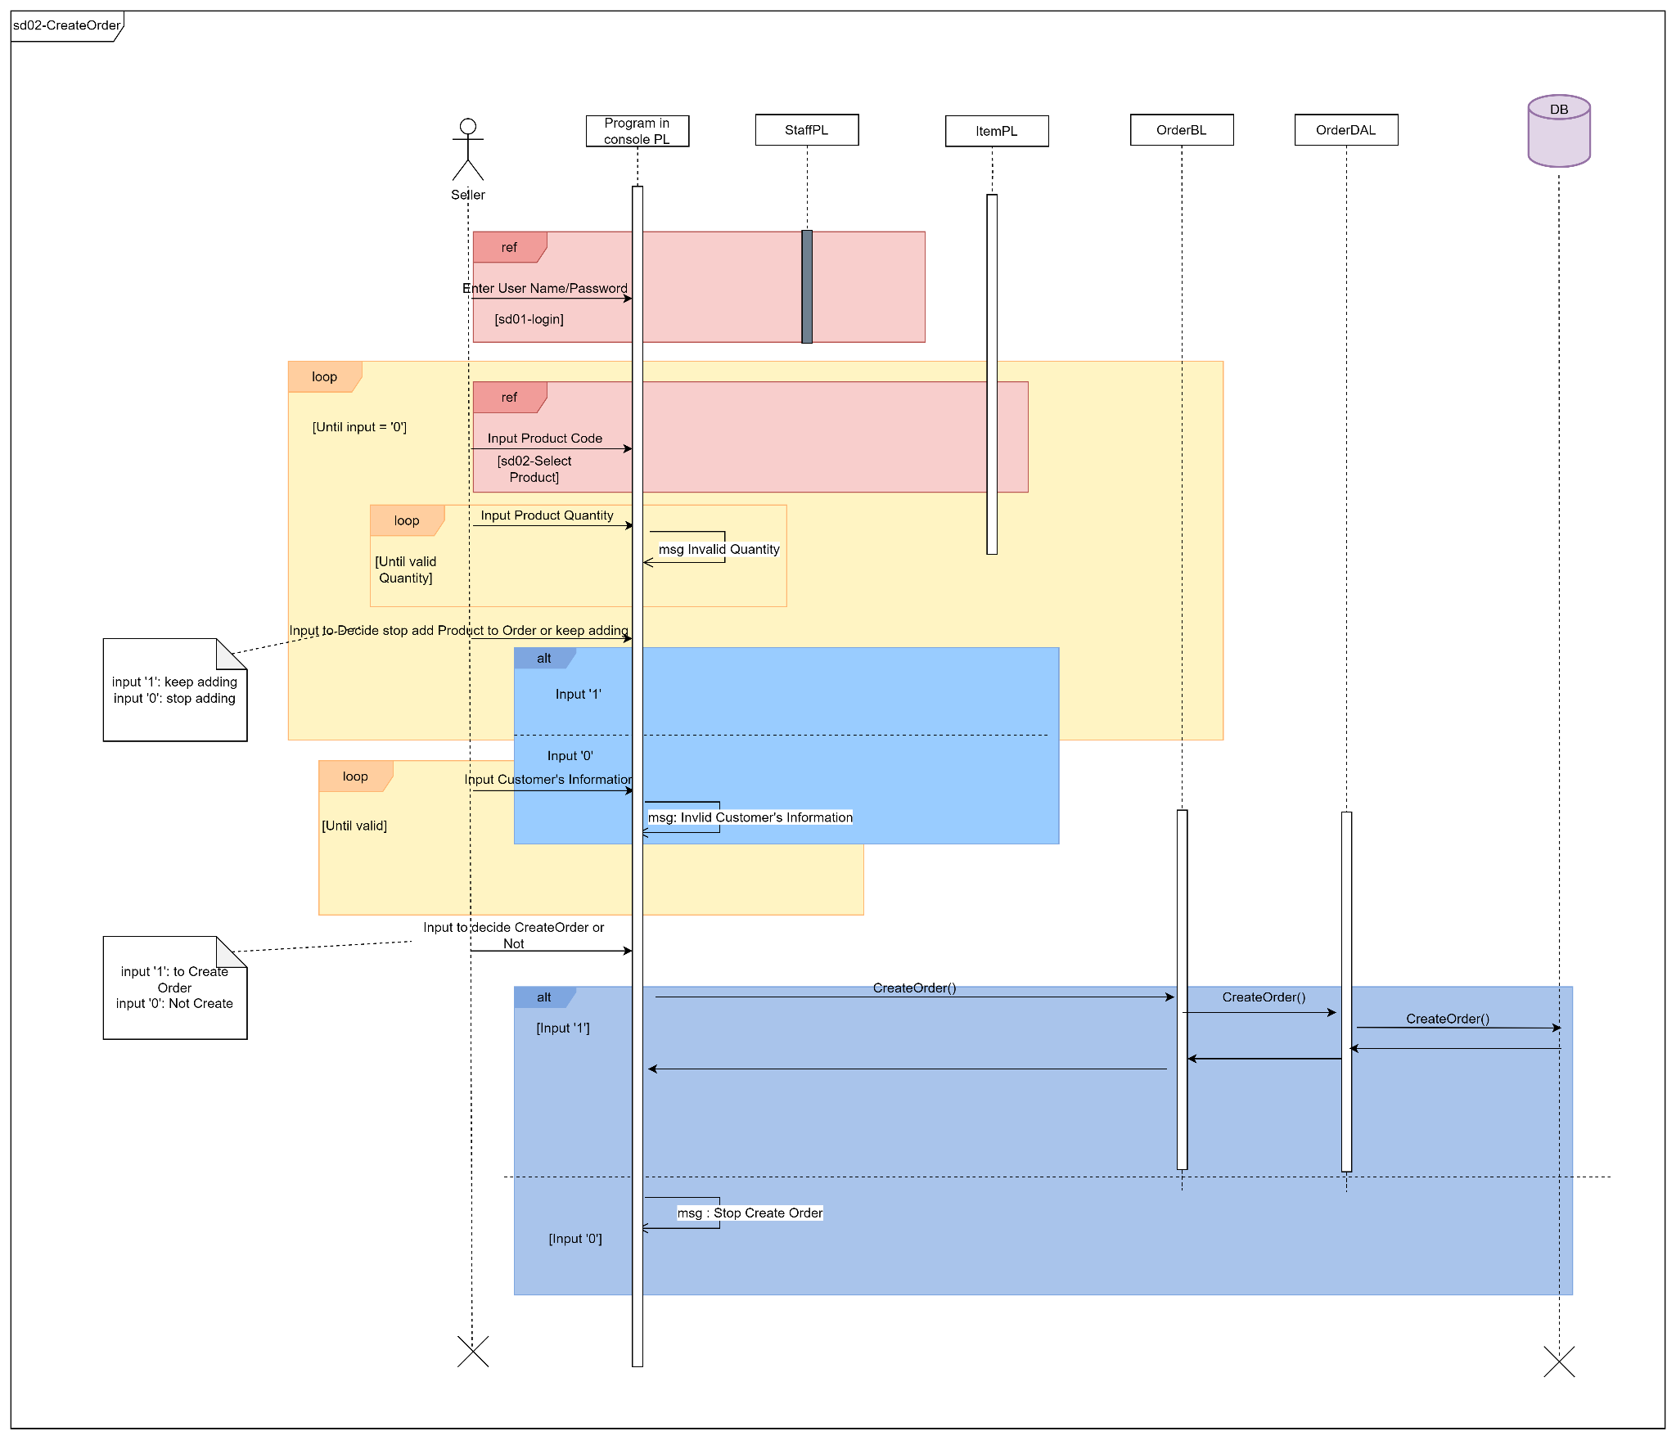
Sequence Diagram
2. Create Order:

Slide 20
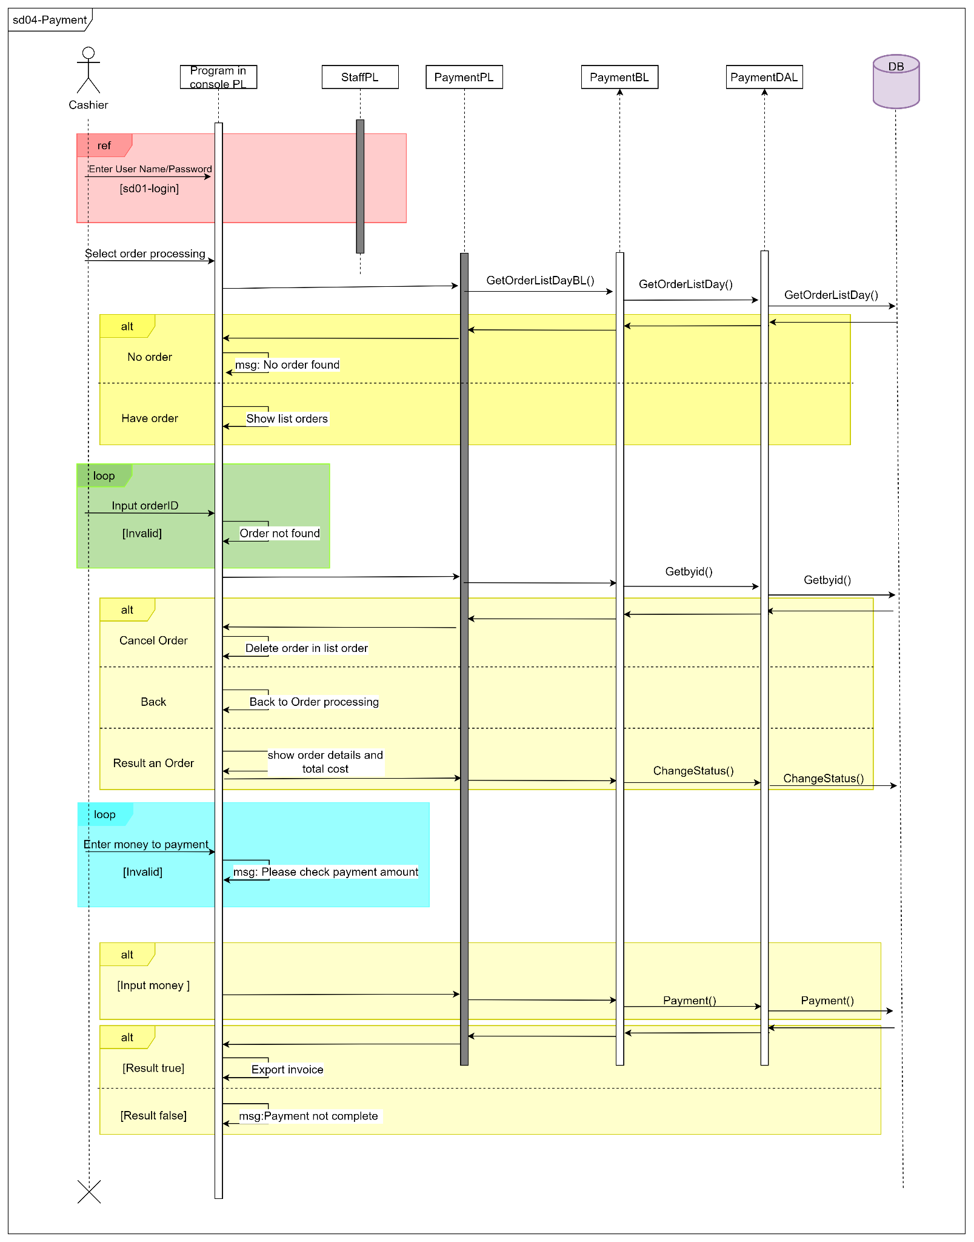
Sequence Diagram
3. Payment:

Slide 21
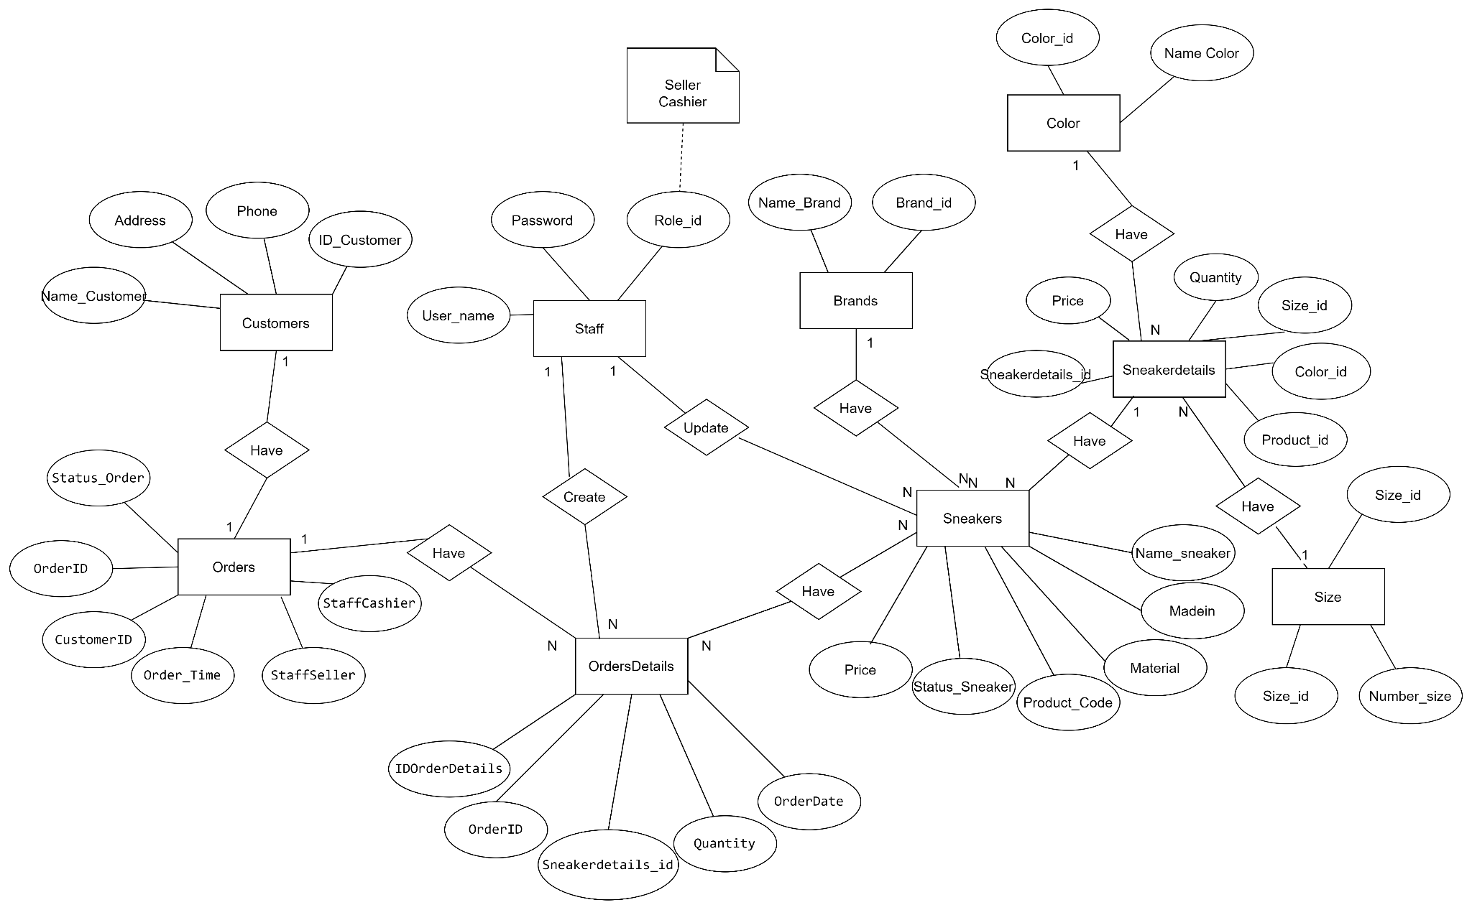
Entity Relationship Diagram
1. Entity Relationship Diagram:

Slide 22
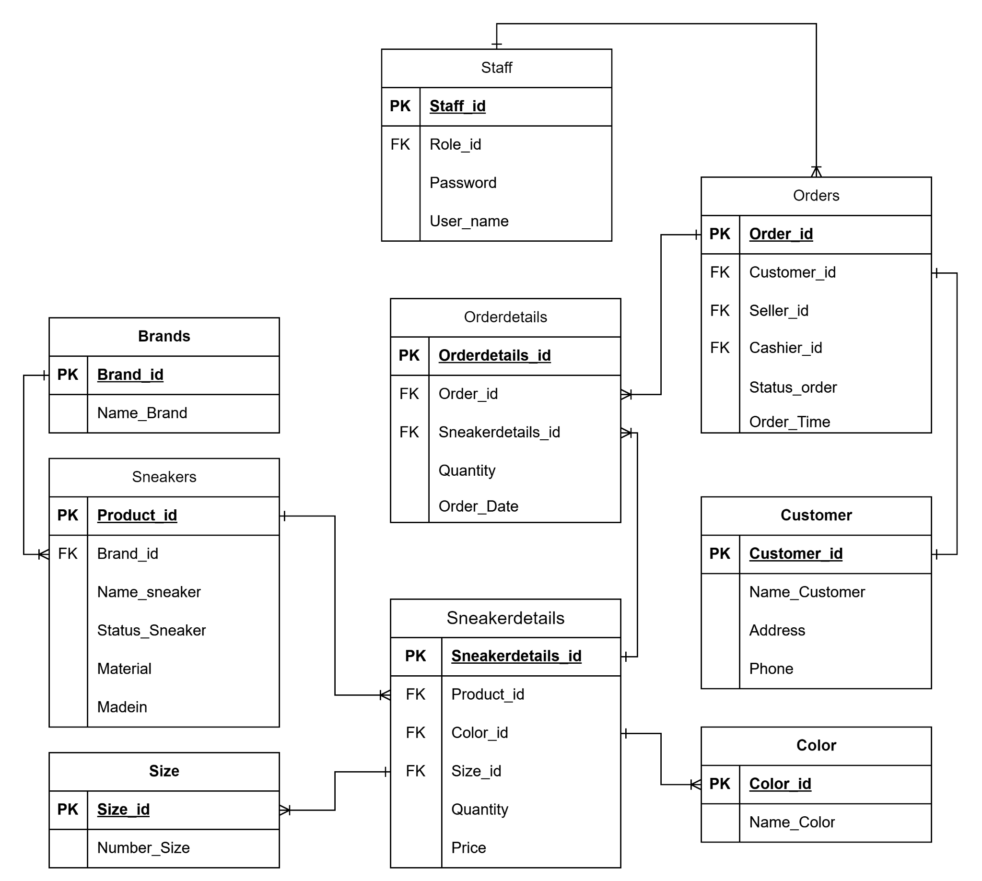
Entity Relationship Diagram
2. Database design details:

Slide 23
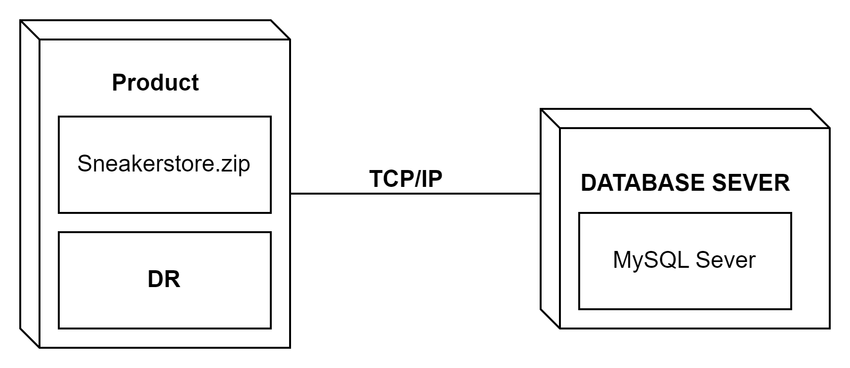
Deployment Diagram

Slide 24
Task Assign (to each team member)
H&T Sneaker Team | Sneaker Store
No | Task name | Description | Start Date | End Date | Member | Self assessment
1 | Write report |  | August 8 | August 17 | Huong, Truong
2 | Slide |  | August 10 | August 12 | Huong, Truong
3 | Database |  | July 27 | August 6 | Huong, Truong
4 | ERD |  | July 21 | July 26 | Huong, Truong
5 | Use Case, Sequence, Activity, Class Diagram |  | July 1 | July 18 | Huong, Truong
6 | Test case |  | August 22 | August 24 | Huong, Truong
7 | Code |  | July 18 | August 21 | Huong, Truong

Slide 25
Experience Learned
Collaborating on the final project in the C# course helped me apply practical and useful knowledge of C#. A specific example is when we needed to develop a login feature for our application. Instead of relying solely on general principles, I demonstrated my C# programming skills by creating source code that implemented the login functionality using this programming language.
This way, applying C# knowledge to the project enhanced my understanding of how to implement programming concepts and techniques in real-world scenarios. This experience honed various capabilities and established a robust foundation for my growth in programming and software development.

Slide 26


Slide 27
Q & A

