Slide 1

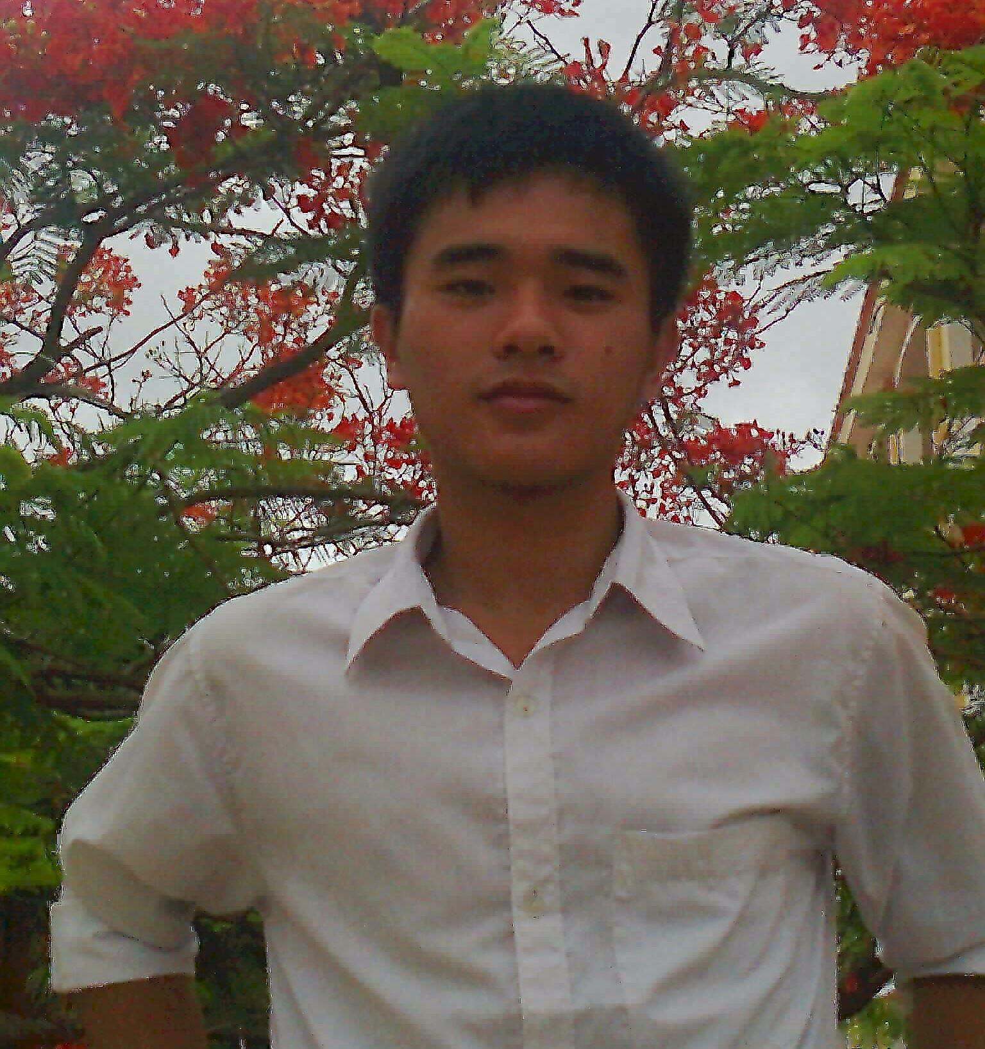

Member profile
BUI XUAN TRUONG
JUNIOR SOFTWARE ENGINEER
Previous Projects
Developed Fire Warning System in Building System of Fire Department.
Developed HF Digital Communication System of 'Ministry of Industry and Trade'.
Developed Bluetooth module in car infotainment system.
Developed monitor system for steel production line in manufacturing companies of Japan
Developed QR code scaner filter application
He has worked as a embedded engineer since 2016. With various positions and experiences in development projects , he has joined VTI where he was responsible for embedded department. He is one of the initial developer of embedded department, also has knowledge about desktop (windows, linux), mobile application (android) , embedded device ( Micro controler,IOT, high frequence communication ) development.
Currently, v Jr. Software Engineer

