Slide 1
Introduce the method of designing a DIVIDE AND CONQUER algorithm
Subject: Design and Analysis of Algorithms – CS112.L23.KHCL
Lecturer : Nguyen Thanh Son

Slide 2


Group 11
Member:
Truong Quoc Truong
Nguyen Quang Tuan
Nguyen Ngoc Tan

Slide 3


Overview
I: Introduce algorithm
II: Generality algorithm
III: Problems
IV: Conclusion
www.slidescarnival.com/help-use-presentation-template

Slide 4
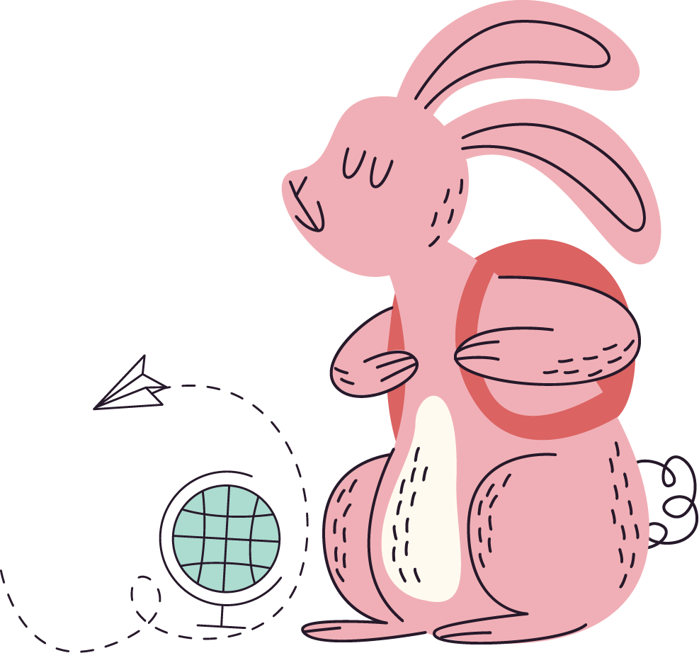
Warm up
The classic problem in the practice part of Data Structure and Algorithms is the Hanoi Tower lesson.

Slide 5
1.
Introduce Algorithm
Divide and conquer algorithm

Slide 6
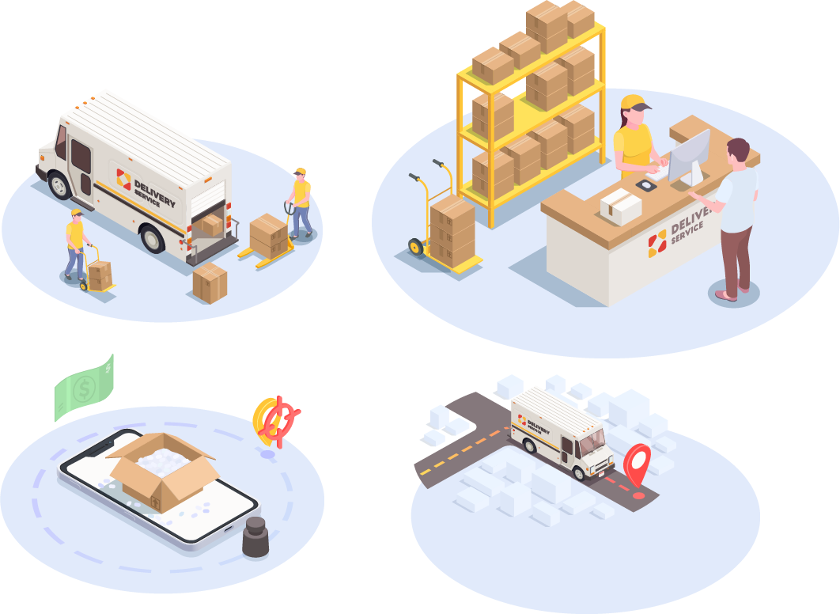
Introduce Algorithm

Slide 7

Introduce Algorithm
What is divide and conquer?

Slide 8
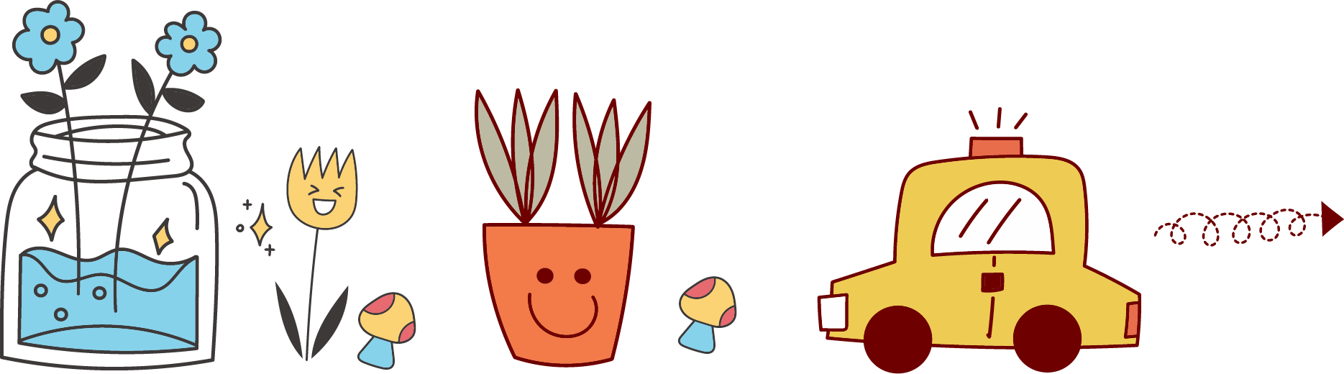
- It is an algorithm design paradigm, isn’t a programming technique.
- The basis of efficient algorithms for many problems.

Slide 9
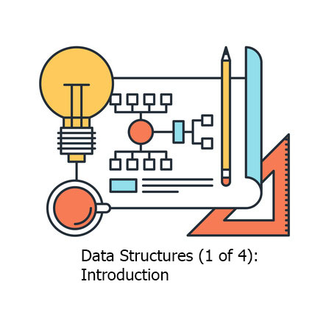
Introduce Algorithm
Have you
seen or used the
divide-and-conquer method?

Slide 10
2.
Generality Algorithm
Divide and conquer algorithm

Slide 11

Feature of the problem
How do we know it's a divide-and-conquer problem?
< / >
D-A-C

Slide 12
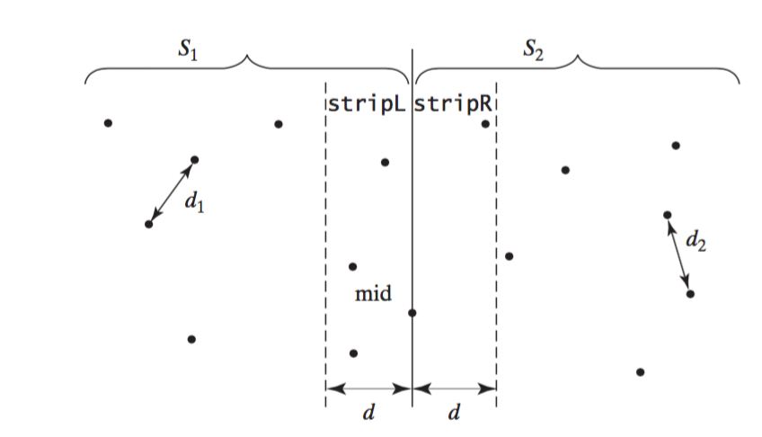
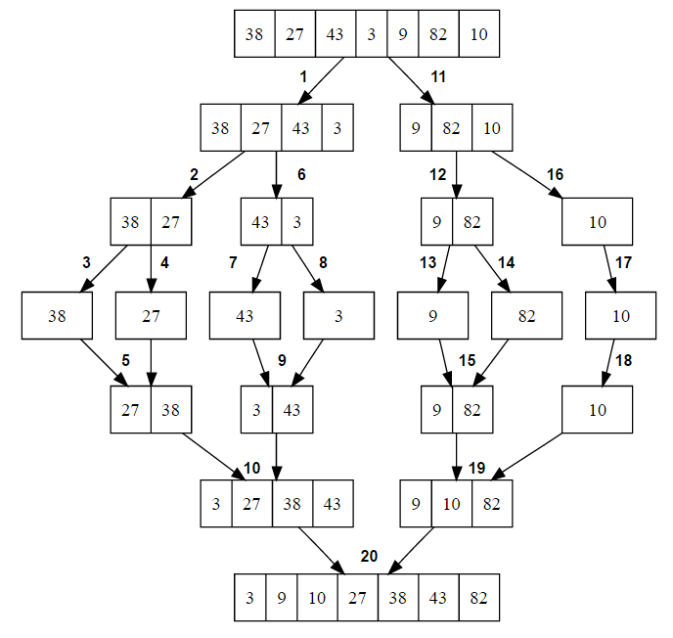
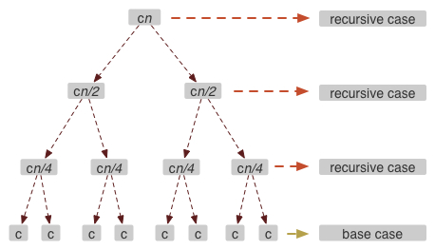
What do these problems have
in common?

Slide 13


- The original problem is replaced with a more general problem in order to create a recursive relationship.
- Each difficult or large problem and it can be divided into two or more subproblems.

Slide 14
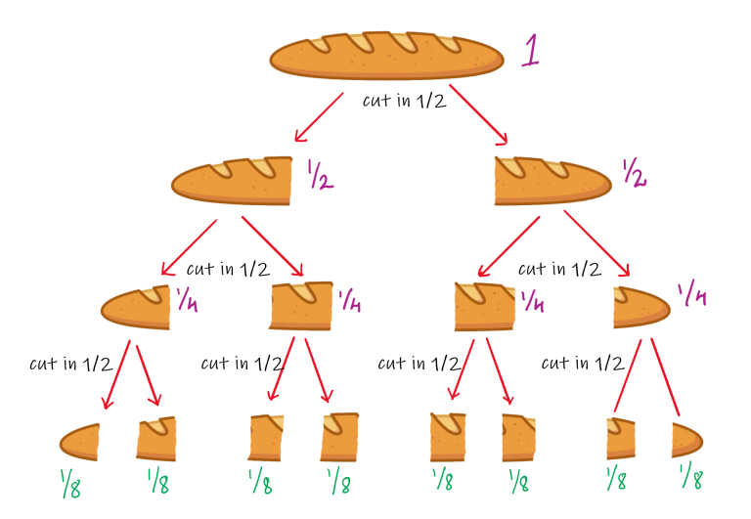
Question
Why do we have to use recursive call? If we don't use recursive calls, what other ways can we use them?

Slide 15
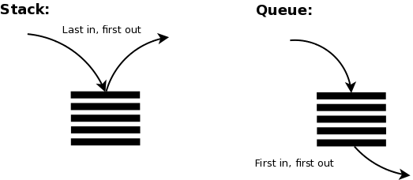
- Algorithm creates at least two subproblems, so it makes multiple recursive calls. It’s easier and more brief.
- In addition to the recursive call, we can also use stack data structures, queue, etc.

Slide 16


Generality Algorithm
How to solve problems by the divide and conquer algorithm?

Slide 17
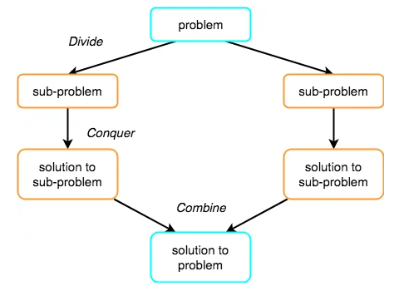
original problem
into a number of
subproblems
Devide
Combine
Conquer
by solving
them recursively

Slide 18
T(n) = aT(n/b) + f(n)
n = size of input
a = number of subproblems in the recursion
n/b = size of each subproblem.
f(n) = cost of the work done outside the recursive call, which includes the cost of dividing the problem and cost of merging the solutions.

Slide 19
3.
Problems
Divide and conquer algorithm

Slide 20
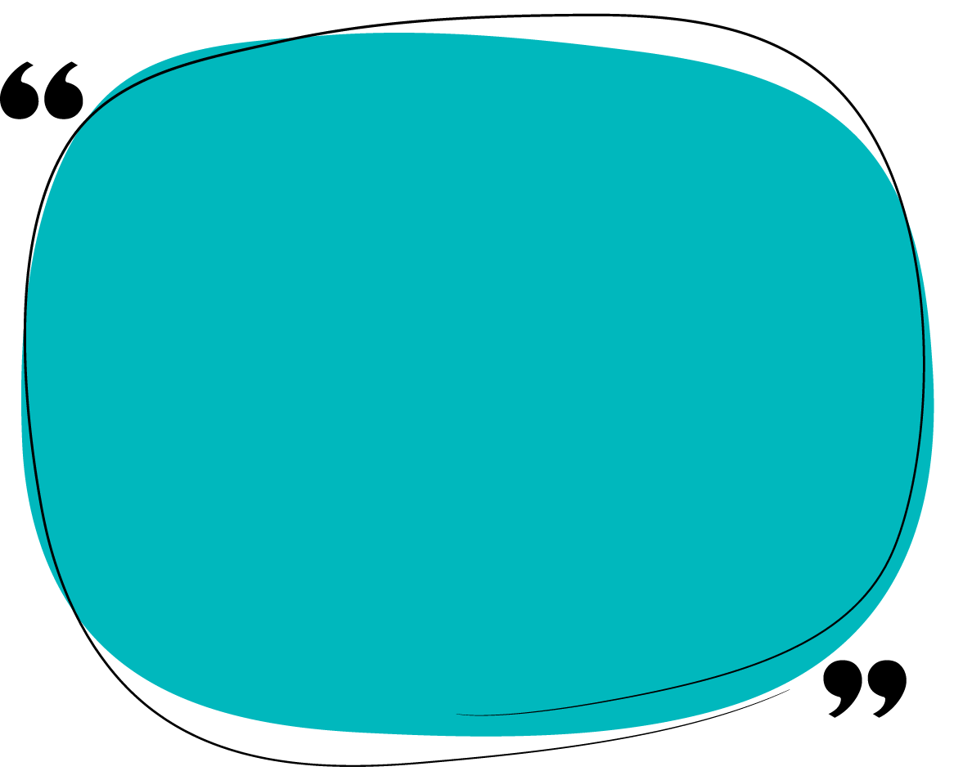

Pseudocode
# P(proplem | size: n)
DAC (P)
{
if( small(P) ){
Solve( (P) );
}
else{
Divide P into P1,P2,P3,...Pk;
Apply DAC( P1 ), DAC( P2 ),...;
Combine ( DAC( P1 ), DAC( P2 ),...)
}
}

Slide 21
Problems
Pseudocode:
function binary_search(A, n, T) is
L := 0
R := n − 1
while L ≤ R do
m := floor((L + R) / 2)
if A[m] < T then
L := m + 1
else if A[m] > T then
R := m − 1
else:
return m
return unsuccessful
Suitable case:
Given a sorted array Arr[] of n elements, write a function to search a given element x in Arr[].
=> within a Sorted array.
=> Binary search runs in logatithmic time in the worst case.

Slide 22
Problems
Pseudocode:
def sum(a, L, R):
if (L == R): return a[L]
m = (L + R) // 2
sumL = sum(a, L, m)
sumR = sum(a, m + 1, R)
return sumL + sumR
Unsuitable case:
Given a sorted array Arr[] of n elements, write a function to calculate sum n elements.
Time complexity:
D-A-C:
total run-time: 601.881504 ms
Sum = 4998100215846
Others:
total run-time: 185.421944 ms
Sum = 4998100215846

Slide 23
4.
Conclusion
Divide and conquer algorithm

Slide 24
O(n.log(n))
Pos:
- Solving difficult problems: A powerful tool for solving conceptually dificult problems.
- Algorithm efficiency: Offen helps in the discovery of efficient algorithms.
- Memory access: Naturally tend to make efficient use of memory caches.

Slide 25

Example: Fibonacci
Divide and Conquer approach:
fib(n)
If n < 2, return 1
Else , return f(n - 1) + f(n -2)
Dynamic approach:
mem = []
fib(n)
If n in mem: return mem[n]
else,
If n < 2, f = 1
else , f = f(n - 1) + f(n -2)
mem[n] = f
return f
Neg:
- Divide and conquer cannot save the results through of problems resolved for the next request.

Slide 26

The divide and conquer method is also a way to solve when we encounter difficult tasks, dividing them into smaller tasks to do instead of doing a whole big task.

Slide 27
Reference source:
- Anany Levitin, Introduction to the Design and Analysis of Algorithms, 3rd Edition, 2014
https://www.javatpoint.com/divide-and-conquer-introduction
https://www.geeksforgeeks.org/divide-and-conquer-algorithm-introduction/
http://www.cs.cmu.edu/afs/cs/academic/class/15210-s15/www/lectures/dandc-notes.pdf
https://www.geeksforgeeks.org/fundamentals-of-algorithms/#AnalysisofAlgorithms
https://www.codechef.com/wiki/test-generation-plan

Slide 28


Thank you!

Slide 29
Report
TASK ASSIGNMENT SHEET
Name | Task | Percent
Truong Quoc Truong | Design slide, Presented the parts Introduce algorithm, Generality algorithm | 100%
Nguyen Quang Tuan | Presented the parts Problems, Conclusion | 100%
Nguyen Ngoc Tan | Presented the parts Algorithmic complexity, In charge of the Mini game, Homework | 100%

Slide 30

Report
All team members do the right thing, search for full information, complete their tasks.
In the discussion chaired by the group, there were many mistakes and a lack of connection with the audience
Self-assess the level of completion of the group discussion: 70%

