Slide 1
Audio Steganography
Echo Data Hiding
Jeff England
EE 6886

Slide 2
Steganography vs. Watermarking
Both hide information discretely but for different purposes.
Steganography – Hiding data secretly for communication with another party.
  Ranging from small to large amount of data
  Non Detection most important
Watermarking – Hiding a trademark or identification for the use of determining ownership.
  Usually Small amount of data
  Non Removal most important

Slide 3
Types of Steganography
Images
  LSB
  DCT encoding LSB of MS Byte
  Spread Spectrum
Audio
  LSB (added noise can be heard)
  Phase Coding
  Spread Spectrum
  Tone Insertion
  Echo Data Hiding

Slide 4
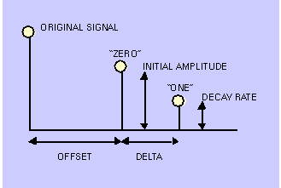
Echo Data Hiding
Echo introduced to hide data into audio signal
Echo is varied with three parameters:
  Initial Amplitude
  Decay Rate
  Offset

Slide 5
Inaudible echo
If the offset or delay is short then the echo produced will be unperceivable.
Depends on the quality of recording but max delay without effect is noted to be around 1 ms.
Also, initial amplitude and decay rate can also be set below the audible threshold of the human ear.

Slide 6
Encoding
The audio signal is divided into multiple windows.
Two delay times are used to encode the hidden data.
  Binary 0 encoded with delay = offset
  Binary 1 encoded with delay = offset + delta.

Slide 7
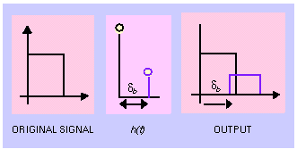
FIR Filter
A simple FIR Filter equation is used to delay the audio signal.
H(z) = 1 +g*z ^{–d}
  g = initial amplitude
  d = delay
Therefore two impulses are used; one to copy the original signal and one to introduce an echo.

Slide 8
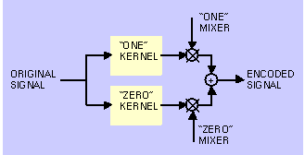
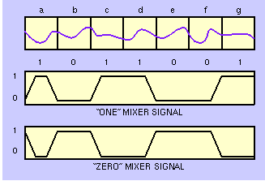
Final Encoding Step
Filter original signal separately through both binary “one” and “zero” filter.
Use mixer signal that contains a ramping function to switch between 0 and 1 encodings.

Slide 9
Decoding
Decoding is done by finding the delay before the echo.
First find the Cepstrum of the encoded signal.
  Finding the Cepstrum makes the echo delay more pronounced and easier to detect.
  F⁻¹(ln(F(x))²)
Then find the autocorrelation of the Cepstrum signal.

Slide 10
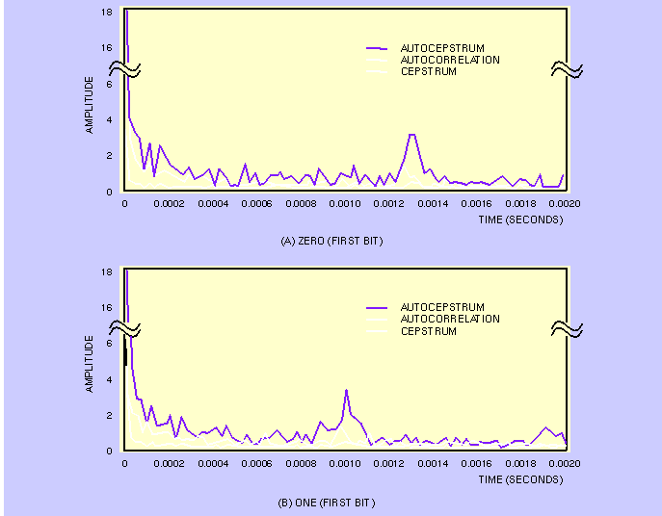
Result of Auto-Correlation of Cepstrum

Slide 11
Goals
Implement Echo hiding Algorithm
Determine the thresholds of when the echo becomes perceivable
  Type of music
  Amount of Delay (determines the amount of data that can be embedded)
Determine if algorithm is easily detectable, via use of spectrograms or other means
Determine if mp3 compression destroys the hidden data

Slide 12
References
W. Bender, D. Gruhl, N. Morimoto, A. Lu, “Techniques for data hiding,” http://www.research.ibm.com/journal/sj/mit/sectiona/bender.html, 1996.
Kaliappan Gopalan and Stanley Wenndt,“Audio Steganography for covert data transmission by imperceptible tone insertion”, www.calumet.purdue.edu/engr/docs/GopalanKali_422_049.pdf
Ingemar J. Cox, Joe Kilian, F. Thomson Leighton, and Talal Shamoon, “Secure Spread Spectrum”, IEEE Transactions on Image Processing, Vol. 6, No. 12, December 1997

