Slide 1
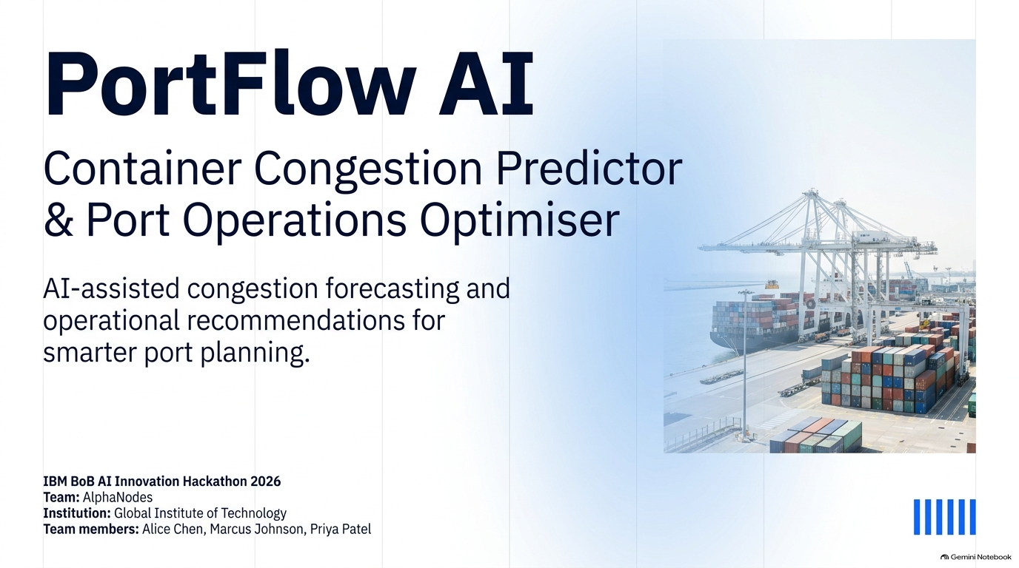
Congestion forecasting and scenario
simulation for informed port planning.
Synthetic-data prototype.
IBM Bobathon 2026 | Team: The Watson Four
Lead: Deep Makwana
Members: Manav Kansagara, Smit Kansagara, Trupesh Hingrajiya
Notes:
Friend: introduce PortFlow AI and the confirmed team. Synthetic-data forecasting prototype.

Slide 2
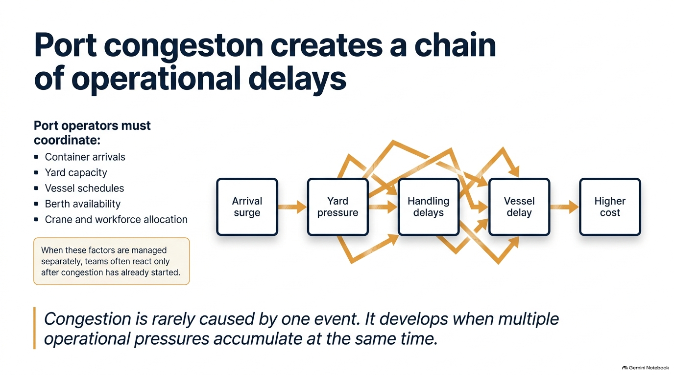
Notes:
Friend: explain interacting arrivals, handling capacity, and vessel delays. No measured savings claimed.

Slide 3
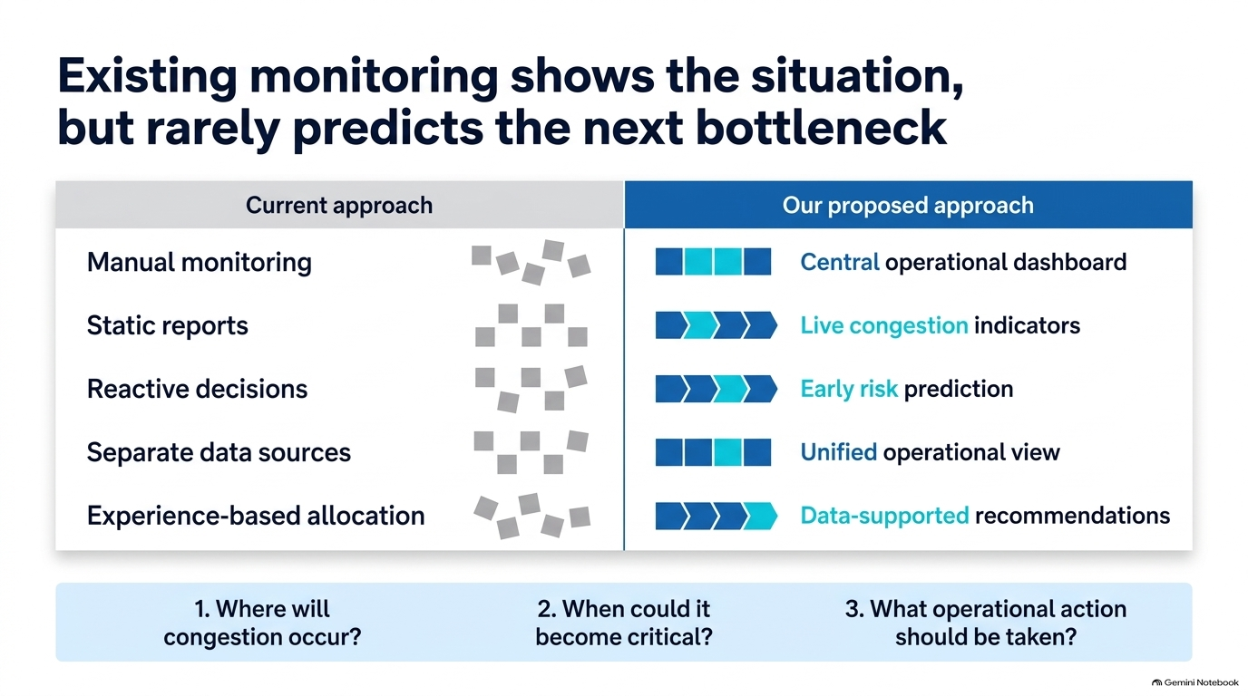
Scenario congestion indicators
Notes:
Friend: contrast fragmented monitoring with scenario visibility and trained predictions.

Slide 4
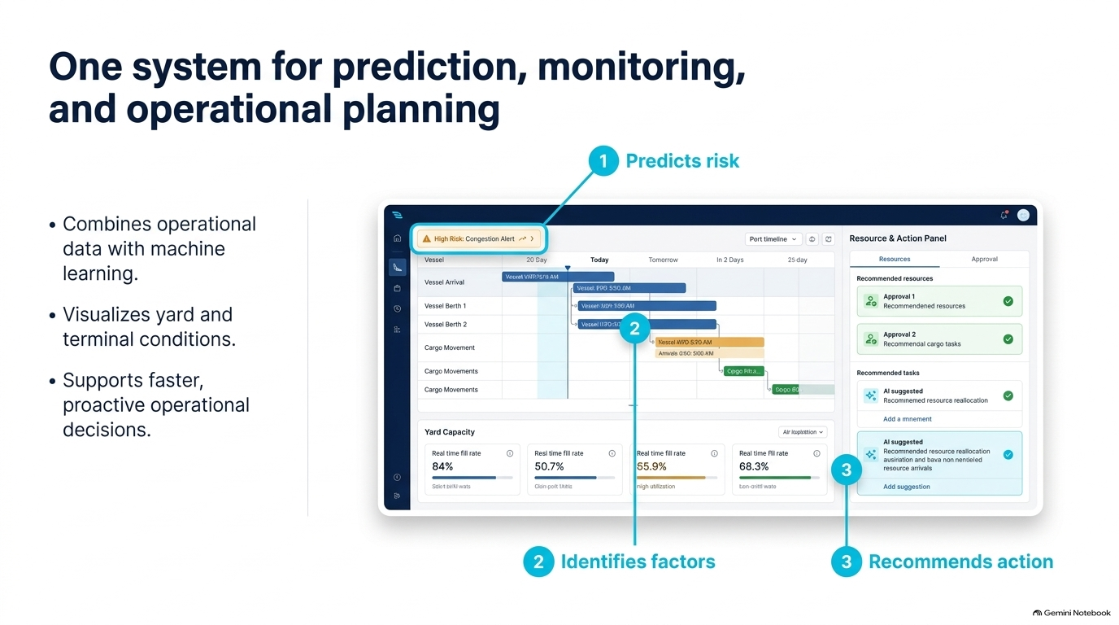
• Combines synthetic
schedules with ML.
• Visualizes berth and
crane availability.
• Supports informed
planning decisions.
Illustrative workflow mockup — see the live demo for actual application output.
Notes:
Friend: identify this image as an illustrative workflow mockup, not the running application.

Slide 5
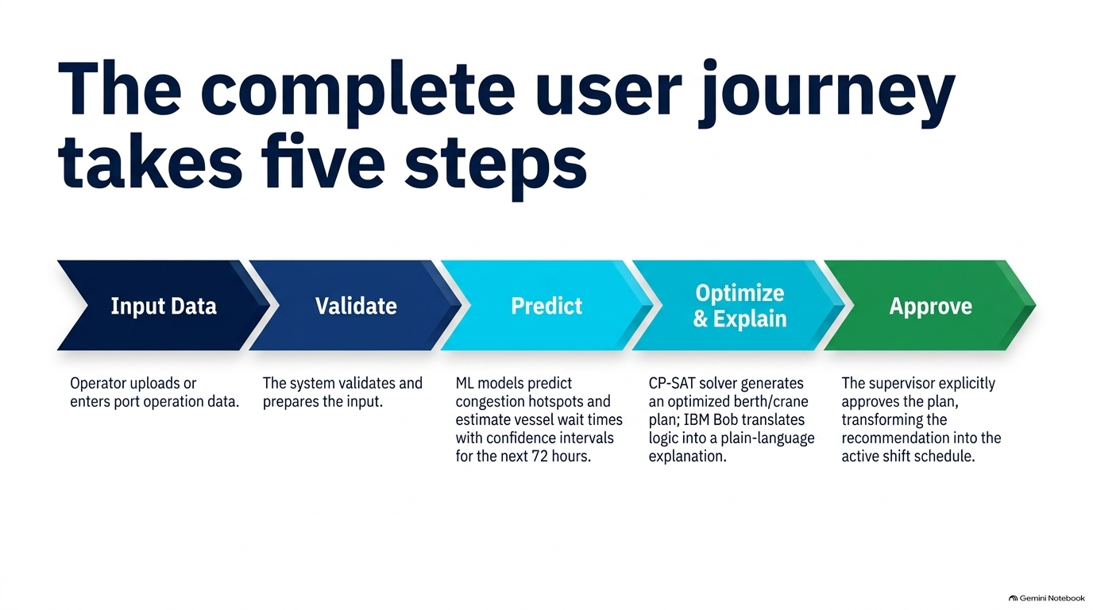
The proposed planning journey
takes five steps
Current input:
seeded synthetic
schedules and resources.
API validation and
feature preparation
are implemented.
Trained models predict
waiting time and
congestion probability.
Roadmap: CP-SAT
assignments and live
Bob explanations.
Current UI is static.
Demo approval changes
local browser state.
Persisted operational
plans are future work.
Notes:
Friend: proposed journey. Uploads, runtime CP-SAT, live Bob MCP, and persisted approvals are not implemented.

Slide 6
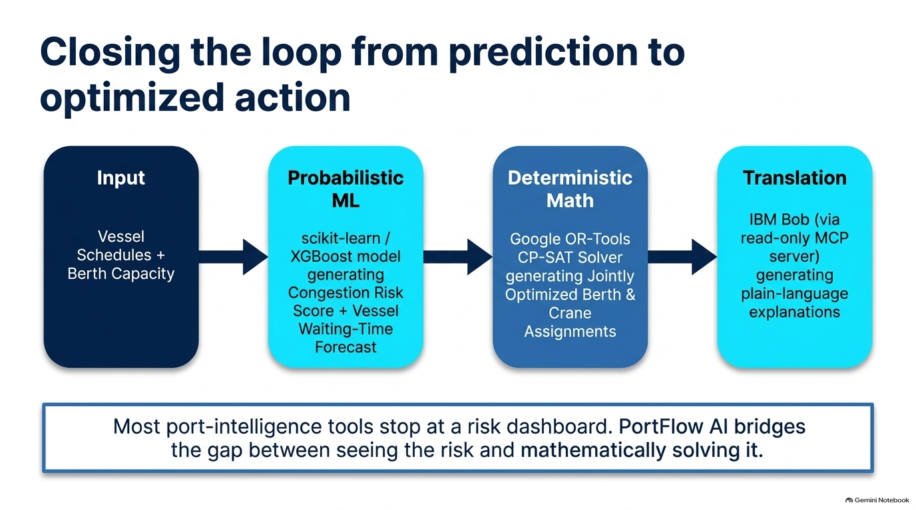
From working predictions
to planned operational action
Planning
(roadmap)
Bob used during
development.
Live MCP explanations
are planned.
Copilot responses
are predefined.
Synthetic vessel
schedules + berth
and crane capacity
scikit-learn
Gradient Boosting
models: congestion
probability and
vessel waiting time
Planned: OR-Tools
CP-SAT berth and
crane assignments.
Current interface:
static demo.
Current: scenario calculations and trained prediction inference.
Next: runtime scheduling and live IBM Bob MCP explanations.
Notes:
Friend: working inference versus planned solver and MCP. Hand over for the actual live demo. See demo/recording-script.md.

Slide 7
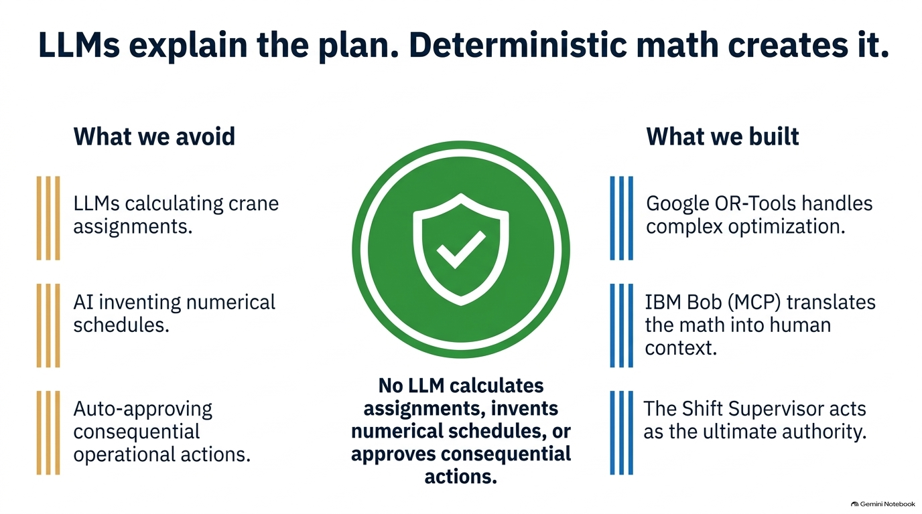
Design principle: models predict. Supervisors decide.
Current build & roadmap
Trained models generate
waiting-time and
congestion predictions.
IBM Bob used in development;
live MCP explanations
are planned.
Supervisor approval is a
local demo workflow.
No equipment is dispatched.
Notes:
Friend after demo: describe team-reported Bob development use and supervisor control. Exact tasks/evidence still needed.

Slide 8
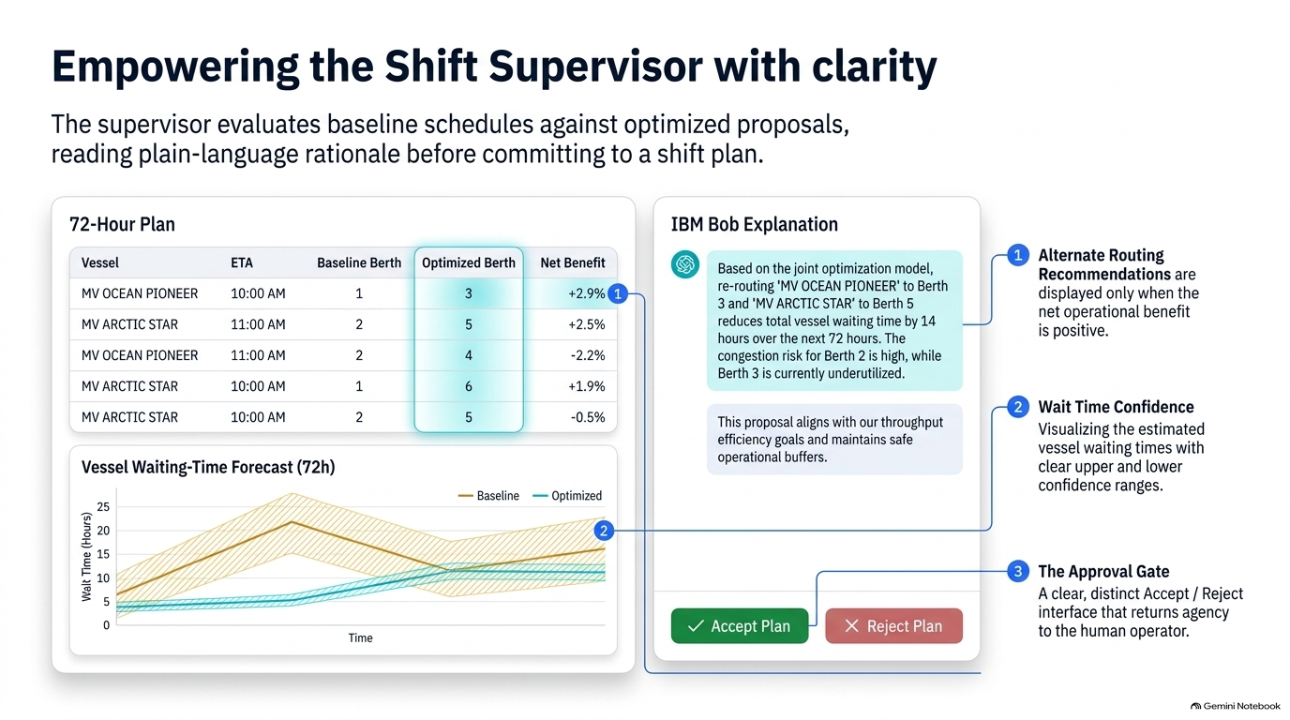
Planning workflow preview — static demonstration
Illustration of the proposed planning and explanation workflow.
Not runtime solver output or measured operational savings.
Copilot preview (not connected)
Illustrative explanation only.
Live IBM Bob MCP is not
connected, and a runtime
solver has not generated
these assignments.
Future: alternate routing
requires a runtime solver
and cost comparison.
Synthetic waiting-time
estimates need real-port
uncertainty validation.
Example text only; no
operational benefit measured.
Demo approval requires
confirmation but changes
local UI state only.
Notes:
Optional static planning preview. Diagram values are illustrative, not computed savings. Skip in a short recording.

Slide 9
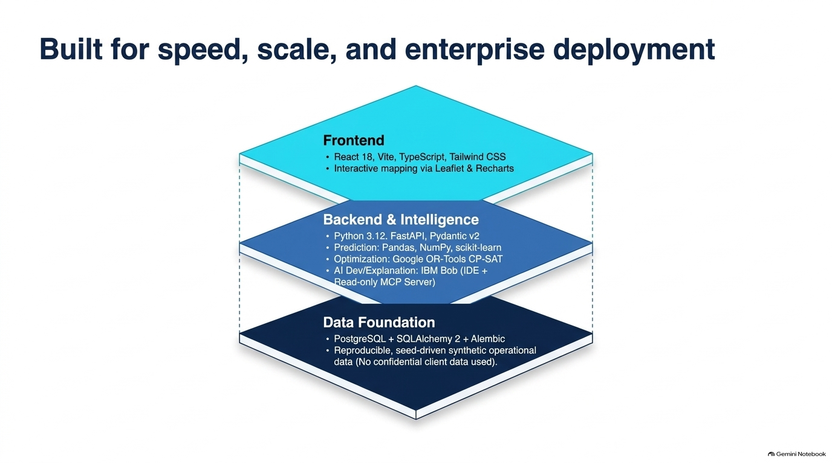
Prototype architecture: working services and roadmap
• React, Vite, TypeScript, Tailwind
• Custom charts and static berth map
• Python, FastAPI, Pydantic
• scikit-learn Gradient Boosting, NumPy
• OR-Tools scheduling: planned
• IBM Bob development; live MCP: planned
• Optional PostgreSQL, SQLAlchemy, Alembic
• Seeded synthetic schedules and resources
• No confidential client data
Notes:
Architecture: React/FastAPI, trained Gradient Boosting, optional database, planned solver/MCP.

Slide 10
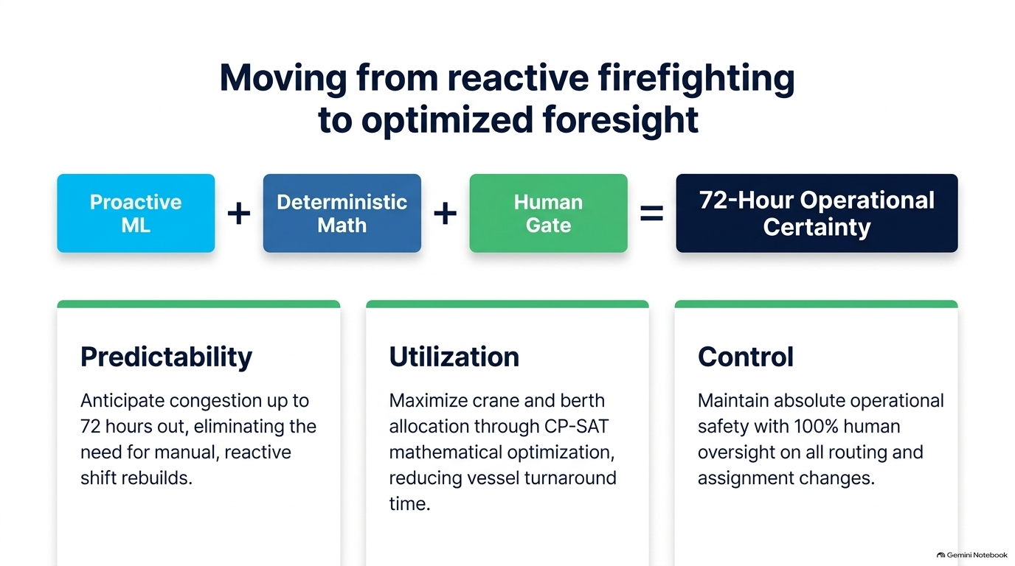
Potential impact: earlier visibility
and informed planning
Baseline
rules
72-hour planning
visibility
Explore 72-hour synthetic
scenarios and inspect
upcoming resource pressure.
Real-port validation is
still required.
Inspect berth and crane
capacity. Runtime CP-SAT
is a next step. No measured
turnaround savings.
Explicit confirmation is
demonstrated in the UI.
No automatic equipment
dispatch or operational
execution.
Notes:
Potential impact only; real-port validation and runtime solver are next steps.

Slide 11
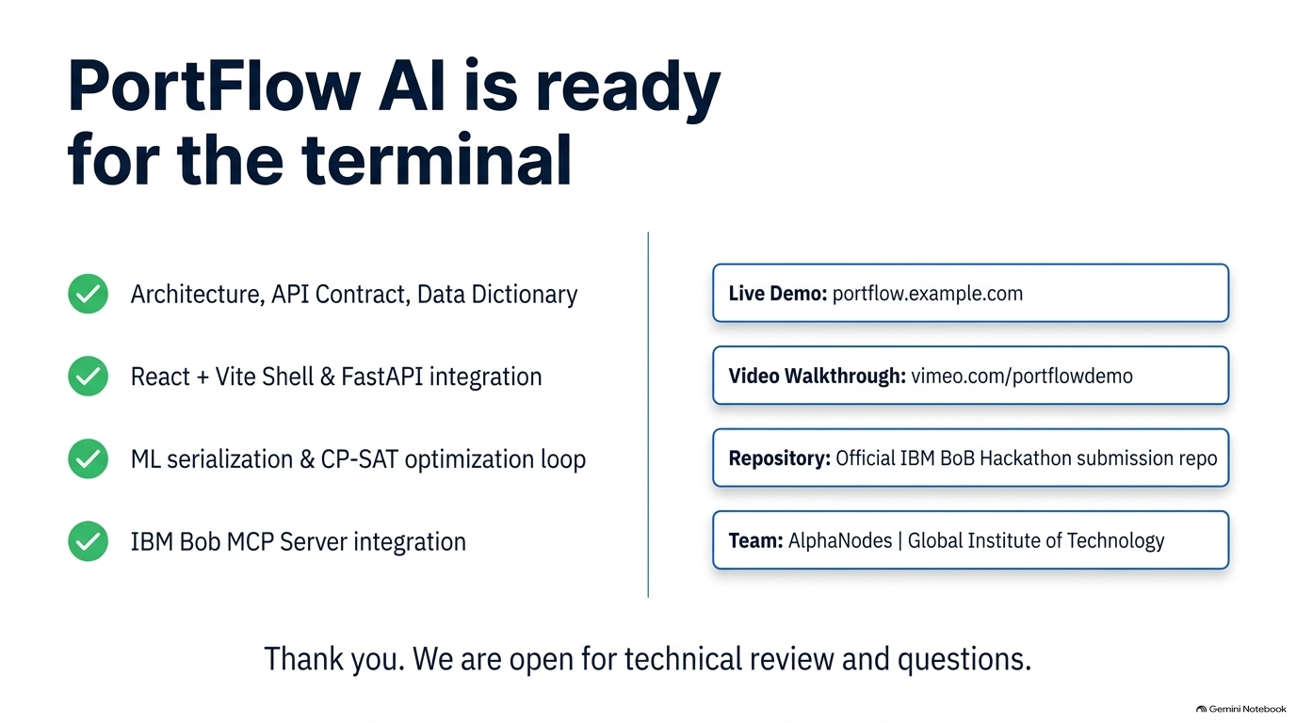
PortFlow AI: working
forecasting prototype
Architecture and reproducible setup
Local demo: localhost:5173 (not deployed)
React + FastAPI dashboard and scenarios
Video: recording and upload pending
Trained waiting-time and congestion models
Repo: github.com/Trupesh29/PortFlow-AI
IBM Bob development use; evidence pending
Team: The Watson Four | Lead: Deep Makwana
Pending: real video URL, Bob evidence, and repository naming/template confirmation.
Notes:
Closing: show actual local/repository links. Video upload and submission metadata/evidence remain pending.

