Slide 1
VoIP: Voice over Internet Protocol for Small Single-board Computers
Term Project Presentation
April 27, 2022
Trupesh Patel,
David Coleman,
Xiaoming Guo
{trpatel2, dmcoleman1, xguo29}@crimson.ua.edu
Dr. Xiaoyan Hong
hxy@cs.ua.edu

Slide 2
Content
Objective
Introduction & Background
Obstacles
Analytical Method
Experiments
Future Directions
Conclusion

Slide 3
Content
Objective
Introduction & Background
Obstacles
Analytical Method
Experiments
Future Directions
Conclusion

Slide 4
Objective
Determine optimal voice transmission paradigm in edge scenario
Architecture: IP-based PBX
Devices: Raspberry Pi, a cheap and energy efficient single board computer, can run IP-PBX software and control calls made over VoIP, but it is limited by its low memory and weak CPU.
Requirements:
Free and cheap communication within the local area, whiling maintaining egress access to remote entities.
Distributed implementation and centralized management.
Implementation using IoT devices
Fulfills the IP-PBX functions with Raspberry Pi
Verifies the suitability of Raspberry Pis for IP-PBX software under a variety of stressors.
Tests
Voice calls and transmission are made at different distances from the device and with the device working with different network difficulties.
Notes:
Modern telephone services are split between using traditional telephone networks and IP networks, such as the Internet. Voice over IP (VoIP) uses IP networks to make telephone calls, but it requires a machine running IP-PBX software to connect devices together for calls. A Raspberry Pi, a cheap and energy efficient single board computer, can run IP-PBX software and control calls made over VoIP, but it is limited by its low memory and weak CPU.
An examination has been performed to see how well the Raspberry Pi fulfills its IP-PBX functions with a variety of stressors, with the goal of determining the suitability of Raspberry Pis for IP-PBX software.
These tests were performed by running IP-PBX software on a Raspberry Pi, with calls made at different distances from the device and with the device working with different network difficulties.

Slide 5
Content
Objective
Introduction & Background
Obstacles
Analytical Method
Experiments
Future Directions
Conclusion

Slide 6
Introduction & Background: PBX & VoIP
Private Branch Exchange (PBX)
a technology which allows telephones to call each other, forwarding audio and controlling call behavior. While other technologies can provide similar services, PBX technology is designed for calls within a private institution.
Voice over IP (VoIP)
allowing for telephone services to be provided over IP networks instead of standard telephone networks. Today, IP networks are so cheap and widespread that it is more cost efficient to use them for telephony than standard phone networks.
Characteristics
Hosting communication within a limited area, while still maintaining access to the entities outside is a natural characteristics of IoT scenarios and the reason IP-based PBX paradigm is suitable for IoT.
Notes:
Private Branch Exchange (PBX) is a technology which allows telephones to call each other, forwarding audio and controlling call behavior. While other technologies can provide similar services, PBX technology is designed for calls within a private institution.
With the advent of the internet, Voice over IP (VoIP) was created, allowing for telephone services to be provided over IP networks instead of standard telephone networks. Today, IP networks are so cheap and widespread that it is more cost efficient to use them for telephony than standard phone networks.
Hosting communication within a limited area, while still maintaining access to the entities outside is a natural characteristics of IoT scenarios and the reason IP-based PBX paradigm is suitable for IoT.

Slide 7
Introduction & Background: IP-PBX
IP-PBX was made to act as a PBX for VoIP services, as a traditional PBX does not interact with IP networks.
IP-PBX is vital for IP telephony services, as without it, no two VoIP callers can connect to each other. IP-PBX can handle SIP messaging to manage call setup and RTP packages to relay audio data between callers and callees.
SIP and RTP/RTCP act as the backbone of IP-PBX.
SIP allows for calls to be started, connecting different callers together and allowing for complex behaviors such as putting callers on hold.
RTP/RTCP allows for an effective means of forwarding audio data between callers and the control of this forwarding.

Slide 8
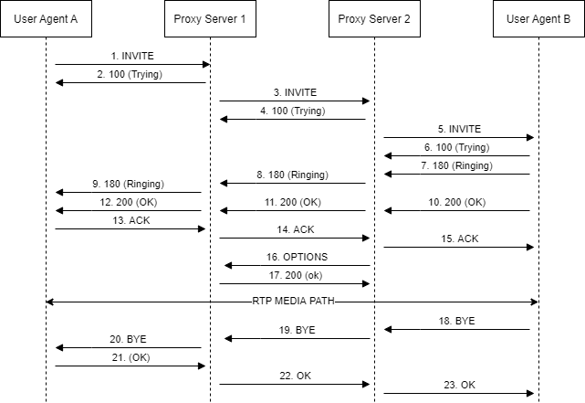
Introduction & Background: SIP
Provides the fundamentals of the PBX communication
In IP-based PBX implemented in the local network, the two proxy servers may merge into one.
SIP components:
Model: session or pager
Format: request/status line, header, body
From the SIP perspective, point out the core factors for a multimedia session: id, authentication, proxy, distance/hop count
Standard SIP

Slide 9
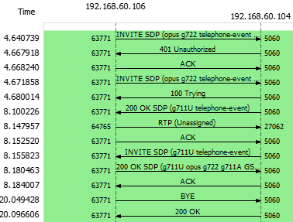
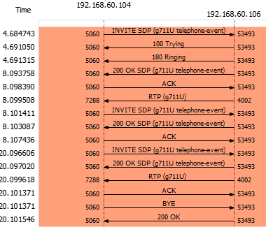
Introduction & Background: RTP/RTCP
RTP carries the media streams, while RTCP is used to monitor transmission statistics and quality of service
RTP: sensitive to packet delays and less sensitive to packet loss
Elements for RTP: sequence number, timestamp, source identifier, contributor identifier for multiple source
RTCP allows the recipients so that they can send feedback to the source or sources.

Slide 10
Content
Objective
Introduction & Background
Obstacles
Analytical Method
Experiments
Future Directions
Conclusion

Slide 11
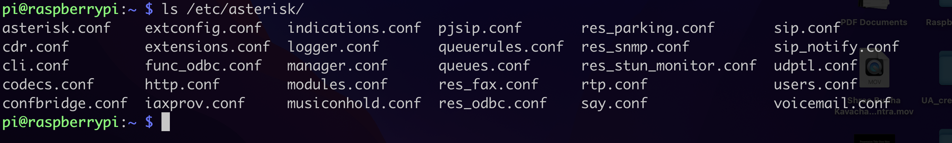
Obstacles
PBX is complex
The IP-PBX software used was Asterisk PBX, a very robust and mature implementation, making it also very complicated
Much third-party software is involved: Asterisk PBX for the PBX, Zoiper to make calls, Wireshark for packet capture, SIP.US for SIP trunking, etc.
Raspberry Pis could not initially access Eduroam without a large amount of additional setup

Slide 12
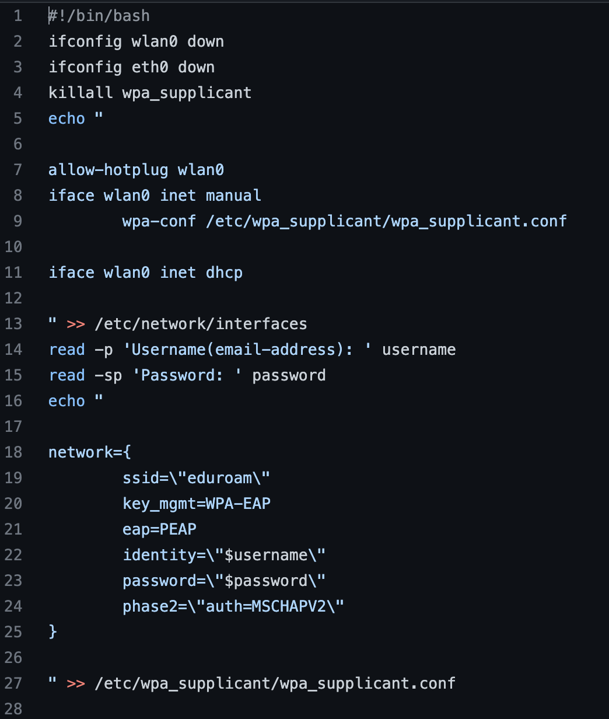
Obstacles
Raspberry Pis could not initially access “eduroam” without a large amount of additional setup

Slide 13
Content
Objective
Introduction & Background
Obstacles
Analytical Method
Experiments
Future Directions
Conclusion

Slide 14
Analytical Method
Primary metrics to be analyzed are loss and jitter.
The implementation of IP-PBX used, Asterisk PBX, provides a command to view jitter and loss for packets involved in telephony.
Wireshark was also used to capture SIP and RTP/RTCP packets involved in telephony.
Notes:
Primary metrics to be analyzed are loss and jitter.
The implementation of IP-PBX used, Asterisk PBX, provides a command to view jitter and loss for packets involved in telephony.
Wireshark was also used to capture SIP and RTP/RTCP packets involved in telephony.
Jitter and loss will be plotted in line graphs, examining the percentage jitter or loss over time. This will be used to visualize trends of the data when VoIP calls are made under different conditions.

Slide 15
Content
Objective
Introduction & Background
Obstacles
Analytical Method
Experiments
Future Directions
Conclusion

Slide 16
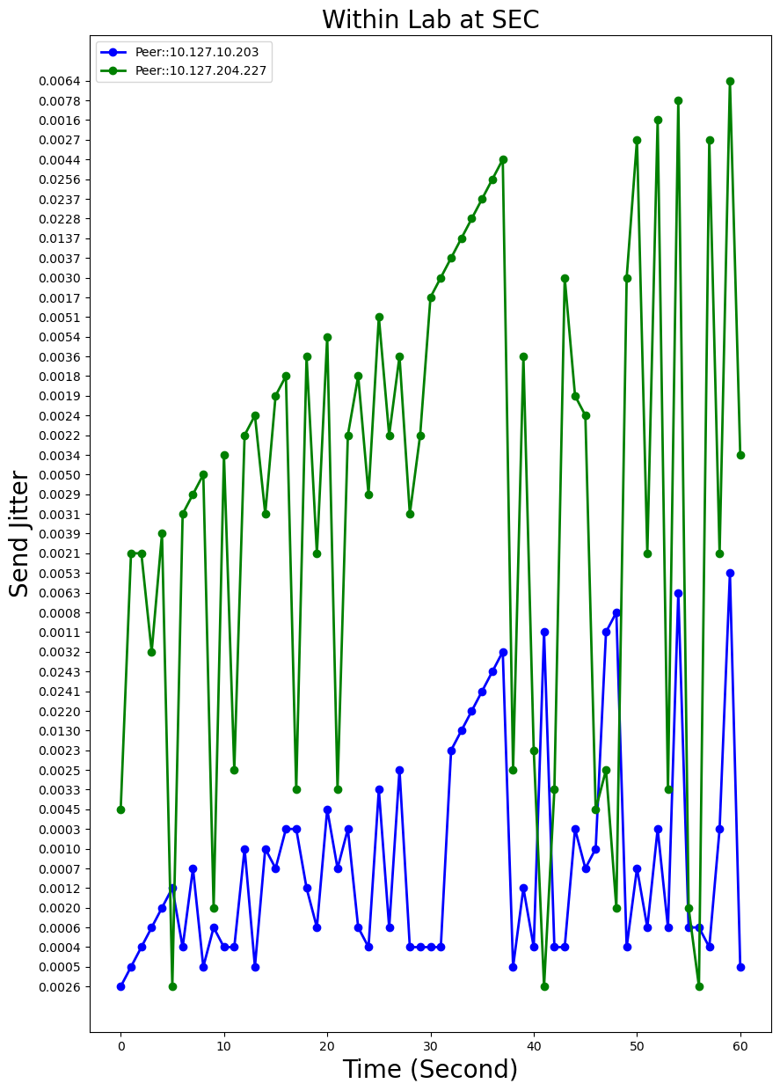
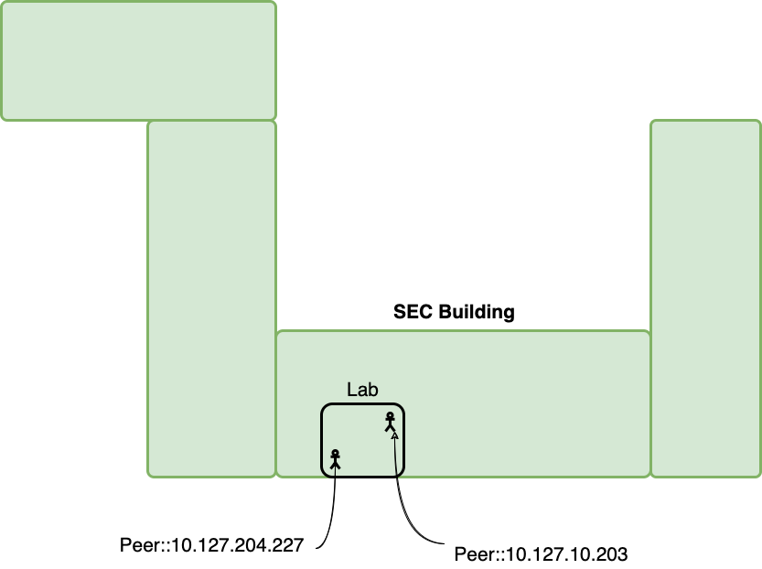
Experiments: Scenario 1
Notes:
To test the Raspberry Pi, the machine ran an open source implementation of IP-PBX called Asterisk PBX. While Asterisk PBX was running, two phones were registered on the software using Zoiper, a VoIP implementation available on smartphones.
There were two primary methods for testing the functionality of the Raspberry Pi running the IP-PBX software.
Make calls at a variety of locations of different distance from the Raspberry Pi
In the same room
On the same floor
In the same building
Outside same building
In a different building
Make calls while the Raspberry Pi is emulating stressful network conditions using the tc […] netem set of commands.
Add a delay to outgoing packets.
Add jitter to outgoing packets.
Add corruption to outgoing packets.
Add chance of loss to outgoing packets.

Slide 17
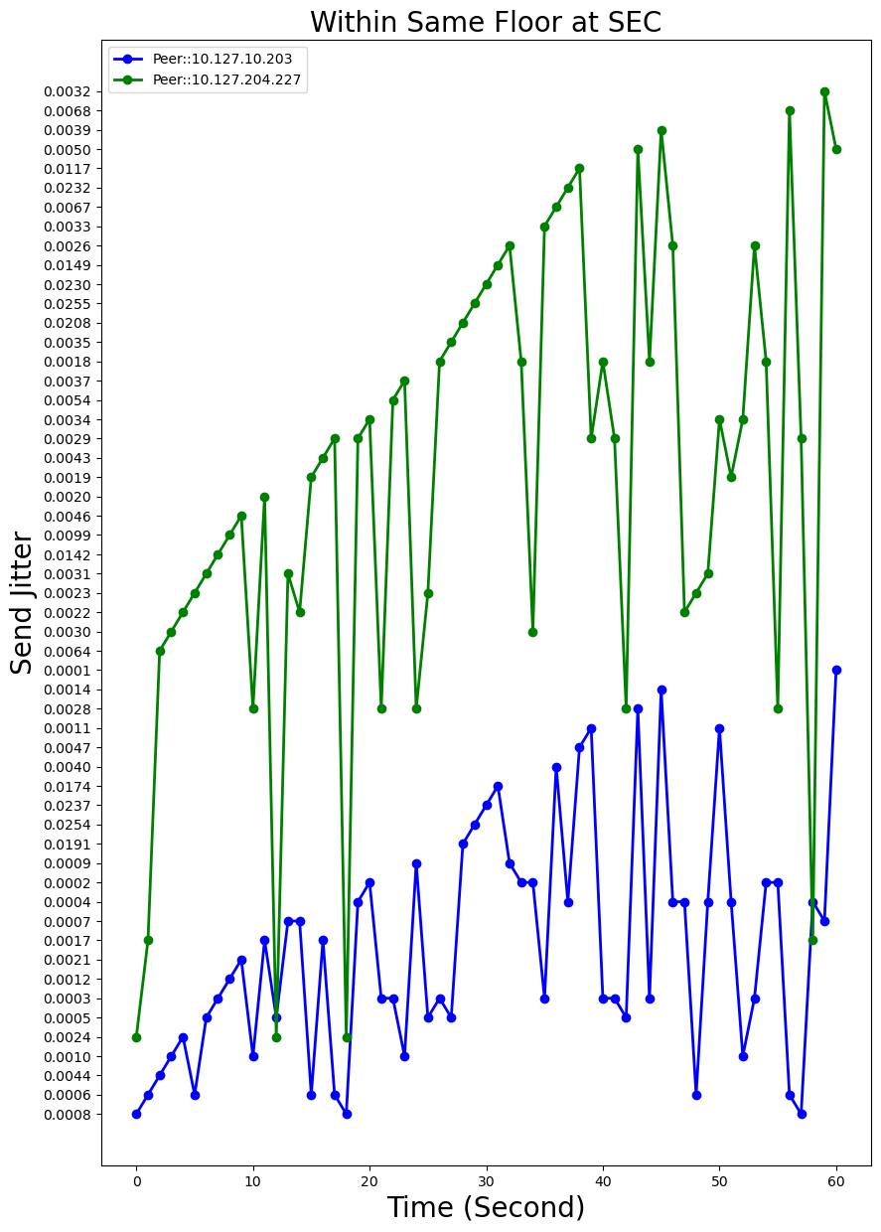
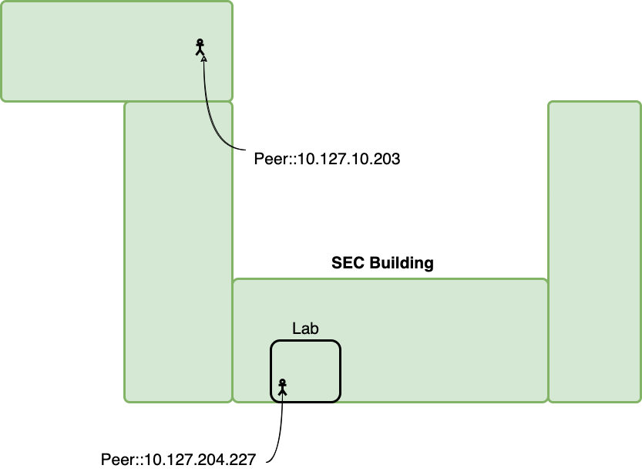
Experiments: Scenario 2
Notes:
To test the Raspberry Pi, the machine ran an open source implementation of IP-PBX called Asterisk PBX. While Asterisk PBX was running, two phones were registered on the software using Zoiper, a VoIP implementation available on smartphones.
There were two primary methods for testing the functionality of the Raspberry Pi running the IP-PBX software.
Make calls at a variety of locations of different distance from the Raspberry Pi
In the same room
On the same floor
In the same building
Outside same building
In a different building
Make calls while the Raspberry Pi is emulating stressful network conditions using the tc […] netem set of commands.
Add a delay to outgoing packets.
Add jitter to outgoing packets.
Add corruption to outgoing packets.
Add chance of loss to outgoing packets.

Slide 18
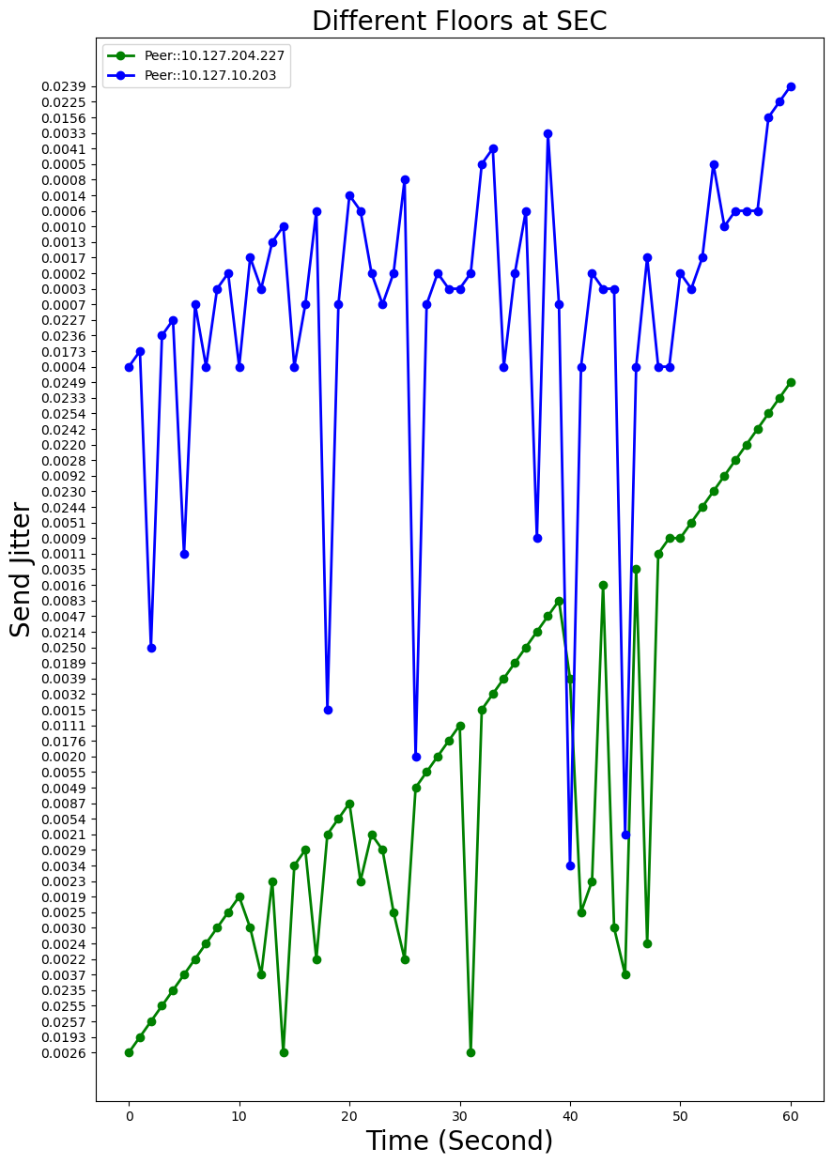
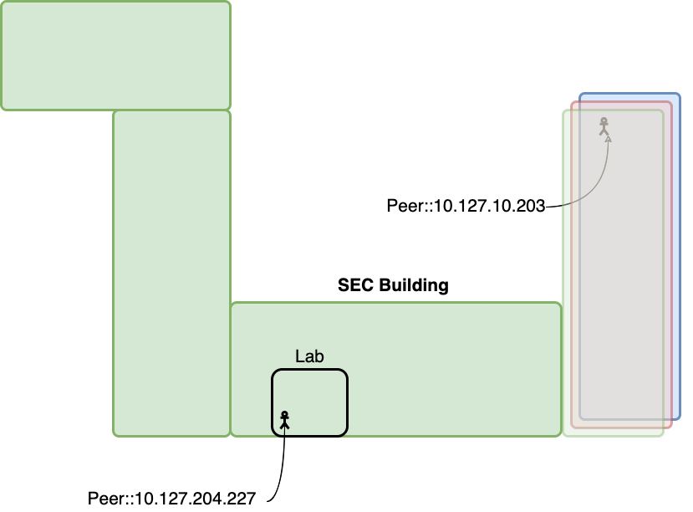
Experiments: Scenario 3
Notes:
To test the Raspberry Pi, the machine ran an open source implementation of IP-PBX called Asterisk PBX. While Asterisk PBX was running, two phones were registered on the software using Zoiper, a VoIP implementation available on smartphones.
There were two primary methods for testing the functionality of the Raspberry Pi running the IP-PBX software.
Make calls at a variety of locations of different distance from the Raspberry Pi
In the same room
On the same floor
In the same building
Outside same building
In a different building
Make calls while the Raspberry Pi is emulating stressful network conditions using the tc […] netem set of commands.
Add a delay to outgoing packets.
Add jitter to outgoing packets.
Add corruption to outgoing packets.
Add chance of loss to outgoing packets.

Slide 19
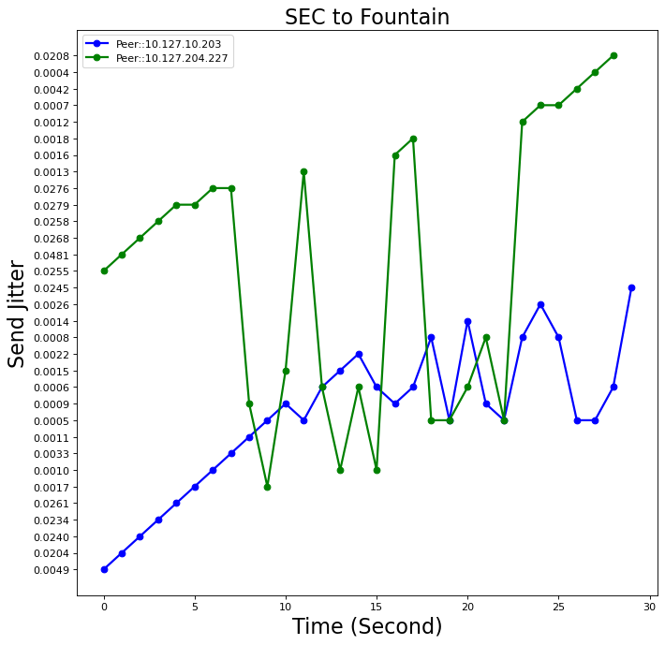
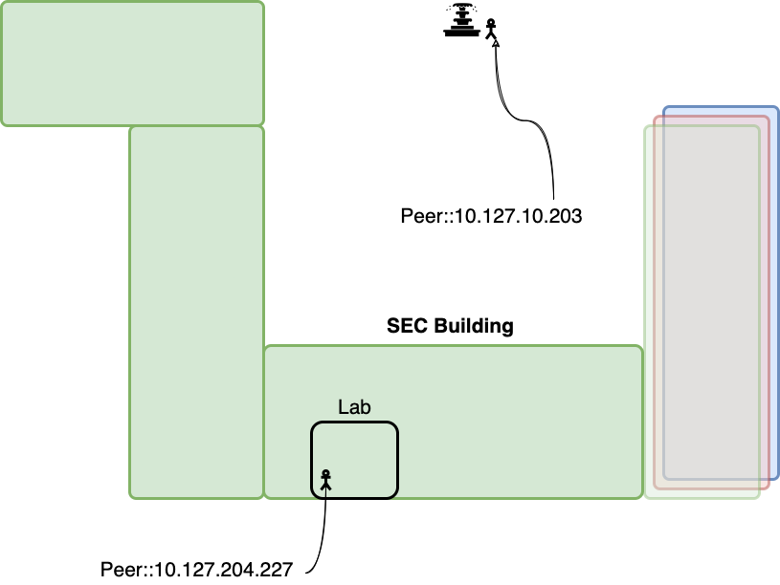
Experiments: Scenario 4
Notes:
To test the Raspberry Pi, the machine ran an open source implementation of IP-PBX called Asterisk PBX. While Asterisk PBX was running, two phones were registered on the software using Zoiper, a VoIP implementation available on smartphones.
There were two primary methods for testing the functionality of the Raspberry Pi running the IP-PBX software.
Make calls at a variety of locations of different distance from the Raspberry Pi
In the same room
On the same floor
In the same building
Outside same building
In a different building
Make calls while the Raspberry Pi is emulating stressful network conditions using the tc […] netem set of commands.
Add a delay to outgoing packets.
Add jitter to outgoing packets.
Add corruption to outgoing packets.
Add chance of loss to outgoing packets.

Slide 20
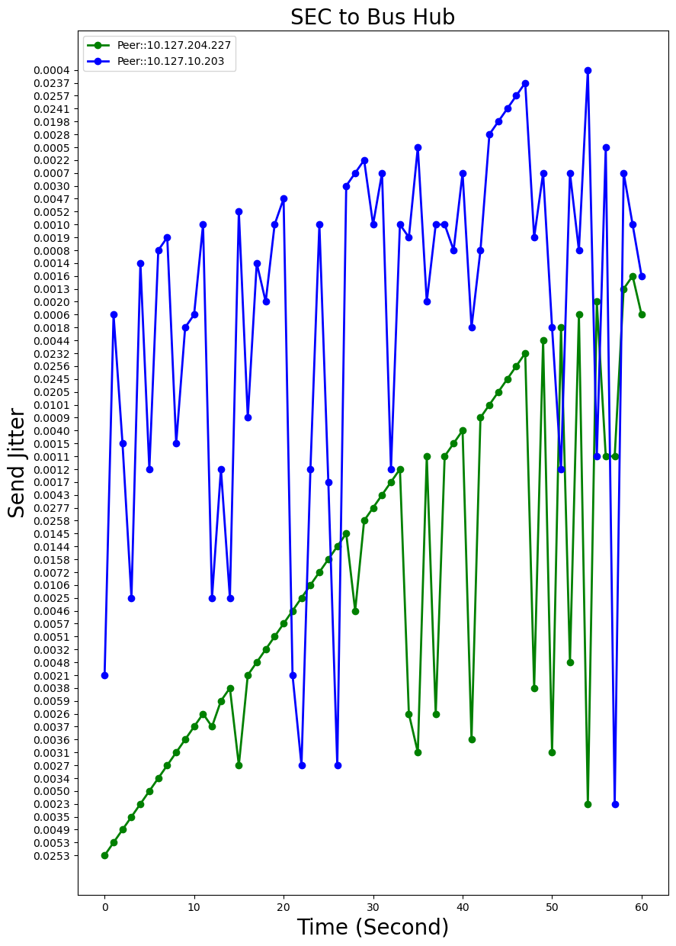
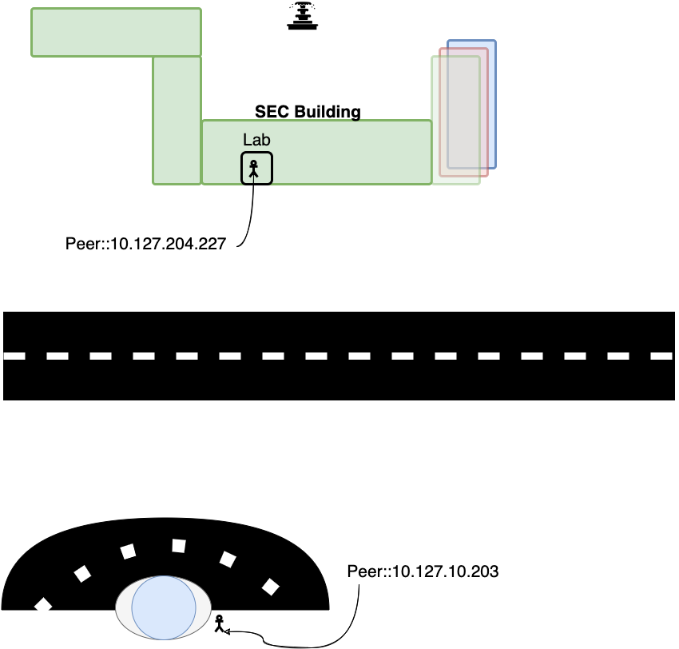
Experiments: Scenario 5
Notes:
To test the Raspberry Pi, the machine ran an open source implementation of IP-PBX called Asterisk PBX. While Asterisk PBX was running, two phones were registered on the software using Zoiper, a VoIP implementation available on smartphones.
There were two primary methods for testing the functionality of the Raspberry Pi running the IP-PBX software.
Make calls at a variety of locations of different distance from the Raspberry Pi
In the same room
On the same floor
In the same building
Outside same building
In a different building
Make calls while the Raspberry Pi is emulating stressful network conditions using the tc […] netem set of commands.
Add a delay to outgoing packets.
Add jitter to outgoing packets.
Add corruption to outgoing packets.
Add chance of loss to outgoing packets.

Slide 21
Expectation at Final Submission
Currently, the experiment to make calls at different locations has been completed, and the results of which have been recorded.
The experiment to test how well calls function while the Raspberry Pi is emulating different network conditions is to be completed soon.
An analysis will be performed on data from both experiments, examining the loss and jitter under different conditions in the first experiment and the quality of telephony under the different conditions of the second experiment.

Slide 22
Content
Objective
Introduction & Background
Obstacles
Analytical Method
Experiments
Future Directions
Conclusion

Slide 23
Future Direction
Add Interconnection between IP-PBX devices
Connect different Raspberry Pis running Asterisk PBX or some other implementation so that calls made to a phone registered on one can reach calls registered on the other
Add Scalability
Make a group of Raspberry Pis, all of which run the same IP-PBX software, such that the workload of connecting phones and controlling calls is spread over them horizontally
Test under More Conditions
How many callers can a Pi handle?
Effectiveness of Pi in different networks?
Making a call from an outside network?

Slide 24
Content
Objective
Introduction & Background
Obstacles
Analytical Method
Experiments
Future Directions
Conclusion

Slide 25
Conclusion
VoIP is a cheap alternative to traditional telephone services currently.
Raspberry Pis are cheap in terms of cost and energy usage, while still being powerful enough to easily handle IP-PBX software.
When making VoIP calls, distance from the machine running the IP-PBX can matter.
Can cause more jitter and loss.
Disconnections can happen.
Still need to test the Raspberry Pi with network emulation.

Slide 26
Special Thank You!

Slide 27


Any Questions?

Slide 28
Experiments
To test the Raspberry Pi, the machine ran an open source implementation of IP-PBX called Asterisk PBX. While Asterisk PBX was running, two phones were registered on the software using Zoiper, a VoIP implementation available on smartphones.
There were two primary methods for testing the functionality of the Raspberry Pi running the IP-PBX software.
Make calls at a variety of locations of different distance from the Raspberry Pi
In the same room
On the same floor
In the same building
Outside same building
In a different building
Make calls while the Raspberry Pi is emulating stressful network conditions using the tc […] netem set of commands.
Add a delay to outgoing packets.
Add jitter to outgoing packets.
Add corruption to outgoing packets.
Add chance of loss to outgoing packets.

