Slide 1

Internship Project Presentation
ENTERPRISE SALES INTELLIGENCE
Interactive Sales Analytics & Business Intelligence Dashboard
Presented by: Trupti Sonavane
Project Domain: Data Analytics & Business Intelligence
Tools Used: Power BI, Power Query, DAX

Slide 2
EXECUTIVE SUMMARY
PROJECT AT A GLANCE
Project Overview
PROBLEM STATEMENT & OBJECTIVES
Enterprise Sales Intelligence is a business intelligence project designed to analyze sales performance and transform raw business data into meaningful insights.
Problem Statement
Organizations generate large volumes of sales data across products, customers, and regions. Analyzing this data manually can be time-consuming and makes it difficult to identify important business trends.
Without a centralized reporting system, decision-makers may struggle to monitor sales performance, compare results, and identify areas that require attention.
Analyzing sales and profit performance.
Identifying trends across different time periods.
Evaluating product, customer, and regional performance.
Building an interactive Power BI dashboard.
Supporting data-driven business decisions.
Project Objectives
Project Goal
Develop an interactive sales intelligence dashboard.
Track important sales and profitability KPIs.
Analyze sales performance across different regions and products.
Identify sales trends and patterns over time.
Enable dynamic filtering and drill-through analysis.
Implement role-based access to regional data.
To provide a centralized and interactive reporting solution that helps stakeholders monitor business performance and identify opportunities for improvement.
02

Slide 3
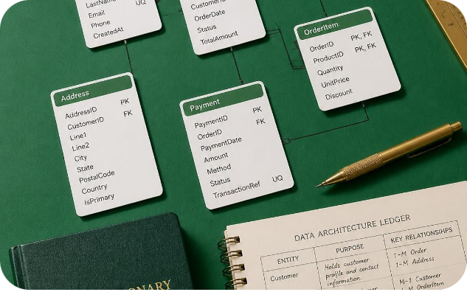
DATASET OVERVIEW
Dataset Description
DATA TRANSFORMATION & MODELING
The project uses the Microsoft AdventureWorks sample business dataset for sales analysis.
The dataset contains business information related to sales transactions, products, customers, and geographical regions.
Data Preparation
Power Query was used to prepare and transform the raw dataset before analysis.
Importing data into Power BI.
Cleaning and transforming raw data.
Checking data types and column consistency.
Removing unnecessary columns where required.
Preparing tables for analytical reporting.
Key Data Areas
Sales Data: Transaction-level sales information.
Product Data: Product details and product categories.
Customer Data: Customer-related information.
Reseller Data: Reseller and business partner details.
Date Data: Date information for time-based analysis.
Sales Territory Data: Geographical and regional information.
Data Modeling
A data model was created to establish relationships between relevant tables.
Sales transactions
Products
Customers
Resellers
Dates
Sales territories
Purpose of Dataset
To analyze business performance from multiple perspectives and generate meaningful sales insights.
Outcome
A structured data model that supports accurate calculations, interactive filtering, and efficient report analysis.
03

Slide 4
DAX MEASURES & BUSINESS KPIs
DAX-Based Analysis
Key Business KPIs
DAX (Data Analysis Expressions) was used to create calculated measures for evaluating business performance.
Total Sales: Overall revenue generated.
Total Profit: Total profit earned from sales.
Profit Margin: Percentage of sales revenue retained as profit.
YTD Sales: Sales accumulated from the beginning of the year.
Previous Year Sales: Sales performance during the previous year.
YoY Growth: Percentage change in sales compared with the previous year.
Rolling 3-Month Average: Average sales over a moving three-month period.
Business Value
These KPIs help stakeholders understand business performance, monitor growth, and evaluate profitability.
04

Slide 5
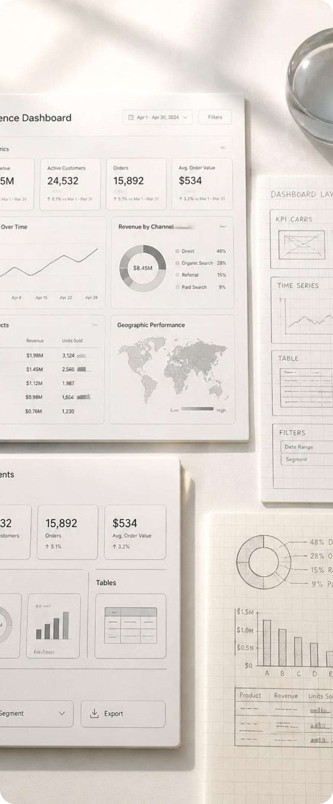
DASHBOARD DESIGN & ANALYSIS
Interactive Power BI Dashboard
The dashboard provides a consolidated view of enterprise sales performance through interactive visualizations.
Dashboard Components
Analytical Capabilities
KPI cards for important business metrics.
Sales performance analysis.
Profitability analysis.
Product and customer-level insights.
Regional sales comparison.
Time-based sales trends.
Compare performance across regions.
Identify high-performing and low-performing areas.
Analyze sales trends over different periods.
Explore business data through interactive visuals.
05

Slide 6
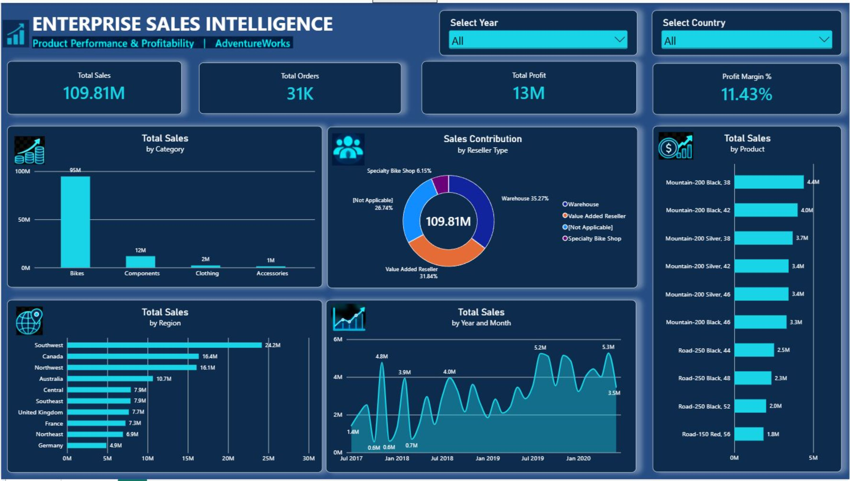
06

Slide 7
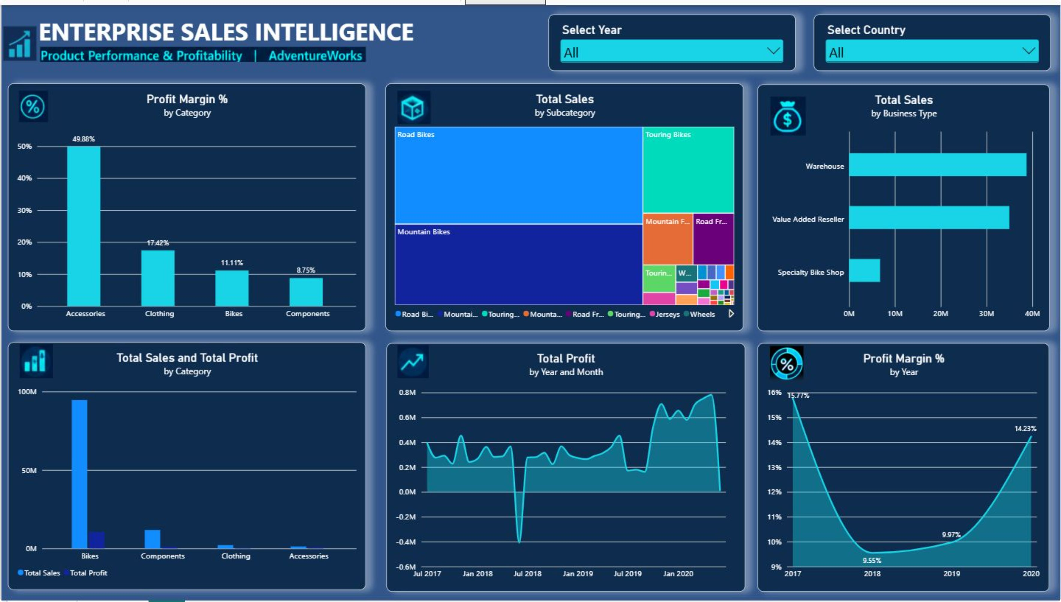
07

Slide 8
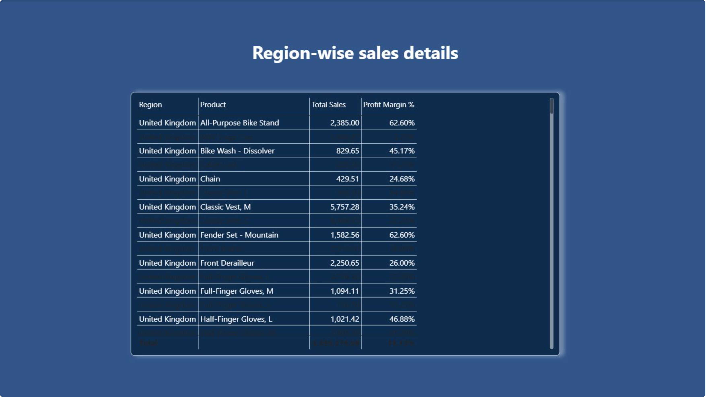
08

Slide 9
DYNAMIC USER EXPERIENCE · PART 1
INTERACTIVE FEATURES & ACCESS CONTROL
Interactive Dashboard Features
DIMENSION 01
DIMENSION 02
1. Year Filter
2. Region Filter
Allows users to analyze sales performance for a selected year.
Supports time-based comparisons.
Enables region-wise sales analysis.
Helps compare business performance across geographical areas.
09

Slide 10
DYNAMIC USER EXPERIENCE · PART 2
INTERACTIVE FEATURES & ACCESS CONTROL
3. Combined Filtering
4. Drill-Through Analysis
5. Row-Level Security (RLS)
Year and Region filters can be used together.
Visualizations update dynamically based on selections.
Allows users to navigate from summary-level analysis to detailed regional information.
Provides a deeper view of selected regions.
Controls data visibility based on assigned user roles.
The RegionManager role is intended to restrict access to relevant regional data.
Business Benefit
These features improve report usability, support detailed analysis, and help maintain controlled access to business information.
10

Slide 11
QUALITY ASSURANCE · SCOPE & CORE CHECKS
TESTING & VALIDATION
Testing and Validation
Testing was performed to check the functionality and reliability of the Power BI report.
Key Validation Areas
Data Validation
Relationship Validation
KPI Validation
Filter Testing
Combined Filter Testing
Checked whether imported data was available correctly.
Verified Year and Region filter interactions.
Reviewed relationships between the relevant tables.
Checked DAX calculations and KPI outputs.
Checked whether multiple filters work together.
11

Slide 12
QUALITY ASSURANCE · SECURITY & OUTCOMES
TESTING & VALIDATION
Key Validation Areas
Validation Outcome
Drill-Through Testing: Verified navigation to the regional detail page.
RLS Testing: Checked data visibility for the configured security role.
The report was reviewed for data consistency, calculation accuracy, and interactive functionality.
Testing Objective
To ensure that the dashboard provides reliable information and supports effective business analysis.
12

Slide 13

CONCLUSION & FUTURE SCOPE
Conclusion
The Enterprise Sales Intelligence project demonstrates how business data can be transformed into meaningful insights using Power BI.
The interactive dashboard provides a consolidated view of sales performance and enables users to analyze business results across different dimensions.
Key Learnings
Future Scope
Working with real-world business datasets.
Data cleaning and transformation using Power Query.
Data modeling and relationship management.
Creating DAX measures and business KPIs.
Designing interactive Power BI dashboards.
Implementing filters, drill-through, and access control.
Integrate real-time sales data.
Add advanced sales forecasting.
Apply machine learning for predictive analytics.
Expand customer segmentation analysis.
Improve automated reporting and alerts.
Thank You
13

