Slide 1
~ 0:35
PROJECT PRESENTATION
ENTERPRISE
SALES INTELLIGENCE
Turning sales data into actionable business insight
SQL Server • Power BI • DAX • SQL Server Agent
DATA → INSIGHT → ACTION
10-minute project walkthrough

Slide 2
01 / OVERVIEW
~ 0:45
Project at a glance
A compact analytics solution built around a SQL-backed Power BI reporting workflow.
BUSINESS QUESTION
SOLUTION
PRESENTATION FLOW
Where is revenue coming from, which products and resellers perform best, and how can performance be monitored?
A structured sales data pipeline, a relational reporting model, interactive Power BI visuals and scheduled SQL data-load automation.
Problem → Design → Dashboard → Engineering challenges → Results → Next steps
The goal is not just to display numbers — it is to make sales performance easier to explore, compare and explain.
02

Slide 3
02 / PROBLEM
~ 1:00
The reporting problem
Sales information is useful only when it is consistent, connected and easy to interpret.
SCATTERED DATA
LIMITED VISIBILITY
REPEATABLE REPORTING
Seven source tables contain different business entities — customers, products, resellers, dates, orders, sales and territories.
Without a consolidated view, comparing regions, identifying top contributors and tracking profitability takes extra effort.
A useful dashboard needs a dependable data source and a repeatable loading process — not repeated manual file handling.
Project objective: create one clear, interactive view of sales performance with a maintainable data workflow.
03

Slide 4
03 / SOLUTION DESIGN
~ 1:10
End-to-end solution architecture
The implementation separates source files, database storage, analytics modelling and reporting.
01
02
03
04
05
AdventureWorks
source workbook
→
7 CSV files
→
SQL Server
EnterpriseSalesDB
→
Power BI Desktop
→
Interactive
Dashboard
Original dataset
One file per source table
7 main tables
+ 2 staging tables
SQL connection
Transform • Model • DAX
KPIs • Trends • Rankings
DATA LOAD AUTOMATION
REPORT UPDATE
SQL stored procedure + SQL Server Agent job configured for a daily 3:00 AM schedule.
Power BI Desktop is refreshed manually after the database load. Power BI Service publishing is outside this version.
04

Slide 5
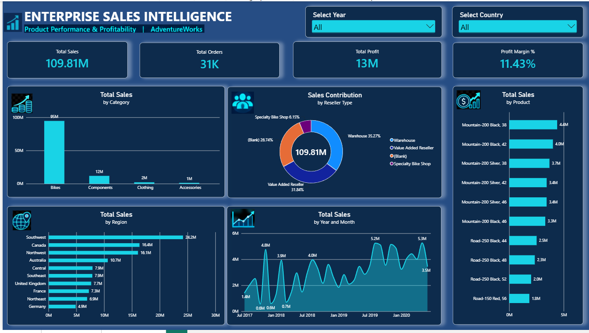

Slide 6
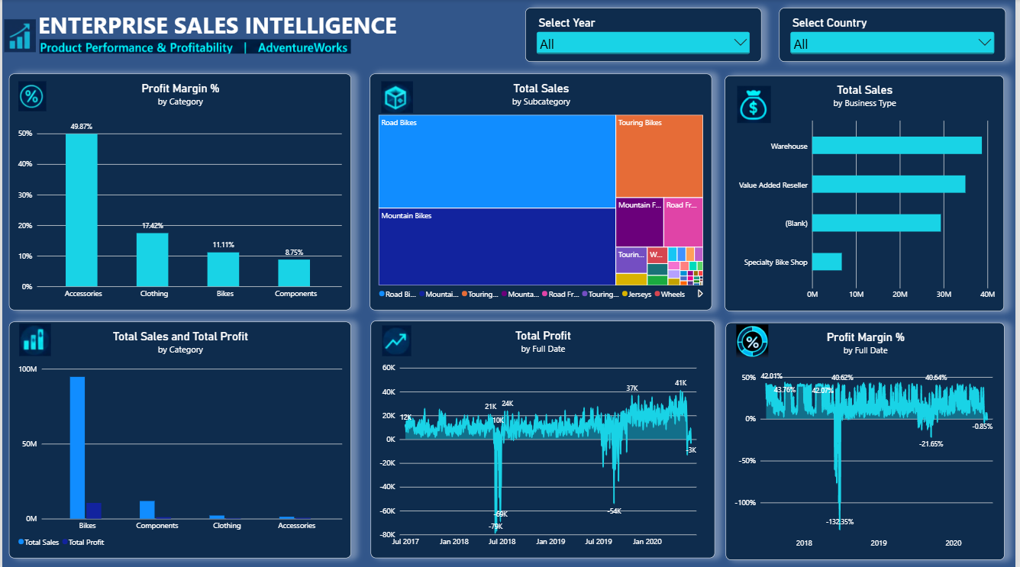

Slide 7
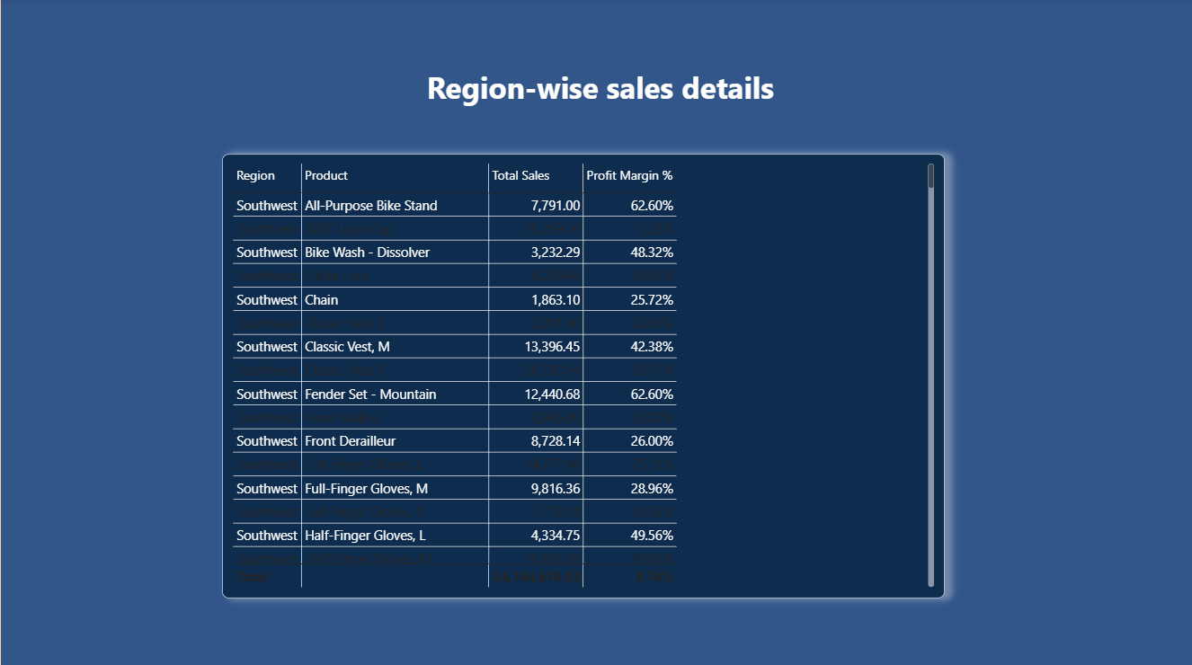

Slide 8
04 / DATA FOUNDATION
~ 0:55
A structured reporting layer
Seven business tables provide the dimensions and facts needed for sales analysis.
Customer data
Reseller data
SALES
Fact table
Date data
Sales_territory data
Product data
Sales_order data
SQL Server database: EnterpriseSalesDB | 7 main reporting tables | 2 staging tables
05

Slide 9
05 / DASHBOARD EXPERIENCE
~ 1:10
Designed for fast answers and guided exploration
A consistent visual hierarchy moves from headline KPIs to detailed comparisons.
KPI CARDS
TOTAL SALES
TOTAL PROFIT
TOTAL ORDERS
PROFIT MARGIN
109.81M
12.55M
~31K
11.43%
Revenue, profit, order volume and margin at a glance.
COMPARISON VISUALS
SALES BY REGION
TOP 10 PRODUCTS / RESELLERS
Regional performance and top products / resellers.
INTERACTION
Date and region slicers filter the report for focused analysis.
Illustrative dashboard layout
06

Slide 10
06 / ANALYTICS LOGIC
~ 0:55
Measures that turn data into business metrics
DAX measures keep calculations consistent across cards, charts and filters.
PERFORMANCE
EXAMPLE DAX PATTERNS
Total Sales • Total Profit • Total Orders • Profit Margin %
Total Profit = Total Sales − Total Product Cost
Profit Margin = Total Profit ÷ Total Sales
YoY Growth compares current sales with previous-year sales.
YTD and rolling averages add a time-based view of performance.
TIME INTELLIGENCE
Previous Year Sales • YoY Growth % • YTD Sales
TREND CONTEXT
Rolling 3-Month Average Sales
Time intelligence relies on a correctly related Date table and consistent date values.
07

Slide 11
07 / OPERATIONS
~ 0:55
A repeatable SQL data-load workflow
Automation reduces repetitive loading work; report refresh remains a separate step.
CSV SOURCE
STORED PROCEDURE
SQL AGENT JOB
SCHEDULE
Latest source files
→
usp_Automate_EnterpriseSales_Load
→
EnterpriseSales_Automated_Data_Load
→
Daily at 3:00 AM
WHAT IS AUTOMATED
WHAT IS STILL MANUAL
SQL Server Agent is configured to run the data-load procedure on the daily schedule.
Refresh the Power BI Desktop report after the database load to bring in updated data.
The job's ongoing execution should be monitored through SQL Server Agent Job History.
08

Slide 12
08 / ENGINEERING
~ 1:10
Challenges and how they were handled
The project involved both data-quality work and integration across tools.
CSV date formatting
→
RESPONSE
Date values imported in inconsistent text formats.
Standardized date values before using the Date table in reporting.
Excel-to-SQL migration
→
RESPONSE
Changing the source connection affected model relationships and measures.
Reconnected Power BI to SQL Server and reviewed the reporting model.
SQL automation setup
→
RESPONSE
SQL Server Agent service and job configuration needed attention.
Started/configured SQL Server Agent and created a stored procedure and scheduled job.
Refresh expectations
→
RESPONSE
A database job does not automatically refresh a local Power BI report.
Documented the separate manual Power BI Desktop refresh step.
09

Slide 13
09 / OUTCOMES
~ 0:45
Project results
A consolidated reporting workflow and a set of reusable sales performance measures.
109.81M
12.55M
121,253
~31K
Total Sales
Total Profit
Sales rows
Distinct orders
DELIVERED
BUSINESS VALUE
SQL-backed Power BI dashboard • 7 source tables integrated • DAX KPI and time-intelligence measures • SQL load procedure and scheduled job configuration.
Faster access to key sales metrics • Regional and product-level comparisons • A foundation for repeatable reporting and future enhancements.
Metrics shown are a project data snapshot; results may change when source data is refreshed.
10

Slide 14
10 / ROADMAP
~ 0:40
Next steps
The current solution is a strong desktop analytics prototype; these improvements would move it toward production use.
01 VALIDATE AUTOMATION
02 AUTOMATE REPORT REFRESH
Monitor SQL Agent Job History and confirm successful daily loads.
Publish to Power BI Service and configure an appropriate gateway and scheduled refresh.
03 STRENGTHEN DATA QUALITY
04 IMPROVE GOVERNANCE
Add row-count checks, duplicate checks, null checks and load audit logging.
Add role-based access, documentation updates and controlled deployment.
Thank you
Questions & discussion
11

