Slide 1

Mini-Project
Guest Feedback Data Analysis Using Excel
Detailed analysis of guest feedback based on specific criteria and conditions using Excel. The project includes data visualization through Pivot Tables, charts, and graphs to identify key insights from the feedback.

Slide 2
Question 1: Column chart for column purposes
Create a column chart to visualize the count of guests based on their "Purpose"(Business, Vacation, Function).
How many guests came for each purpose, and which purpose has the highest number of guests?

Slide 3
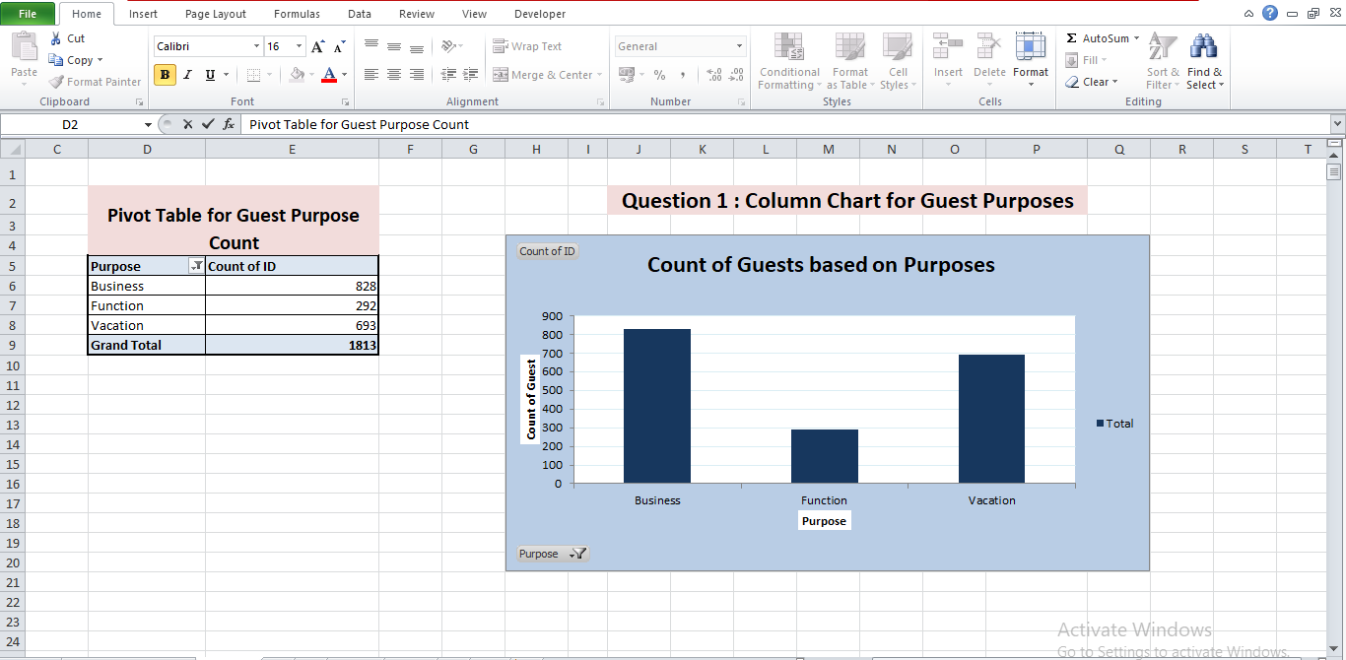

Slide 4
Question 2: Pie Chart for gender
Create a pie chart to visually represent the percentage distribution of gender within the dataset.
Which gender has a higher percentage?

Slide 5
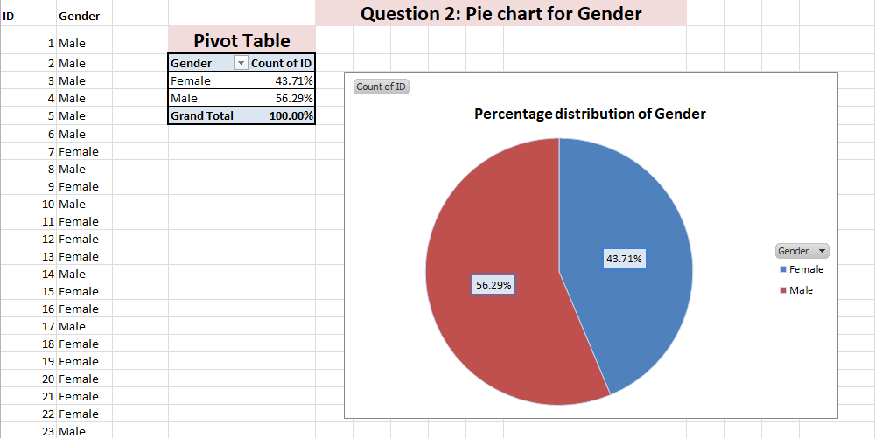

Slide 6
Question 3 : Pie chart for NPS Category
Create a pie chart to show the proportion of guests in each "NPS CATEGORY“ (Promoters, Passives, Detractors).
What percentage of guests fall into each NPS category? Which category has the largest proportion of guests?

Slide 7
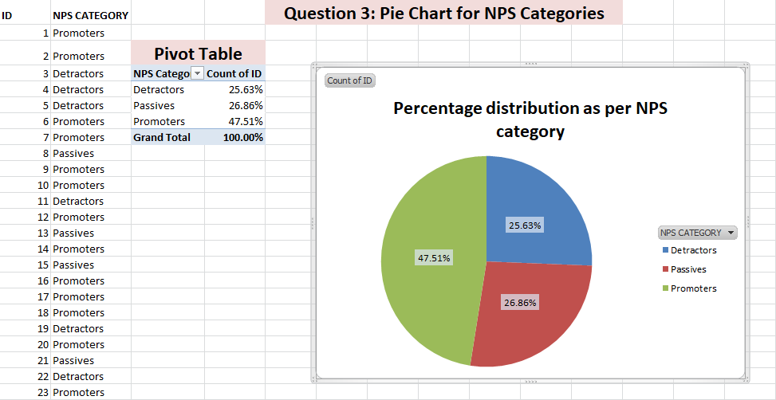

Slide 8
Question 4 : Bar Chart for Overall experience by Feedback Category
Create a bar chart to compare the average "Overall Experience" for each "Feedback Category" (Staff, Room, Restaurant, Facility).
Which feedback category has the highest average overall experience score? What insights can you gain from this comparison?

Slide 9
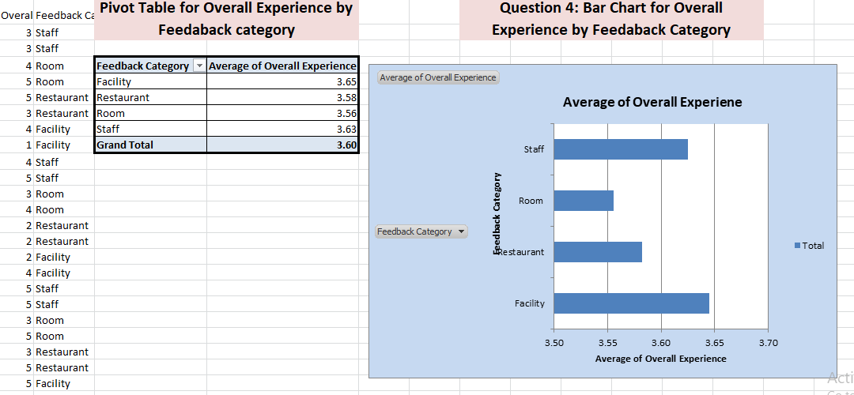

Slide 10
Question 5 : Pivot Table for Guest Purpose Count
Create a pivot table to count how many guests had each "Purpose" (Business, Vacation, Function).
What is the total count of guests for each purpose? Which purpose has the most guests?

Slide 11
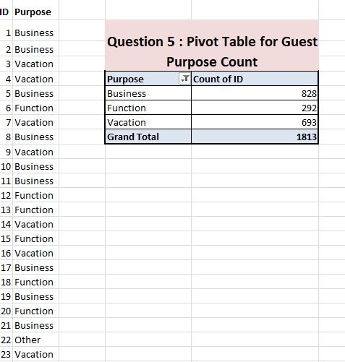

Slide 12
Question 6 :Pivot Table for Average NPS Rating by Purpose
Create a pivot table to calculate the average "NPS RATING" for each guest "Purpose.“
What is the average NPS Rating for each purpose? Which purpose shows the highest guest satisfaction?

Slide 13
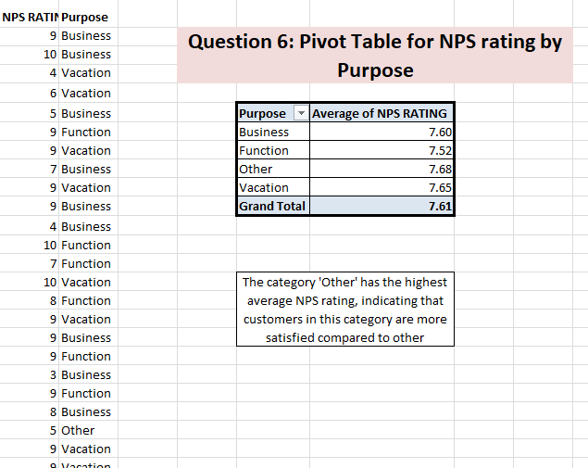

Slide 14
Question 7: Pivot Table for Overall Experience by Feedback Category
Create a pivot table to find the average "Overall Experience" for each "Feedback Category" (Staff, Room, Restaurant, Facility).
Which feedback category has the best overall experience rating? How do the categories compare?

Slide 15
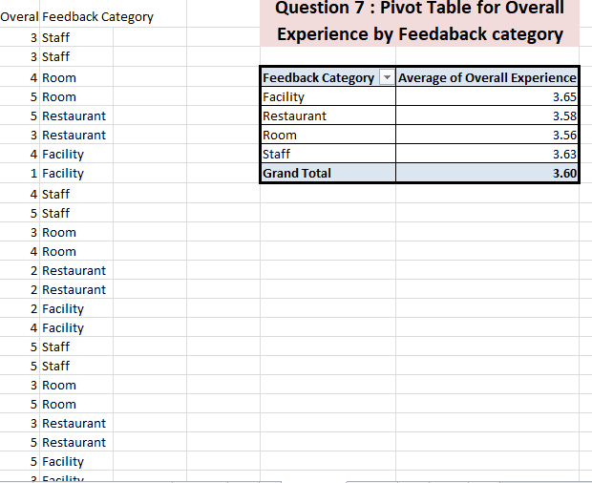

Slide 16
Question 8: Pivot Chart for NPS Ratings by Purpose
Using the pivot table from Question 5, create a pivot chart to visualize the average "NPS RATING" for each "Purpose."
What can you learn from the pivot chart about NPS ratings based on the guest's purpose of stay?

Slide 17
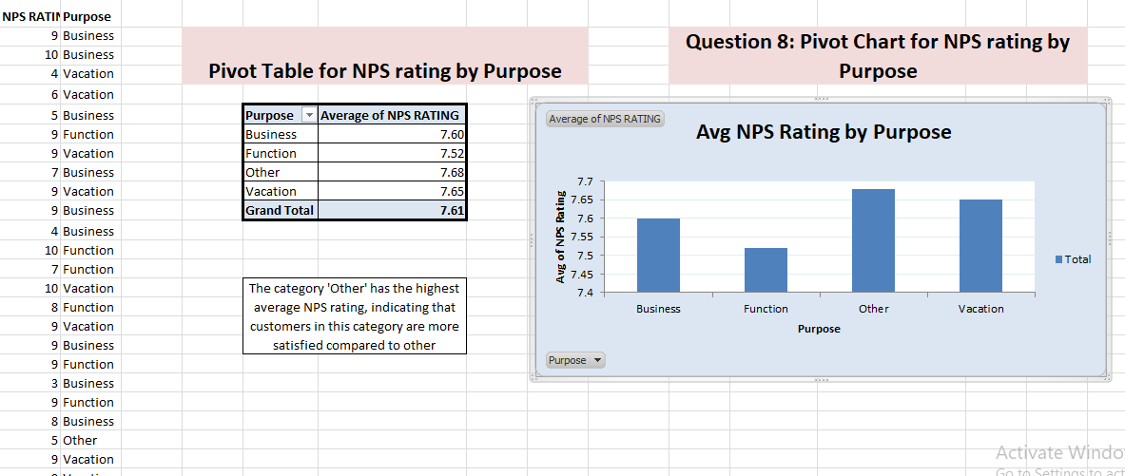

Slide 18
Question 9: Analyze Trends in Ratings Over Time
Create a line chart to visualize how the "NPS RATING" has changed over the years based on the "Checkout Date."(Note: You can extract the year from the checkout date before plotting, and you can utilize this information accordingly.)
Add a trend line to the chart to illustrate the overall direction of ratings over time.
What does the trend line indicate about guest satisfaction? Are there any noticeable increases or decreases in ratings during specific periods? What insights can you draw from this trend analysis?

Slide 19
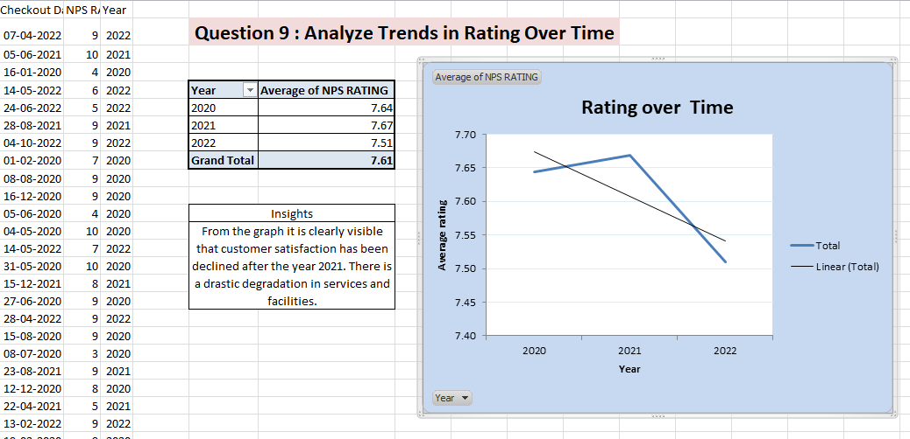

Slide 20
Question 10: Analyze Feedback Quality by Rating Range
Create a pivot table & pivot chart to analyze the relationship between "Feedback Category" and "Rating Range.“
How many feedback responses fall into each rating range (1-5) for different feedback categories (Staff, Room, Restaurant, Facility)?
What trends or patterns can you identify from the feedback ratings across different categories?

Slide 21
