Slide 1
Amazon EC2 & Virtualization
Darren Korman December 6, 2012 CSS434 – Distributed Computing

Slide 2
Outline
What is Amazon-EC2 and Why did Amazon create it?
Start a live demonstration using Elastic Beanstalk
How does EC2 work?
Finish demo, Conclusions & Questions

Slide 3
A Distributed System you can actually use!
What is EC2?

Slide 4
What is EC2?
“Amazon Elastic Compute Cloud (Amazon EC2) is a web service that provides resizable compute capacity in the cloud. It is designed to make web-scale computing easier for developers.”
EC2 is part of Amazon’s “pay per use” web services for software development

Slide 5
Amazon web services include:
Compute (EC2, MapReduce, Scaling & Load-balancing)
Database (Relational & NoSQL)
File Storage (S3, Elastic Block Store)
Deployment (Elastic Beanstalk)
Others including Email, Payments, Networking, etc…
aws.amazon.com/products/

Slide 6
What can you do with EC2?
Develop and run web-sites & web-services. From a personal blog all the way up to a large services like foursquare, netflix, reddit.com
Do large-scale data processing (Like Dr. Stiber’s GPU calculations, or the Global Warming simulation Prof. Fukuda mentioned in last lecture)
Allocate & De-allocate computing resources dynamically.

Slide 7
Comparable Cloud Services
Amazon Web Services
Google Cloud
Microsoft Azure

Slide 8
To make money off developers! (a.k.a. you)
Why did Amazon create EC2?

Slide 9
Motivation
Early 2000’s: Amazon already had a large distributed computing platform for its own business use.
They needed large capacity to handle high-demand service spikes, but otherwise their computing resources were under-utilized.

Slide 10
Motivation
There’s only so much stuff amazon.com can sell…
However, demand for software as a service will continue to grow in the future.
So, take the already existing infrastructure and commoditize it like a utility.

Slide 11
Break my Mandelbrot app
Elastic Beanstalk live demonstration

Slide 12
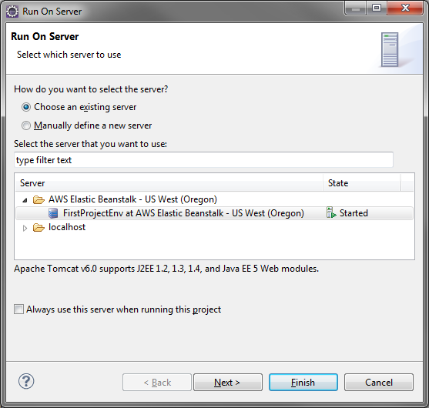
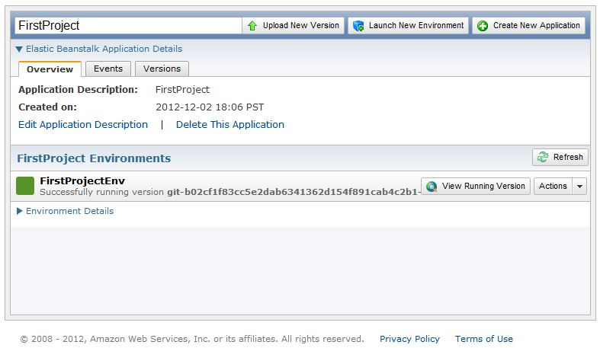
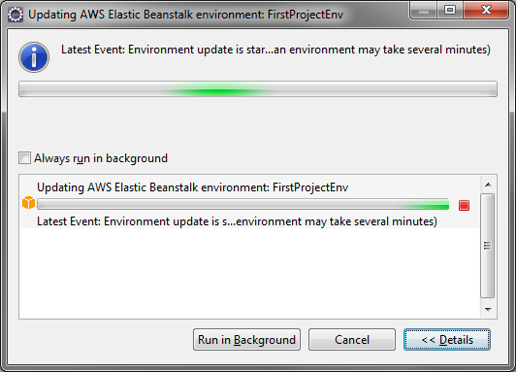
Elastic Beanstalk Overview
A 1-click service which packages a web-app, uploads it to AWS and deploys.

Slide 13
Behind the scenes…
Elastic Beanstalk is…
Allocating EC2 server instances
Setting up load balancing
Configuring auto-scaling
Setting health monitor notifications
http://media.amazonwebservices.com/AWS_Overview.pdf

Slide 14
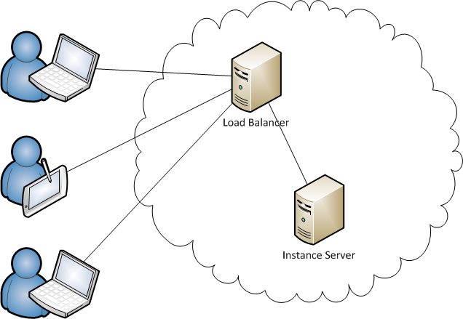
Demonstration
Example App is a simple Mandelbrot generator running on only 1 instance server. (Performance is bad on purpose)

Slide 15
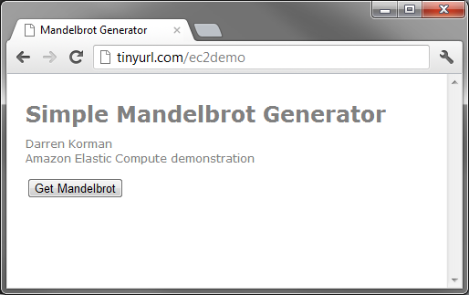
Web App URL
http://tinyurl.com/ec2demo
The performance experiment: In one minute, how many people successfully get a generated image?

Slide 16
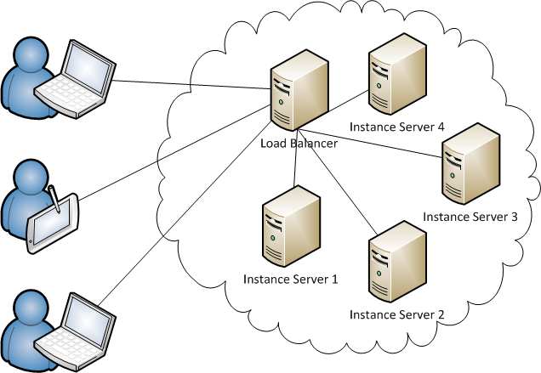
Demonstration
Through web console, deploy new servers to handle our increased demand.
Later, when deployment is complete, we will compare performance difference.

Slide 17
Virtual Servers
How does EC2 work?

Slide 18
Virtualization 101
“Fundamental idea is to abstract the hardware of a single computer into several different execution environments. This creates the illusion that each environment is running its own private computer.”

Slide 19
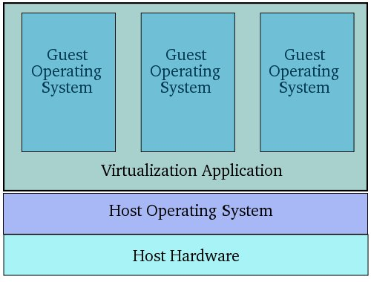
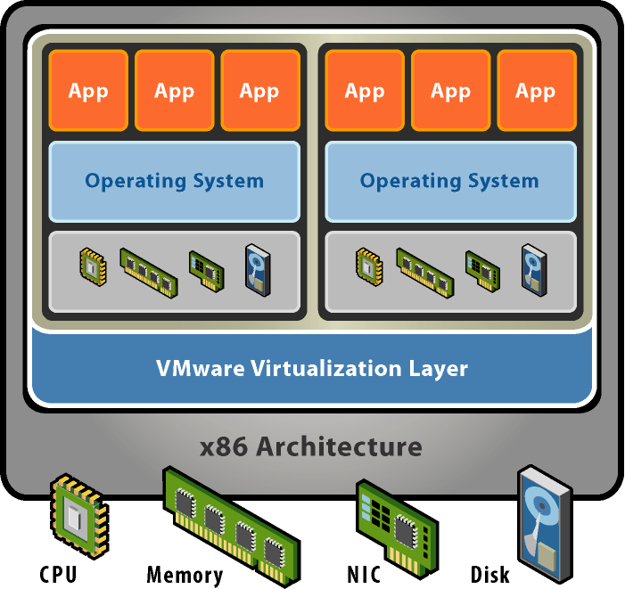
2 Types of Virtualization
Hosted
virtualization is installed as an application on top of an installed OS.
Hypervisor (bare-metal)
virtualization software is run directly on system hardware.
ex: VirtualBox, Parallels, etc…
ex: Xen, Microsoft Hyper-V & VMware ESX
http://www.virtuatopia.com/index.php/ An_Overview_of_VirtualBox_2
http://www.vmware.com/files/pdf/ VMware_paravirtualization.pdf

Slide 20
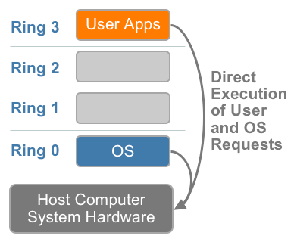
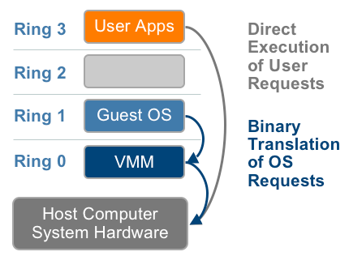
Difficulty of x86 virtualization
User instructions from apps can run on hardware as normal.
Privileged instructions from OS expect to be executed from ring 0.
http://www.vmware.com/files/pdf/VMware_paravirtualization.pdf

Slide 21
Virtualization techniques
Full virtualization using binary translation
OS assisted Para-virtualization
Hardware assisted virtualization

Slide 22
Full virtualization using binary translation
Emulation of hardware instruction set by virtualization software through translation of code.
Examples:
MacOS Rosetta – Run PowerPC mac applications on X86 hardware.
VMware was one of the first to fully virtualize x86 in 1998.

Slide 23
OS assisted Para-virtualization
Guest OS presented with a similar, but not identical interface to underlying hardware.
Guest OS needs to be specially modified (or use special drivers).
Not as big of an issue today as most server operating systems (Linux, Windows & BSD) already have the necessary modifications.

Slide 24
Hardware assisted virtualization
CPU manufactures have added new features which improve virtualization
AMD-V
Intel VT-x
Allows for hosted OS to run some privileged instructions directly on CPU (no translation by virtualization needed)

Slide 25
Benefits of Virtualization
Consolidation – Operator can run many OS instances on a single system. This increases resource optimization.
Protection – If a running OS instance crashes, the host machine, and other peer instances are un-affected.
Mobility – Since the OS instances are not installed on any one machine, they can be moved.

Slide 26
Virtualization used by Amazon
Xen Hypervisor - Open Source Para-virtualization
Microkernel – Only manages CPU, memory and interrupts. No knowledge of disk or network I/O.
Allows for many os instances to be run concurrently on same machine
Technology is comparable to Hyper-V (Microsoft) & VMware ESX
http://wiki.xen.org/wiki/Xen_Overview

Slide 27
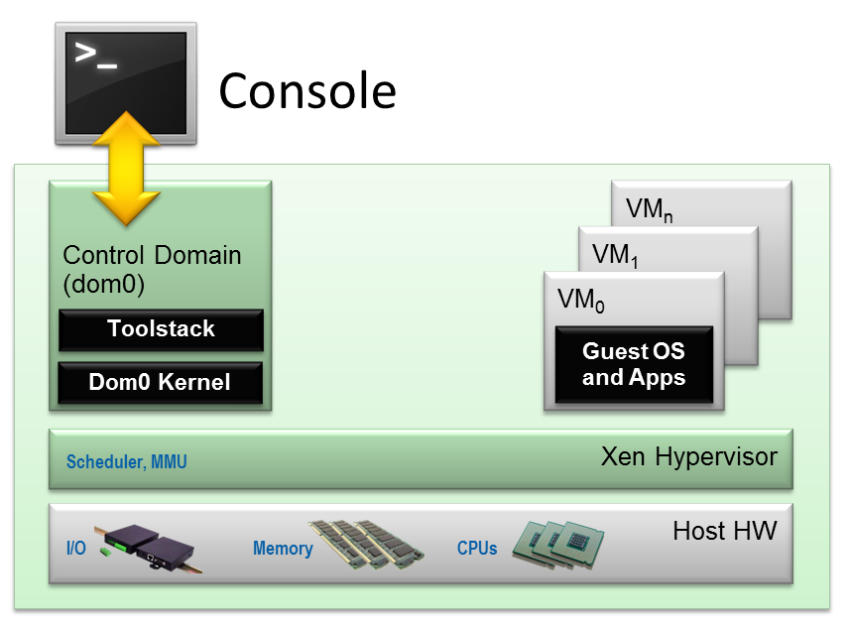
Xen architecture
http://wiki.xen.org/wiki/File:Xen_Arch_Diagram.png

Slide 28
Instance server OSs in EC2
Linux (RedHat, openSuSE, Fedora, Debian,Cent OS, Gentoo, Linux)
OpenSolaris
Windows Server
BSD
There are over 5000 OS instance images to choose from. (2996 are versions of ubuntu!)

Slide 29
Server types
Micro (free)
Standard
High-Memory (17-64 GB)
High-CPU
Cluster Computer
Cluster GPU
High-I/O

Slide 30
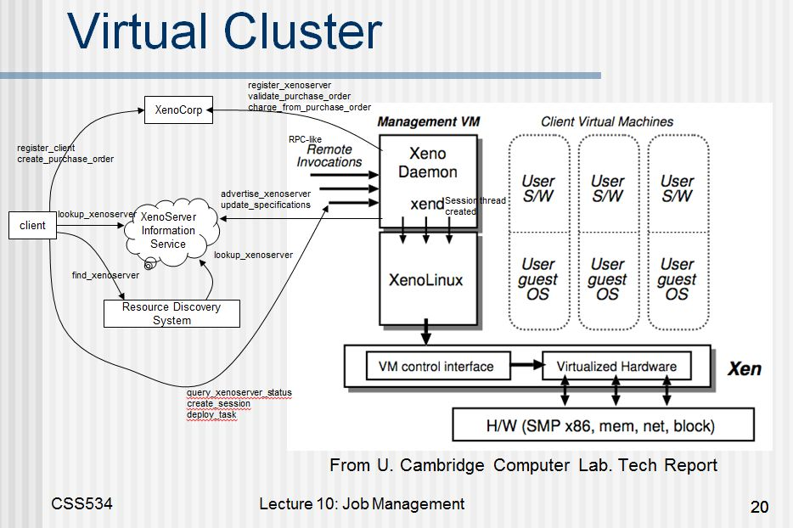
Deployment infrastructure

Slide 31
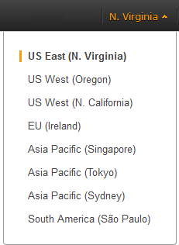
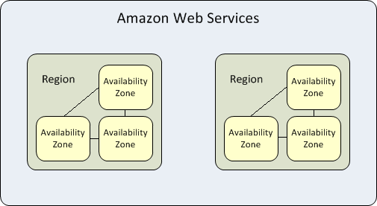
Deploy instances to an Availability Zone within a specified Region
http://docs.amazonwebservices.com/AWSEC2/latest/ UserGuide/using-regions-availability-zones.html

Slide 32
Special Deployments
GPU clusters
When allocating resources, developer can specify they want to use a “Placement Group” within a single Availability Zone.
“Instances within a Placement Group have low latency, full bisection 10 Gbps bandwidth between instances.”
http://docs.amazonwebservices.com/AWSEC2/latest/ UserGuide/using_cluster_computing.html

Slide 33
Benefits of Virtualization for EC2
Flexibility. Developers can choose to run whatever instance type they want.
Rapid deployment. No need to install software on a dedicated machine. Just spin up a new, pre-configured instance when needed.
Resource Utilization. Amazon can put a server instance wherever it best fits.

Slide 34
Is deployment done yet?
Elastic Beanstalk live demonstration

Slide 35
Experiment #2
Same as before… How many people get the downloaded image in a minute?
Did adding capacity increase the application’s overall performance?

Slide 36
Convenience at a price…
Discussion & Conclusion

Slide 37
Positives
As a developer, there is no investment in infrastructure. Like a utility, you pay only for what you use.
Developer friendly tools.
It only took me an evening to get my simple web app working.
I had zero experience with java web frameworks.

Slide 38
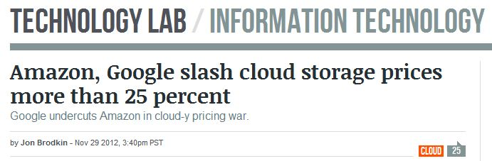
Positives
“Fast” deployment tools allows for rapid development iterations.
Continuing competition means better value
http://arstechnica.com/information-technology/2012/11/ amazon-google-slash-cloud-storage-prices-more-than-25/

Slide 39
Negatives
Pay for each hour that an instance is running, regardless of use.
Like any system, it can have downtime. However, this is pretty rare.
At the mercy of Amazon’s lawyers… (Just ask Wikileaks)

Slide 40
Conclusion
EC2 and cloud computing is super cool!
Amazon web services is a mature platform which is great for prototyping and launching a product.
At most, my demo costs about $2.00. (And that’s because I’m not using the free service)

Slide 41
Citations
aws.amazon.com/products
http://media.amazonwebservices.com/AWS_Overview.pdf
http://wiki.xen.org/wiki/Xen_Overview
http://arstechnica.com/information-technology/2012/11/ amazon-google-slash-cloud-storage-prices-more-than-25/
http://www.virtuatopia.com/index.php/An_Overview_of_VirtualBox_2
http://en.wikipedia.org/wiki/Paravirtualization
Operating System Concepts with Java, Silberschatz, Galvin, Gange
http://aws.amazon.com/hpc-applications/

