Slide 1
Client Side Scripting Language(22519)
Department of Computer Engineering, VAPM, Almala, Latur

Slide 2
JavaScript where to
The <script> Tag
In HTML, JavaScript code is inserted between <script> and </script> tags.
You can place any number of scripts in an HTML document
Scripts can be placed in the <body>, or in the <head> section of an HTML page, or in both.
Three Places to put JavaScript code
Between the body tag of html
Between the head tag of html
In .js file (external javaScript)

Slide 3
JavaScript Output:
JavaScript Display Possibilities
JavaScript can "display" data in different ways:
Writing into an HTML element, using innerHTML.
Writing into the HTML output using document.write().
Writing into an alert box, using window.alert().
Writing into the browser console, using console.log().
Using innerHTML
To access an HTML element, JavaScript can use the document.getElementById(id) method.
The id attribute defines the HTML element. The innerHTML property defines the HTML content.

Slide 4
Example
<!DOCTYPE html> <html> <body> <h1>Program</h1> <p id="demo">Wellcome</p> <script> document.getElementById("demo").innerHTML = 50 + 60; </script> </body> </html>

Slide 5
Using document.write()
For testing purposes, it is convenient to use document.write():
Example
<!DOCTYPE html> <html> <body> <h1>Program</h1> <p>hii.</p> <script> document.write(55 + 65); </script> </body> </html>

Slide 6
<!DOCTYPE html> <html> <body> <button type="button" onclick="document.write(5 + 6)">Try it</button> </body> </html>

Slide 7
Using window.alert()
You can use an alert box to display data:
Example
<!DOCTYPE html> <html> <body> <script> window.alert(5 + 6); </script> </body> </html>

Slide 8
You can skip the window keyword.
In JavaScript, the window object is the global scope object, that means that variables, properties, and methods by default belongs to the window object. This also means that specifying the window keyword is optional:
Example
<!DOCTYPE html> <html> <body> <script> alert(5 + 6); </script> </body> </html>

Slide 9
Using console.log()
For debugging purposes, you can call the console.log() method in the browser to display data.
Example
<!DOCTYPE html> <html> <body> <script> console.log(5 + 6); </script> </body> </html>

Slide 10
JavaScript Programs
A computer program is a list of "instructions" to be "executed" by a computer.
In a programming language, these programming instructions are called statements.
A JavaScript program is a list of programming statements.
JavaScript Statements
JavaScript statements are composed of:
Values, Operators, Expressions, Keywords, and Comments.
This statement tells the browser to write "Hello Dolly." inside an HTML element with id="demo":
Example
document.getElementById("demo").innerHTML = "Hello Dolly.";
Semicolons separate JavaScript statements.

Slide 11
JavaScript syntax
JavaScript syntax is the set of rules, how JavaScript programs are constructed:
var x, y, z; // How to declare variables x = 5; y = 6; // How to assign values z = x + y; // How to compute values
JavaScript Values
The JavaScript syntax defines two types of values: Fixed values and variable values.
Fixed values are called literals. Variable values are called variables.
JavaScript Literals
The most important rules for writing fixed values are:
Numbers are written with or without decimals:
10.50 1001

Slide 12
Strings are text, written within double or single quotes:
"John Doe" 'John Doe'
JavaScript Variables
In a programming language, variables are used to store data values.
JavaScript uses the var keyword to declare variables.
An equal sign is used to assign values to variables.
In this example, x is defined as a variable. Then, x is assigned (given) the value 6:
var x; x = 6;

Slide 13
JavaScript Operators
JavaScript uses arithmetic operators ( + - * / ) to compute values:
(5 + 6) * 10
JavaScript uses an assignment operator ( = ) to assign values to variables:
var x, y; x = 5; y = 6;

Slide 14
JavaScript Expressions
An expression is a combination of values, variables, and operators, which computes to a value.
The computation is called an evaluation.
For example, 5 * 10 evaluates to 50:
5 * 10
Expressions can also contain variable values:
x * 10
The values can be of various types, such as numbers and strings.
For example, "John" + " " + "Doe", evaluates to "John Doe":
"John" + " " + "Doe"

Slide 15
JavaScript Keywords
JavaScript keywords are used to identify actions to be performed.
The var keyword tells the browser to create variables:
var x, y; x = 5 + 6; y = x * 10;

Slide 16
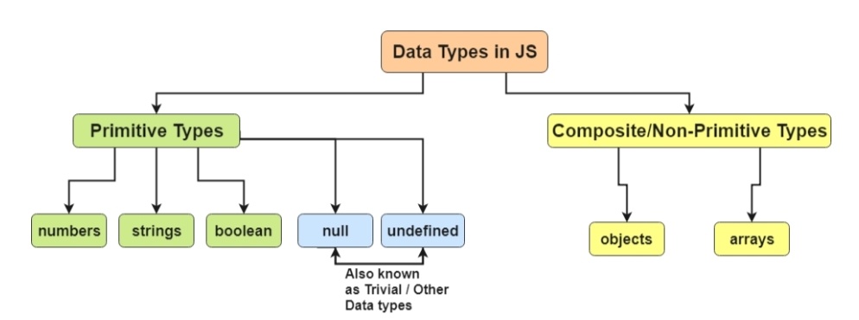
Data Types in JavaScript:

