Slide 1
GPG Encryption
By: 22IT116 TRUSHANG PATEL

Slide 2
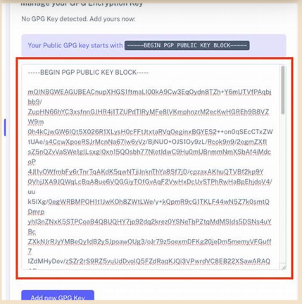
What is GPG and How Does It Work?
Public Key Infrastructure
GPG operates on a decentralized public key infrastructure, allowing users to independently verify identities and establish trust without relying on centralized authorities, enhancing security and user autonomy in digital communications.

Slide 3
The Role of Public Key Cryptography
Digital Signatures Functionality
It allows users to create digital signatures, ensuring message authenticity and integrity, which helps in verifying the sender's identity and preventing tampering.
Key Pair Mechanism
Public key cryptography utilizes a pair of keys, enabling secure data encryption and decryption without the need for shared secret keys, enhancing security protocols.
Trust Establishment through PKI
Public Key Infrastructure (PKI) supports the management of digital certificates, linking public keys to identities, thereby establishing trust in secure communications across various platforms.

Slide 4
Benefits of Using GPG for Secure Communication
Robust Encryption Mechanism
GPG employs strong asymmetric encryption, ensuring that only intended recipients can decrypt messages, thereby protecting sensitive information from unauthorized access during transmission.
Integrity Verification Process
Through digital signatures, GPG allows recipients to confirm that messages remain unchanged, providing assurance that the content received is authentic and has not been tampered with.
Decentralized Trust Model
GPG's reliance on a decentralized public key infrastructure enables users to independently verify identities, fostering trust without dependence on centralized authorities, enhancing overall communication security.

Slide 5
Overview of GPG Key Management
Revocation Importance
Trust Model Implementation
Key Pair Significance
The generation of a secure key pair is fundamental, as it enables both encryption and digital signing, ensuring confidentiality and authenticity in communications.
Creating a revocation certificate is crucial for maintaining trust, allowing users to invalidate compromised keys and alert others to potential security breaches.
Establishing a web of trust through mutual key signing enhances security, enabling users to verify identities and strengthen the integrity of shared public keys.

Slide 6
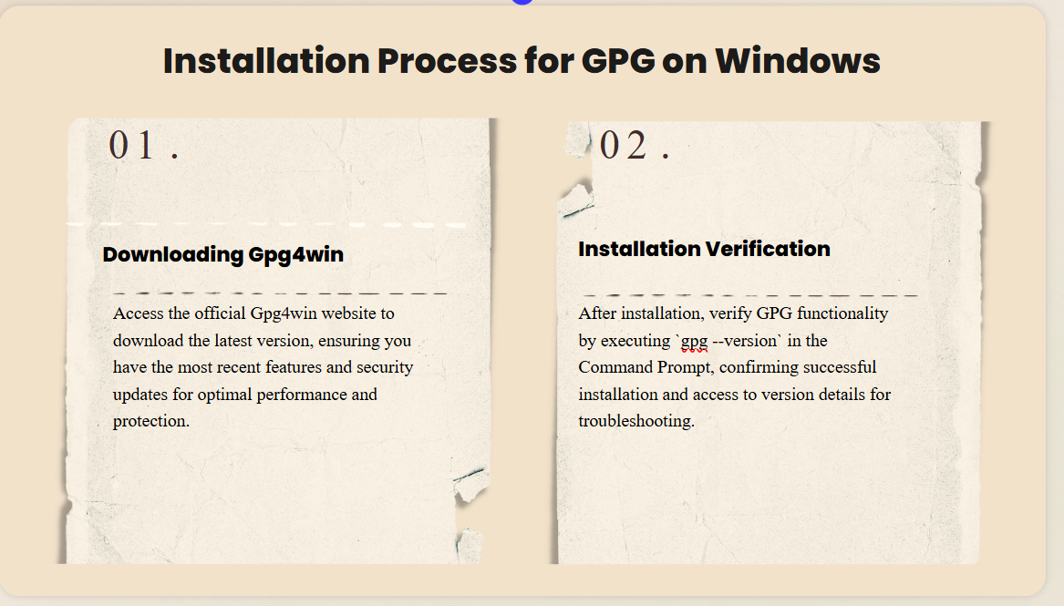

Slide 7
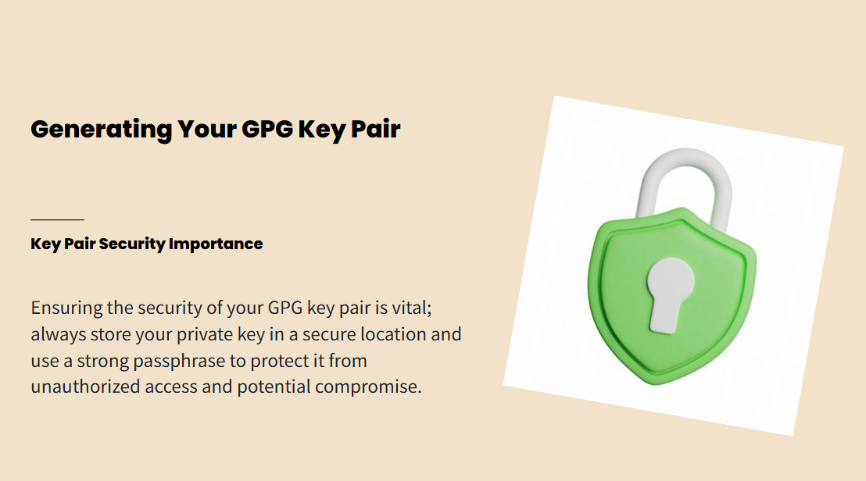

Slide 8
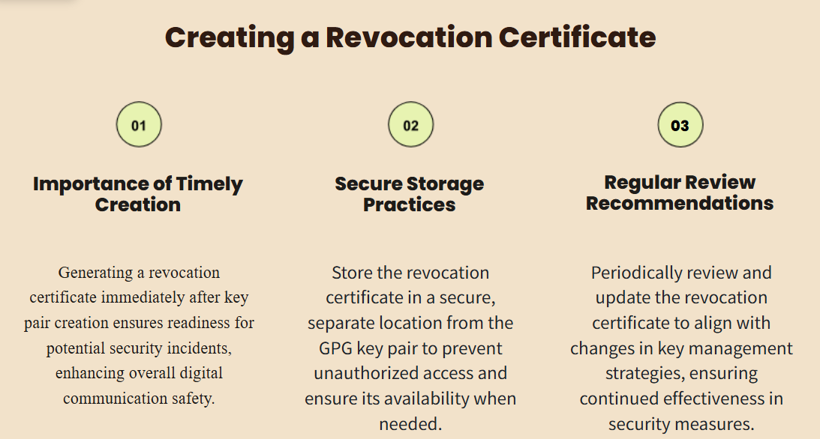

Slide 9
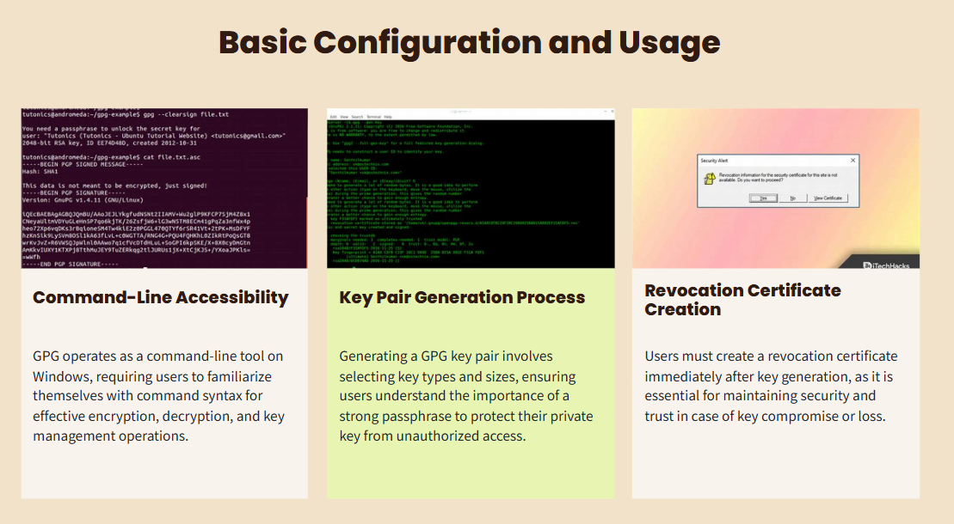

Slide 10
Thank You

