Slide 1
Cryptography and Network Security
Third Edition
by William Stallings
Lecture slides by Lawrie Brown

Slide 2
Chapter 7 – Confidentiality Using
Symmetric Encryption

Slide 3
Confidentiality using Symmetric Encryption
traditionally symmetric encryption is used to provide message confidentiality
consider typical scenario
  workstations on LANs access other workstations & servers on LAN
  LANs interconnected using switches/routers
  with external lines or radio/satellite links
consider attacks and placement in this scenario
  snooping from another workstation
  use dial-in to LAN or server to snoop
  use external router link to enter & snoop
  monitor and/or modify traffic one external links
Notes:
Have many locations where attacks can occur in typical scenarios.

Slide 4
Confidentiality using Symmetric Encryption
have two major placement alternatives
link encryption
  encryption occurs independently on every link
  implies must decrypt traffic between links
  requires many devices, but paired keys
end-to-end encryption
  encryption occurs between original source and final destination
  need devices at each end with shared keys

Slide 6
Traffic Analysis
when using end-to-end encryption must leave headers in clear
  so network can correctly route information
hence although contents protected, traffic pattern flows are not
ideally want both at once
  end-to-end protects data contents over entire path and provides authentication
  link protects traffic flows from monitoring

Slide 7
Placement of Encryption
can place encryption function at various layers in OSI Reference Model
  link encryption occurs at layers 1 or 2
  end-to-end can occur at layers 3, 4, 6, 7
  as move higher less information is encrypted but it is more secure though more complex with more entities and keys

Slide 8
Traffic Analysis
is monitoring of communications flows between parties
  useful both in military & commercial spheres
  can also be used to create a covert channel
link encryption obscures header details
  but overall traffic volumes in networks and at end-points is still visible
traffic padding can further obscure flows
  but at cost of continuous traffic

Slide 9
Key Distribution
symmetric schemes require both parties to share a common secret key
issue is how to securely distribute this key
often secure system failure due to a break in the key distribution scheme
Notes:
This is one of the most critical areas in security systems - on many occasions systems have been broken, not because of a poor encryption algorithm, but because of poor key selection or management. It is absolutely critical to get this right!

Slide 10
Key Distribution
given parties A and B have various key distribution alternatives:
  A can select key and physically deliver to B
  third party can select & deliver key to A & B
  if A & B have communicated previously can use previous key to encrypt a new key
  if A & B have secure communications with a third party C, C can relay key between A & B
Notes:
Physical delivery (1 & 2) is simplest - but only applicable when there is personal contact between recipient and key issuer. Is fine for link encryption where devices & keys occur in pairs, but does not scale as number of parties who wish to communicate grows.
A third party is a trusted intermediary, whom all parties trust, to mediate the establishment of secure communications between them. Must trust intermediary not to abuse the knowledge of all session keys.
As number of parties grow, some variant of 4 is only practical solution.

Slide 11
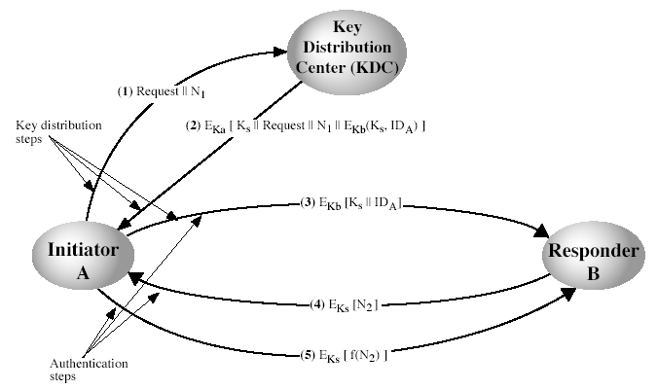
Key Distribution Scenario
Notes:
Stallings Fig 7.9.
Based on concept of having a “Key Distribution Center” (KDC) which shares a unique key with each party (user).
See text for details of steps in distribution process.

Slide 12
Key Distribution Issues
hierarchies of KDC’s required for large networks, but must trust each other
session key lifetimes should be limited for greater security
use of automatic key distribution on behalf of users, but must trust system
use of decentralized key distribution
controlling purposes keys are used for

Slide 13
Summary
have considered:
  use of symmetric encryption to protect confidentiality
  need for good key distribution
  use of trusted third party KDC’s

