Slide 1
Cryptography and Network Security
Third Edition
by William Stallings
Lecture slides by Lawrie Brown

Slide 2
Chapter 9 – Public Key Cryptography and RSA

Slide 3
Private-Key Cryptography
traditional private/secret/single key cryptography uses one key
shared by both sender and receiver
if this key is disclosed communications are compromised
also is symmetric, parties are equal
hence does not protect sender from receiver forging a message & claiming is sent by sender
Notes:
So far all the cryptosystems discussed have been private/secret/single key (symmetric) systems. All classical, and modern block and stream ciphers are of this form.

Slide 4
Public-Key Cryptography
probably most significant advance in the 3000 year history of cryptography
uses two keys – a public & a private key
asymmetric since parties are not equal
uses clever application of number theoretic concepts to function
complements rather than replaces private key crypto
Notes:
Will now discuss the radically different public key systems, in which two keys are used. Anyone knowing the public key can encrypt messages or verify signatures, but cannot decrypt messages or create signatures, counter-intuitive though this may seem. It works by the clever use of number theory problems that are easy one way but hard the other. Note that public key schemes are neither more secure than private key (security depends on the key size for both), nor do they replace private key schemes (they are too slow to do so), rather they complement them.

Slide 5
Public-Key Cryptography
public-key/two-key/asymmetric cryptography involves the use of two keys:
  a public-key, which may be known by anybody, and can be used to encrypt messages, and verify signatures
  a private-key, known only to the recipient, used to decrypt messages, and sign (create) signatures
is asymmetric because
  those who encrypt messages or verify signatures cannot decrypt messages or create signatures

Slide 6

Public-Key Cryptography
Notes:
Stallings Fig 9.1

Slide 7
Why Public-Key Cryptography?
developed to address two key issues:
  key distribution – how to have secure communications in general without having to trust a KDC with your key
  digital signatures – how to verify a message comes intact from the claimed sender
public invention due to Whitfield Diffie & Martin Hellman at Stanford Uni in 1976
  known earlier in classified community
Notes:
The idea of public key schemes, and the first practical scheme, which was for key distribution only, was published in 1977 by Diffie & Hellman. The concept had been previously described in a classified report in 1970 by James Ellis (UK CESG) - and subsequently declassified in 1987. See History of Non-secret Encryption (at CESG). Its interesting to note that they discovered RSA first, then Diffie-Hellman, opposite to the order of public discovery!

Slide 8
Public-Key Characteristics
Public-Key algorithms rely on two keys with the characteristics that it is:
  computationally infeasible to find decryption key knowing only algorithm & encryption key
  computationally easy to en/decrypt messages when the relevant (en/decrypt) key is known
  either of the two related keys can be used for encryption, with the other used for decryption (in some schemes)
Notes:
Public key schemes utilise problems that are easy (P type) one way but hard (NP type) the other way, eg exponentiation vs logs, multiplication vs factoring. Consider the following analogy using padlocked boxes: traditional schemes involve the sender putting a message in a box and locking it, sending that to the receiver, and somehow securely also sending them the key to unlock the box. The radical advance in public key schemes was to turn this around, the receiver sends an unlocked box to the sender, who puts the message in the box and locks it (easy - and having locked it cannot get at the message), and sends the locked box to the receiver who can unlock it (also easy), having the key. An attacker would have to pick the lock on the box (hard).

Slide 9
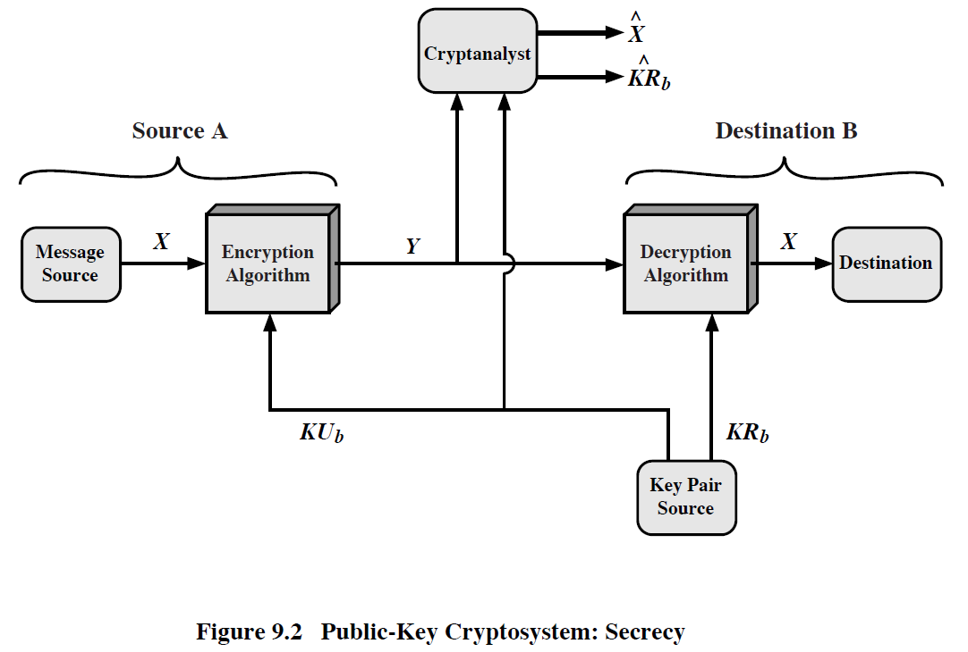

Slide 10
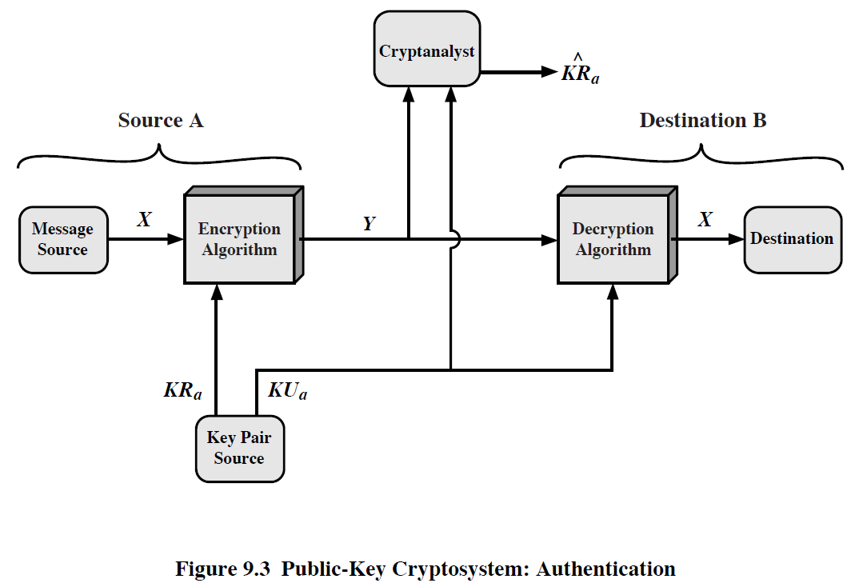

Slide 11
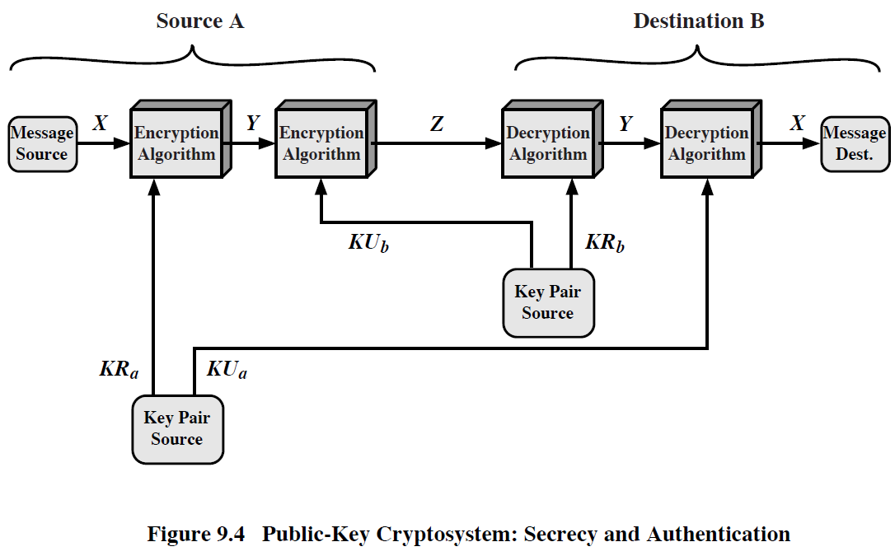

Slide 12
Public-Key Applications
can classify uses into 3 categories:
  encryption/decryption (provide secrecy)
  digital signatures (provide authentication)
  key exchange (of session keys)
some algorithms are suitable for all uses, others are specific to one

Slide 13
Security of Public Key Schemes
like private key schemes brute force exhaustive search attack is always theoretically possible
but keys used are too large (>512bits)
security relies on a large enough difference in difficulty between easy (en/decrypt) and hard (cryptanalyse) problems
more generally the hard problem is known, its just made too hard to do in practise
requires the use of very large numbers
hence is slow compared to private key schemes
Notes:
Public key schemes are no more or less secure than private key schemes - in both cases the size of the key determines the security. Note also that you can't compare key sizes - a 64-bit private key scheme has very roughly similar security to a 512-bit RSA - both could be broken given sufficient resources. But with public key schemes at least there's usually a firmer theoretical basis for determining the security since its based on well-known and well studied number theory problems.

Slide 14
RSA
by Rivest, Shamir & Adleman of MIT in 1977
best known & widely used public-key scheme
based on exponentiation in a finite (Galois) field over integers modulo a prime
  nb. exponentiation takes O((log n)³) operations (easy)
uses large integers (eg. 1024 bits)
security due to cost of factoring large numbers
  nb. factorization takes O(e ^{log n log log n}) operations (hard)
Notes:
RSA is the best known, and by far the most widely used general public key encryption algorithm.

Slide 15
RSA Key Setup
each user generates a public/private key pair by:
selecting two large primes at random p, q
computing their system modulus N=p.q
  note ø(N)=(p-1)(q-1)
selecting at random the encryption key e
    where 1<e<ø(N), gcd(e,ø(N))=1
solve following equation to find decryption key d
  e.d=1 mod ø(N) and 0≤d≤N
publish their public encryption key: KU={e,N}
keep secret private decryption key: KR={d,p,q}
Notes:
This key setup is done once (rarely) when a user establishes (or replaces) their public key. The exponent e is usually fairly small, just must be relatively prime to ø(N). Need to compute its inverse to find d. It is critically important that the private key KR={d,p,q} is kept secret, since if any part becomes known, the system can be broken. Note that different users will have different moduli N.

Slide 16
RSA Use
to encrypt a message M the sender:
  obtains public key of recipient KU={e,N}
  computes: C=Me mod N, where 0≤M<N
to decrypt the ciphertext C the owner:
  uses their private key KR={d,p,q}
  computes: M=C^{d} mod N
note that the message M must be smaller than the modulus N (block if needed)

Slide 17
Why RSA Works
because of Euler's Theorem:
a^{ø(n)}mod N = 1
  where gcd(a,N)=1
in RSA have:
  N=p.q
  ø(N)=(p-1)(q-1)
  carefully chosen e & d to be inverses mod ø(N)
  hence e.d=1+k.ø(N) for some k
hence :
C^{d} = (Me)^{d} = M^{1+k.ø(N)} = M¹.(M^{ø(N)})^{q} = M¹.(1)^{q} = M¹ = M mod N
Notes:
Can show that RSA works as a direct consequence of Euler’s Theorem.

Slide 18
RSA Example
Select primes: p=17 & q=11
Compute n = pq =17×11=187
Compute ø(n)=(p–1)(q-1)=16×10=160
Select e : gcd(e,160)=1; choose e=7
Determine d: de=1 mod 160 and d < 160 Value is d=23 since 23×7=161= 10×160+1
Publish public key KU={7,187}
Keep secret private key KR={23,17,11}
Notes:
Here walk through example using “trivial” sized numbers.
Selecting primes requires the use of primality tests.
Finding d as inverse of e mod ø(n) requires use of Inverse algorithm (see Ch4)

Slide 19
RSA Example cont
sample RSA encryption/decryption is:
given message M = 88 (nb. 88<187)
encryption:
  C = 88⁷ mod 187 = 11
decryption:
  M = 11²³ mod 187 = 88
Notes:
Rather than having to laborious repeatedly multiply, can use the "square and multiply" algorithm with modulo reductions to implement all exponentiations quickly and efficiently (see next).

Slide 20
Summary
have considered:
  principles of public-key cryptography
  RSA algorithm, implementation, security

