Slide 1
Cryptography and Network Security
Third Edition
by William Stallings
Lecture slides by Lawrie Brown

Slide 2
Chapter 10 – Key Management; Other Public Key Cryptosystems

Slide 3
Key Management
public-key encryption helps address key distribution problems
have two aspects of this:
  distribution of public keys
  use of public-key encryption to distribute secret keys

Slide 4
Distribution of Public Keys
can be considered as using one of:
  Public announcement
  Publicly available directory
  Public-key authority
  Public-key certificates

Slide 5
Public Announcement
users distribute public keys to recipients or broadcast to community at large
  eg. append PGP keys to email messages or post to news groups or email list
major weakness is forgery
  anyone can create a key claiming to be someone else and broadcast it
  until forgery is discovered can masquerade as claimed user

Slide 6
Publicly Available Directory
can obtain greater security by registering keys with a public directory
directory must be trusted with properties:
  contains {name,public-key} entries
  participants register securely with directory
  participants can replace key at any time
  directory is periodically published
  directory can be accessed electronically
still vulnerable to tampering or forgery

Slide 7
Public-Key Authority
improve security by tightening control over distribution of keys from directory
has properties of directory
and requires users to know public key for the directory
then users interact with directory to obtain any desired public key securely
  does require real-time access to directory when keys are needed

Slide 8
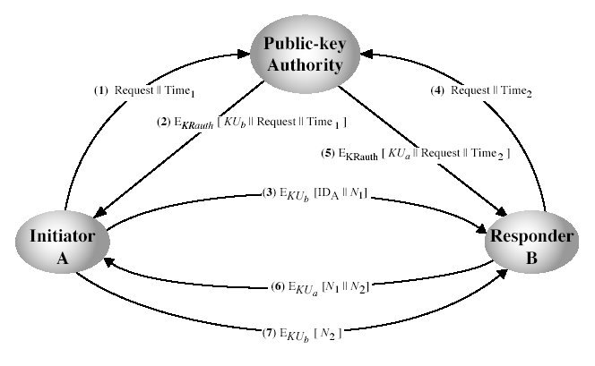
Public-Key Authority
Notes:
Stallings Fig 10.3. See text for details of steps in protocol.

Slide 9
Public-Key Certificates
certificates allow key exchange without real-time access to public-key authority
a certificate binds identity to public key
  usually with other info such as period of validity, rights of use etc
with all contents signed by a trusted Public-Key or Certificate Authority (CA)
can be verified by anyone who knows the public-key authorities public-key

Slide 10
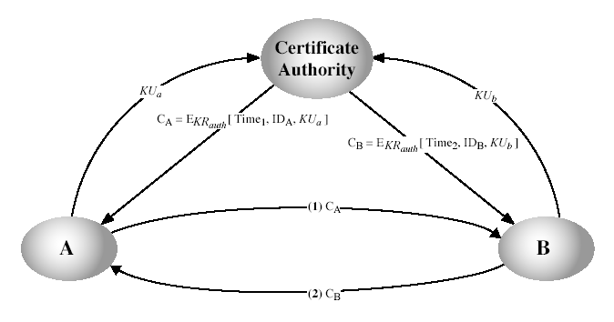
Public-Key Certificates
Notes:
Stallings Fig 10.4. See text for details of steps in protocol.

Slide 11
Summary
have considered:
  distribution of public keys

