Slide 1
1
背景
目录
2
算法介绍
3
发展状况
CONTENTS
4
总结

Slide 2
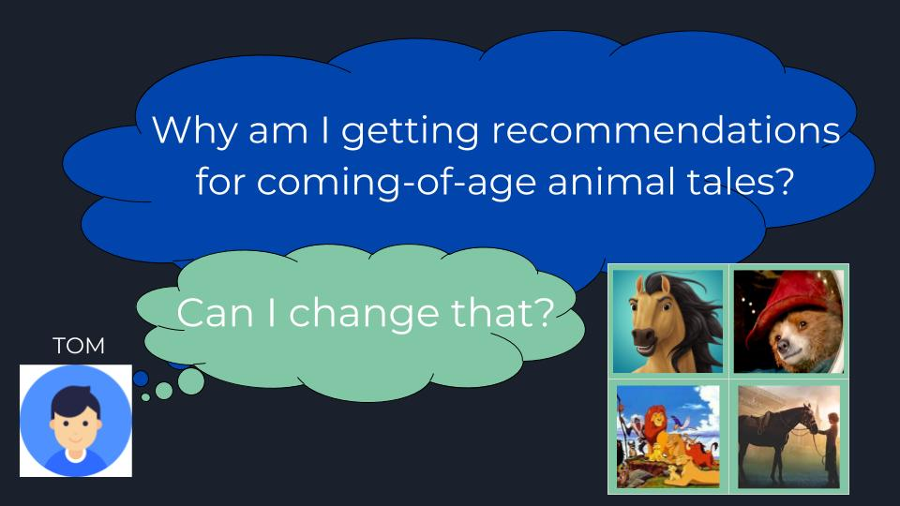
1
The Waste of Unwanted Recommendations
不想要的推荐
You return home from work. It’s been a long day and you just want to relax and watch some movie.Then you realize your little sister has been watching cartoon movie on your account and now you can’t relax because of all the cartoon movie recommendations?
你下班回家了，想看一些电影。然后你想到你的妹妹一直在用你的帐户上的卡通电影。推荐给你的电影全是动画片。
it is inevitable for media users to get locked into a negative feedback loop of unwanted irrelevant ads or recommendations (recs).
不受欢迎/不相关的广告或推荐（recs）的负面反馈循环
We are constantly bombarded with recs telling us what to eat, buy, and wear*, yet there is little we can do to understand our recs and even less we can do to tune our preferences efficiently.
告诉我们吃什么，买什么，穿什么，但我们几乎无法理解我们的推荐，甚至我们很难有效地调整我们的偏好

Slide 3
Not only are undesired or irrelevant recs wasting our time, but they are also costing media companies millions of dollars every year. Media companies want to give you useful recs to keep you happy and engaged with their platforms, but why do they have such a hard time tuning our individual recommendation preferences? What makes this process so difficult?
媒体公司希望为用户提供有用的记录，让用户开心地与平台互动，但为什么他们很难调整我们的个人推荐偏好？是什么让这个过程如此困难？
Machine learning (ML) algorithms increase in popularity and the “black boxes” of neural networks in deep learning (DL) become the industry standard
机器学习（ML）算法的普及和深度学习（DL）中的神经网络的“黑盒子”成为行业标准
In the recent booming world of artificial intelligence (AI), we are now entering a trade-off between sophisticated models and the interpretability of their predictions.
蓬勃发展的人工智能（AI），在进行复杂模型与其预测可解释性之间的权衡

Slide 4
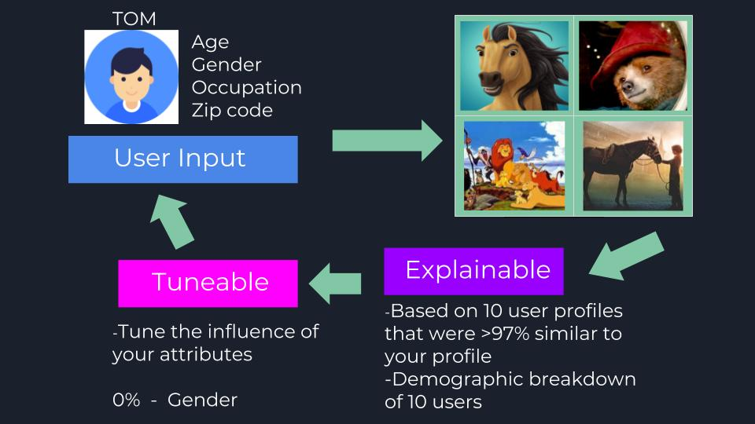
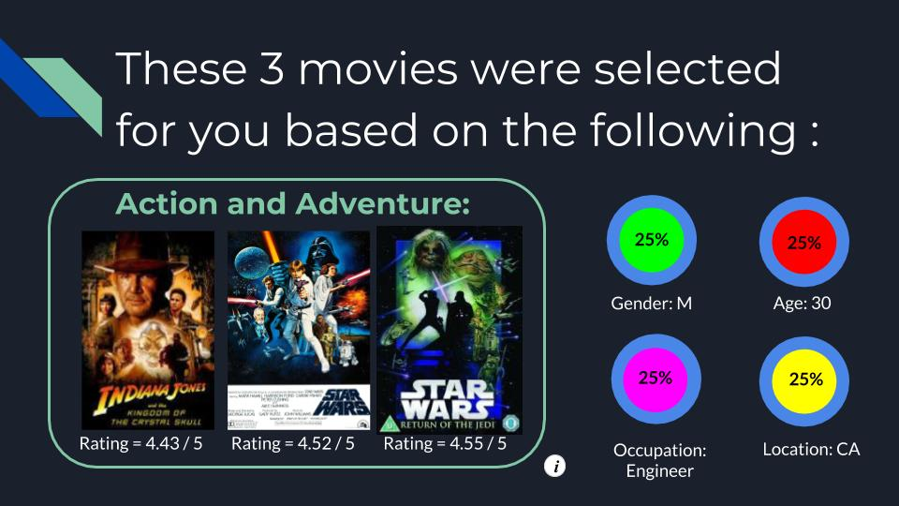
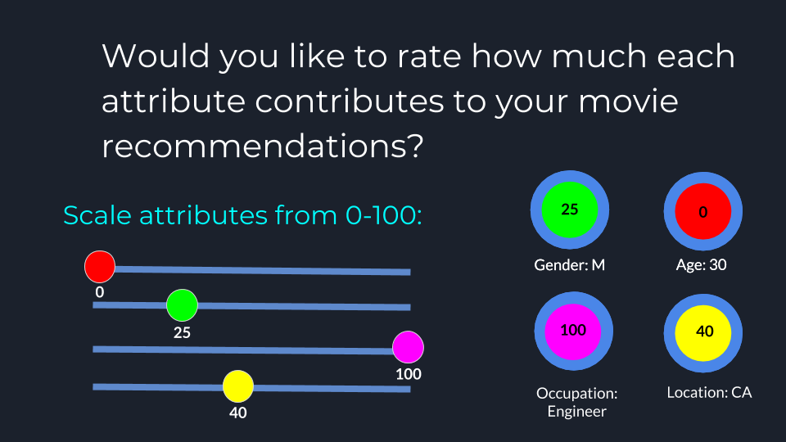
This lack of transparency in recs is what led me to build my own recommender system (RS) called Project Orient. Project Orient is a movie RS where the attributes that determine the recs are not only explainable but actually tunable to the individual consumer.
Orient是一个电影推荐系统，其中确定recs的属性不仅可以解释，而且可以根据每个人自己调整。

Slide 5
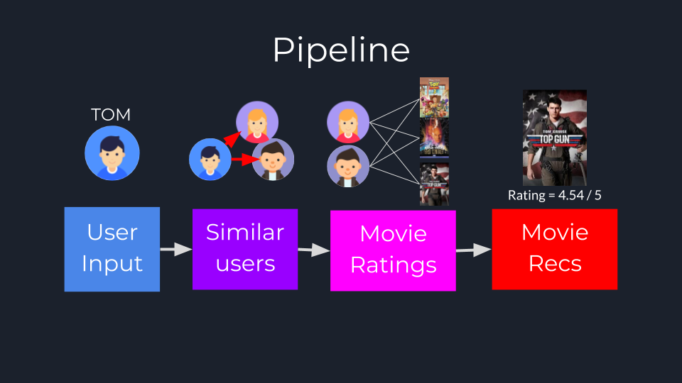
Collaborative filtering (CF) on the other hand can be divided into Item-Item CF (“Users who liked this item also liked …”) and User-Item CF (“Users who are similar to you also liked …”).
Some RS’s use one type of filtering, while other systems use a hybrid approach, Orient uses the User-Item CF model.
协作过滤（CF）可以分为Item-Item CF CF （ “喜欢此项目的用户也喜欢......”）和User-Item CF（“与您相似的用户也喜欢......”）。
一些RS使用一种类型的过滤，也有些系统使用混合方法

Slide 6
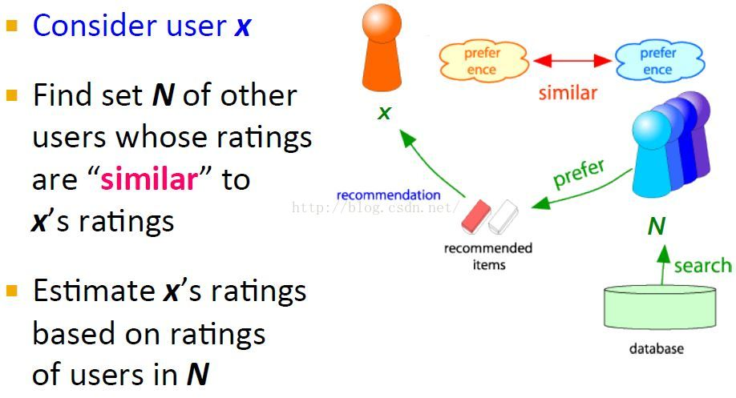
User-based collaboratIve filtering
基于用户的协同过滤算法UserCF
兴趣相同的用户可能带来新颖的东西。
对于一个用户x，首先找到与其相似的一个用户集，这个相似是通过它们的评分rating来判定的，likes和dislikes越相似，他们就越相似。然后推荐这些相似用户集喜欢的items并且预测x评分最高的items给用户x。

Slide 7
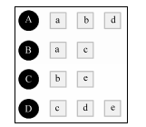
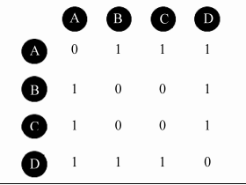
基于用户的协同过滤算法主要包括两个步骤：
（1）找到和目标用户相似的用户集合。
（2）找到这个集合中的用户喜欢的，且目标用户没有听说过的物品推荐给目标用户。
(1)的关键就是计算两个用户的兴趣相似度。
协同过滤算法主要利用行为的相似度计算兴趣的相似度。
(2)针对目标用户u，找到其最相似的K个用户，产生N个推荐
（假设K为与用户u兴趣相似的用户个数，N为用户u推荐的物品数）
i.对用户u，在用户相似度中找到与其相似度最高的K个用户。利用公式计算用户u对物品i的感兴趣程度p(u, i)。
ii.根据感兴趣程度由高到低确定N个推荐给用户u的物品。
建立物品到用户的倒查表，表示该物品被哪些用户产生过行为；
根据倒查表，建立用户相似度矩阵

Slide 8
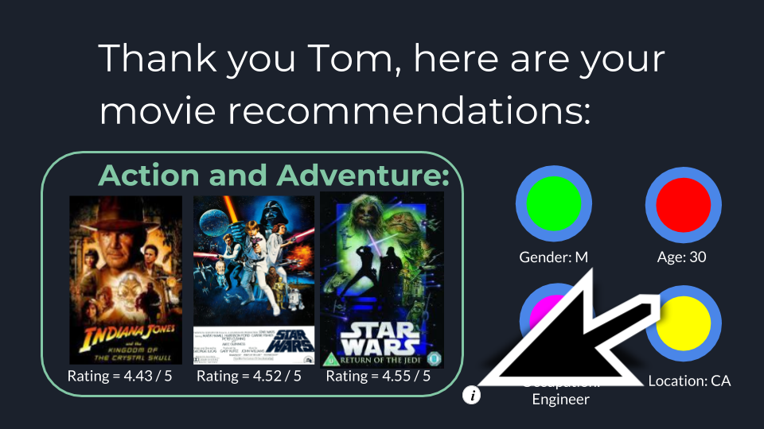
Orient’s Movie Recs
Entered some characteristics about himself (male, engineer, age 30, from CA) –个人信息
Some movie preferences
(genres: action and adventure,
minimum average movie rating: 3-star,
the number of movies to be recommended: 3 movies) – 电影偏好
Using these factors and a cosine similarity function，
Orient generates the following three movies for User
使用这些因素和余弦相似度函数，Orient为用户生成推荐电影
After recs are generated in a given media platform, the user is then given more options to better understand what led to the recs.
生成推荐后为用户提供更多选项以更好地理解Recs的内容
Ideally, this could be formatted as an information button that the user would click on to fine-tune their own contributed data.
用户可以单击该按钮来微调他们自己的贡献数据

Slide 9
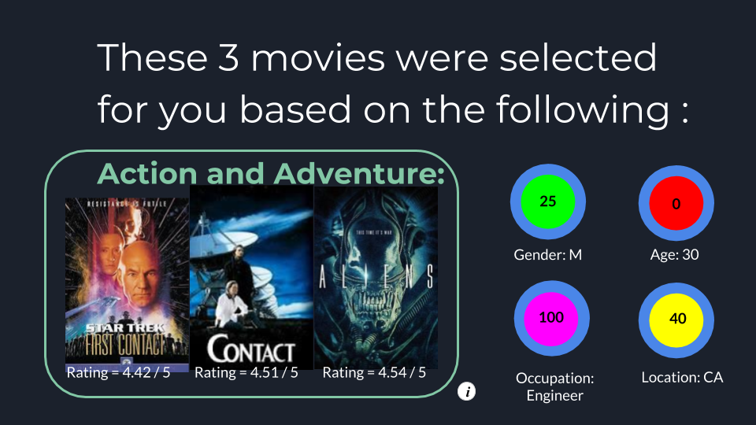
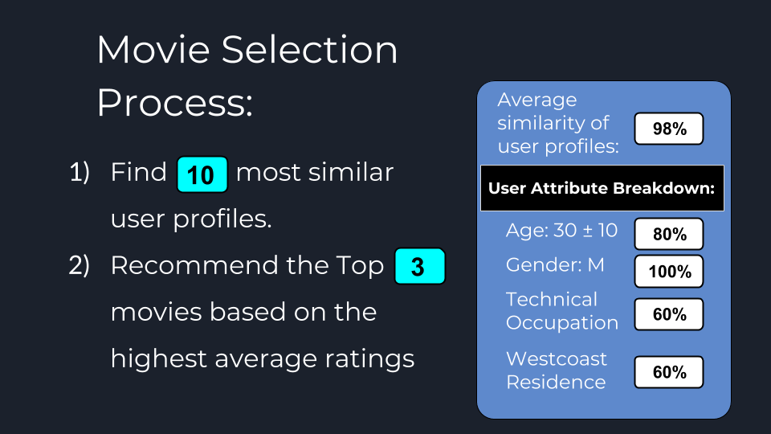
“tunable factor”
User can choose to only use the top 10 most similar user profiles or even use the 300 most similar user profiles to generate his movie recommendations.
使用前10个最相似的用户配置文件，可以使用300个最相似的用户配置文件来生成他的电影推荐
Increasing the number of similar user profiles can generate a more diverse set of movies, but might result in movies Tom would be less interested in.
All the movies recommended to User were rated by male users, and 6 of the 10 most similar user profiles had a technical profession.
10个最相似的用户配置文件中有6个具有技术背景
Tom may be satisfied with these numbers and will move on to enjoy his movie night, or he may choose to further customize his recommendations.
进一步定制他的推荐

Slide 10
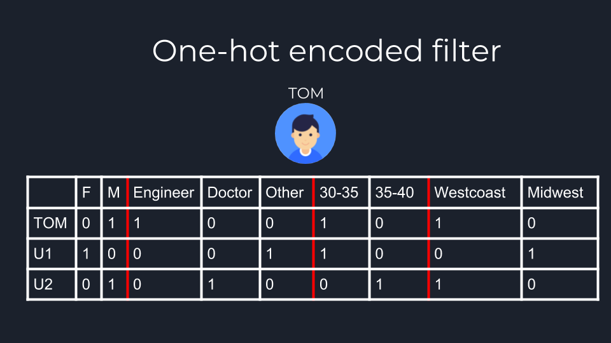
Finding Similar Users
“one-hot encoded filter” to apply the scaling Tom gave to each of the four attributes
(Age, Gender, Location, Occupation) above.
normalized scaled value
1表示有这个属性，0表示没有
Use a cosine similarity function to take the most similar user profiles to User’s new matrix
使用余弦相似度
This is fine for continuous values like age, which fall on a continuous scale and are easy to normalize, one-hot encoding is not ideal for categorical data like occupation
对年龄这样的连续值很好，这些值是连续的，易于标准化，对于职业等分类数据并不理想。

Slide 11
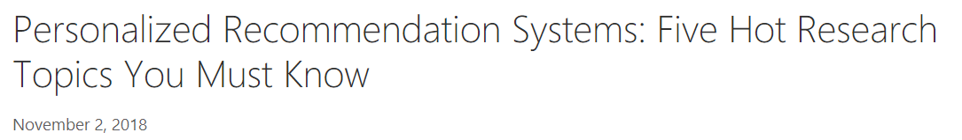
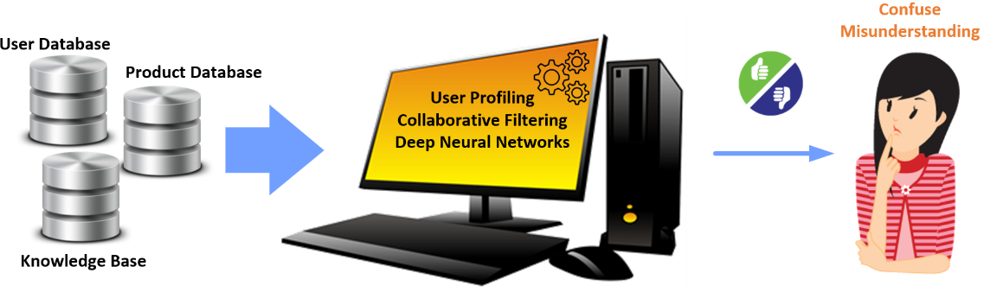
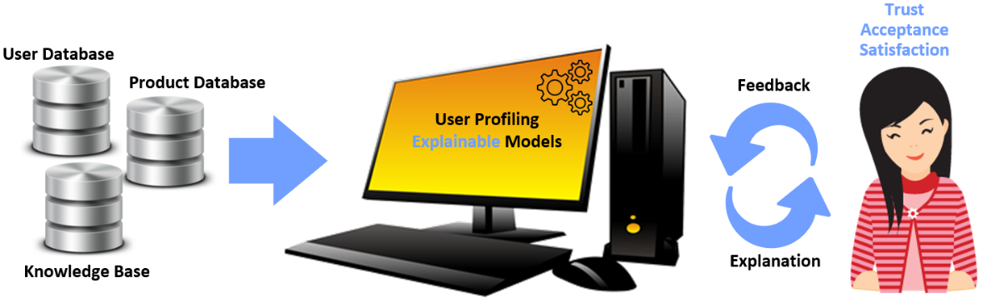
微软亚洲研究院
Research topic 1: recommendation system and deep learning
Research topic 2: recommendation system and knowledge graph
Research topic 3: recommendation system and reinforcement learning
Research topic 4: user profiling in recommendation systems
Research topic 5: explainable recommendation system
一类是传统的推荐系统（下图a），将重心放在提高推荐准确性上，与推荐对象的沟通考虑得不够。
另一类是这种可解释的推荐系统（下图b），能够以用户容易接受的方式（话家常），充分抓住用户心理给出适当的例子与用户沟通。研究发现，这样的系统不仅能够提升系统透明度，还能够提高用户对系统的信任和接受程度 、用户选择体验推荐产品的概率以及用户满意程度等等。

Slide 12
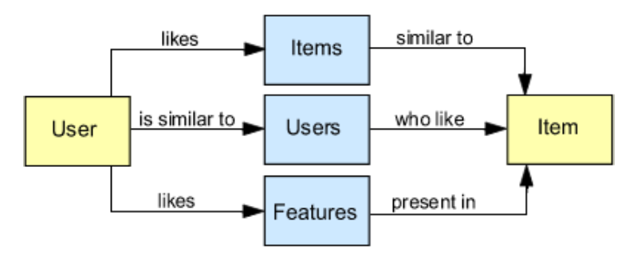
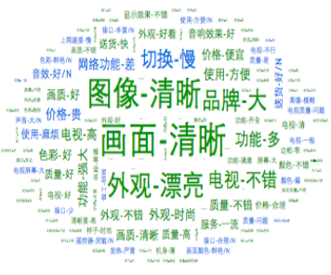
可解释推荐的分类
1.以物品为媒介的推荐解释用一句话表述是“这个推荐物品和您喜欢的其他物品相似”。但是这类推荐解释的问题是用户有时可能难以找到物品之间的关联，另外用户有时可能希望看到一些自己没有购买过的、不一样的物品。
2.以用户为媒介的推荐解释用一句话表述是“跟您相似的用户都喜欢该推荐物品”。如果只是随机选择一个朋友，说服力反而会降低。
3.以特征为媒介的推荐解释用一句话表述是“您可能喜欢推荐物品的这些特征”。研究表明这类推荐解释有助于用户准确判断是否喜欢推荐物品，与前两类推荐解释相比，用户对这类推荐的满意度更高。这类推荐需要判断物品特征以及用户对不同特征的感兴趣程度，从而找到最适合用于解释的特征，因此建模粒度更细。

Slide 13

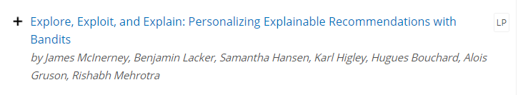

12th ACM Conference on Recommender Systems (Vancouver, Canada, 2nd-7th October 2018)
探索:就是把不确定用户喜不喜欢的商品推荐给用户，来探索用户到底喜欢什么。利用:就是说从用户已知的用户喜欢的东西里找到用户最喜欢的。
对互惠推荐系统做解释。作者对互惠推荐系统的解释，做了一个展现，推荐系统给这个用户推荐了一个朋友，这个用户的是因为喜欢西班牙语艺术，两个人学历差不多，所以推荐。每次推荐都会作出的解释。
https://recsys.acm.org/recsys18/accepted-contributions/

Slide 14
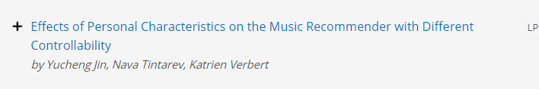
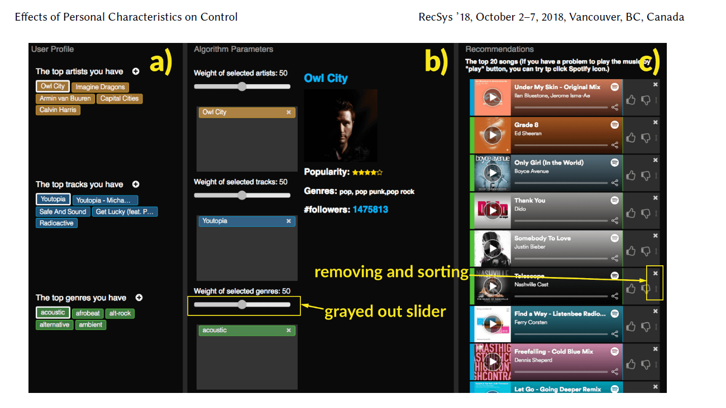

Slide 15
THANK
YOU

