Slide 1
Dataflow Analysis

Slide 2

A toy example

Slide 3
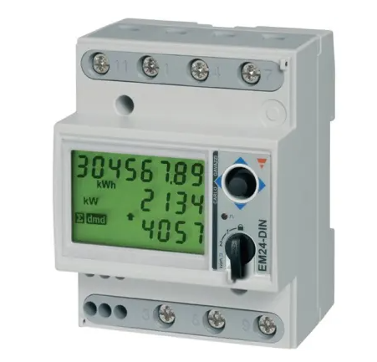
Smart meter example
The software we are analyzing runs on a smart meter.
It has two periods: peek hours (electricity is expensive) and off-peak hours where electricity is cheap.
We want to make sure that electricity consumption data is correctly computed from either peek hours or off-peak hours but do data is exchanged between the two periods.

Slide 4
Analyzed code
enum period {PEAK,OFFPEAK,NBPERIOD } current_period;
unsigned total;
unsigned total_during_period[NBPERIOD];
unsigned previous_t;
void update_totals(unsigned t, unsigned instant_pow) {
unsigned duration = t - previous_t;
unsigned energy = instant_pow * duration;
total = total + energy;
switch (current_period) {
case PEAK:
// do_peak_things();
break;
case OFFPEAK:
// do_offpeak_things();
break;
}
total_during_period[current_period] = total_during_period[current_period] + energy;
previous_t = t;
}

Slide 5
Analysis driver
// analysis driver
int main(void) {
// set up the inputs:
tis_make_unknown( & previous_t, sizeof previous_t);
current_period = tis_interval(0, NBPERIOD - 1);
unsigned t;
tis_make_unknown( & t, sizeof t);
unsigned instant_pow;
tis_make_unknown( & instant_pow, sizeof instant_pow);
// call the target function
update_totals(t, instant_pow);
}

Slide 6
Analysis driver
> tis-analyzer –val -slevel 10 -graphdeps -deps update_totals.c
…
[from] Function update_totals:
total FROM total; previous_t; t; instant_pow
total_during_period[0]
FROM current_period; total_during_period[0]; previous_t;
t; instant_pow (and SELF)
[1]
FROM current_period; total_during_period[1]; previous_t;
t; instant_pow (and SELF)
previous_t FROM t
…
Data in total_during_period[0] does not depend on total_during_period[1].
Data in total_during_period[1] does not depend on total_during_period[0].

Slide 7

real world example

Slide 8
Semantic Pattern
Key mySecret;
int f() {
int result =some_computation(mySecret);
// . . .
if (result & 7) {
// . . .
} else {
// . . .
}
}
We want to detect if a computation from a secret is used in a test condition.
It’s a way to prevent some side channel attacks.
In this example variable result is computed from a secret and used in the condition of an ”if” statement

Slide 9
s2n_verify_cbc from s2n
int s2n_verify_cbc(struct s2n_connection *conn,
struct s2n_hmac_state *hmac,
struct s2n_blob *decrypted)
{
// . . . .
int cutoff = check - padding_length;
for (int i = 0, j = decrypted->size - 1 - check;
i < check && j < decrypted->size; i++, j++) {
uint8_t mask = ~(0xff << ((i >= cutoff) * 8));
mismatches |= (decrypted->data[j] ^ padding_length) & mask;
}
if (mismatches) {
S2N_ERROR(S2N_ERR_CBC_VERIFY);
}
return 0;
}
The variable mistmatches is computed from a secret (decrypted->data).
We detect the dependency between the secret and the test in the if statement.
Error detected
Full source code: https://github.com/awslabs/s2n/blob/e5cadd53a85ac27976d5bdb7ba1501945675c5de/tls/s2n_cbc.c#L48

