Slide 1
REPOTR
Searching and Classifying Empirical Studies
group12
presenter：陶泽华
member：孙浩峰、邹英龙、丁笑宇

Slide 2
01
Search Process
CONTENT
02
Search Result
目录
03
Problems and experience

Slide 3
“
01
搜索过程
Search Process

Slide 4
Data Sources
step1 choosing database
JOURNAL | DATABASE
Empirical Software Engineering Journal(EMSE) | Springer
International Symposium on Empirical Software Engineering and Measurement(ESEM) | ACM digital library
International Conference on Evaluation and Assessment in Software Engineering(EASE) | ACM digital library

Slide 5
Screen & Get papers list
step2 screening & getting papers list and download by sci-hub
Research method | Definition
Controlled Experiments | control variable、experiments
Case studies | Systematic collection of data and information
Survey | Interview survey, questionnaire investigation, huge amounts of data
Ethnographies | field investigation, observation
Action Research | practical work
Systematic reviews | Summary and analysis of existing papers
Expert opinions | the advice of professionals
1.Published in 2020.
2.Must use one or more empirical study methods.
3.Written in English.
4.Shouldn't be preprint.
5.More than 6 pages.
6.Shouldn't be graduation dissertation.
1 文字内容
("empirical software engineering" OR "empirical study" OR "empirical research") AND ("controlled experiments" OR "case studies" OR "survey" OR "Ethnographies" OR "action research" OR "systematic reviews" OR "literature reviews" OR "experts")

Slide 6
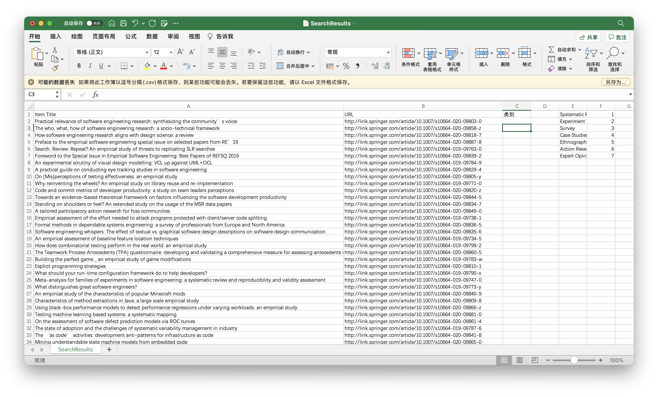
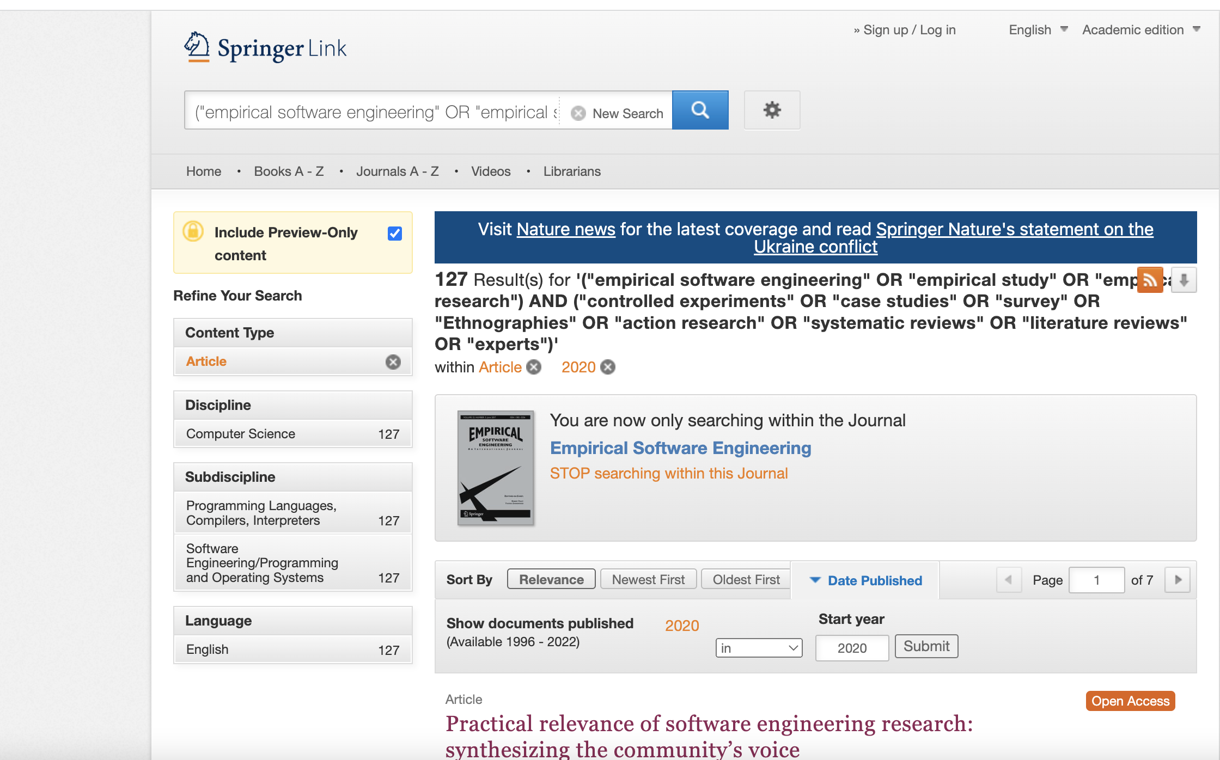
Screen & Get papers list
step2 screening & getting papers list and download by sci-hub
1 文字内容
step3 Categorizing

Slide 7
“
02
搜索结果展示
Search Result

Slide 8
Search Result
 | EASE | EMSE | ESEM | TOTAL
Experiments | 3 | 35 | 4 | 42
Case study | 6 | 30 | 10 | 46
Survey | 10 | 26 | 4 | 40
Action Research | 1 | 19 | 1 | 21
Systematic Reviews | 6 | 10 | 2 | 18
Ethnographies | 2 | 3 | 0 | 5
Expert Opinions | 2 | 2 | 1 | 5
TOTAL | 30 | 125 | 22 | 177

Slide 9
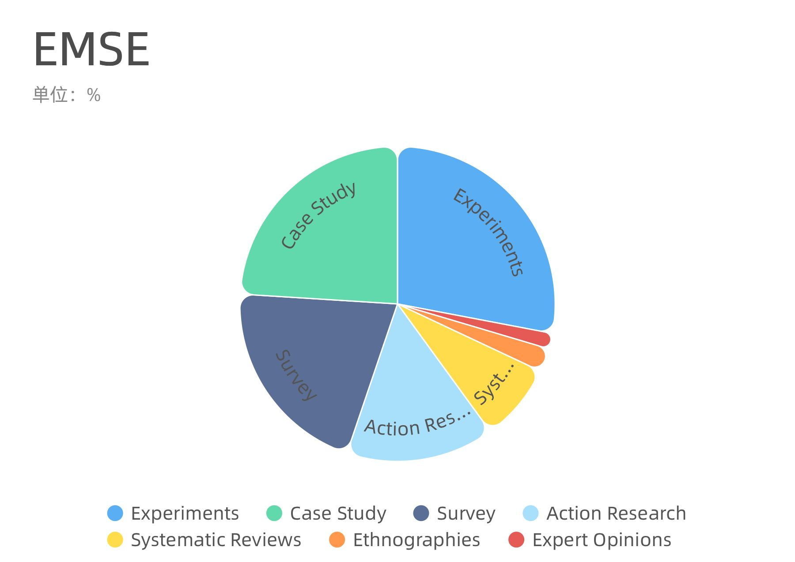
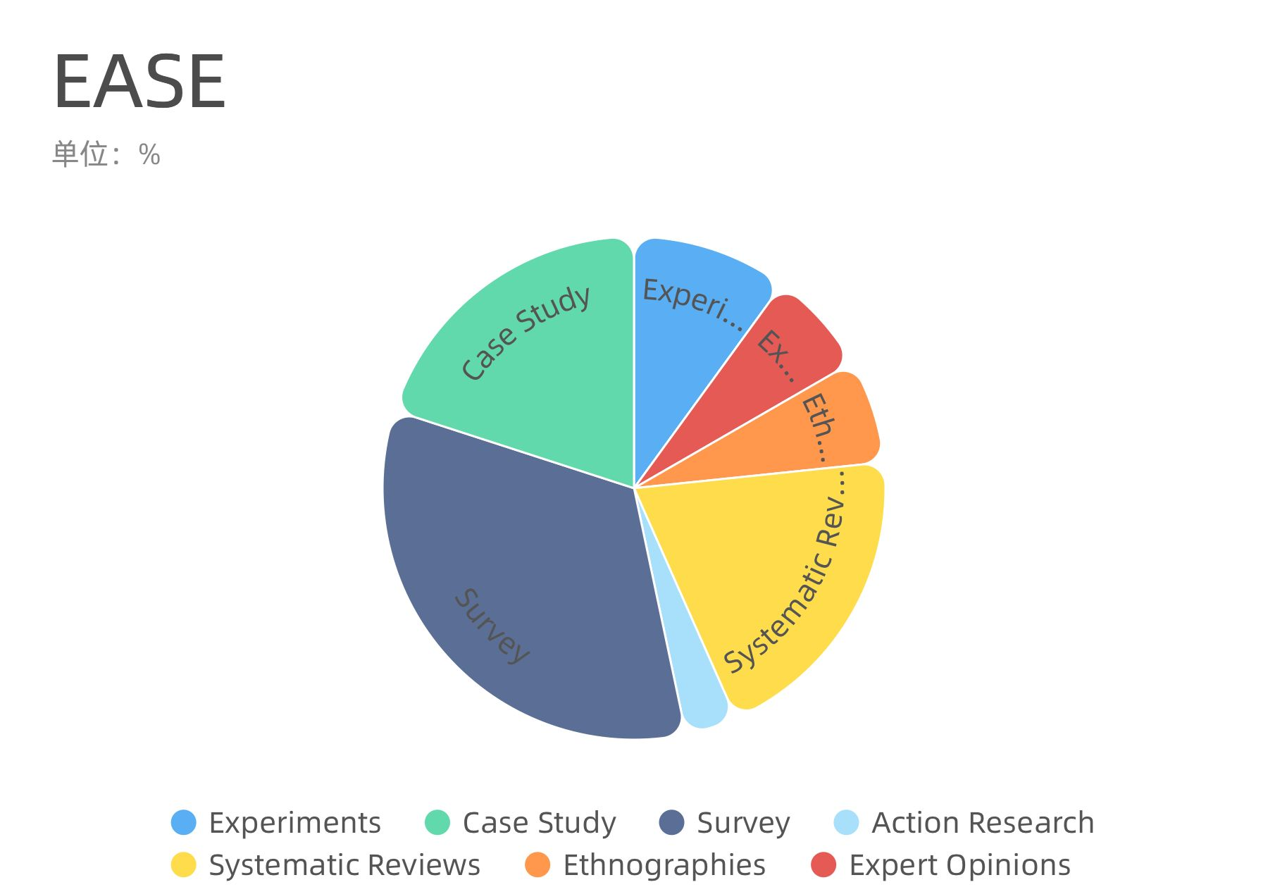
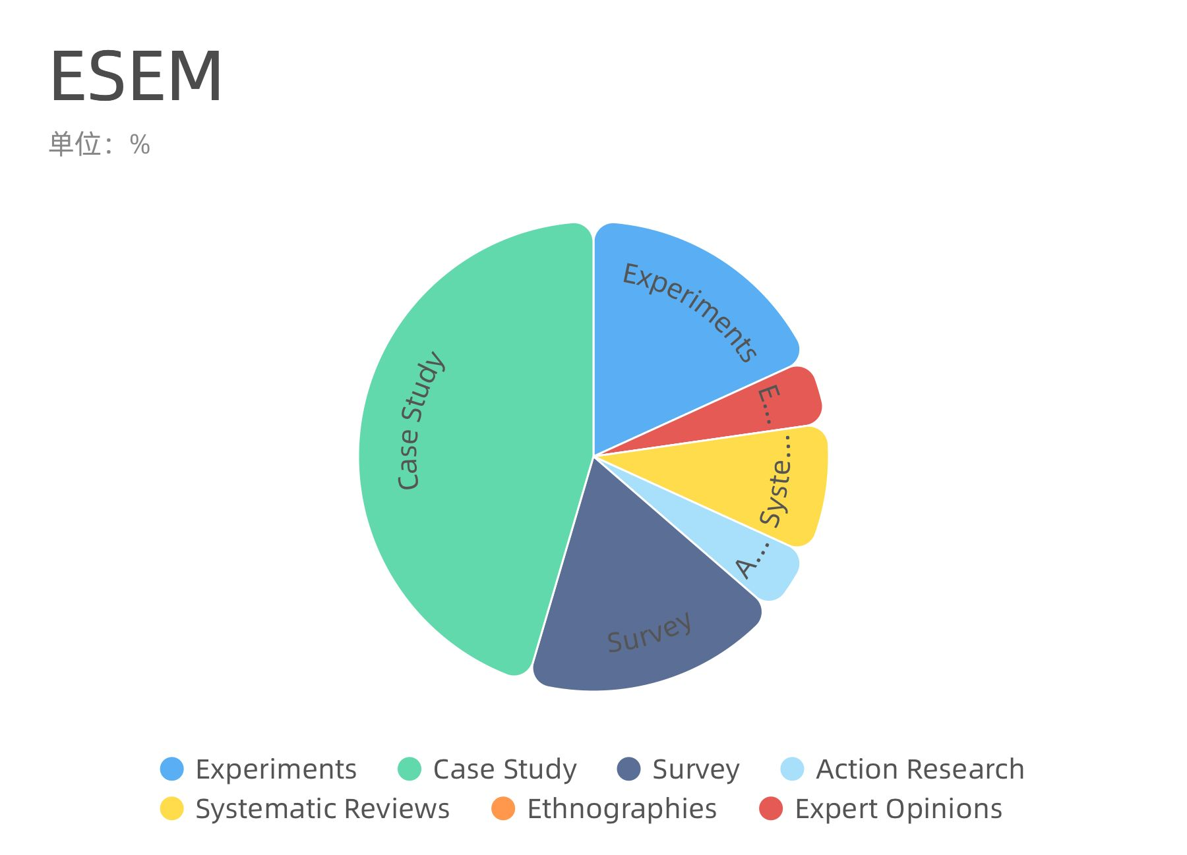
Search Result

Slide 10
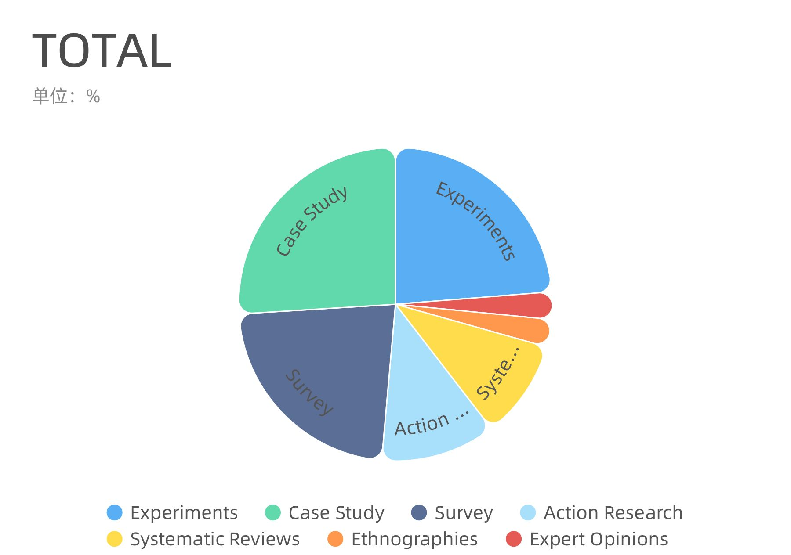
Search Result

Slide 11
“
03
搜索过程中遇到的问题和经验
Problems and experience

Slide 12

Problems and experience
01
一个论文中采用了多种研究方法，该如何进行分类
对其进行深入阅读，进行小组讨论，找出最关键步骤使用的研究方法，以作为分类标准。
02
研究方法具体的定义

Slide 13

THANKS
谢谢观看
group12
presenter：陶泽华
member：孙浩峰、邹英龙、丁笑宇

