Slide 1


HOMECOMING
-Complete home health solution!

Slide 2


Our Application Story!!
A portal for Real estate Agents, Apartment Owners, and customers looking for a new place to rent/ buy.
Customer can search for any apartment.
Select any apartment after checking its health(temperature, humidity , light conditions ).
Agents / Owners/ Renter can mitigate issue in the apartment in time as the app notifies them in advance about possible adverse situations.

Slide 3

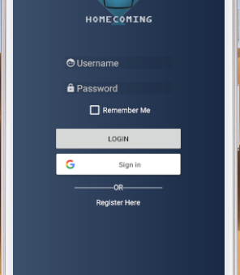
Login Interface

Slide 4
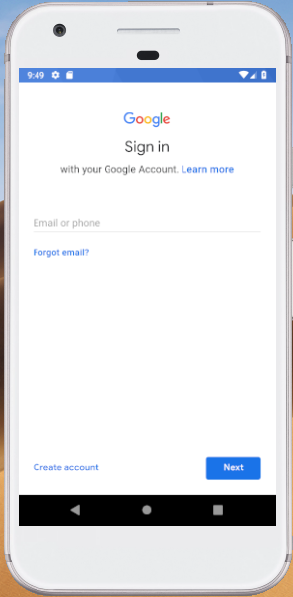
Google Sign-In Authentication

Slide 5
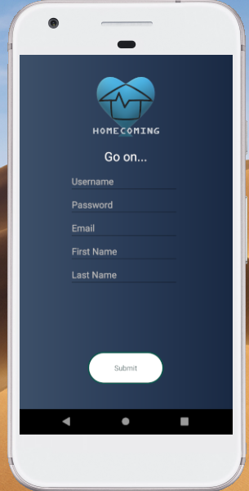
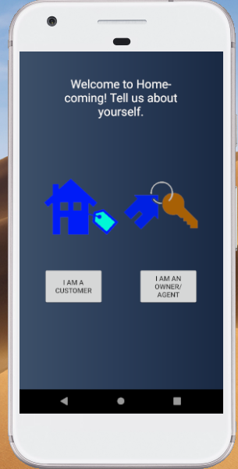
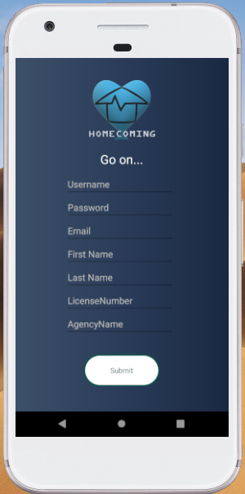
Registration page for Agents and Customers

Slide 6
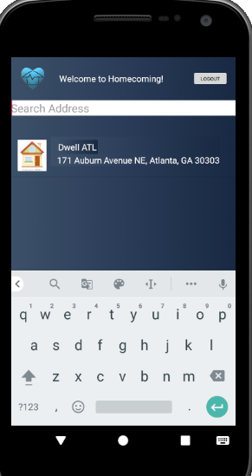
Customer search for apartments and the corresponding list display

Slide 7
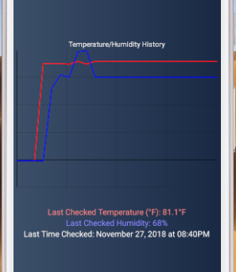
Graph depicting house condition in realtime

Slide 8
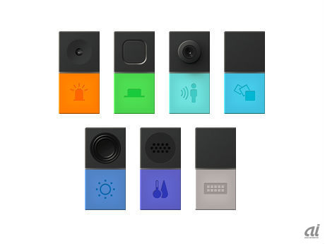
Sensor Used:
Humidity
Temperature.
Condition Evaluation
Extreme Condition shows in light blue/red
Normal Condition Shows in bright blue/red.

Slide 9

The soul of HOMECOMING app - Sensors
Our sensors placed in an apartment, reports when humidity has dropped below the set threshold level.
Our sensors placed in an apartment, reports when temperature has increased above the set threshold level.
Our sensors placed in an apartment report, when water level rises above the set threshold level.
Sensors continuously monitor and send real-time data to the cloud server which can be checked on the app.

Slide 10

The Road Ahead…
Other sensors can be added for better accuracy of predictions.
Customer and owners will be able to review the apartments and give their feedback.
Customers and Owners can call or mail the agent through this application for faster turn around time and resolution.
Scalability…
It can be used in shops and supermarkets to prevent fire, flooding and possible areas of mold infestation.
We can add the motion sensor to detect unwanted intrusion in the dark without the need of security cameras.
Motion detectors can be placed near safe vault to send immediate notification to the nearest police station of possible burglary in progress.
The possibilities are endless...

Slide 11
Thank You

