Slide 1


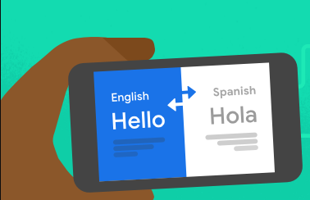
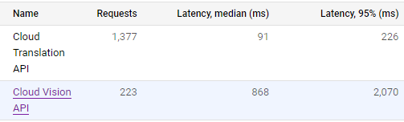
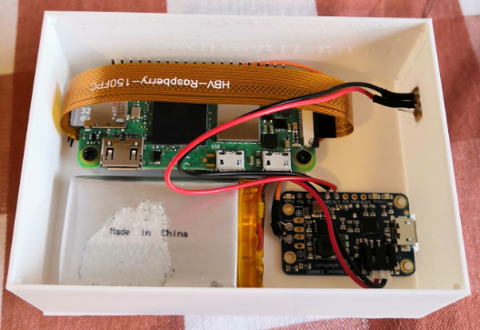
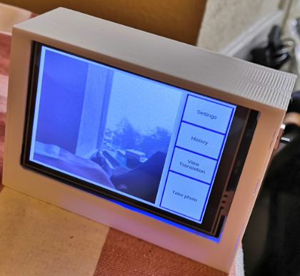
Portable Translation Device
Preslav Chonev
Advisor: Dr. Jacky Visser
The Goal
The language barrier is a common problem for all foreigners inexperienced in a language. To help with that, this project developed a portable translation device that helps people translate visual text with the use of Optical Character Recognition (OCR) technology managed on a Raspberry Pi with an attached camera module. To achieve this, the project explored different OCR algorithms and attempted at creating a physical model with a user-friendly interface.
Challenges
Balancing the software’s efficiency with the hardware’s limitations was a major challenge
Designing a suitable interface with consideration of the screen size
Selecting the correct camera resolution and image format with regard to file size and image clarity
Designing the physical model
The prototype
The final version of the artefact did achieve this by providing a translation device, using Google Vision and Translation API, which can easily be navigated through the graphical interface. The prototype provides customisation functions for the text display and allows the user to change the translation language. It has a battery life of about 2 hours when fully charged and can be recharged through the charging port on the box.

