Slide 1

The Patents Case
Exfiltration of corporate intellectual property

Slide 2
The patent company is a new company that researches patent information for clients.
Facts of the case:
  1 president / CEO
  3 additional employees
  The firm is planning to hire more employees, so they have a lot of inventory on hand (computers, printers, etc).
Current employees:
  President: Pat McGoo
  Information Technology: Terry
  Patent Researchers: Jo, Charlie

Slide 3
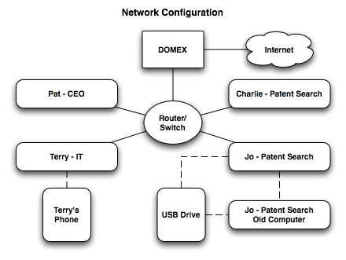
organization
Employees work onsite, and conduct most business exchanges over email. All of the employees work in Windows environments, although each employee prefers different software (e.g. Outlook vs. Thunderbird).
Note: In the above figure “DOMEX” is the local server managing external network access and email.

Slide 4
The case: exfiltration of corporate IP
One of the employees in M57 is stealing proprietary research from the company and passing it on to an outside entity. This employee has taken some measures to cover their tracks, but probably did not count on the company machines being imaged in the ongoing investigation of other criminal activity.
You are tasked with determining the following:
  Who is exfiltrating the data?
  How are they doing it? Can you identify the specific items they have stolen? What is required to access the data?
  Who is the outside contact?
  Is there anything in your analysis to suggest that this person might be charged with more than one criminal offense?

Slide 5
Electronic identities
Pat McGoo (President):
  pat@m57.biz (email password: mcgoo01)
Terry Johnson (IT Administrator):
  terry@m57.biz (email password: johnson01)
Jo Smith (Patent Researcher):
  jo@m57.biz (email password: smith01)
Charlie Brown (Patent Researcher):
  charlie@m57.biz (email password: brown01)

Slide 6
Corpus and Supporting Documents
You have been given the “Police Evidence” set of data includes the following:
  Hard drive images from a workstation in the office:
    charlie-2009-12-07.E01

Slide 7
Comments and Additional Activities
Use Prodiscover to examine the M57 Patents disk image.
  Most of Prodiscover features can be used on these images.
  They are big enough to be realistic, small enough so that the Prodiscover functionality will run in a short time.
Try using FTK to compare functionality.

