Slide 1
The importance of technological innovation
for a company

Slide 2
ZTE operating income per business segment
billion yuan

Slide 3
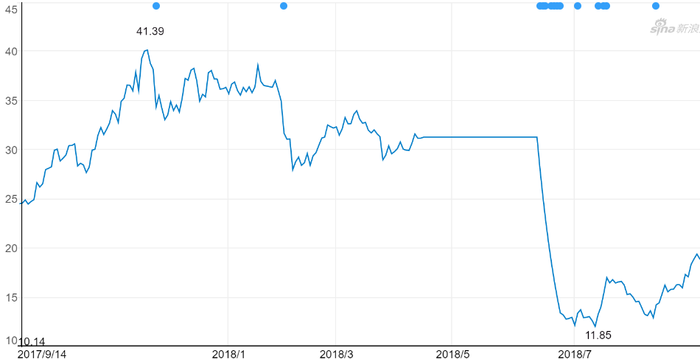
ZTE stock price chart
Yuan / stock
date

Slide 4
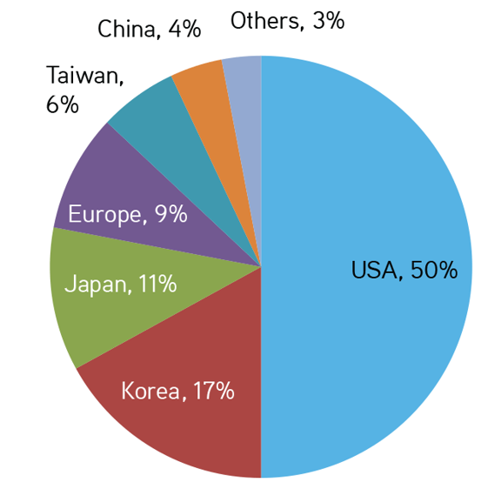
Chip provider of ZTE Product

Slide 5
Thank you

