Slide 1
NLP
王冰丰
2019年07月22日

Slide 2
Outline
RNN
Word Embedding
Research Orientation

Slide 3
RNN

Slide 4
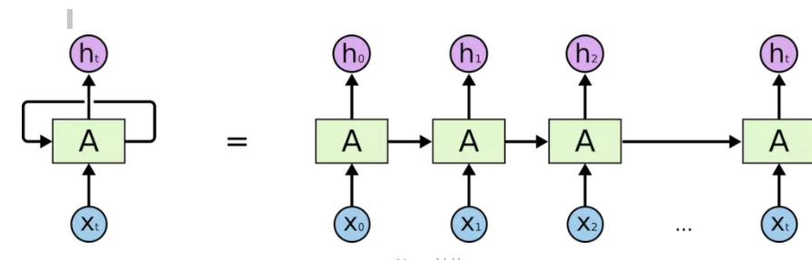
RNN
Structure

Slide 5
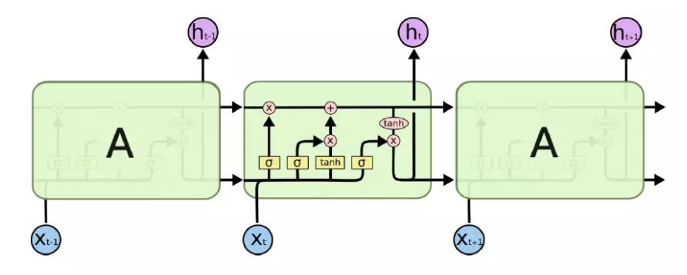
RNN
LSTM

Slide 6
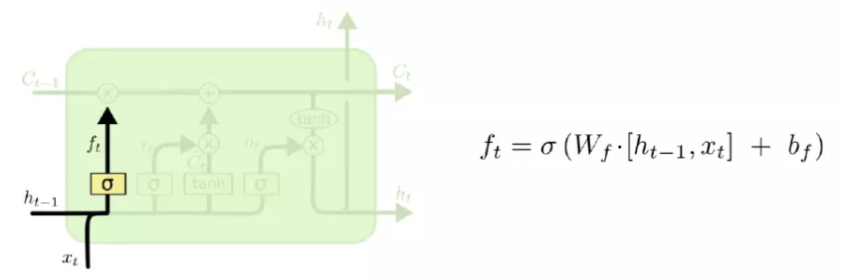
RNN
LSTM (forget gate)

Slide 7
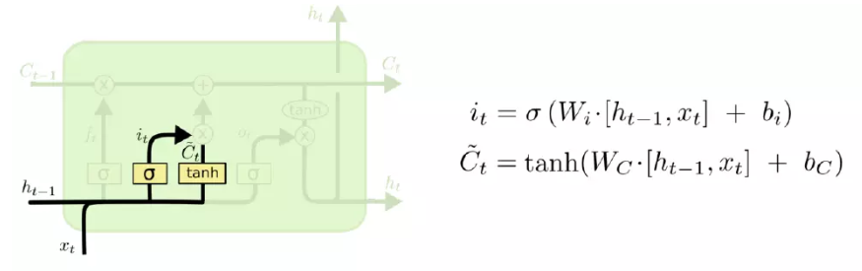
RNN
LSTM (input gate)

Slide 8
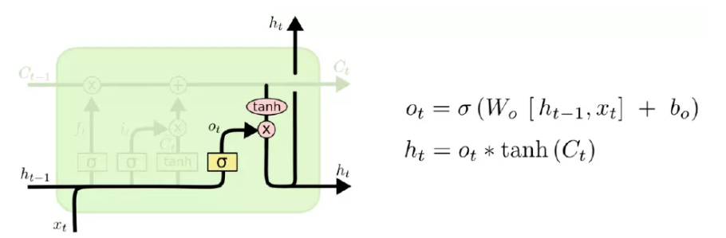
RNN
LSTM (output gate)

Slide 9
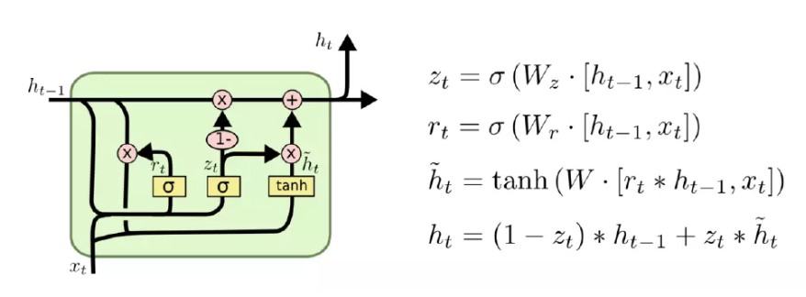
RNN
GRU

Slide 10
Word Embedding

Slide 11
Word Embedding
One hot representation
Distributed representation

Slide 12
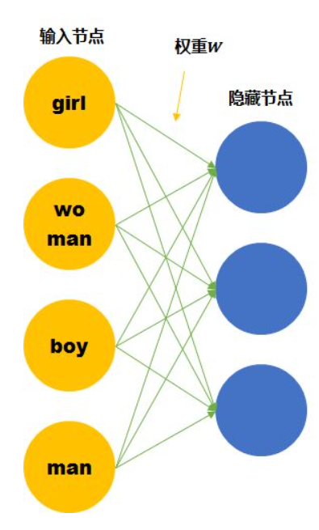
Word Embedding
One hot representation

Slide 13
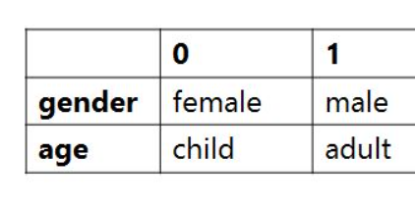
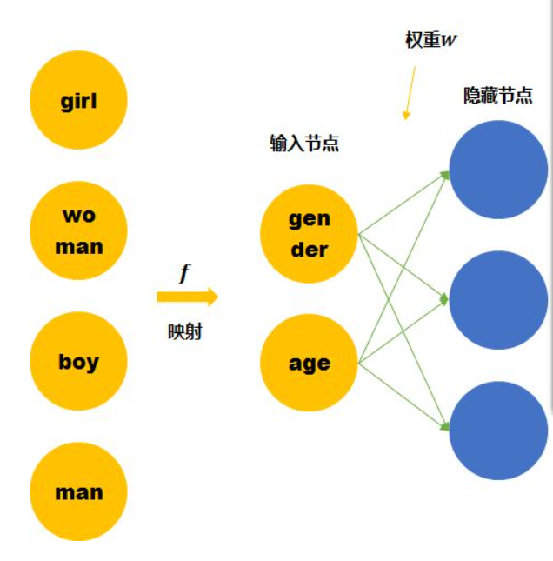
Word Embedding
Distributed representation

Slide 14
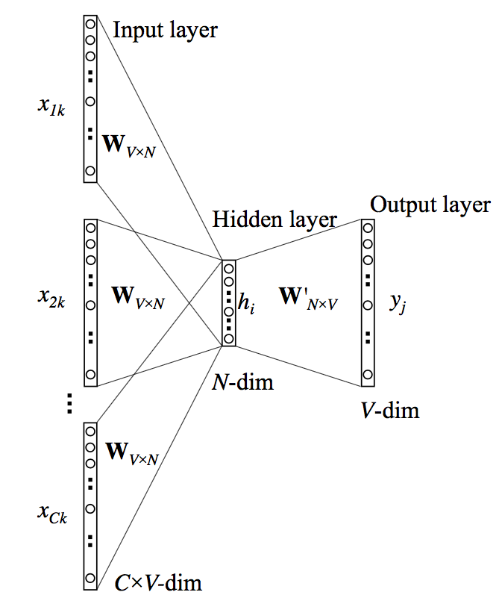
Word Embedding
CBOW

Slide 15
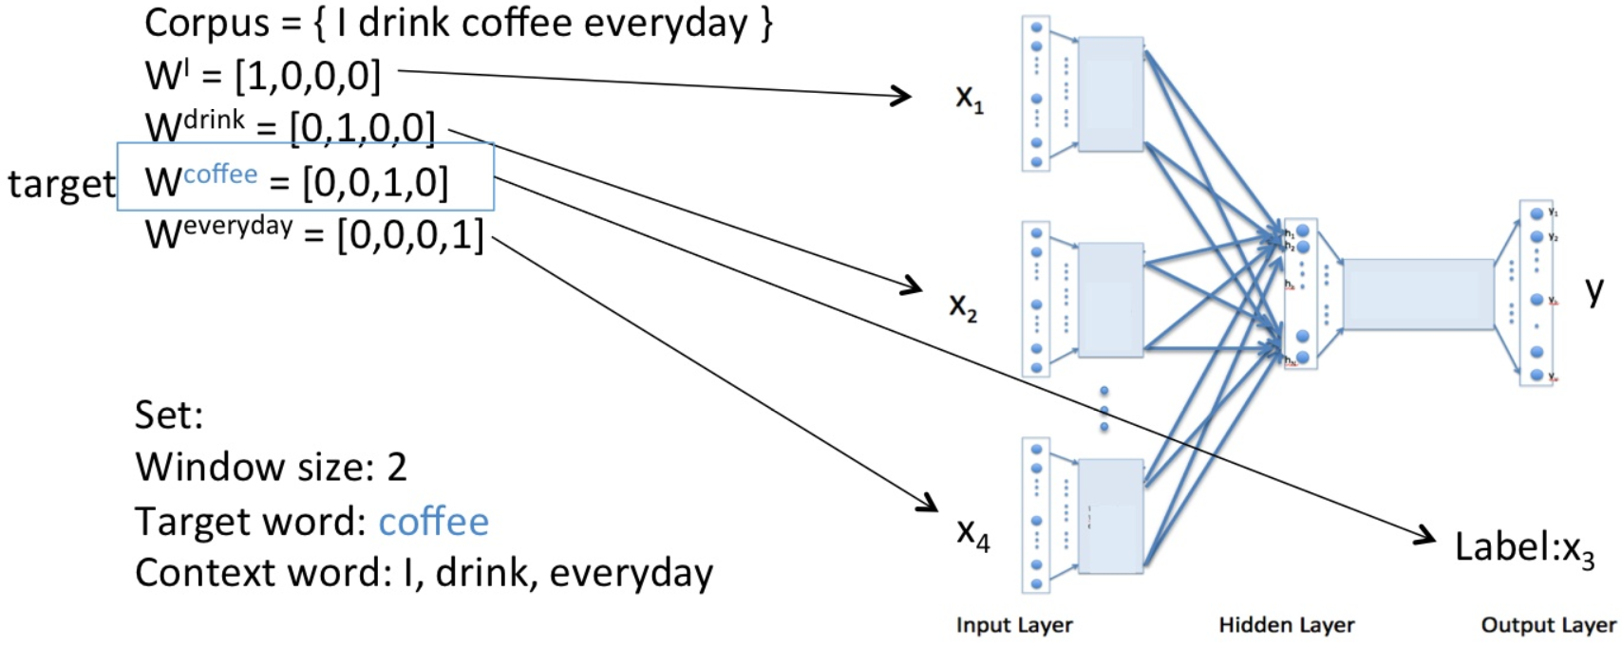
Word Embedding
CBOW

Slide 16
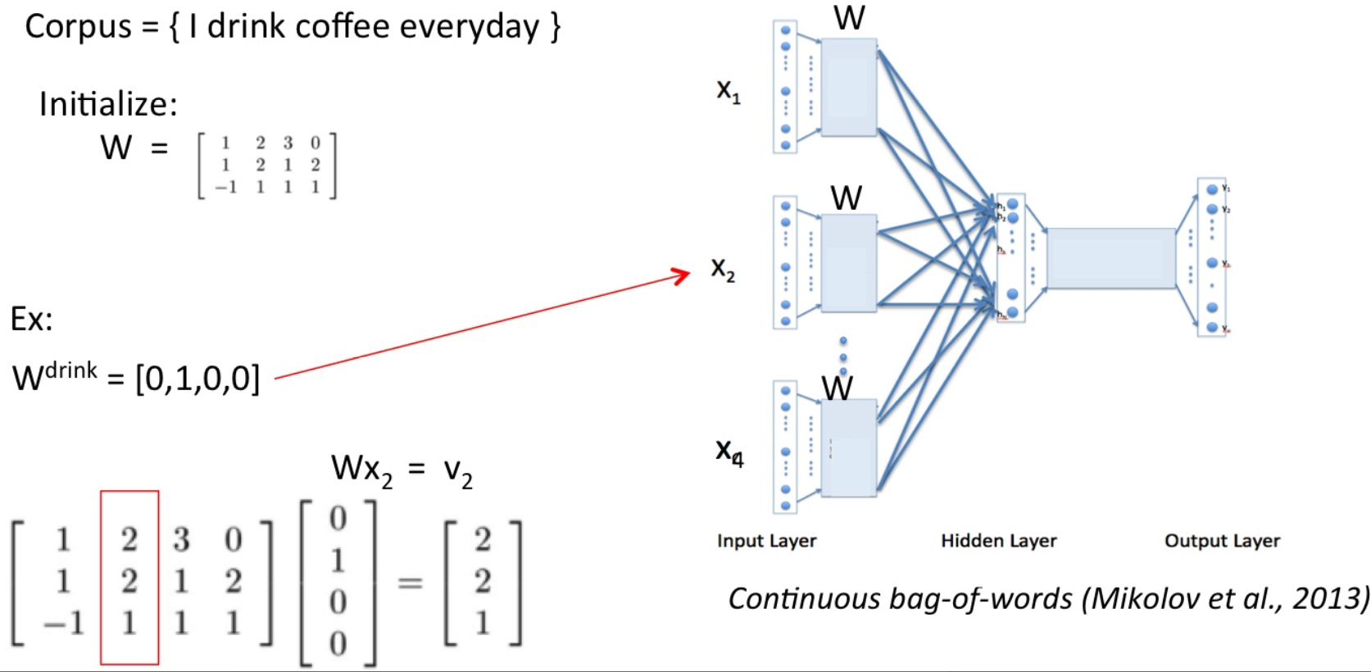
Word Embedding
CBOW

Slide 17
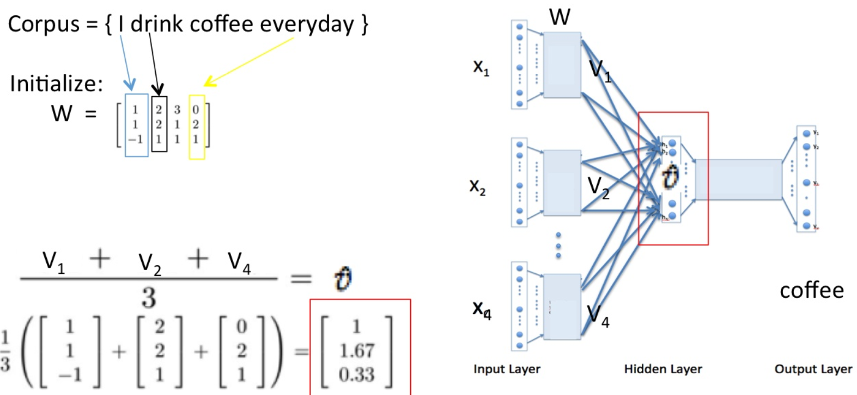
Word Embedding
CBOW

Slide 18
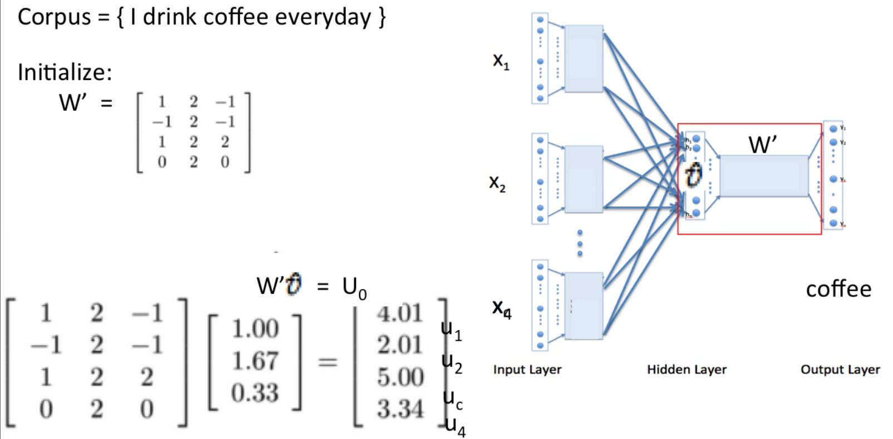
Word Embedding
CBOW

Slide 19
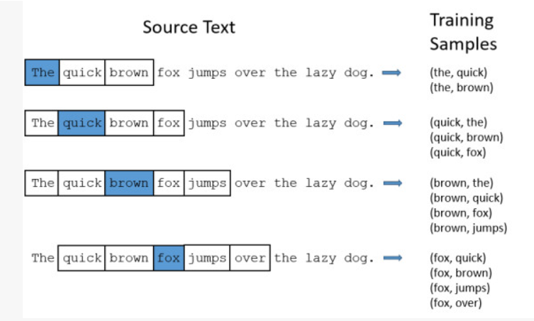
Word Embedding
Skip-gram

Slide 20
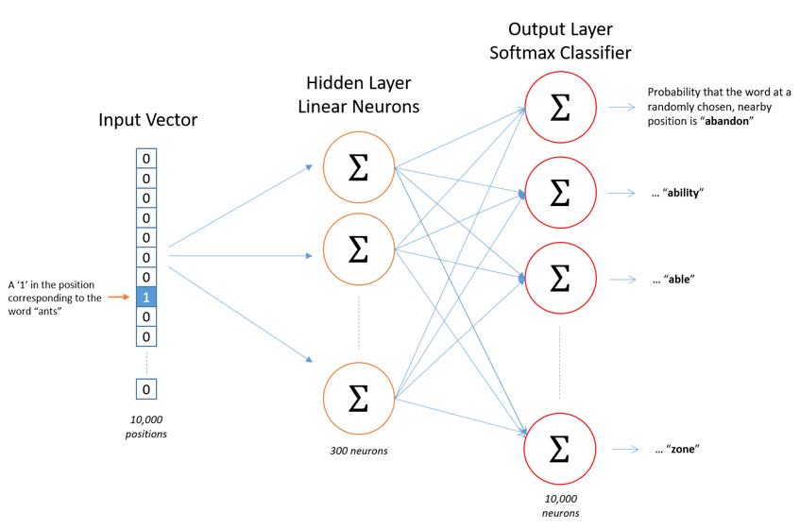
Word Embedding
Skip-gram

Slide 21
Research Orientation

Slide 22
Research Orientation
Machine Translation
Information Retrieval
Information Extraction
Sentiment Analysis
Question Answer
Few-shot Learning

