Slide 1
Enrollment System
-- ENR1 --
Timotej Kotlín & Sara Alić-Ekinović
Group: - EXA1 -

Slide 2
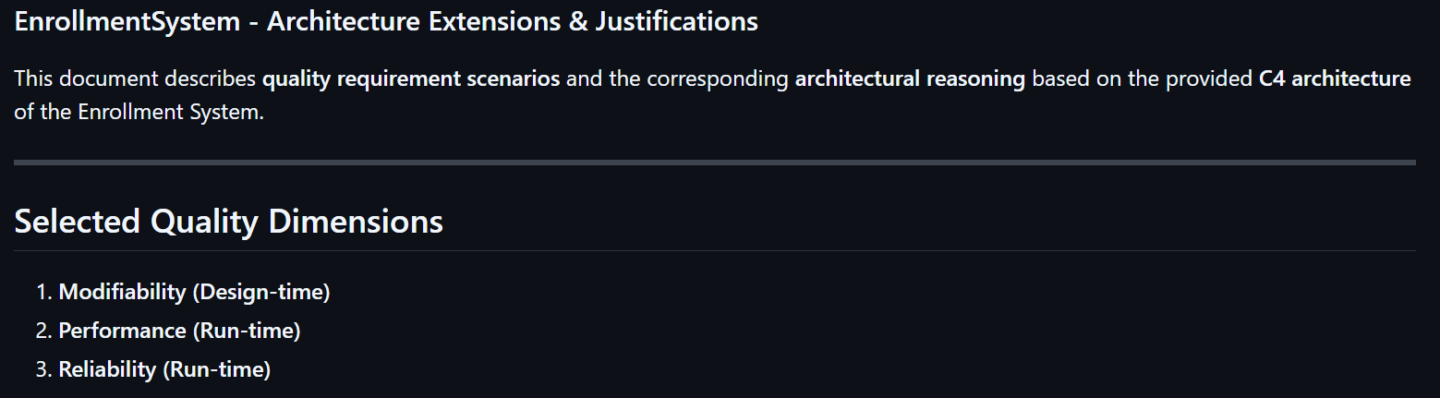



Modifications to C4 Model & Quality Scenarios

Slide 3
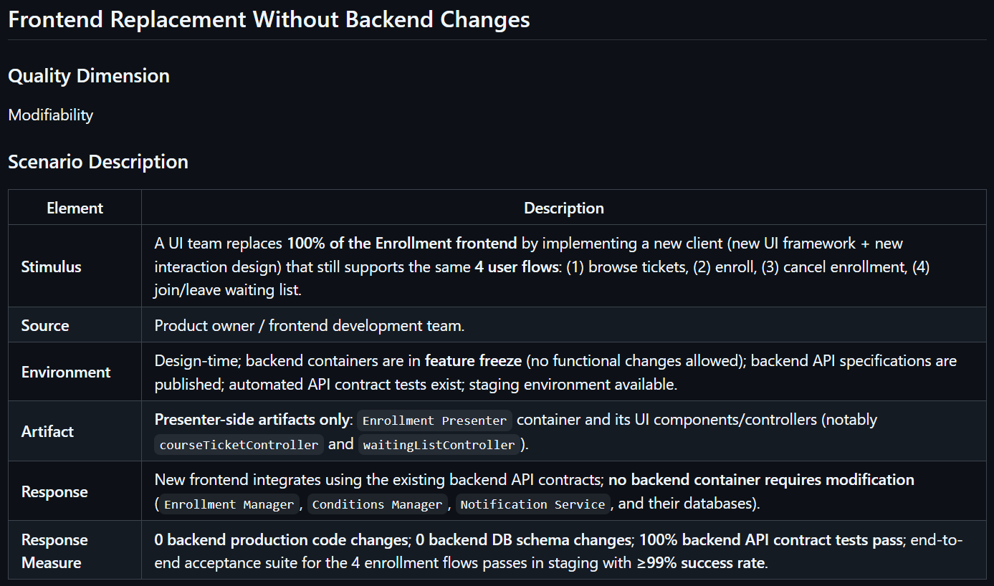
Scenario 0 - Modifiability (Design-time)

Slide 4
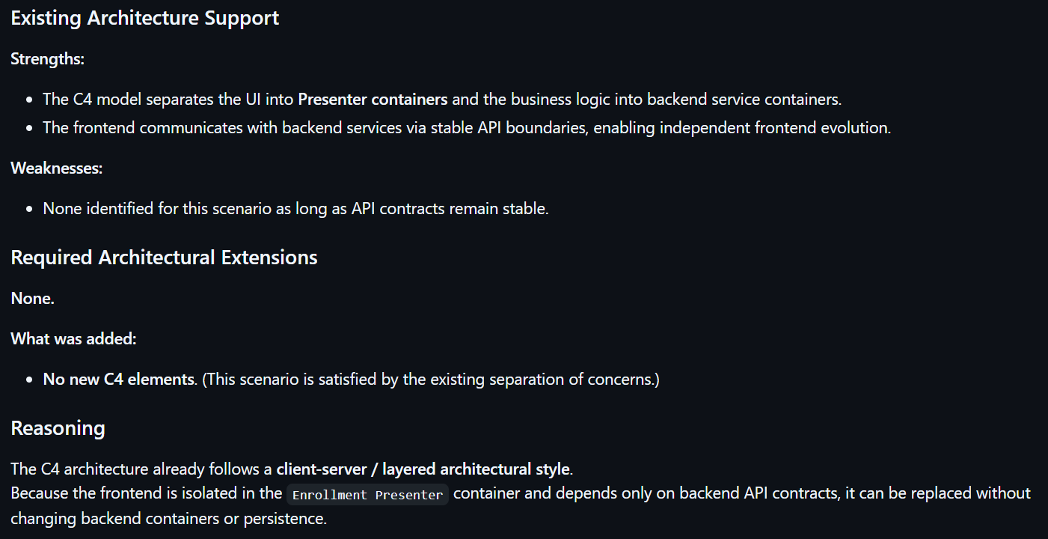
Scenario 0 - Modifiability (Design-time)

Slide 5
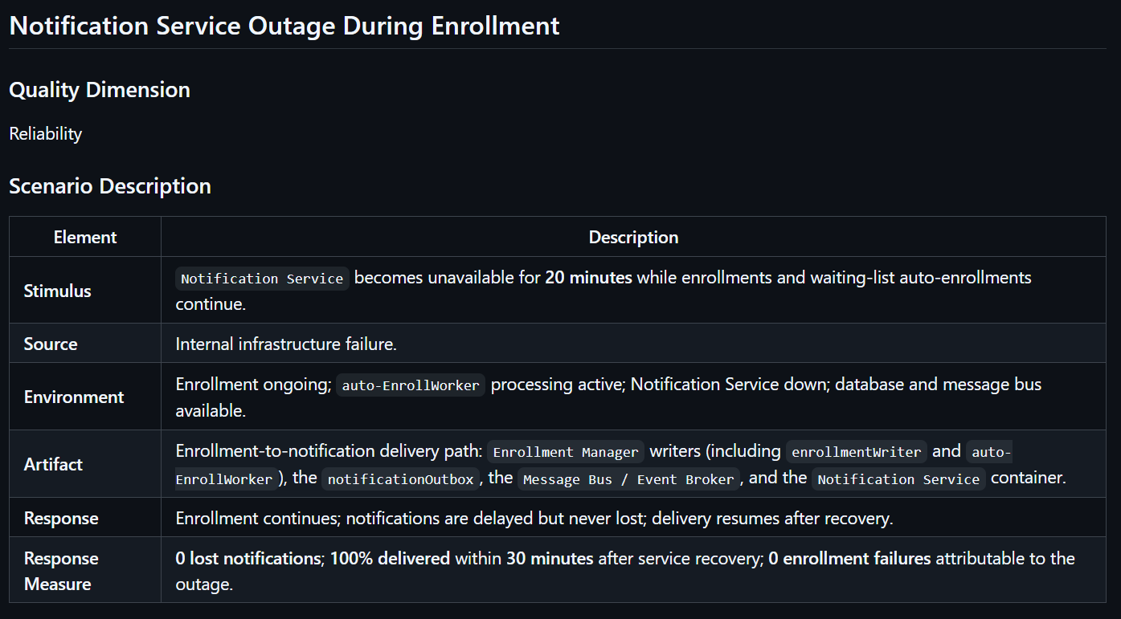
Scenario 3 - Reliability (Run-time)

Slide 6
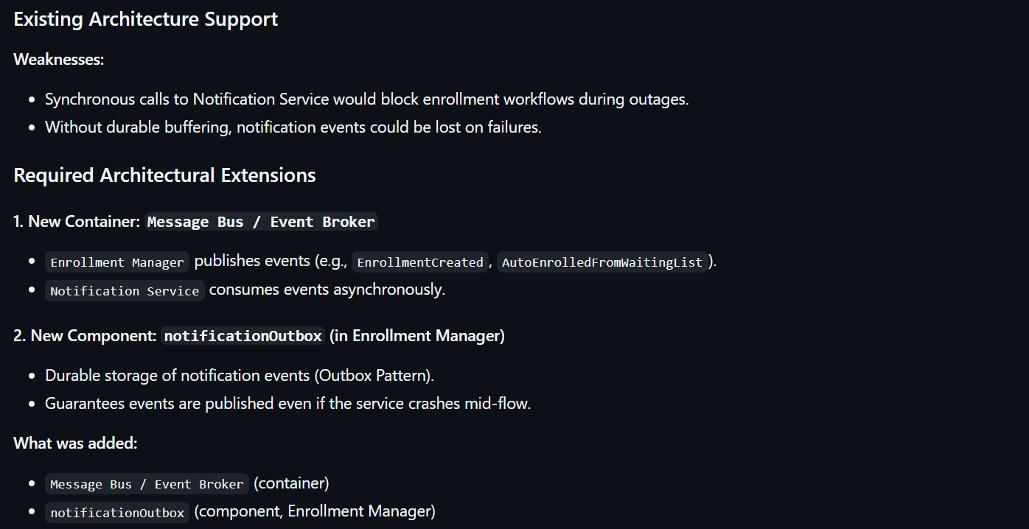
Scenario 3 - Reliability (Run-time)

Slide 7
Scenario 3 - Reliability (Run-time)

Slide 8
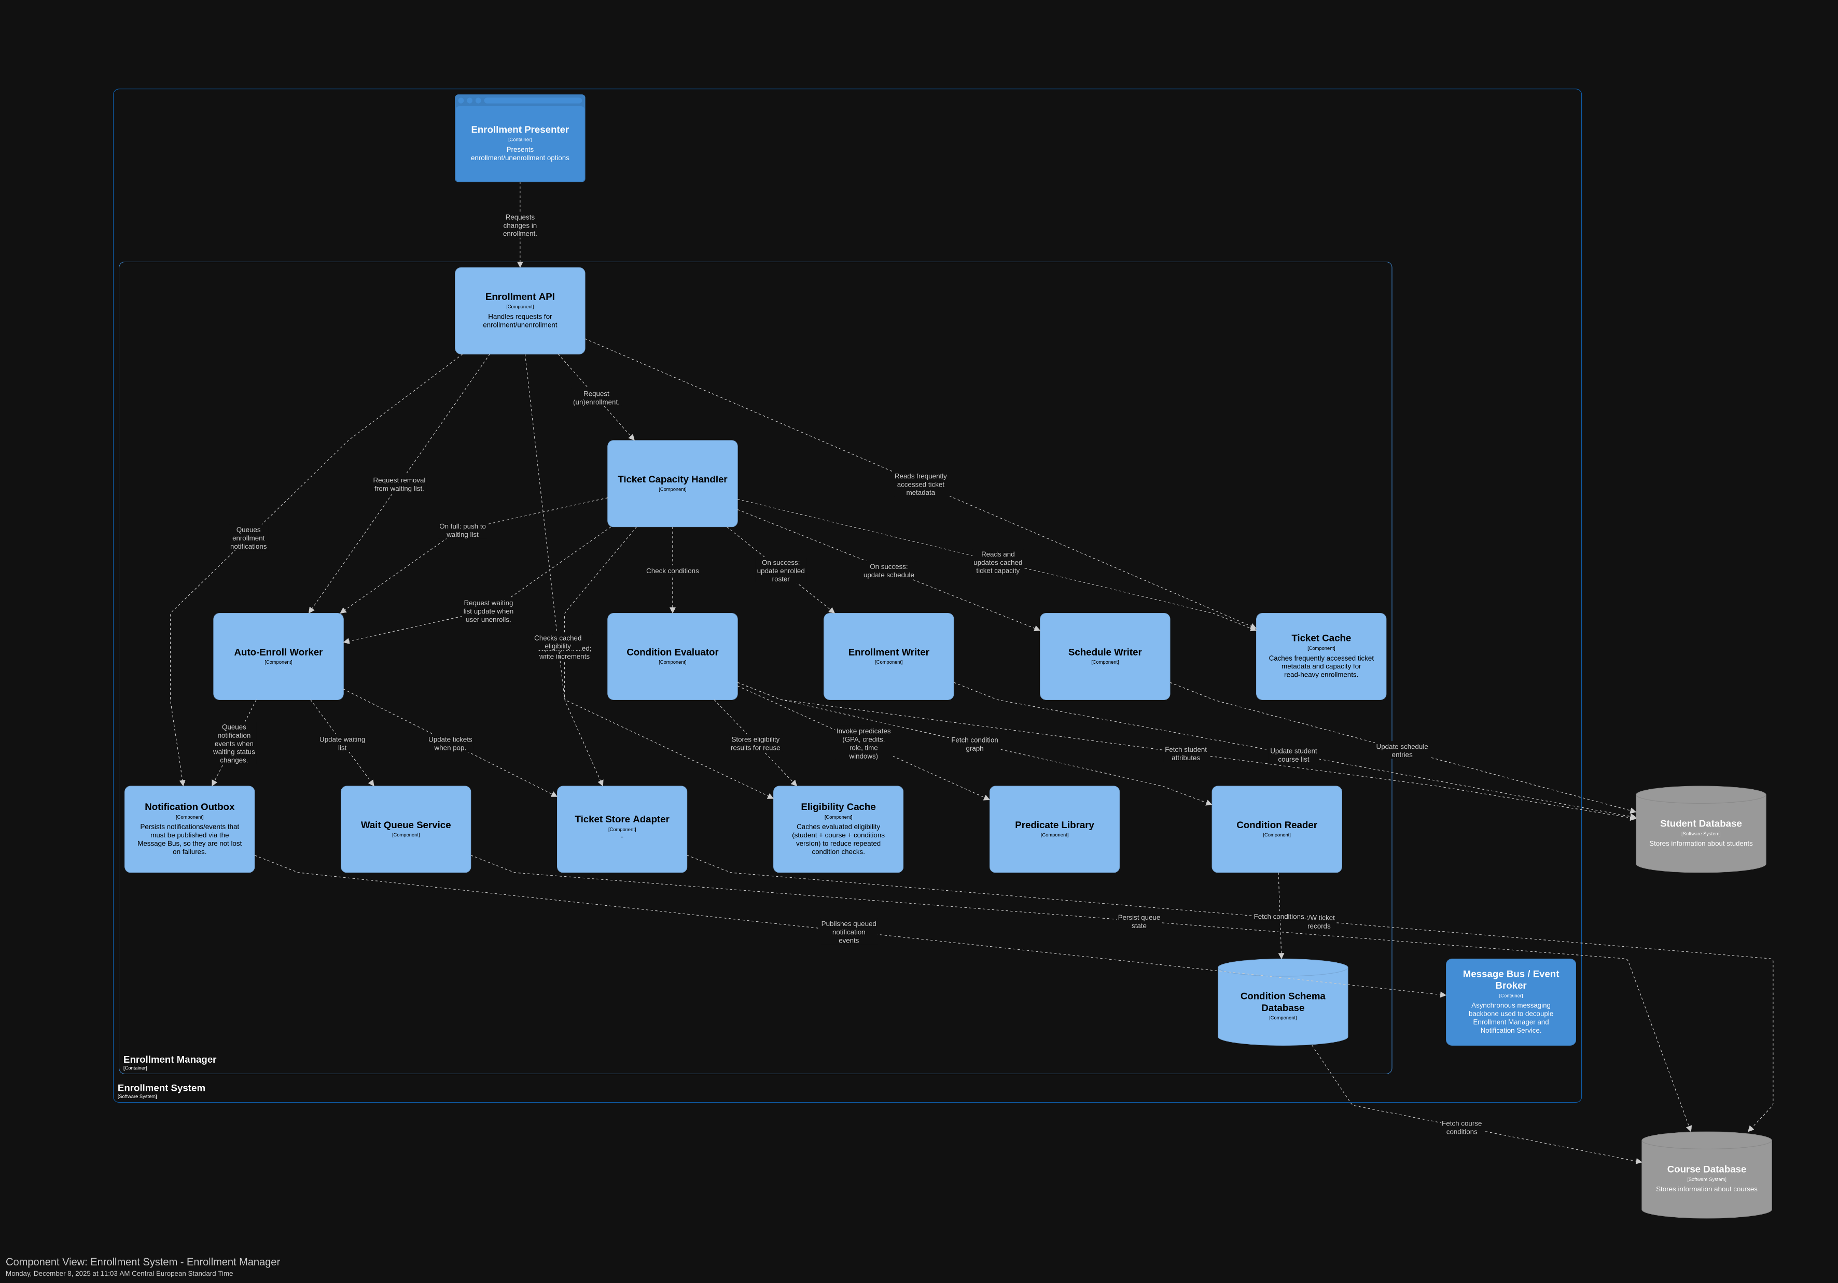
Scenario 3 - Reliability (Run-time)

Slide 9


Slide 10


Slide 13
Thank You For your attention

