Slide 1
Applied System Software Project
The Frenchies

Slide 2
Who we are
The Frenchies
7 members: each one took part in design, coding, and testing
https://github.com/TrysRelife/DIP392-TheFrenchies
https://youtu.be/oRFhfQNDgCU

Slide 3
Project Overview and Motivation
a visibility problem of the client
no digital presence
The website showcases his expertise for the clients
tested technical skills and our ability to understand real-world expectations

Slide 4
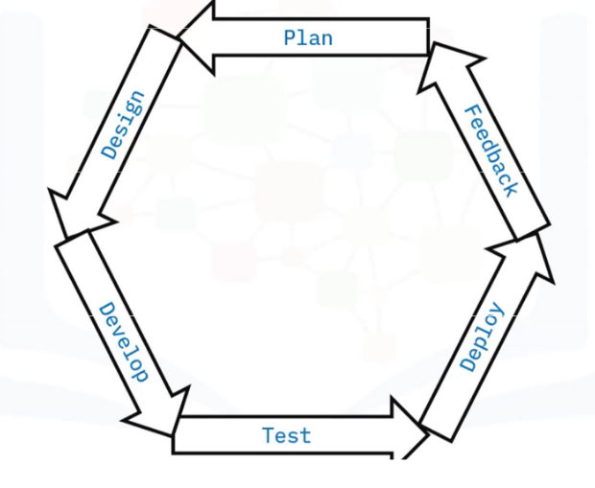
Chosen SDLC Methodology
Agile Method
Worked with feedback from the client
There wasn’t a very precise idea in our clients mind
Made it possible to adapt the website along the way

Slide 5
Requirements Gathering & Analysis
identified what features were essential
Display offered services
Contact informations
asked about
design inspirations
language
hosting preferences

Slide 6
Software Requirements Specification
Functional requirements
Display a hero section
List and describe tailored services
personal introduction
A way for the user to contact the client
Non functional
Clear, direct and readable
Responsivity
Fast to load
Adaptative
Feel premium

Slide 7
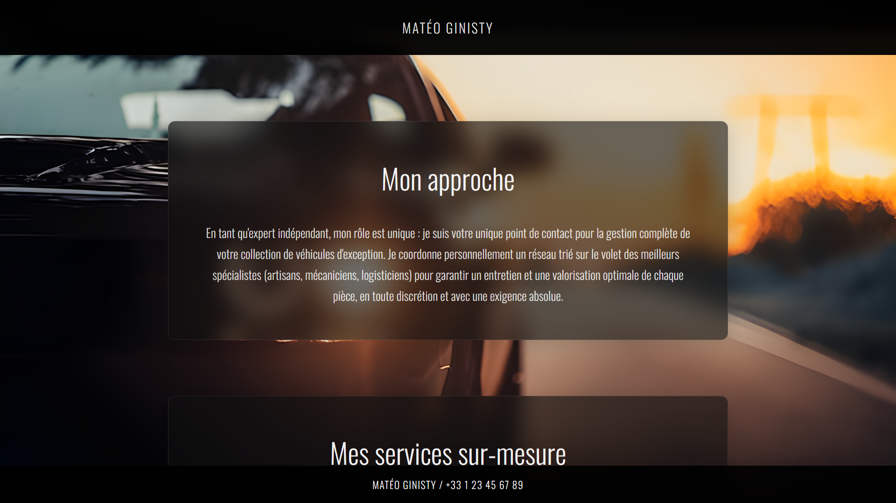
System and Software Design
We used to create a sense of luxury
Dark themes
Large fonts
Glassmorphism

Slide 8
Implementation Phase
Used
HTML CSS
JavaScript GitHub
Worked individually or by group of 2
We kept file structure clean, so anyone can understand

Slide 9
Testing Strategy
We tested
The animations
The contact form
Responsiveness
Compatibility

Slide 10

Test Results and Validation
All our tests passed
Client feedback was positive
Did not get a response for the most recent version

Slide 11
Process Reflection and Lessons Learned
Challenges were solved step-by-step
Learned
That it’s better to over-communicate than to assume
Importance of clear documentation and regular updates
JavaScript animation and responsive CSS

Slide 12
Demo Overview
https://trysrelife.github.io/DIP392-TheFrenchies/

Slide 13
Conclusion and Future Work
website met all project goals
site could be extended with
CMS
multilingual support
richer media galleries
taught us how to apply theory to practice

