Slide 1
Modern Intelligent Hand Prostheses
Tobias Stocker, Pascal Weiner and Tamim Asfour
Seminar: Humanoide Roboter, WS 2017/18

Slide 2
The Task
Research of modern intelligent hand prostheses of the last 2-3 years
Overview of the important properties
Design / structure
Kinematic / dynamic characteristics
Sensor feedback / embedded systems
Comparison of the prostheses
What do they have in common?
What are special features of the different hands?
Do they provide intelligent functions?

Slide 3
My previous work
Searching for papers with prosthetic hands
Summarizing the important information for each hand
Creating a table with important properties

Slide 4
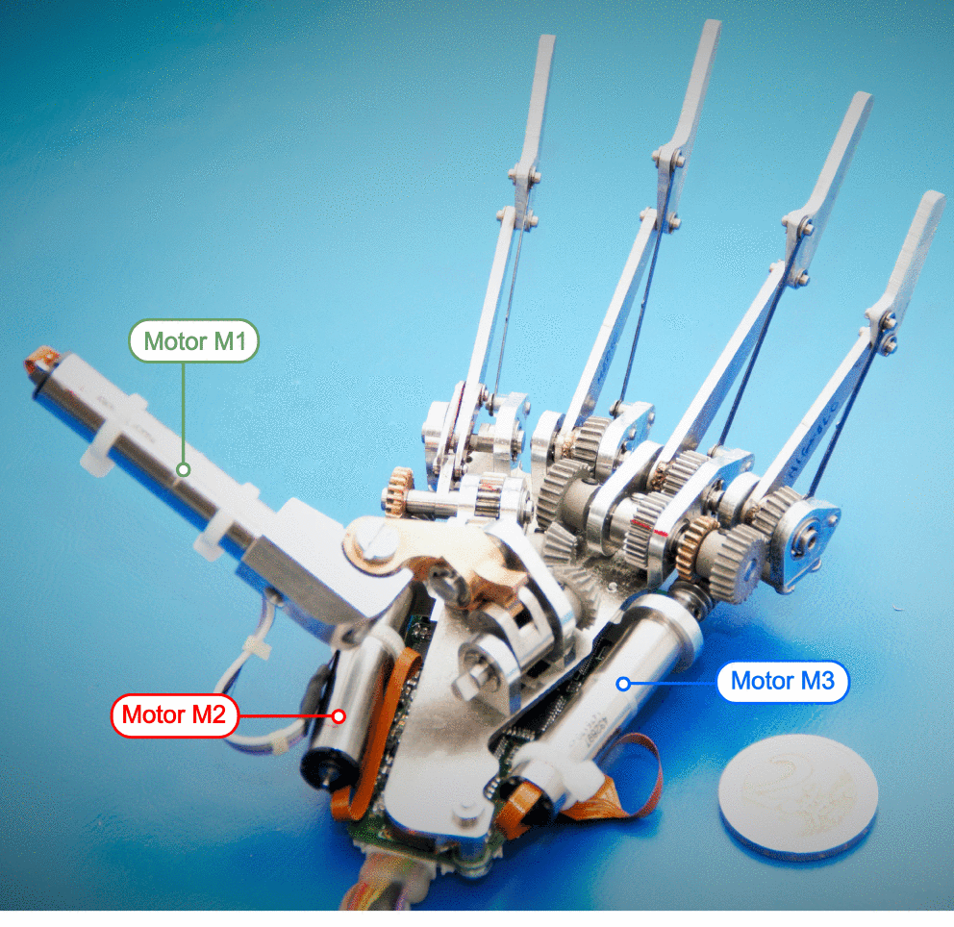
Example: SSSA-MyHand
Name | Developer | Year | Weight | Size | Joints | Actuators
MyHand | SSSA | 2016 | 478 g | 200x84x56 mm | 10 | 3
Name | Integrated Actuators | Transmission | Sensors | Finger Force | Joint Speed
MyHand | Yes | Geneva drive | Position / Force | 12-31N | 160-250°/s
[1] http://ieeexplore.ieee.org/abstract/document/7488269/
SSSA-MyHand [1]

Slide 5
My future work
Collecting more information about
Underactuation
Sensor feedback systems
Embedded systems
Comparison of the prostheses
Common properties / features
Unique features

