Slide 1
Modern Myoelectric Intelligent Hand Prostheses
Tobias Stocker (Advisor: Pascal Weiner)
Seminar: Humanoid Robotics, WS 2017/18

Slide 2
Outline
Motivation and Challenges
Overview of Hand Prostheses
Comparison of Hand Prostheses
Conclusion

Slide 3
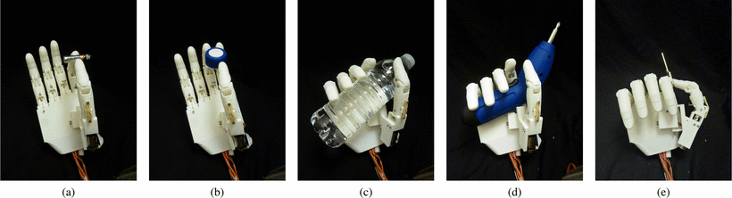
Motivation
Why myoelectric hand prostheses?
Make a normal life possible for amputees
Enable users to perform different grasps
for activities of daily living (ADLs)
Allow the user to control the hand through muscle contraction (with EMG)
Electric actuators are rather small, quiet and
have good precision and controllability

Slide 4
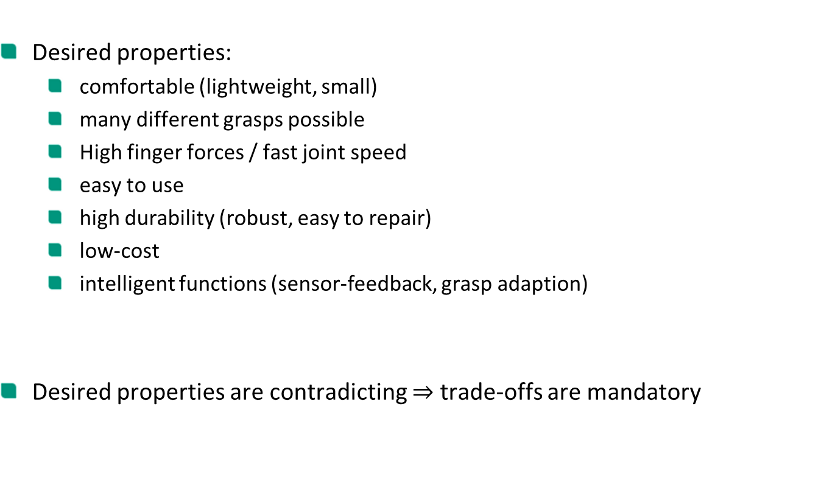
Motivation
Desired properties:
comfortable (lightweight, small)
many different grasps possible
High finger forces / fast joint speed
easy to use
high durability (robust, easy to repair)
low-cost
intelligent functions (sensor-feedback, grasp adaption)
Desired properties are contradicting $⇒$ trade-offs are mandatory

Slide 5
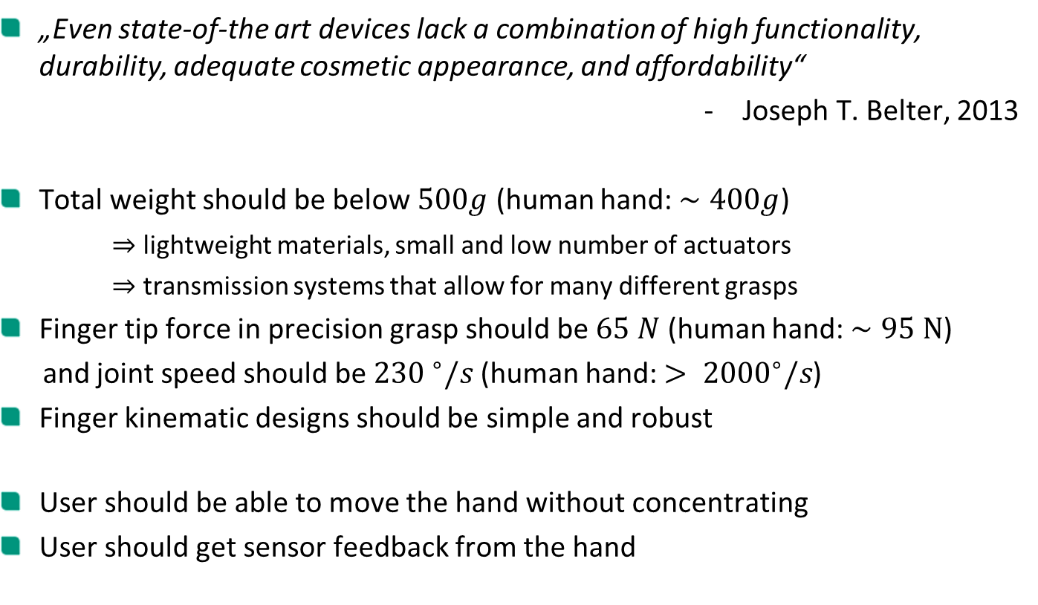
Challenges
„Even state-of-the art devices lack a combination of high functionality, durability, adequate cosmetic appearance, and affordability“
Joseph T. Belter, 2013
Total weight should be below $500g$ (human hand: $∼400g$)
$⇒$ lightweight materials, small and low number of actuators
$⇒$ transmission systems that allow for many different grasps
Finger tip force in precision grasp should be $65 N$ (human hand: $∼95 N$)
and joint speed should be ${230 }^{∘}/s$ (human hand: $> {2000}^{∘}/s$)
Finger kinematic designs should be simple and robust
User should be able to move the hand without concentrating
User should get sensor feedback from the hand

Slide 6
Outline
Motivation and Challenges
Overview of Hand Prostheses
Comparison of Hand Prostheses
Conclusion

Slide 7
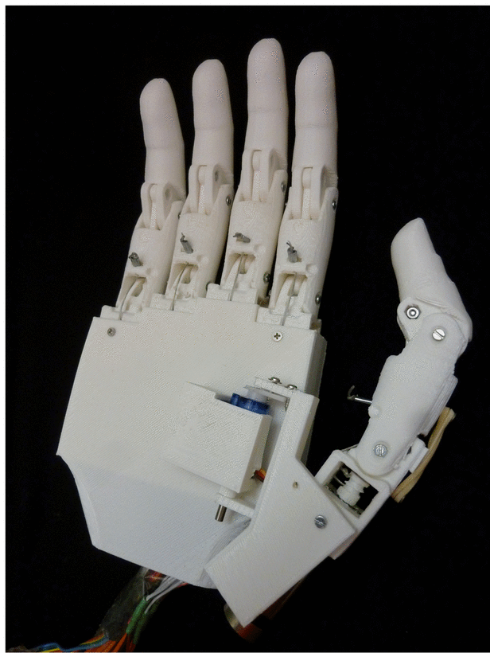
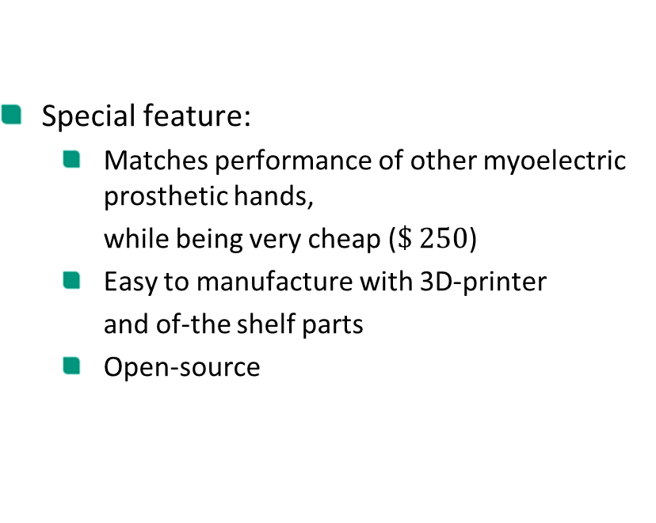

Tact
Year | Mass (g) | Joints | Actuators | Transmission
2015 | 350 | 11 | 6 | Tendons
Special feature:
Matches performance of other myoelectric prosthetic hands,
while being very cheap ($\$ 250$)
Easy to manufacture with 3D-printer
and of-the shelf parts
Open-source

Slide 8
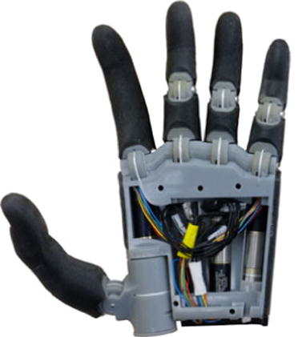
Hand of Bennett et al.
Year | Mass (g) | Joints | Actuators | Transmission
2015 | 546 | 12 | 4 | Tendons
Special feature:
Four motor units in unique configuration:
2 for thumb and 1 for index (fully actuated)
1 for other fingers (underactuated)
Embedded control system that enables
self-contained control of hand movement

Slide 9
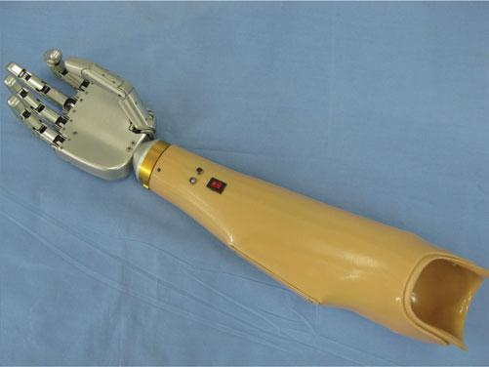
Hand of Zhang et al.
Year | Mass (g) | Joints | Actuators | Transmission
2015 | 420 | 15 | 5 | Linkage
Special feature:
Fingers are equipped with numerous
torque and position sensors
Integrated motion control system consisting of a motion control subsystem and several sensory subsystems
New concept for sensory feedback system
based on an electrical stimulator

Slide 10
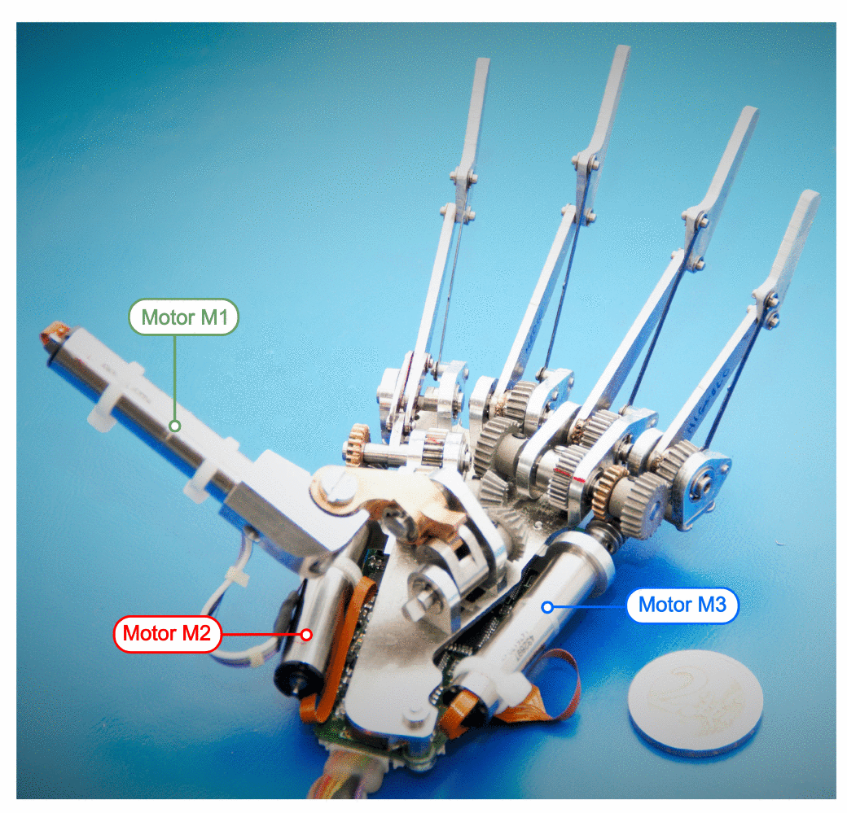
SSSA-MyHand
Year | Mass (g) | Joints | Actuators | Transmission
2016 | 478 | 10 | 3 | Four-bar, Geneva drive
Special feature:
Only three actuators
Abduction/adduction of the thumb and flexion/extension of the index with single actuator via Geneva drive
Embedded controller and sensory system with force/position sensors and automatic grasp control

Slide 11
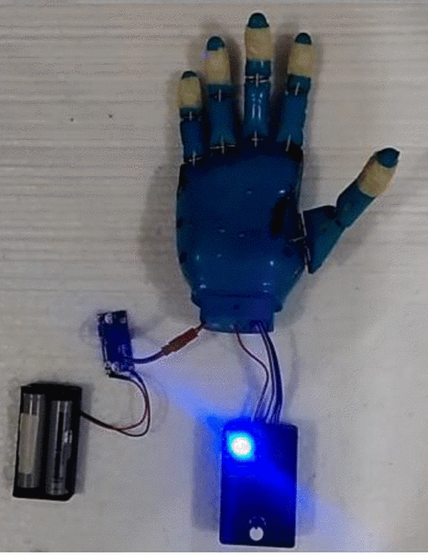
AstoHand v.1
Year | Mass (g) | Joints | Actuators | Transmission
2016 | 261 | 10 | 5 | Tendon-spring
Special feature:
Low-cost
Very lightweight
Built with 3D-printed material
(easy to manufacture and maintain)

Slide 12
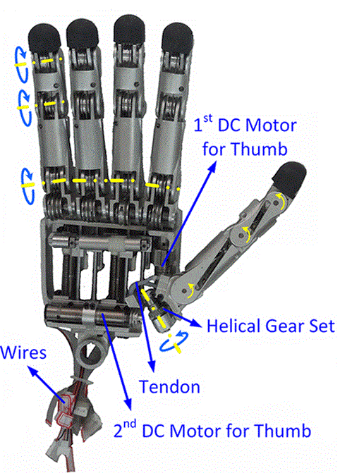
X-Hand
Year | Mass (g) | Joints | Actuators | Transmission
2016 | - | 16 | 4 | Tendons
Special feature:
Anthropomorphic grasping ability via special motion distribution mechanism structure
Can replicate almost all natural movement of the human hand while using few actuators

Slide 13
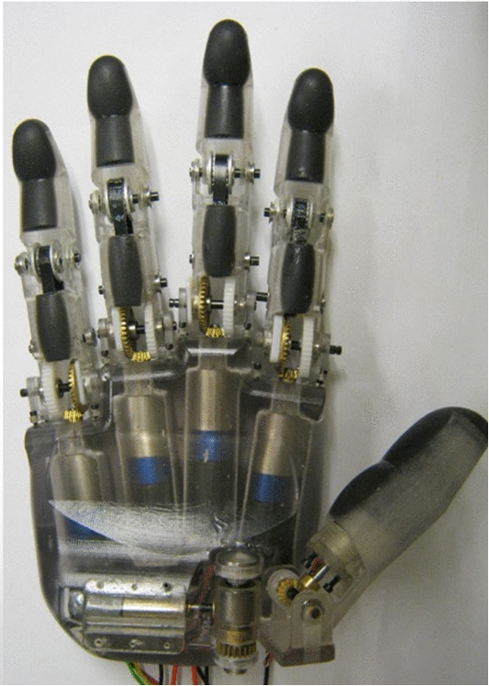
Six-DOF-Hand
Year | Mass (g) | Joints | Actuators | Transmission
2016 | 584 | 10 | 6 | Gears/Belts
Special feature:
Inexpensive
Open source
Independent finger movements
Actuators with encoders for motor position feedback

Slide 14
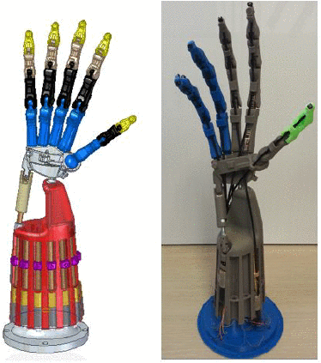
Bionic Hand
Year | Mass (g) | Joints | Actuators | Transmission
2016 | - | 19 | 13 | Tendons
Special feature:
Hybrid actuated with Brushless DC motors and Shape Memory Alloy (SMA)
Close replication of the human hand (with all structures, joints and tendons)
24 degrees of freedom

Slide 15
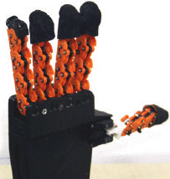
SoftHand Pro-D
Year | Mass (g) | Joints | Actuators | Transmission
2016 | - | 19 | 1 | Tendons
Special feature:
Strongly underactuated softhand
19 joints with only one single actuator
Can move along two different synergistic directions to perform either precision or power grasp
Decoding of movement intensions using the dynamic frequency content

Slide 16
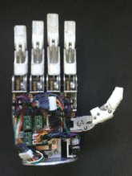
UOMPro
Year | Mass (g) | Joints | Actuators | Transmission
2017 | 432 | 10 | 6 | Four-bar
Special feature:
Simple serial communication interface to link with high-level control methods
The implemented low-level controller can handle individual finger position commands or hand grip pattern commands

Slide 17
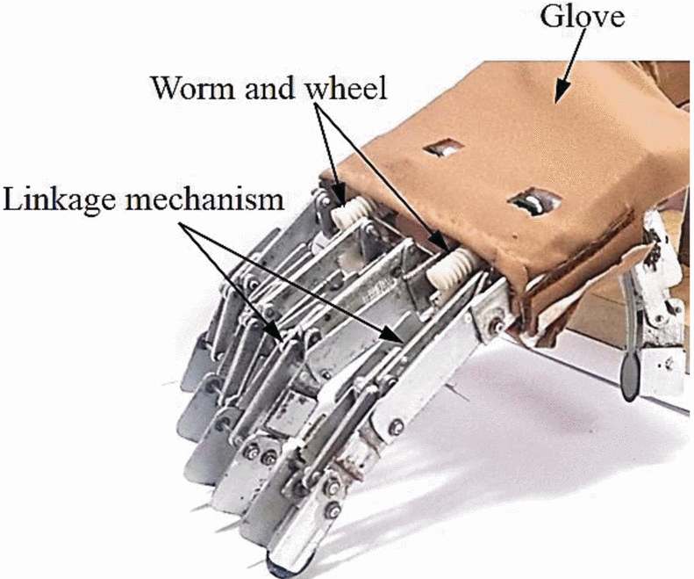
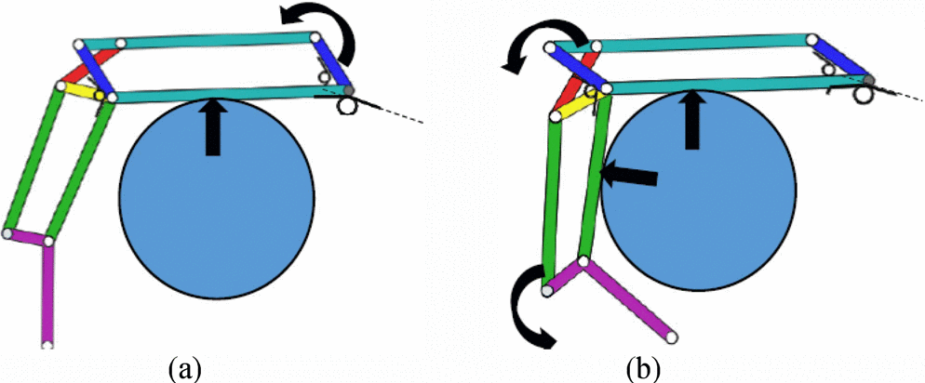
MORA Hap-2
Year | Mass (g) | Joints | Actuators | Transmission
2017 | 250 | 14 | 4 | Four-bar
Special feature:
Self-adaption ability
Finger mechanism is capable of generating passively different flexion/extension angles
Fingers have under-actuation mechanism

Slide 18
Outline
Motivation and Challenges
Overview of Hand Prostheses
Comparison of Hand Prostheses
Conclusion

Slide 19
Physical properties
Name | Weight (g) | Size (length x width x thickness in mm)
Tact | 350 | 200 x 98 x 27
Hand of Bennett et al. | 546 | 200 x 89 x -
Hand of Zhang et al. | 420 | 159 x 79 x 21
MyHand | 478 | 200 x 84 x 56
AstoHand v.1 | 261 | 180 x 85 x 50
X-Hand | - | Human hand size
Six-DOF-Hand | 584 | 202 x 99 x 61
Bionic Hand | - | -
SoftHand Pro-D | - | -
UOMPro | 432 | 189 x 88 x -
MORA Hap-2 | 250 | 95 (fingers) x 83 x 25

Slide 20
Finger Kinematics
Name | Number of Joints | Joints per Finger
 |  | Thumb | Index | Others
Tact | 11 | 3 | 2 | 2
Hand of Bennett et al. | 12 | 3 | 3 | 2
Hand of Zhang et al. | 15 | 3 | 3 | 3
MyHand | 10 | 2 | 2 | 2
AstoHand v.1 | 10 | 2 | 2 | 2
X-Hand | 16 | 4 | 3 | 3
Six-DOF-Hand | 10 | 2 | 2 | 2
Bionic Hand | 19 | 3 | 4 | 4
SoftHand Pro-D | 19 | 3 | 4 | 4
UOMPro | 10 | 2 | 2 | 2
MORA Hap-2 | 14 | 2 | 3 | 3

Slide 21
Actuation and Transmission
Name | Actuators | Transmission system
Tact | 6 | Four-bar linkage, Geneva drive
Hand of Bennett et al. | 4 | Tendons
Hand of Zhang et al. | 5 | Tendons
MyHand | 3 | Tendons
AstoHand v.1 | 5 | Tendons
X-Hand | 4 | Tendons
Six-DOF-Hand | 6 | Gears / Belts
Bionic Hand | 13 | Tendons
SoftHand Pro-D | 1 | Tendons
UOMPro | 6 | Four-bar linkage
MORA Hap-2 | 4 | Four-bar linkage

Slide 22
Grasping
Most of the hands are capable of performing the known grasping patterns:
Power grasp (Cylindrical grasp)
Precision grasp (Pinch grasp)
Lateral grasp
Hook grasp
The MORA Hap-2 is mainly developed for power and hook grasp
The SoftHand Pro-D with its single actuator can perform power and precision grasps

Slide 23
Dynamics

Slide 24
Outline
Motivation and Challenges
Overview of Hand Prostheses
Comparison of Hand Prostheses
Conclusion

Slide 25
Conclusion
Most research groups focused mainly on one important feature in their hand design
The main goal was to develop preferably low-cost protheses
Only a few tried to incorporate intelligent functions

