Slide 1
Modern Myoelectric Intelligent Hand Prostheses
Tobias Stocker (Advisor: Pascal Weiner)
Seminar: Humanoid Robotics, WS 2017/18

Slide 2
Outline
Motivation and Challenges
Overview of Hand Prostheses
Comparison of Hand Prostheses
Conclusion

Slide 3
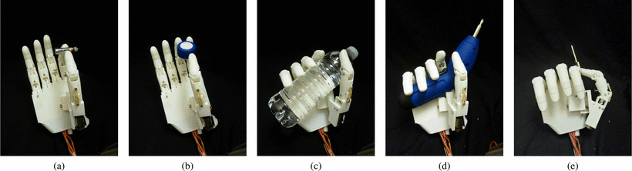
Motivation
Why myoelectric hand prostheses?
Make a normal life possible for amputees
Enable users to perform different grasps
for activities of daily living (ADLs)
Allow the user to control the hand through muscle contraction (with EMG)
Electric actuators are rather small, quiet and
have good precision and controllability

Slide 4
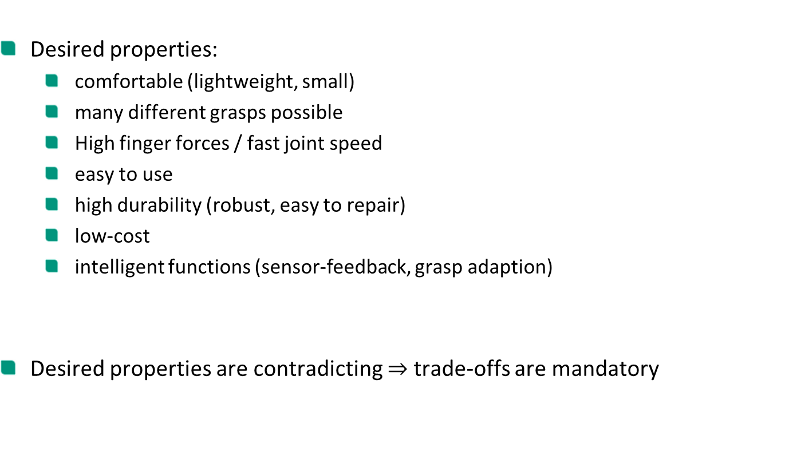
Motivation
Desired properties:
comfortable (lightweight, small)
many different grasps possible
High finger forces / fast joint speed
easy to use
high durability (robust, easy to repair)
low-cost
intelligent functions (sensor-feedback, grasp adaption)
Desired properties are contradicting $⇒$ trade-offs are mandatory

Slide 5
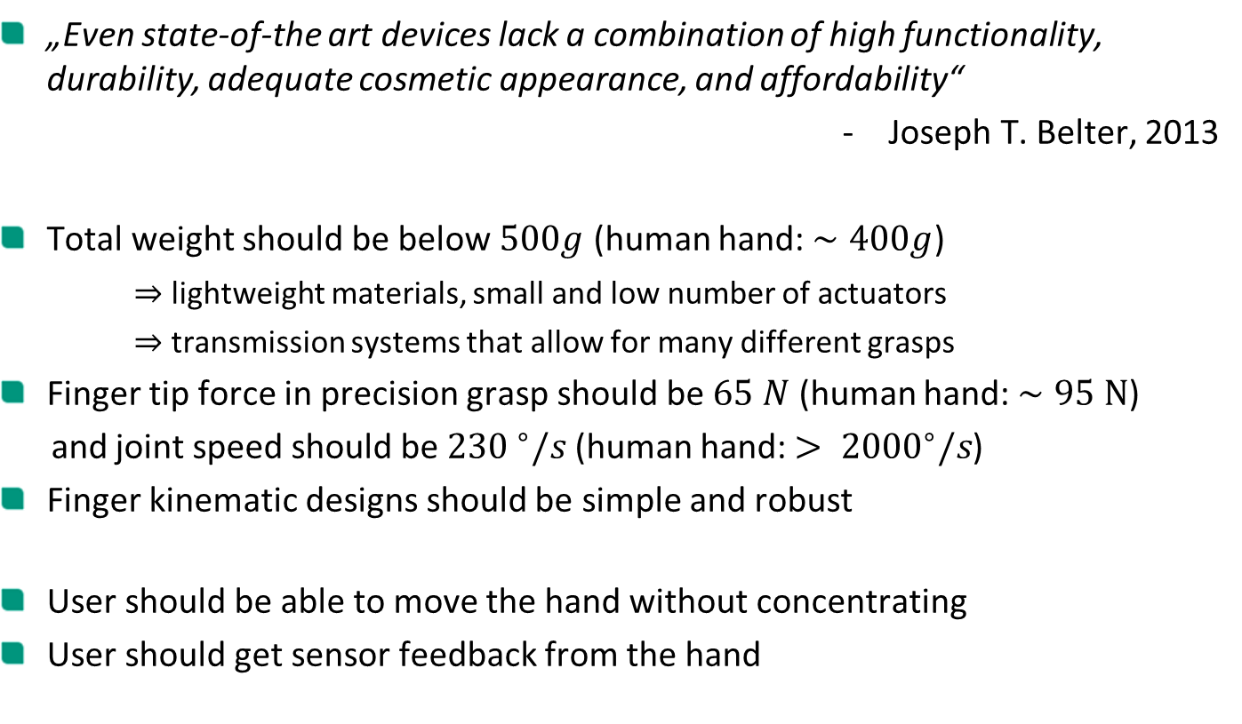
Challenges
„Even state-of-the art devices lack a combination of high functionality, durability, adequate cosmetic appearance, and affordability“
Joseph T. Belter, 2013
Total weight should be below $500g$ (human hand: $∼400g$)
$⇒$ lightweight materials, small and low number of actuators
$⇒$ transmission systems that allow for many different grasps
Finger tip force in precision grasp should be $65 N$ (human hand: $∼95 N$)
and joint speed should be ${230 }^{∘}/s$ (human hand: $> {2000}^{∘}/s$)
Finger kinematic designs should be simple and robust
User should be able to move the hand without concentrating
User should get sensor feedback from the hand

Slide 6
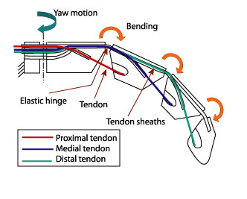
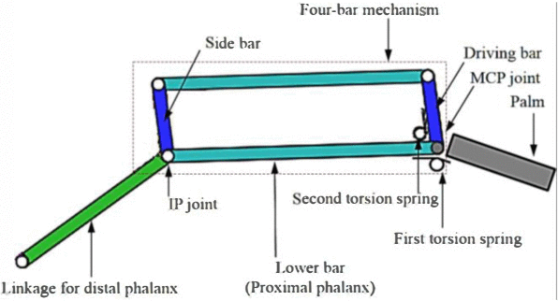
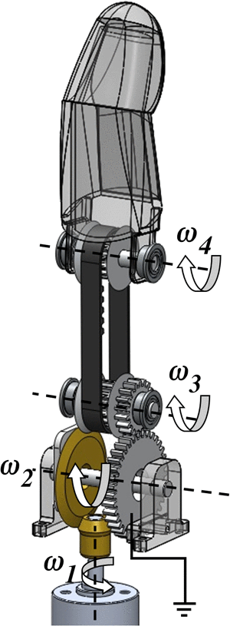

Transmission systems
Tendons
Four-bar linkage
Gears/belts

Slide 7
Outline
Motivation and Challenges
Overview of Hand Prostheses
Comparison of Hand Prostheses
Conclusion

Slide 8
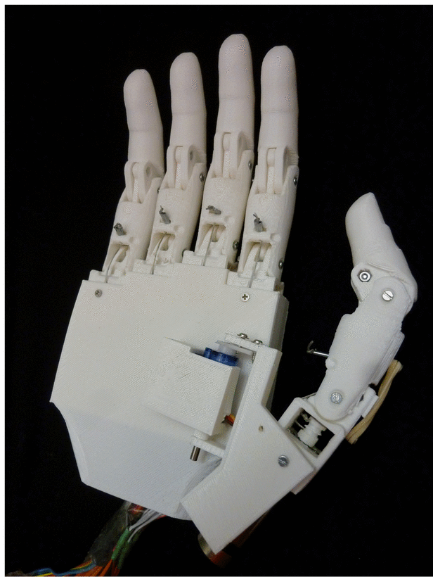
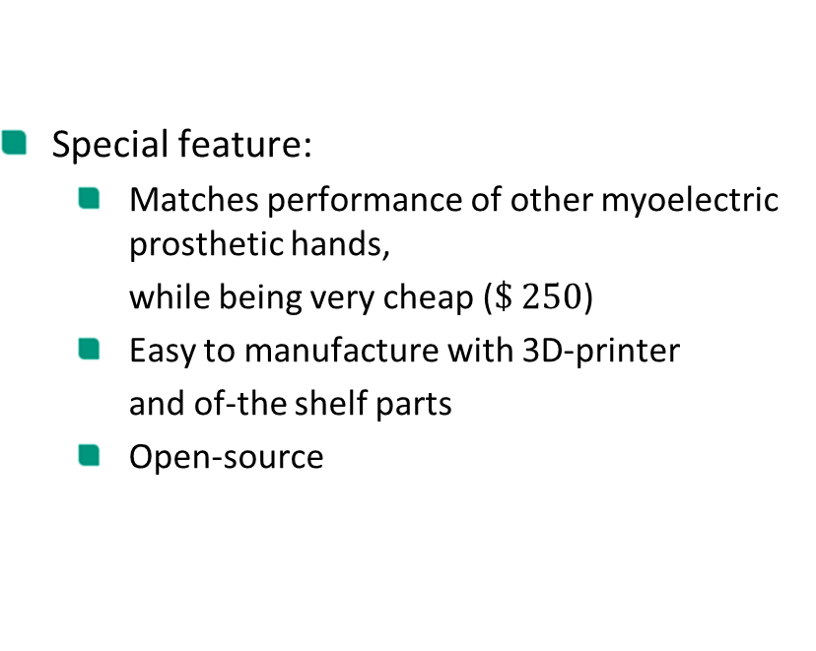
Tact
Year | Mass (g) | Joints | DoF | Actuators | Transmission
2015 | 350 | 11 | 6 | 6 | Four-bar linkage
Special feature:
Matches performance of other myoelectric prosthetic hands,
while being very cheap ($\$ 250$)
Easy to manufacture with 3D-printer
and of-the shelf parts
Open-source

Slide 9
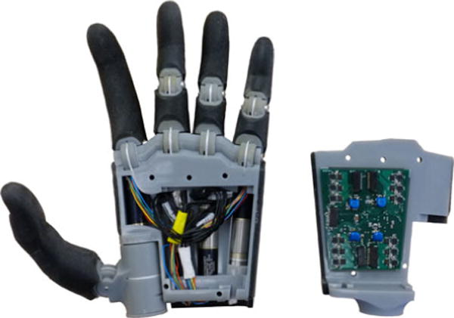
Hand of Bennett et al.
Year | Mass (g) | Joints | DoF | Actuators | Transmission
2015 | 546 | 12 | 12 | 4 | Tendons
Special feature:
Four motor units in unique configuration:
2 for thumb and 1 for index (fully actuated)
1 for other fingers (underactuated)
Embedded control system that enables
self-contained control of hand movement

Slide 10
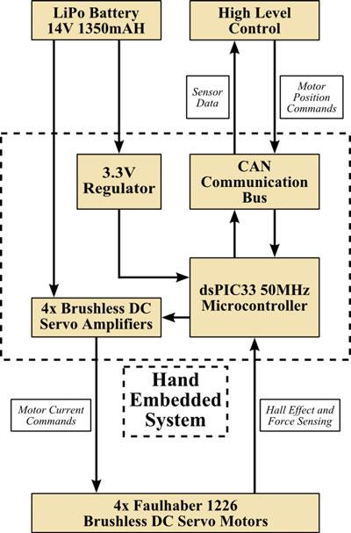
Hand of Bennett et al.
Embedded system:
Consists of a single , four-layer circuit board
Accepts and executes motion/force commands from a high-level controller
Returns processed position/force information

Slide 11
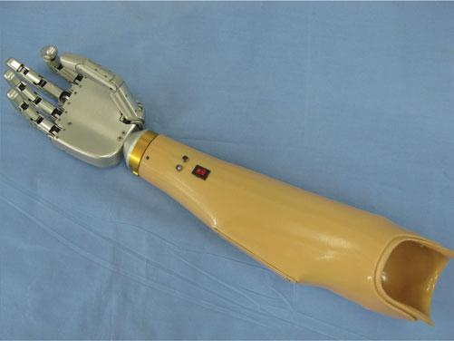
Hand of Zhang et al.
Year | Mass (g) | Joints | DoF | Actuators | Transmission
2015 | 420 | 15 | 5 | 5 | Four-bar linkage
Special feature:
Fingers are equipped with numerous
torque and position sensors
Integrated motion control system consisting of a motion control subsystem and several sensory subsystems
New concept for sensory feedback system
based on an electrical stimulator

Slide 12
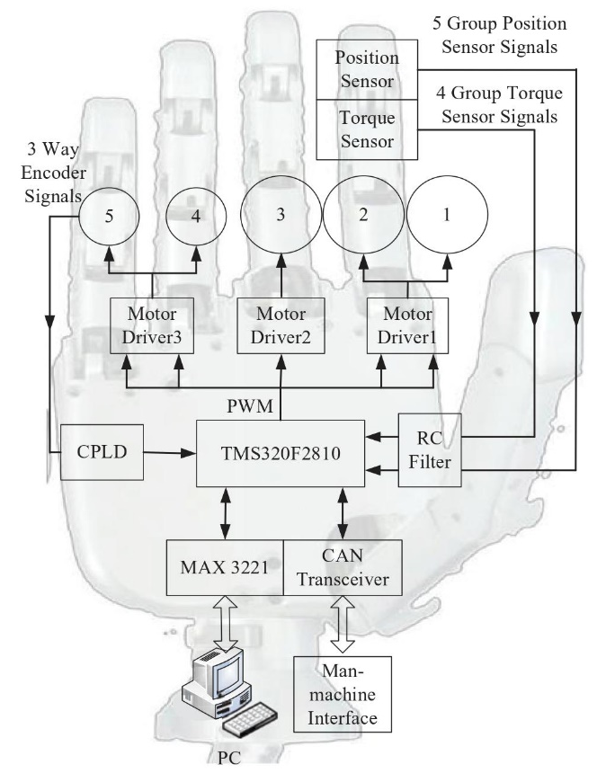
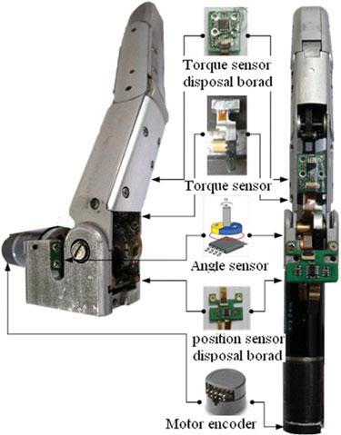
Hand of Zhang et al.
Sensor system:
Equipped with 18 proprioceptive and exteroceptive sensors
Embedded system:
Consists of a motion control subsystem and several sensory subsystems

Slide 13
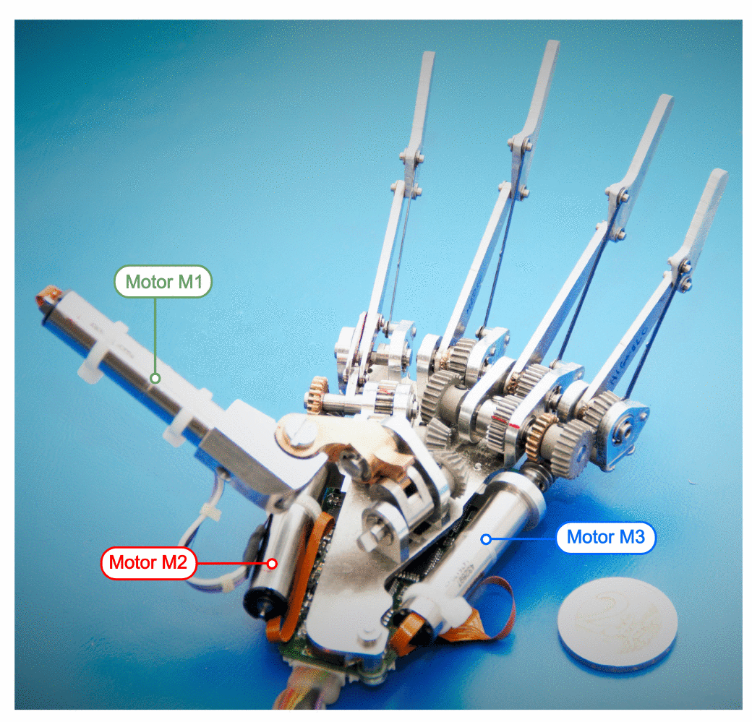
SSSA-MyHand
Year | Mass (g) | Joints | DoF | Actuators | Transmission
2016 | 478 | 10 | 4 | 3 | Four-bar linkage, Geneva drive
Special feature:
Only three actuators
Abduction/adduction of the thumb and flexion/extension of the index with single actuator via Geneva drive
Embedded controller and sensory system with force/position sensors and automatic grasp control

Slide 14
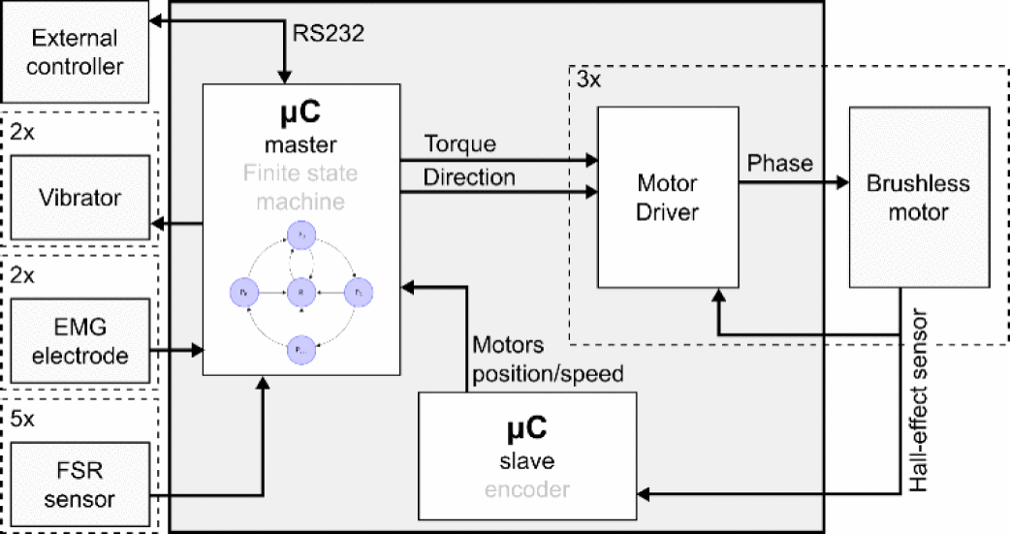
SSSA-MyHand
Embedded system:
Master-slave configuration based on a pair of 8-bit microcontrollers
Supports:
Identification of external commands
Implementation of automatic motor functions
Real time processing of the internal sensors
Potential delivery of sensory feedback

Slide 15
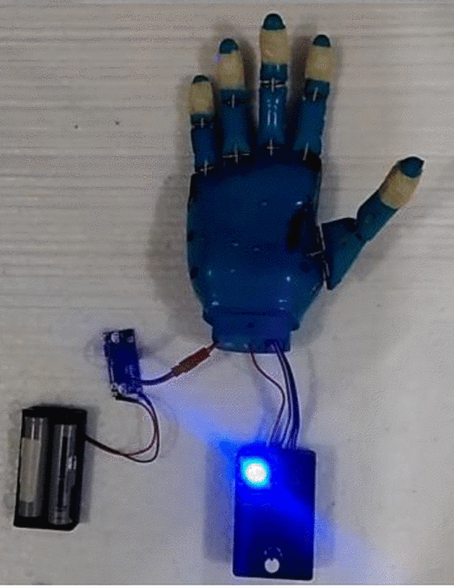
AstoHand v.1
Year | Mass (g) | Joints | DoF | Actuators | Transmission
2016 | 261 | 10 | 5 | 5 | Tendons
Special feature:
Low-cost
Very lightweight
Built with 3D-printed material
(easy to manufacture and maintain)
Embedded system:
Arduino Nano microcontroller
Control algorithm developed in Simulink
Digital input is used for selecting one of seven grip patterns

Slide 16
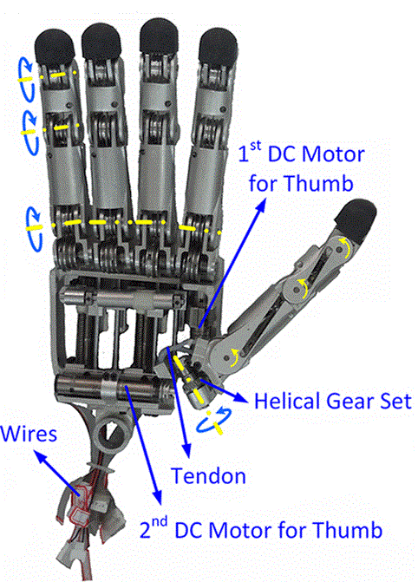
X-Hand
Year | Mass (g) | Joints | DoF | Actuators | Transmission
2016 | - | 16 | 4 | 4 | Tendons
Special feature:
Anthropomorphic grasping ability via special motion distribution mechanism structure
Can replicate almost all natural movement of the human hand while using few actuators

Slide 17
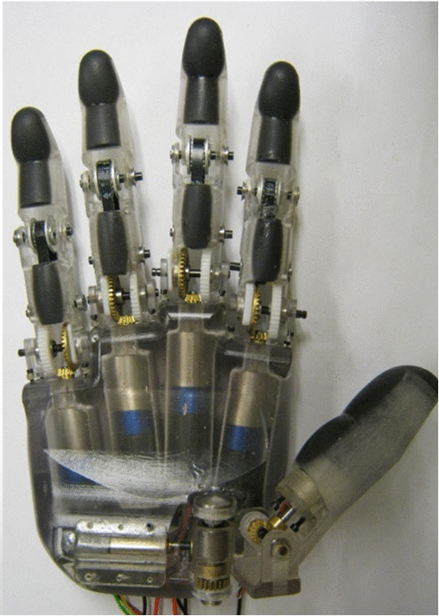
Six-DOF-Hand
Year | Mass (g) | Joints | DoF | Actuators | Transmission
2016 | 584 | 10 | 6 | 6 | Gears/Belts
Special feature:
Inexpensive
Open source
Independent finger movements
Actuators with encoders for motor position feedback

Slide 18
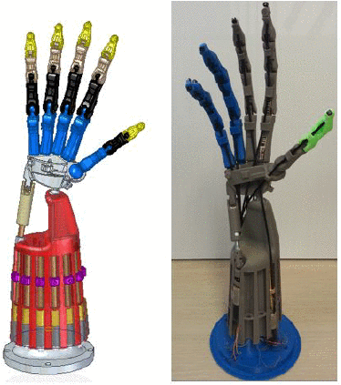
Bionic Hand
Year | Mass (g) | Joints | DoF | Actuators | Transmission
2016 | - | 24 | 24 | 13 | Tendons
Special feature:
Hybrid actuated with Brushless DC motors and Shape Memory Alloy (SMA)
Close replication of the human hand (with all structures, joints and tendons)
24 degrees of freedom

Slide 19
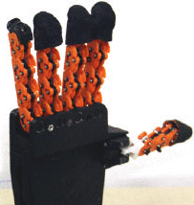
SoftHand Pro-D
Year | Mass (g) | Joints | DoF | Actuators | Transmission
2016 | - | 19 | 19 | 1 | Tendons
Special feature:
Strongly underactuated softhand
19 joints with only one single actuator
Can move along two different synergistic directions to perform either precision or power grasp
Decoding of movement intensions using the dynamic frequency content

Slide 20
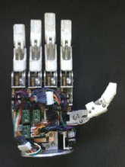
UOMPro
Year | Mass (g) | Joints | DoF | Actuators | Transmission
2017 | 432 | 10 | 6 | 6 | Four-bar linkage
Special feature:
Simple serial communication interface to link with high-level control methods
The implemented low-level controller can handle individual finger position commands or hand grip pattern commands

Slide 21
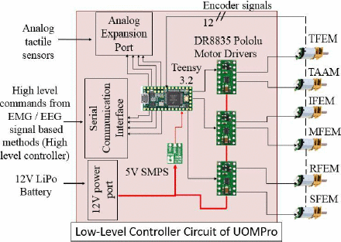
UOMPro
Embedded system:
Low-level controller for close loop control of the motors using various control techniques
High-level controller to identify the motion intention

Slide 22
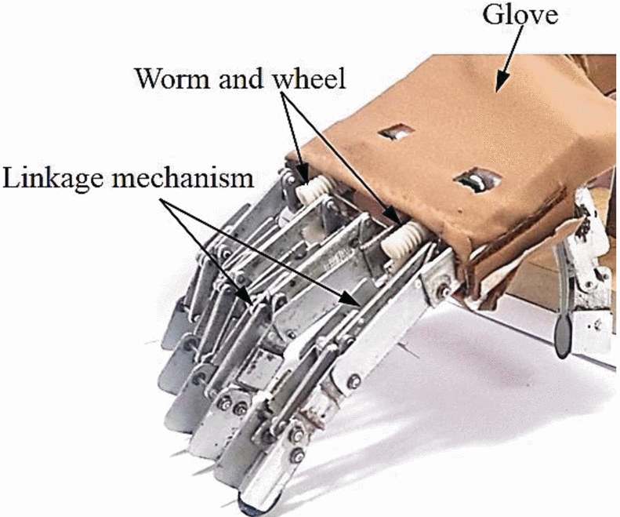
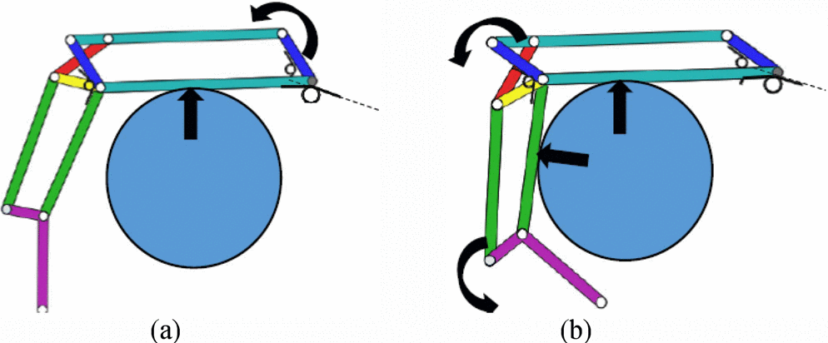
MORA Hap-2
Year | Mass (g) | Joints | DoF | Actuators | Transmission
2017 | 250 | 14 | 11 | 4 | Four-bar linkage
Special feature:
Self-adaption ability
Finger mechanism is capable of generating passively different flexion/extension angles
Fingers have under-actuation mechanism

Slide 23
Outline
Motivation and Challenges
Overview of Hand Prostheses
Comparison of Hand Prostheses
Conclusion

Slide 24
Physical properties
Name | Weight (g) | Size (length x width x thickness in mm)
Tact | 350 | 200 x 98 x 27
Hand of Bennett et al. | 546 | 200 x 89 x -
Hand of Zhang et al. | 420 | 159 x 79 x 21
MyHand | 478 | 200 x 84 x 56
AstoHand v.1 | 261 | 180 x 85 x 50
X-Hand | - | Human hand size
Six-DOF-Hand | 584 | 202 x 99 x 61
Bionic Hand | - | -
SoftHand Pro-D | - | -
UOMPro | 432 | 189 x 88 x -
MORA Hap-2 | 250 | 95 (fingers) x 83 x 25

Slide 25
Finger Kinematics
Name | Number of Joints | Joints per Finger
 |  | Thumb | Index | Others
Tact | 11 | 3 | 2 | 2
Hand of Bennett et al. | 12 | 3 | 3 | 2
Hand of Zhang et al. | 15 | 3 | 3 | 3
MyHand | 10 | 2 | 2 | 2
AstoHand v.1 | 10 | 2 | 2 | 2
X-Hand | 16 | 4 | 3 | 3
Six-DOF-Hand | 10 | 2 | 2 | 2
Bionic Hand | 24 | 3 | 4 | 4
SoftHand Pro-D | 19 | 3 | 4 | 4
UOMPro | 10 | 2 | 2 | 2
MORA Hap-2 | 14 | 2 | 3 | 3

Slide 26
Actuation and Transmission
Name | Actuators | Transmission system
Tact | 6 | Four-bar linkage
Hand of Bennett et al. | 4 | Tendons
Hand of Zhang et al. | 5 | Four-bar linkage
MyHand | 3 | Four-bar linkage, Geneva drive
AstoHand v.1 | 5 | Tendons
X-Hand | 4 | Tendons
Six-DOF-Hand | 6 | Gears / Belts
Bionic Hand | 13 | Tendons
SoftHand Pro-D | 1 | Tendons
UOMPro | 6 | Four-bar linkage
MORA Hap-2 | 4 | Four-bar linkage

Slide 27
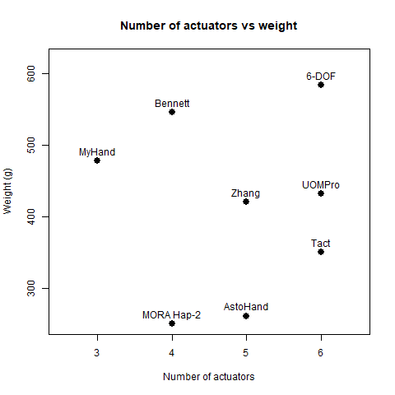
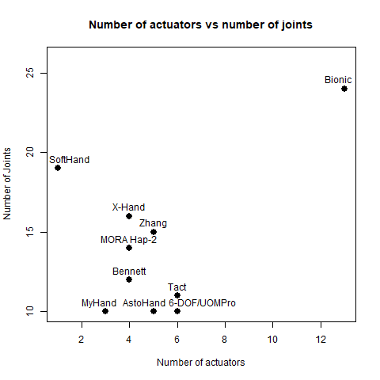
Comparison

Slide 28
Grasping
Most of the hands are capable of performing the known grasping patterns:
Power grasp (Cylindrical grasp)
Precision grasp (Pinch grasp)
Lateral grasp
Hook grasp
The MORA Hap-2 is mainly developed for power and hook grasp
The SoftHand Pro-D with its single actuator can perform power and precision grasps

Slide 29
Dynamics
Name | Individual Finger Force | Joint Speed
Tact | 4.2 N | 250 °/s
Hand of Bennett et al. | 25-30 N | -
Hand of Zhang et al. | 4.3-10 N | 68-118 °/s
MyHand | 12-31 N | 160-250 °/s
AstoHand v.1 | - | -
X-Hand | - | -
Six-DOF-Hand | 4.1 N | 128 °/s
Bionic Hand |  | -
SoftHand Pro-D | - | -
UOMPro | - | -
MORA Hap-2 | - | -

Slide 30
Outline
Motivation and Challenges
Overview of Hand Prostheses
Comparison of Hand Prostheses
Conclusion

Slide 31
Conclusion
There are still a lot of open problems in designing myoelectric hand prostheses
Many research groups develop prosthetic hands with new features
The main goal in the last years was to develop preferably low-cost protheses
Most research groups currently focus mainly on one novel design approach in their hand design
Only a few groups tried to incorporate intelligent functions

Slide 32
Thank you for your attention!

