Slide 1
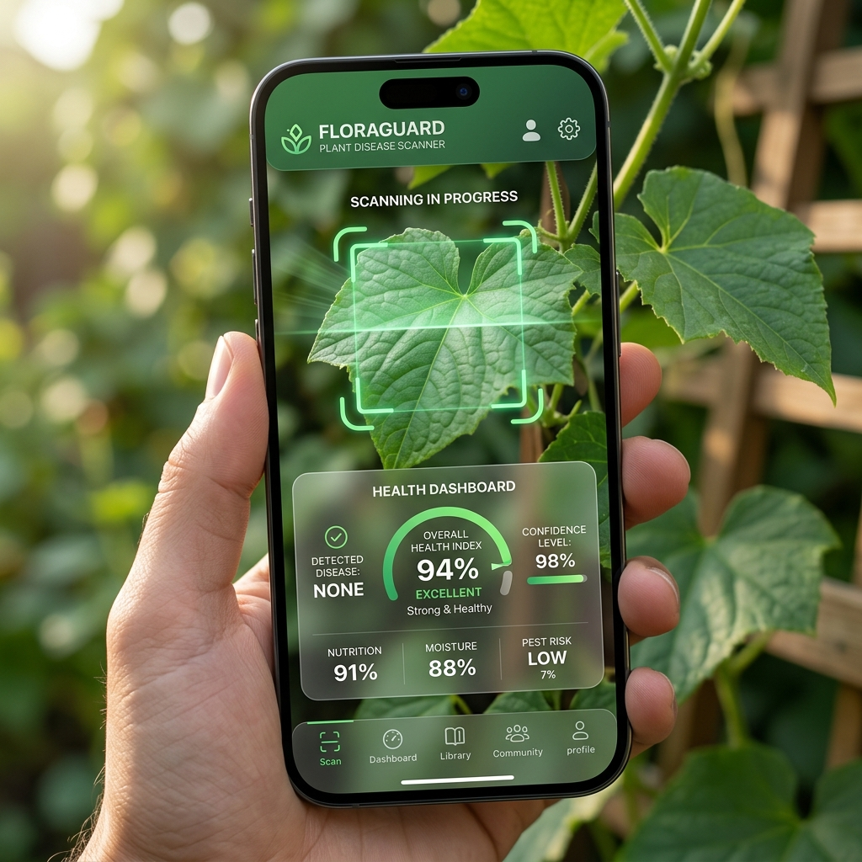
FARMTIME
AI-Powered Sustainable Farming Companion
• Empowering farmers with Gemini Multimodal Vision & ZBNF Solutions • Designed from the perspective of an Agriculture Officer, Farmer, and Senior Developer
Notes:
Good day everyone. Today, I am presenting 'Farmtime', a digital companion application for sustainable agriculture. Built from the combined perspective of an agricultural officer, a local farmer, and a senior app developer, Farmtime bridges the gap between digital diagnostics and organic natural cures, helping farmers save yields and reduce input costs.

Slide 2

Languages Used & The AI Core
Front-End Languages & Stack:
• React JS: Component state management and fluid UI updates.
• Vite Builder: Rapid compiler for zero compilation latency.
• Vanilla CSS: Custom variables (HSL), glassmorphism styles, and responsive grids.
• Lucide-React: Clean vector control and navigation icons.
The Gemini AI Core:
• Gemini Multimodal Vision API: Powers disease detection.
• Visual Analysis: Farm photos are sent directly to the model using a Gemini API key.
• Diagnosis & Curing: Gemini evaluates symptoms (spots, mildew) and outputs precise organic remedies.
Notes:
On Slide 2, we look at the stack. We're using standard React-Vite and Vanilla CSS for maximum efficiency. The core AI disease detection utilizes a Gemini API key. When a farmer takes a photo of a sick leaf, the image is analyzed by Gemini's Multimodal Vision model, which diagnoses the visual symptoms and returns organic ZBNF remedies.

Slide 3
App Overview & Onboarding
Key Navigation Features:
• Agro-Dashboard: Dynamic welcome greetings and quick actions.
• Live Sensor Widget: Simulated relative humidity, wind speed, solar index, and moisture readings.
• Live Advisories: Banners warn growers about blight risks under humid conditions.
• Theme Toggle: Dark/light theme support for field use in bright sunlight or at night.
Notes:
Looking at Slide 3, we have the user onboarding overview. The dashboard provides quick access to all functions. It features live weather data and alerts. If humidity rises above critical limits, the system warns the farmer about fungal risks so they can act preventively. The responsive layout has dark mode for late-night farm checks.

Slide 4
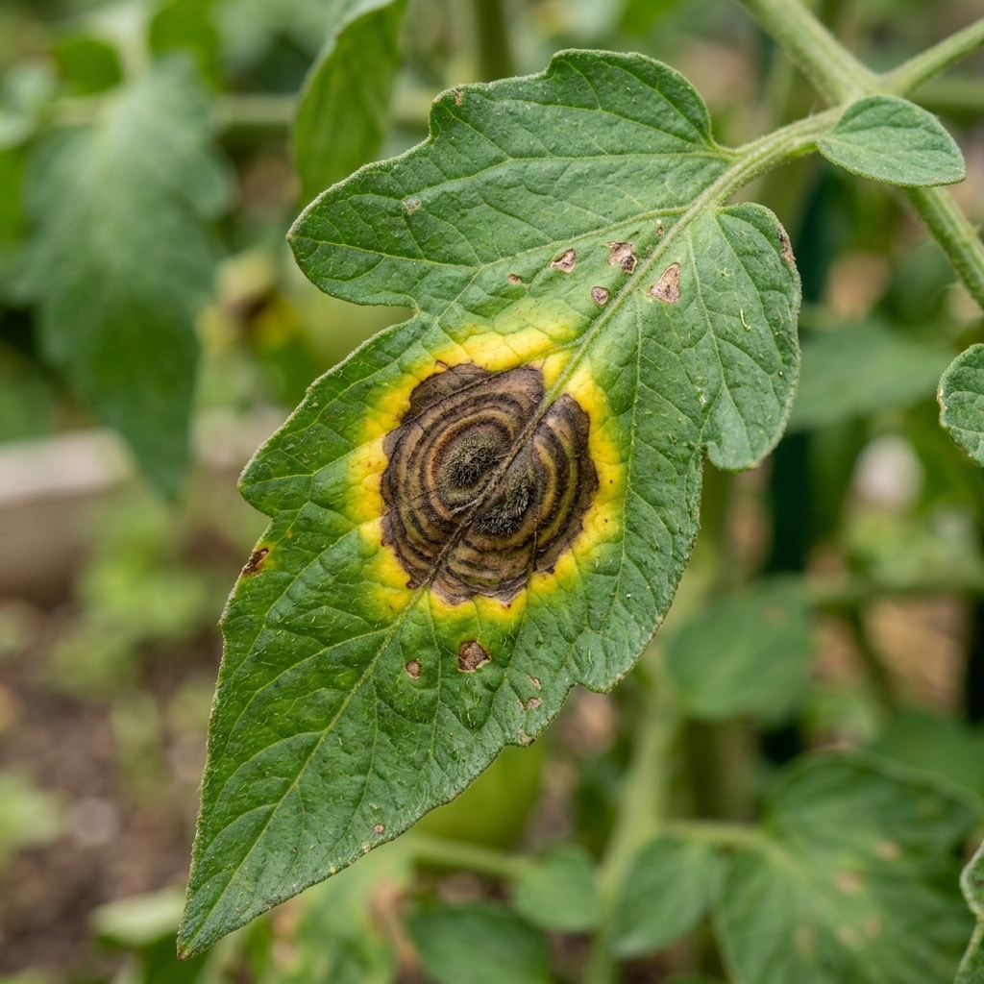
How to Scan & Detect Diseases
Step-by-Step Diagnostic Steps:
• Step 1: Select the crop type (Tomato, Potato, Grape, Rice, etc.).
• Step 2: Snap a live photo using the device camera or drag and drop a file.
• Step 3: Canvas Spectrometry analyzes healthy green, chlorosis, and necrosis.
• Step 4: Metrics are submitted to the Gemini Multimodal API for diagnosis.
• Step 5: The app renders symptoms, organic remedies (buttermilk, neem), and chemical warnings.
Notes:
Now on Slide 4, let's look at the scanning process. The farmer takes a photo of an affected leaf, selects the crop, and submits. The canvas runs a color pigment spectrometry, highlighting chlorosis and necrosis. The Gemini API analyzes this data, diagnosing the disease and giving organic recipes (like sour buttermilk spray) and chemical options.

Slide 5
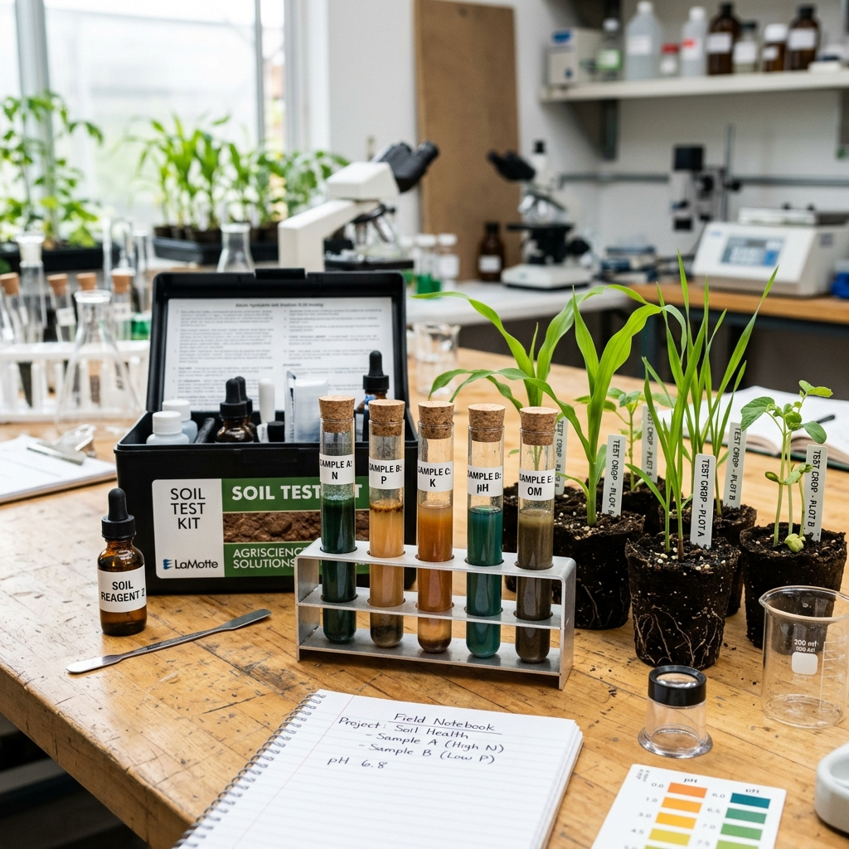
Krishi Mitra & Soil Health Cards
Krishi Mitra AI Chatbot:
• Interactive chat interface with fuzzy keyword matching.
• Pre-loaded natural recipes (Jeevamrutha, Neemastra, Agniastra).
• Shortcut prompts for quick click-and-ask questions.
Soil Health Card Calculator:
• Input soil test values for Nitrogen (N), Phosphorus (P), Potassium (K), and pH.
• Classifies values as low, optimal, or excessive.
• Recommends organic biological amendments (blood meal, bone meal, sulfur, gypsum).
Notes:
Let's move to Slide 5: Chatbot and Soil Health. The Krishi Mitra chatbot allows farmers to ask questions and receive step-by-step recipes. The Soil Health Calculator helps farmers input actual soil card measurements. It determines NPK deficits and recommends organic amendments like bone meal or gypsum to restore balanced pH.

Slide 6
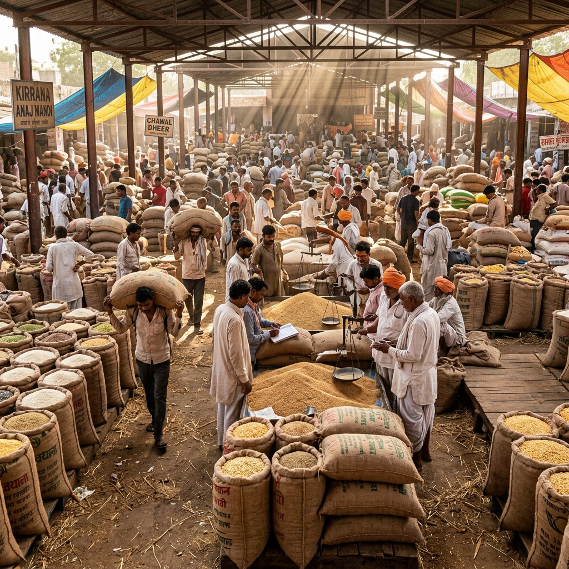
Mandi Prices & Sowing Schedules
Commodity Mandi Rates:
• APMC price indicators for Rice, Wheat, Tomato, Onion, Cotton, and Chilli.
• Daily trends display arrow indicators (+/- %).
• Revenue estimator computes earnings based on crop quintals.
Sowing Schedules & Weather:
• Calendars covering Kharif, Rabi, and Zaid seasons.
• Details optimal rainfall, temperature, and crop durations.
Notes:
On Slide 6, we address Mandi Prices and Sowing Schedules. Commodity trading is crucial. The Mandi tool tracks wholesale rates in local APMC markets. The calculator allows farmers to estimate harvest value. In addition, the sowing calendar tracks Kharif, Rabi, and Zaid crop cycles.

Slide 7

Organic Cures (ZBNF) & Deployment
Sustainable ZBNF Integration:
• Jeevamrutha Recipe: Microbe multiplier (dung, urine, jaggery) to restore soil organic carbon above 1.0%.
• Biopesticides: Step-by-step guides for Neemastra, Agniastra, and Dashaparni Ark.
• Local Setup & Build: Compiles in 591ms for quick deployment on hosting services like Vercel.
Notes:
Finally, Slide 7 details Zero Budget Natural Farming (ZBNF) and deployment. The app provides exact recipes for formulations like Jeevamrutha to rebuild organic soil carbon and boost leaf immunity. The codebase is fully tested, built in 591ms, and ready for one-click Vercel hosting. Thank you.

