Slide 1

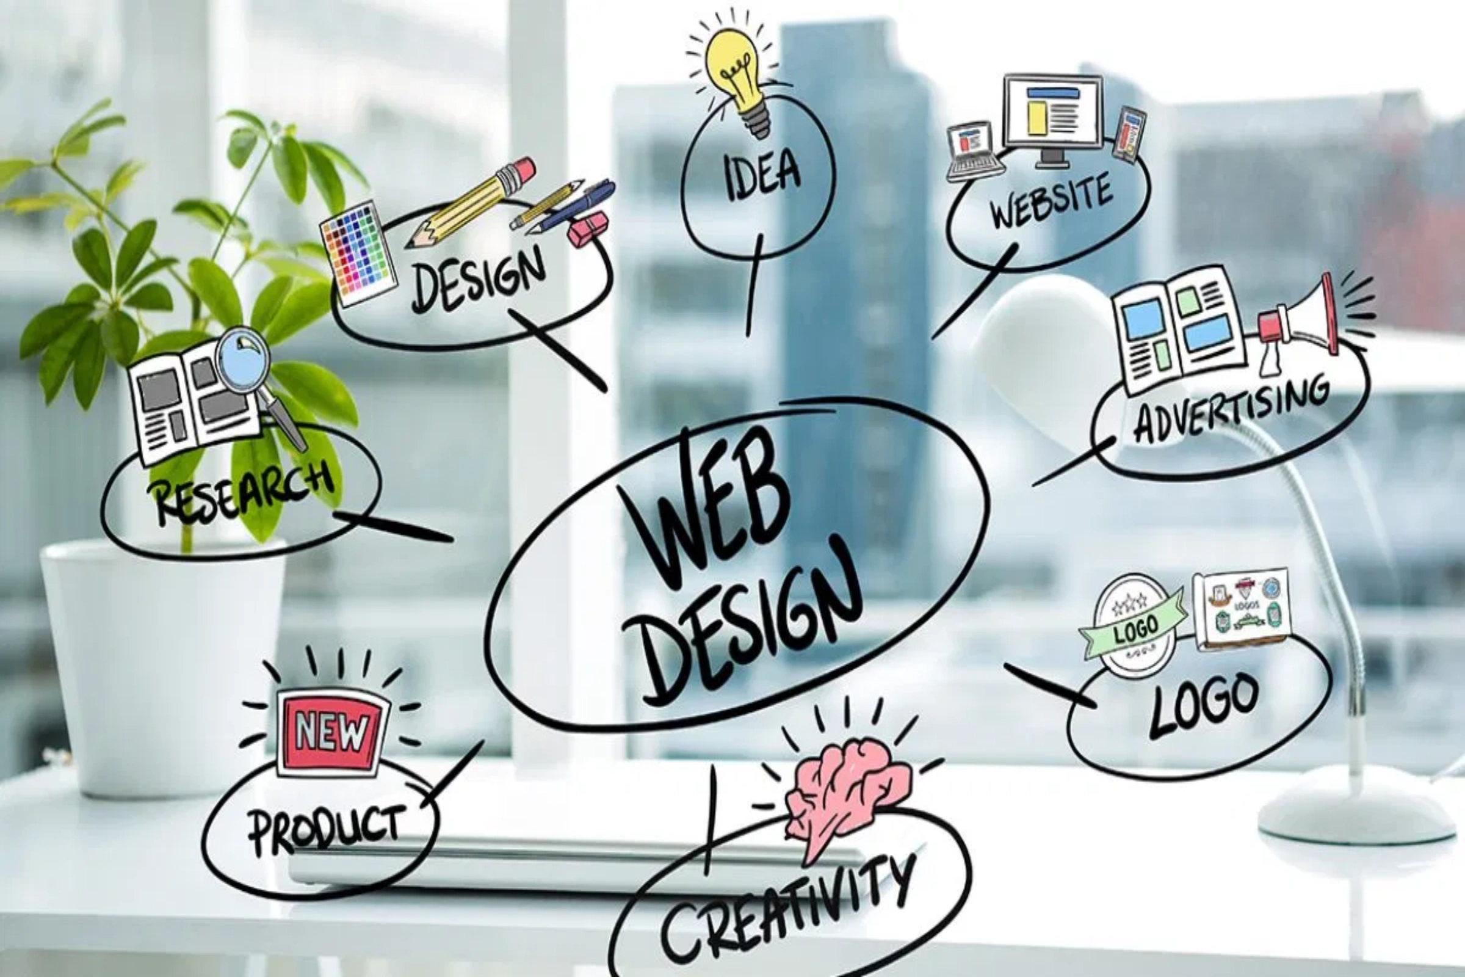
The Beauty of Web Development
Crafting the Digital World

Slide 2

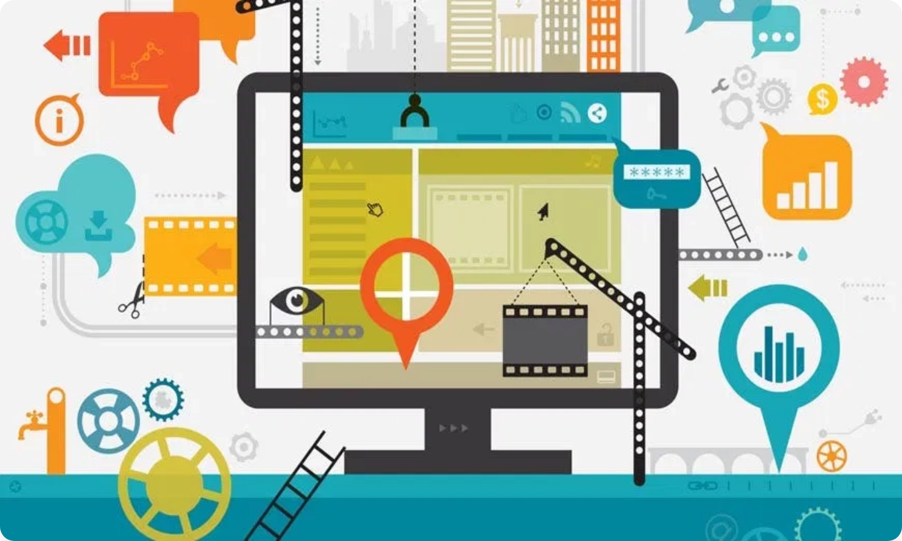
What is Web Development?
Web development is the art and science of creating websites and web applications that power our digital world. It encompasses everything from simple static pages to complex interactive platforms that connect billions of users globally.
Three Core Areas:
Frontend:
User interface and experience
Backend:
Server logic and databases
Full-stack:
Complete end-to-end solutions
In today's digital age, web development serves as the foundation for e-commerce, social media, education, healthcare, and virtually every industry that relies on digital presence and connectivity.

Slide 3





Bringing Ideas to Life: Creativity Unleashed
Web development is where imagination meets implementation. Every website begins as a spark of creativity—a vision of how users should interact, feel, and engage with digital content.
Visual Design
User Experience
Technical Innovation
Colors, typography, layouts
Intuitive interactions
Cutting-edge solutions
The beauty lies in transforming abstract concepts into tangible, interactive experiences that users can touch, navigate, and enjoy across any device, anywhere in the world.

Slide 4

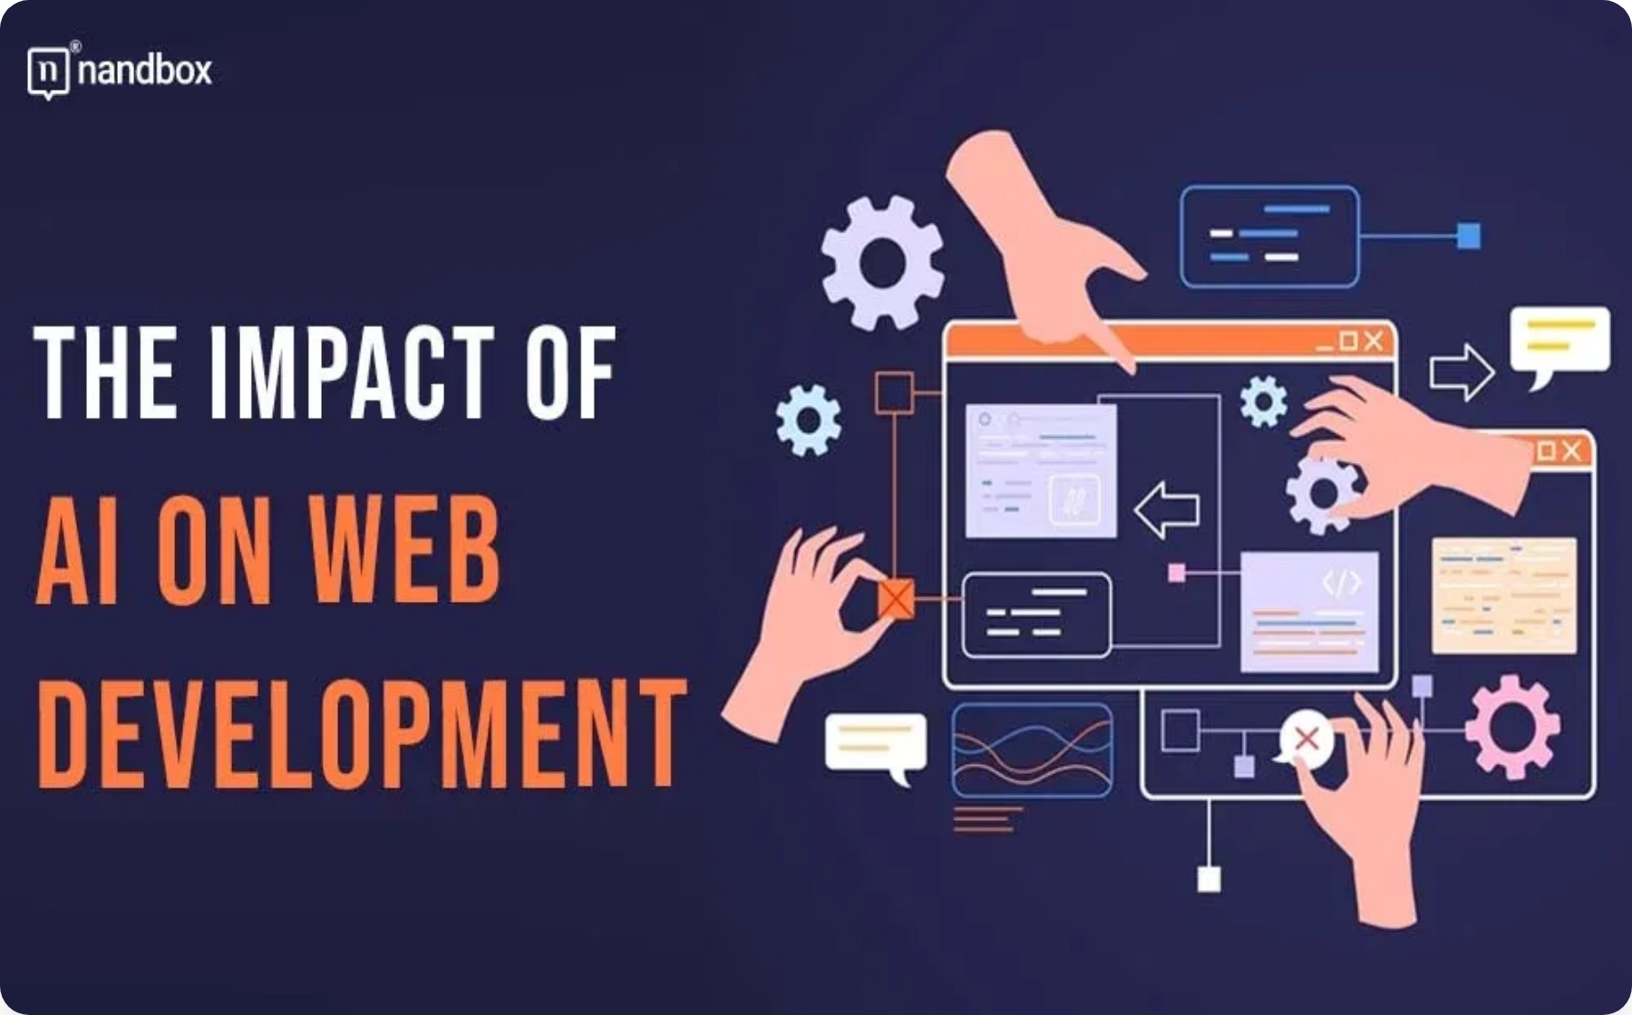




Impact and Problem Solving: Shaping Our World
Web development is fundamentally about solving problems and creating positive impact. Every line of code written has the potential to improve lives, streamline processes, and connect communities across the globe.
E-commerce Revolution
Education Access
Enabling global trade
Learning without borders
Healthcare Innovation
Social Connection
Telemedicine & health apps
Bringing people together
From small business websites to large-scale platforms serving millions, web developers are the architects of digital transformation, creating solutions that make the impossible possible.

Slide 5

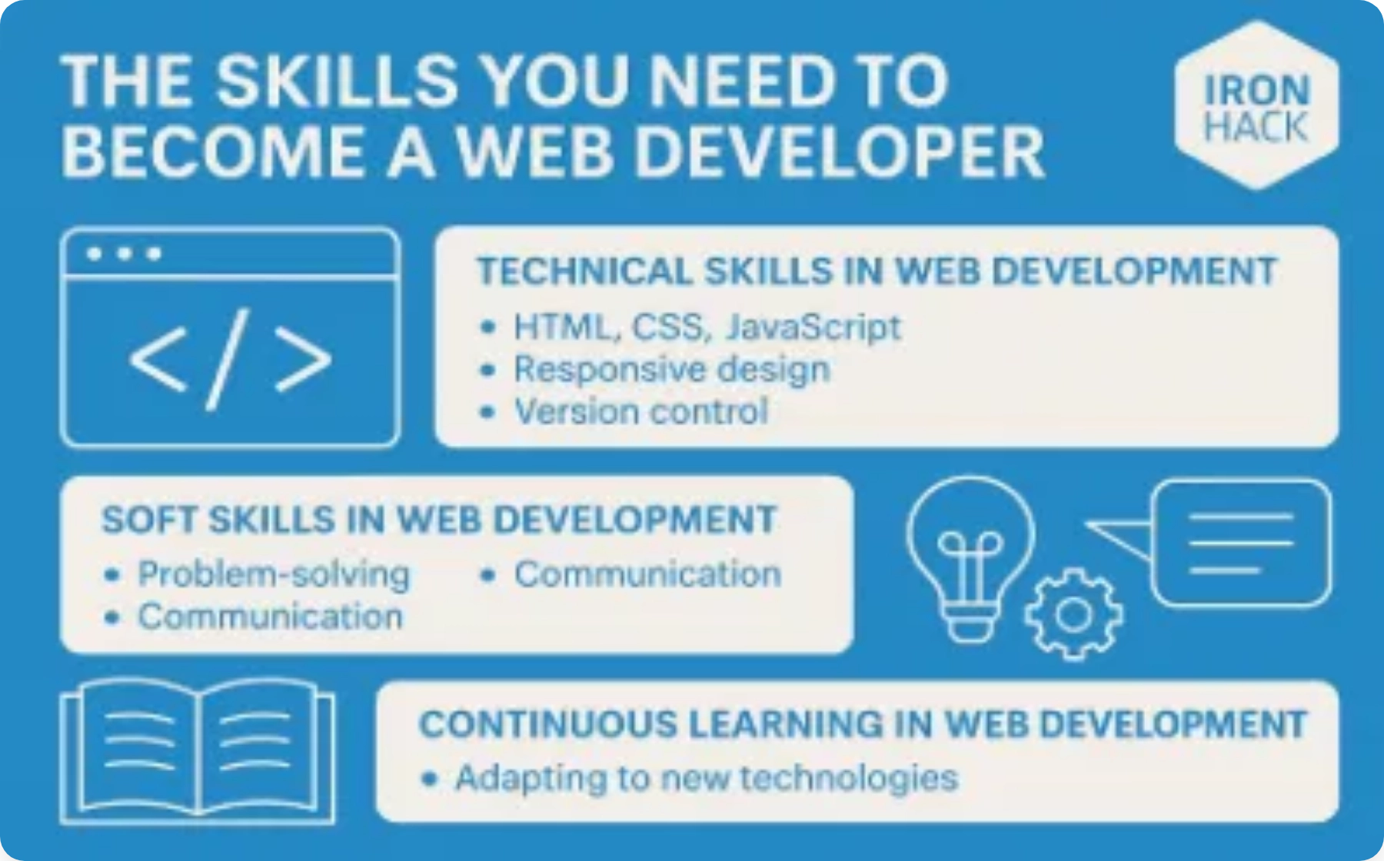





Continuous Learning and Evolution: A Dynamic Field
The beauty of web development lies in its constant evolution. New frameworks, languages, and methodologies emerge regularly, keeping developers engaged in lifelong learning and innovation.
The Learning Journey Never Ends
From HTML basics to AI integration, cloud computing, and emerging technologies like WebAssembly and Progressive Web Apps, developers continuously adapt and grow.
Traditional Web
Modern Web
Future Web
HTML, CSS, JavaScript
React, Vue, Mobile-first
AI, AR/VR, IoT
This constant evolution ensures that web development remains exciting, challenging, and rewarding for those who embrace the journey of continuous learning.

Slide 6

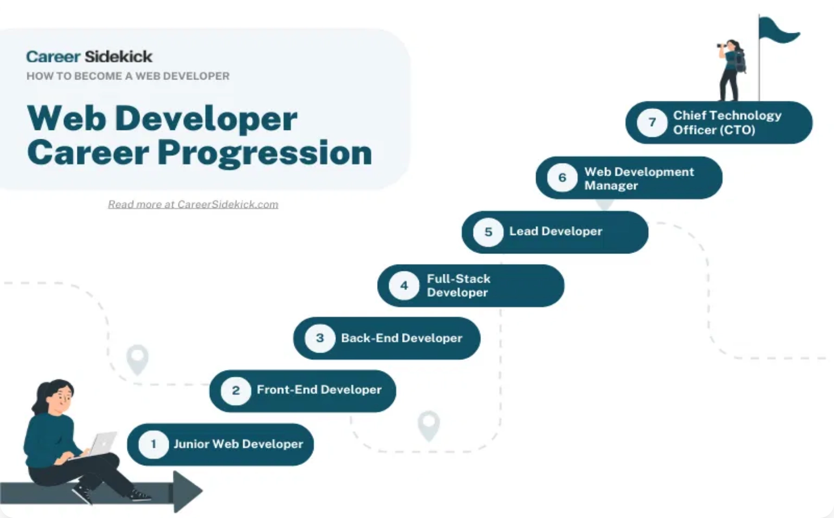






Career Opportunities and Growth: A Rewarding Path
Web development offers one of the most promising career landscapes in today's economy, with high demand, competitive salaries, and diverse opportunities across industries.
Industry Growth
Web development jobs are projected to grow significantly faster than average, with opportunities in startups, enterprises, and freelance markets.
Frontend Developer
Backend Developer
Full-Stack Developer
UI/UX focus
Server & database
End-to-end solutions
Mobile Developer
DevOps Engineer
Tech Lead
App development
Deployment & scaling
Team leadership
The field offers flexibility in work arrangements, from remote opportunities to freelancing, making it accessible to diverse lifestyles and career goals.

Slide 7

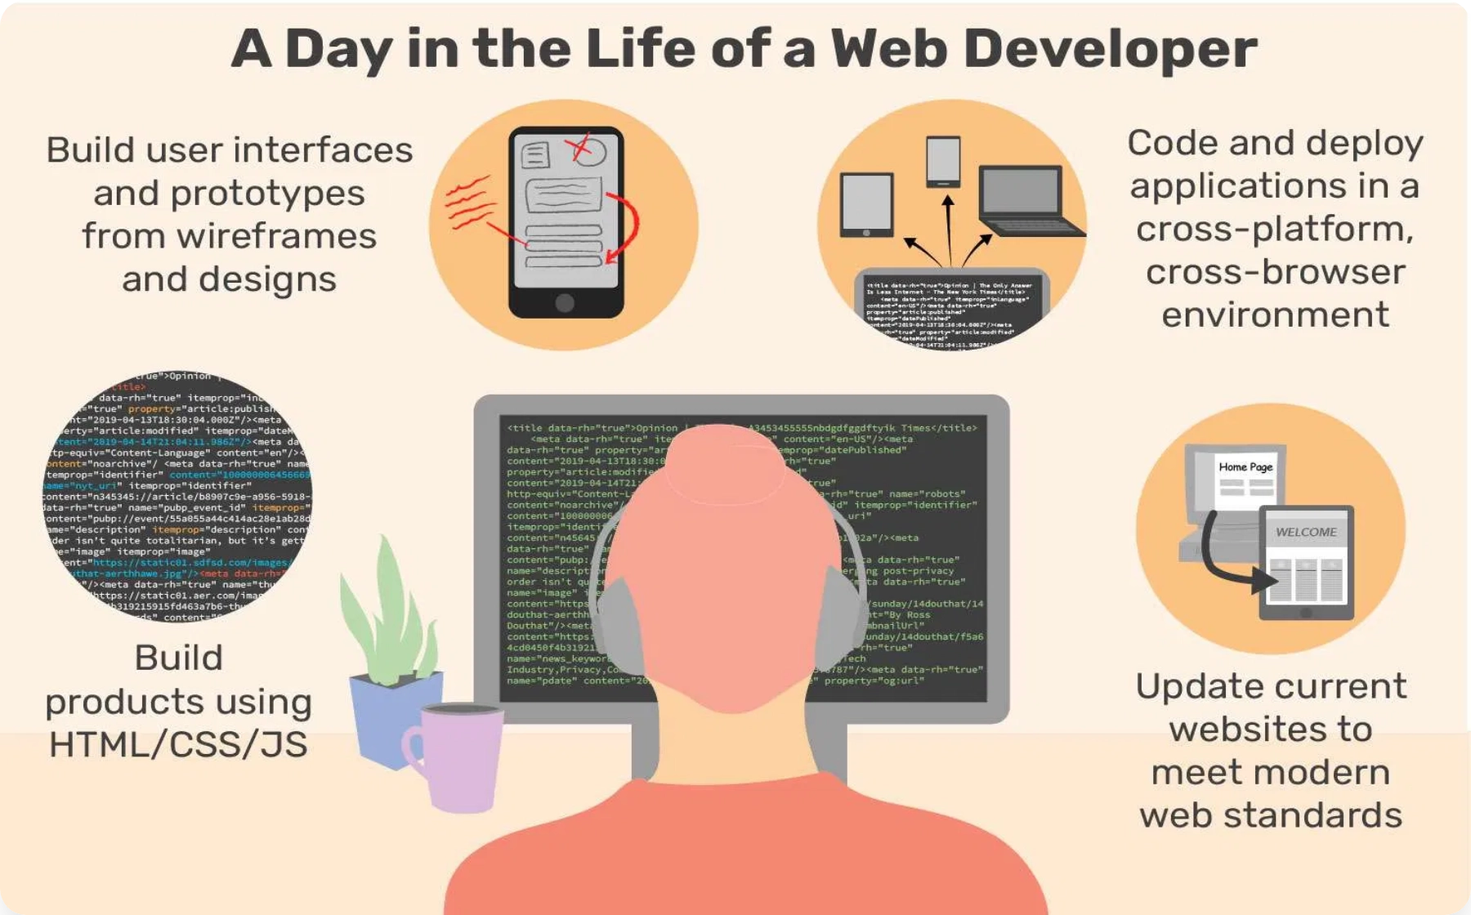



The Tangible Rewards: Seeing Your Work Live
Unlike many professions, web development offers immediate, visible results. Every project deployed is a testament to creativity, problem-solving, and technical skill that can be shared with the world.
From Code to Reality
Watch your ideas transform from lines of code into living, breathing applications that users interact with daily.
Instant Deployment
User Feedback
Measurable Impact
See changes live immediately
Direct impact on user experience
Analytics and performance metrics
The satisfaction of building something from scratch, solving complex challenges, and seeing real people benefit from your work makes web development uniquely rewarding.

Slide 8

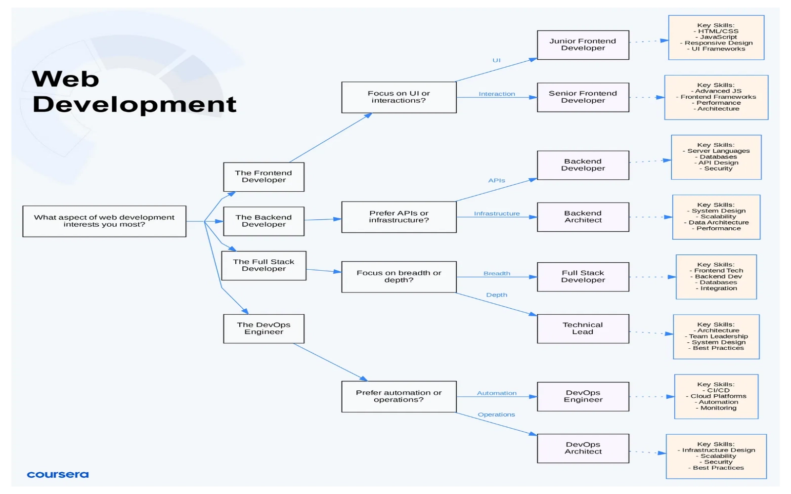




The Enduring Beauty of Web Development
Web development represents the perfect fusion of creativity, logic, and impact. It's a field where artistic vision meets technical precision, where individual creativity can reach global audiences.
Creative Expression
Global Impact
Transforming ideas into reality
Connecting and empowering people
Continuous Growth
Personal Fulfillment
Ever-evolving opportunities
Meaningful, rewarding work
The beauty of web development lies not just in the code we write, but in the lives we touch, the problems we solve, and the future we help create—one website, one application, one line of code at a time.

