Slide 1
Analysis of US Business Loans for Covid-19 Relief
Grammenos Konstantinos Kalatzi Marilena Tsadimas Anargyros

Slide 2


Project analysis slide 8
Analysis of US Business Loans for Covid-19 Relief
Paycheck Protection Program (PPP)
Economic Injury Disaster Loan (EIDL)
Long-standing loan assistance program
Provides low-interest loans to businesses suffering economic injury
Aims to help businesses recover from economic losses
COVID-19 specific loan program
Forgivable loans for small businesses
Aims to maintain payroll
CHARACHTERISTICS

Slide 3
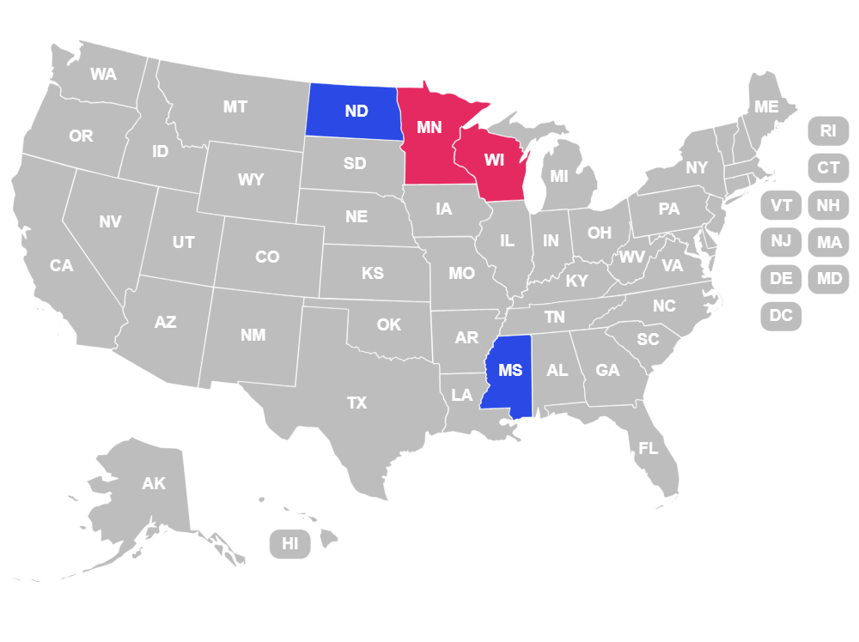
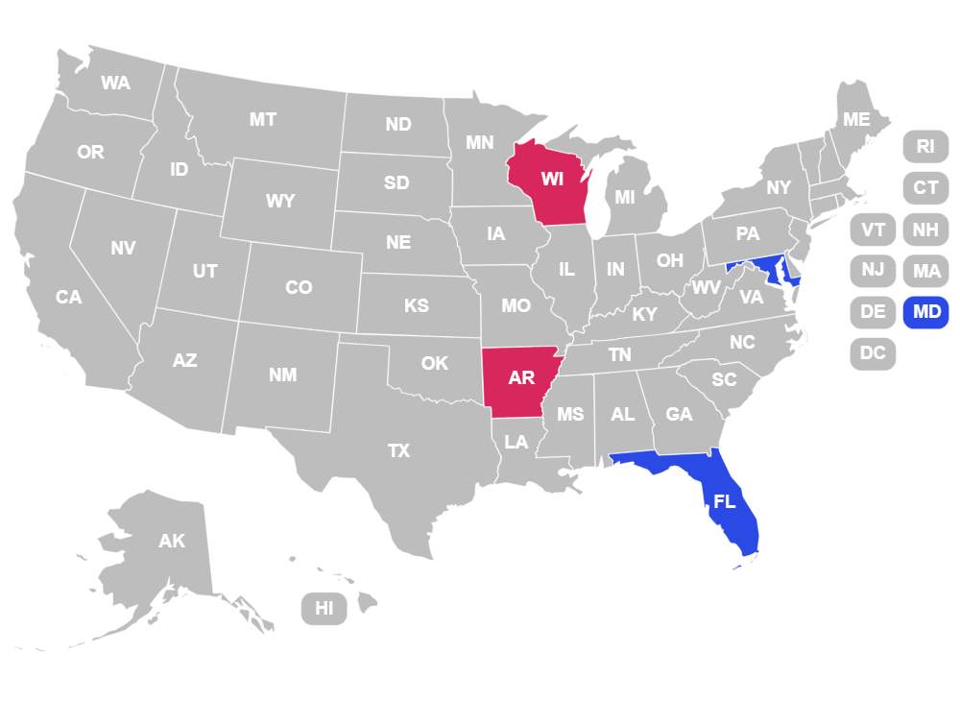
Project analysis slide 4
Analysis Per State
Mississippi (MS) and North Dakota (ND) the highest
Florida (FL), and
Maryland (MD) the highest
Number of Loans Per Firms
Total Loan Amount By Payroll
Minnesota (MN) and Wisconsin (WI) the lowest
Wisconsin (WI) and Arkansas (AR) the lowest
Customer Objectives

Slide 4






Project analysis slide 4
Analysis Per Industry
Non-classifiable Establishments
Entertainment
Most Helped Industries
Arts
Management of companies
Recreation
Least Helped Industries
Utilities

Slide 5

Project analysis slide 5
Impact on consumer spending
Number of loans (7508) and total loan amount ($165.88M) are comparable to Michigan
Michigan
Number of loans (8.006), total loan amount (($196.68M) and number of firms similar
Number of firms (59,317) is slightly higher than Michigan
Almost triple loan amount per payroll ($24.07) than this of NC
North Carolina
Much lower loan amount per payroll ($7.45) compared to Michigan.
Significantly higher loan amount per employee ($786.29).
Significantly lower loan amount per employee ($370.96).
Smaller workforce (250,132 employees)

Slide 6
Project analysis slide 10
Conclusions
Mississippi, North Dakota, Florida and Maryland:
substantial financial support relative to their business populations
effective outreach
high demand
Wisconsin, Arkansas and Minnesota:
lower support
access challenges
Arts, entertainment, and recreation industries, diverse non classifiable establishment: benefited significantly
Utilities and administrative sectors: comparatively less assistance.
Importance of tailored financial assistance to address the varied impacts of the pandemic across different regions and sectors.

Slide 7
Thank You

