Slide 1
Welcome

Slide 2
Overview of Taiwan’s 2020 Presidential and Legislative Election
Election Study Center

Slide 3
Facts about the 2020 election
Voting Day: Jan. 11, 2020
Three Ballots: president, district-level legislator, and party list
President: first-past-the-position
District-level legislator (79 seats): 73 single-member districts and 6 seats for aboriginal voters in 2 SNTV districts.
Party list (34 seats): 5% of votes allocated 2 seats.
Number of eligible voters: 19 million.

Slide 4
Previous Turnout Rates and Vote Shares

Slide 5
Current Seat Shares in LY

Slide 6
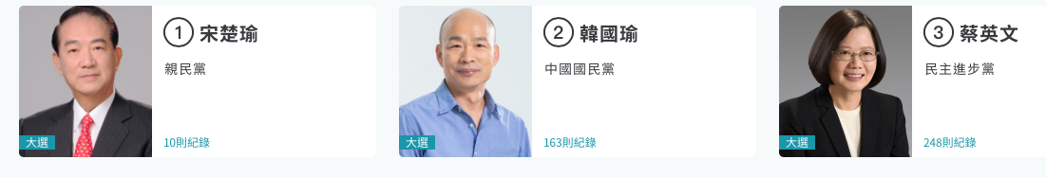
Presidential Candidates

Slide 7
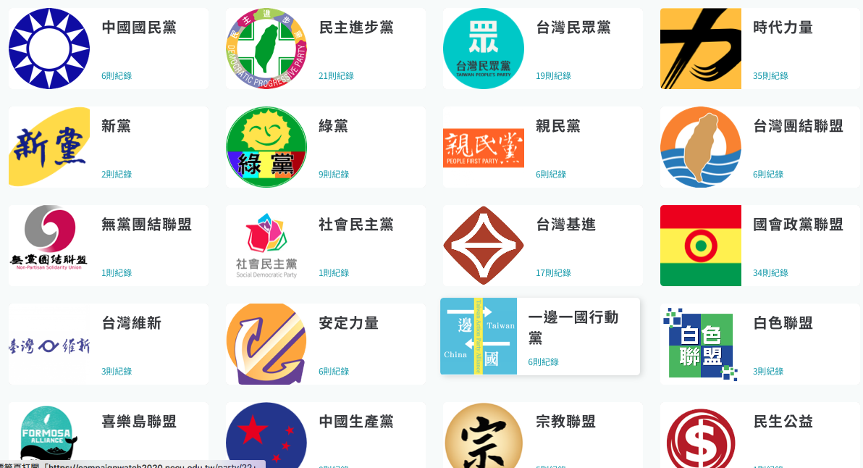
Party Lists

Slide 8
Party Nomination in LY Election
433 candidates register in the LY election.
43 parties nominate district candidates.
17 parties have party lists.
KMT nominates 76 and DPP nominates 69. TPP: 17, PFP: 10, NPP: 5, Green: 11.

Slide 9
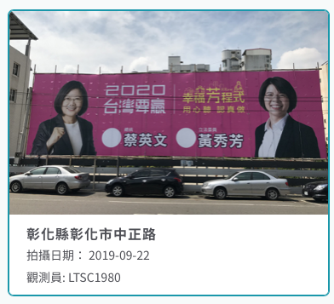
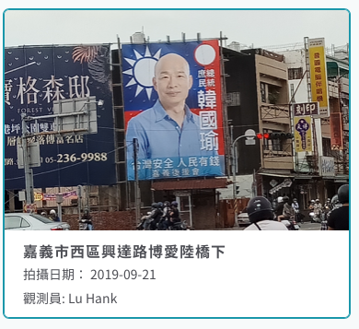
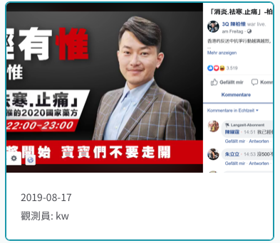
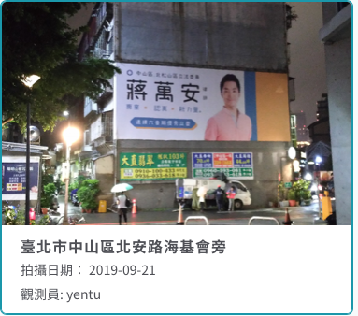
Campaign Activities

Slide 10
Taiwan’s Identity Politics
Taiwanese/Chinese identity characterizes Taiwan politics.
Kuomintang (KMT) and Democratic Progressive Party (DPP) promote Chinese and Taiwan identity respectively.
National identity is related to independence/unification issue; most people prefer the status quo of cross-Strait relations.

Slide 11
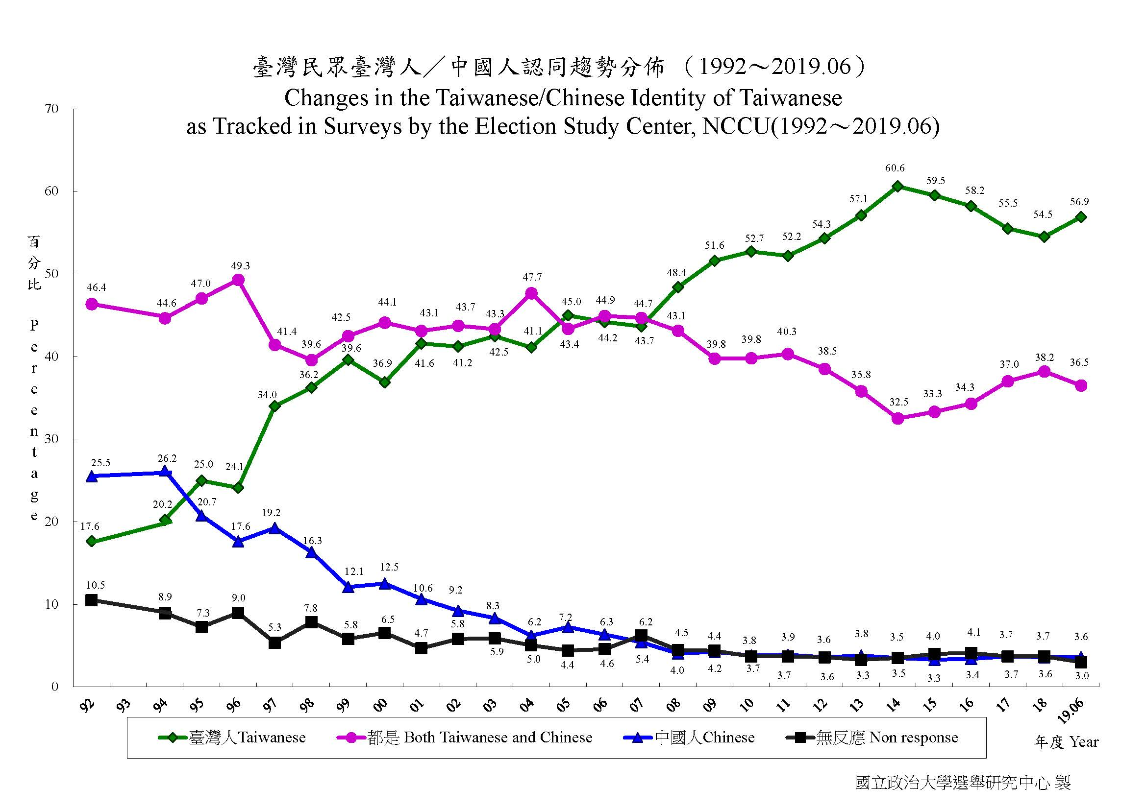
Longitudinal Core Attitudes
ESC has accumulated three longitudinal core attitudes since 1992.
They are partisanship, independence-unification, and Taiwanese identity.
Data are based on various polls for the past half or one year.

Slide 12
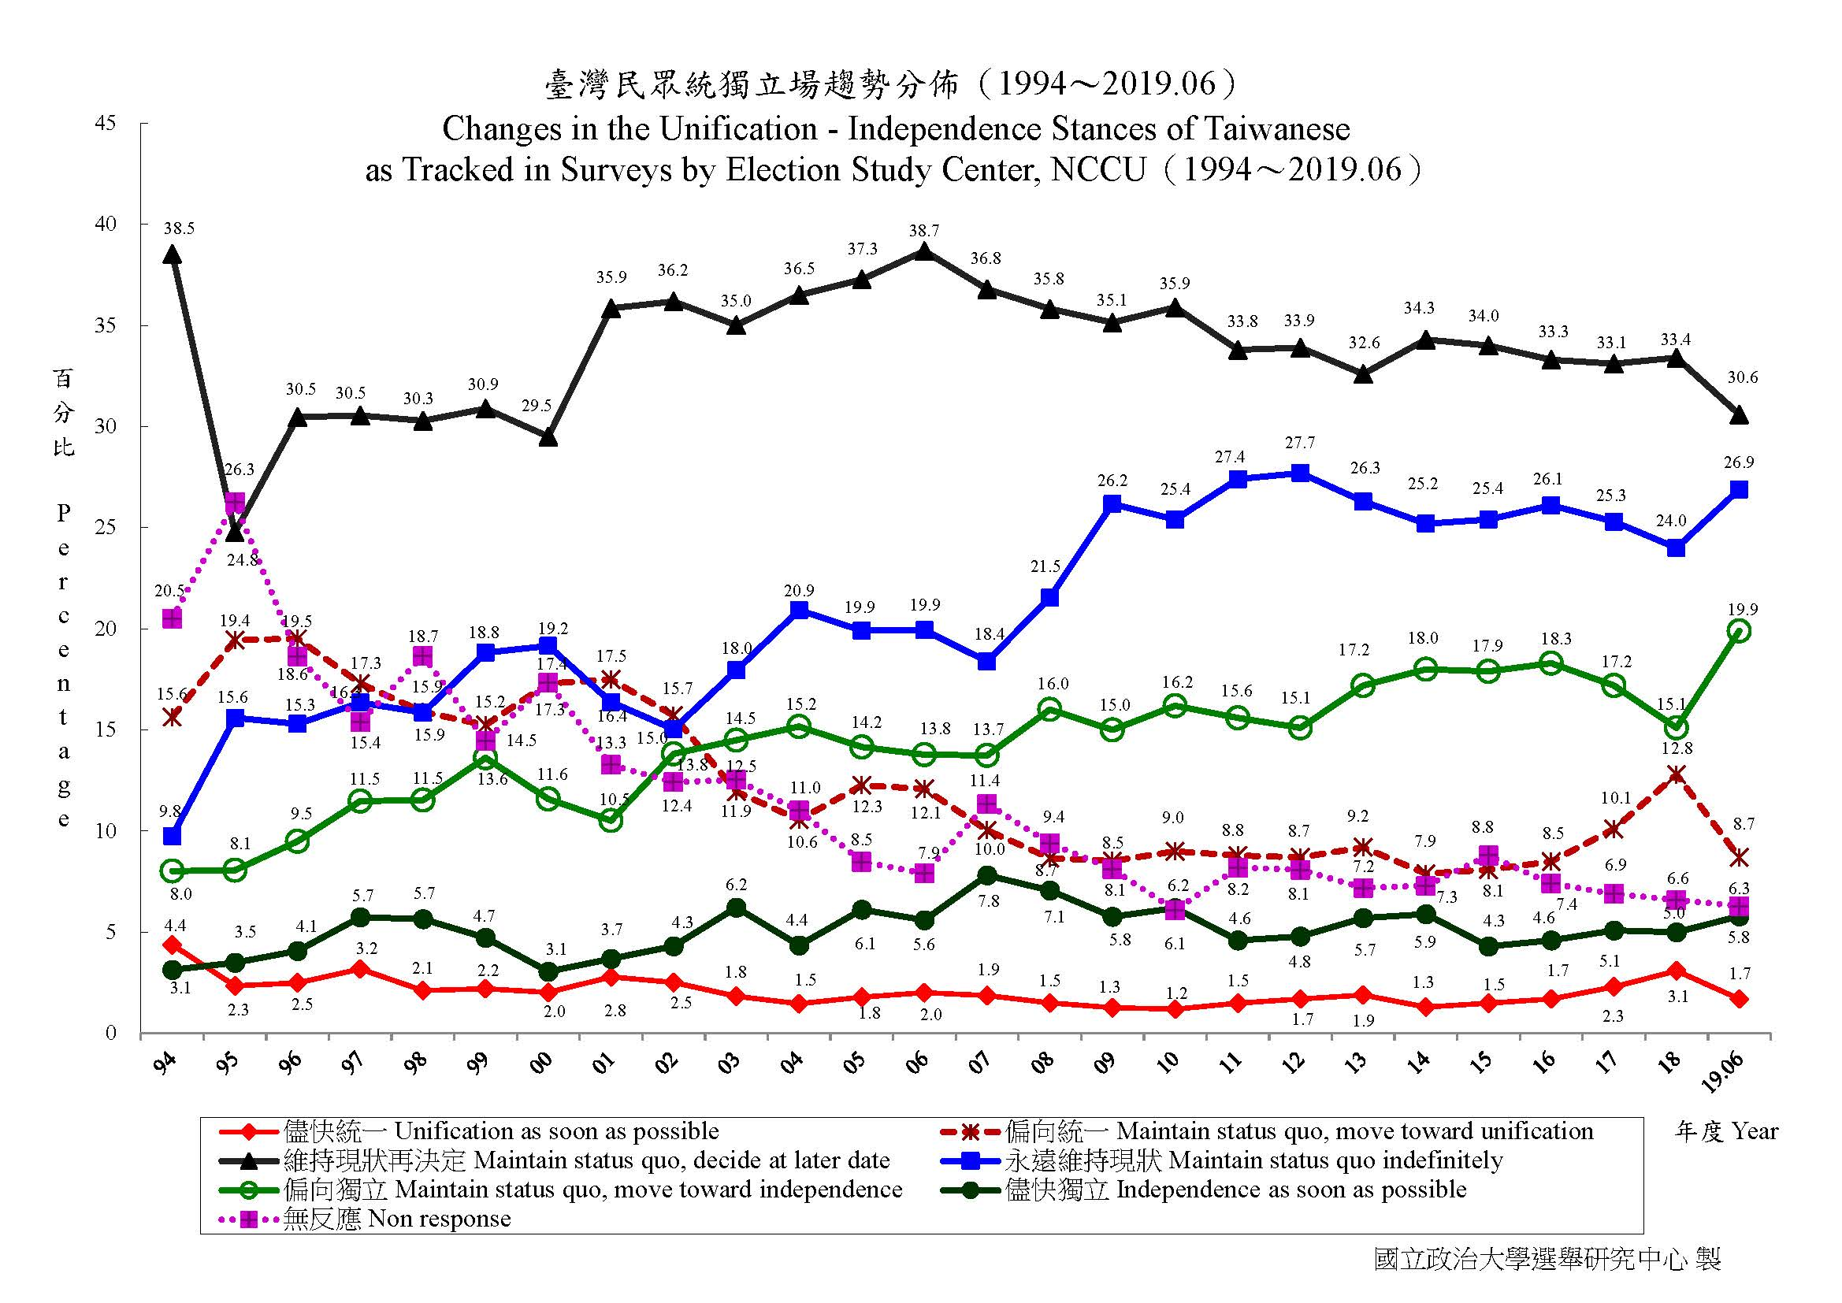

Slide 13
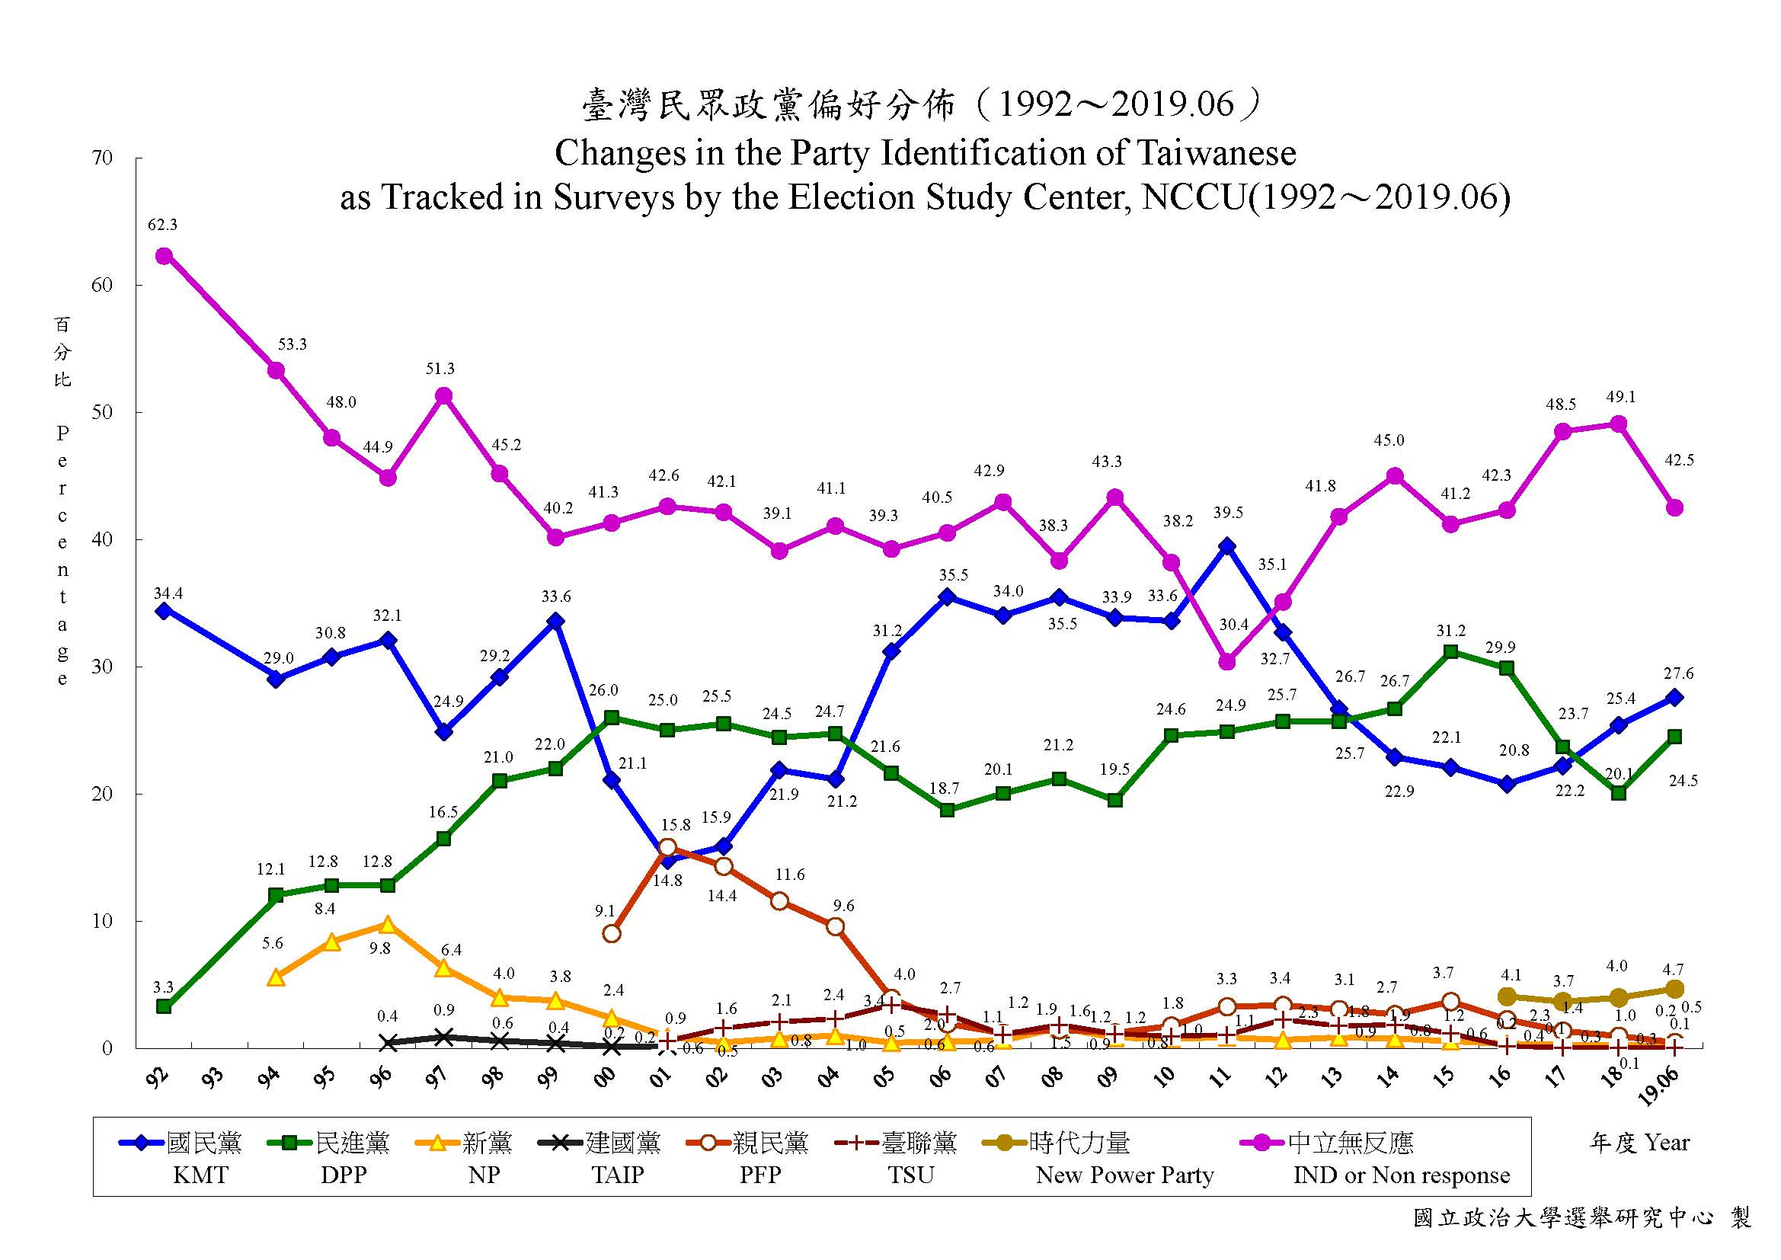

Slide 14
Big Picture
Pro-independence and Taiwanese identity have been growing since 2008, but KMT identification remains strong until 2011.
Since 2008, on average 55% Taiwanese identity and 22% pro-independence. Over 50% choose status quo.
DPP gained momentum in 2013 but has struggled since 2017.

Slide 15
China: Threats or Opportunities?
Taiwan has great trade surplus with China since 1980s. China also receives up to 80% of Taiwan’s foreign investment.
Since 2001, many Taiwanese companies manufacture goods in China, and then importing to US or selling to China.
It is estimated that 400,000 Taiwanese are working in China.

Slide 16
National Security
Xi Jinping, China’s president, urged Taiwanese to consider “one country two systems” in January, 2019.
Many international media and think tanks warn the world about China’s cyberattack and spreading misinformation in Taiwan.
China boycotted Taiwan in every international organization, such as United Nations, WHO, and INTERPOL. They also cut Taiwan’s diplomatic ties.

Slide 17
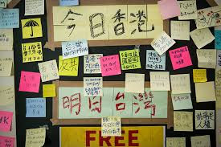
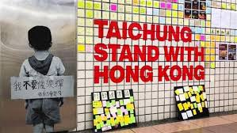
Influence of Protest in HK

Slide 18
So how Taiwanese Think about Politics Lately?
Mainland Affair Council commissioned Election Study Center to do opinion polls three times a year. The latest poll was conducted in October.
Taiwan’s Election and Democratization Study (TEDS) conducts quarterly presidential popularity polls.
ESC and Fairbank Center of Harvard University conducted a survey in mid-November.

Slide 19
Party Identification

Slide 20
Taiwanese/Chinese identity

Slide 21
Unification-Independence Stances

Slide 22
Independence-Unification

Slide 23
Presidential Popularity

Slide 24
Distribution of Age

Slide 25
Age x Party ID

Slide 26
Age X Unification-Independence

Slide 27
Age X Tsai Ing-wen
Data: ESC-Harvard Survey (Nov. 2019)

Slide 28
Economic Retrospect
Compared to six months ago, do you think Taiwan’s economy becomes? (TEDS)

Slide 29
Election Forecast?
The coverage rate of telephone interview might be low (60%?). People who are not contacted may vote for either party or don’t turn out. We also need to assume the intention of people who refuse to answer their voting choice. So election forecast is complicated (Hung Yung-tai, 2014)
Indicator township or village?

Slide 30
Remarks
Young voters prefer Tsai Ing-wen and DPP. They are likely to support independence.
President Tsai bounces back from the 2018 municipal election partly because President Xi of China mentioned ‘one country two systems’ and protest erupted in HK. However, people are not satisfied with economy.
Taiwanese are divided on identity, and governance remains vital to democracy.

Slide 31
Giving to ESC
http://donation.nccu.edu.tw/web/donate/donate.jsp

