Slide 1
Welcome
香港中文大學師生

Slide 2
Overview of Taiwan’s 2020 Presidential and Legislative Election
Election Study Center

Slide 3
Facts about the 2020 election
Voting Day: Jan. 11, 2020
Three Ballots: president, district-level legislator, and party list
President: first-past-the-post
District-level legislator (79 seats): 73 single-member districts and 6 seats for indigenous voters in 2 SNTV districts.
Party list (34 seats): 5% threshold of votes allocation.
Number of eligible voters (20+ years old): 19 million.

Slide 4
Turnout Rates and Vote Shares

Slide 5
Current Seat Shares in LY

Slide 6
Seat Shares in 2020 LY

Slide 7
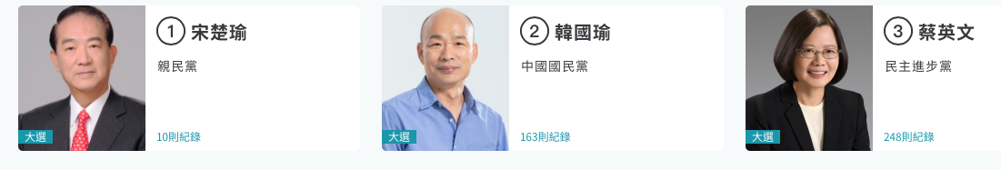
Presidential Candidates
For more campaign pictures, please see https://campaignwatch2020.nccu.edu.tw

Slide 8
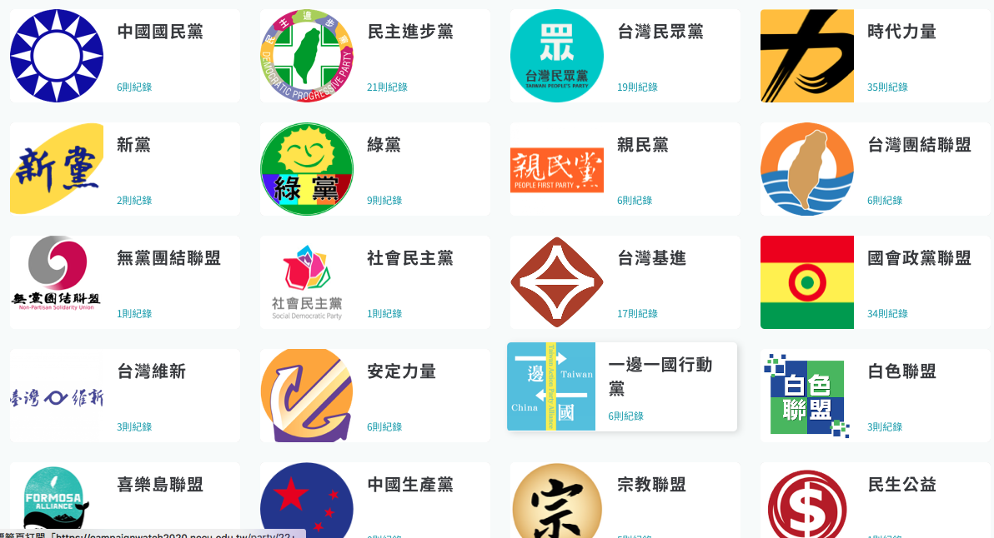




19 Party Lists

Slide 9
Party Nomination in LY Election
433 candidates register in the LY election.
43 parties nominate district candidates.
19 parties have party lists.
KMT nominates 76 district candidates and DPP nominates 69. TPP: 17, PFP: 10, NPP: 5, Green: 11.

Slide 10
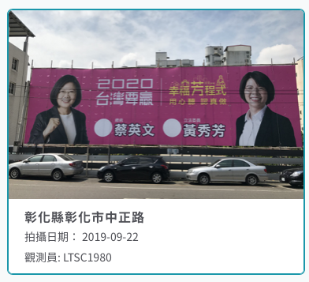
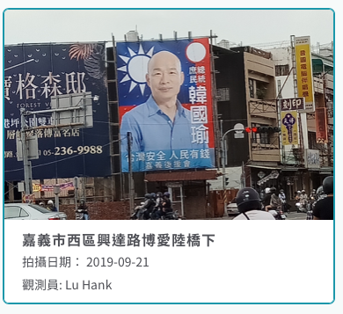
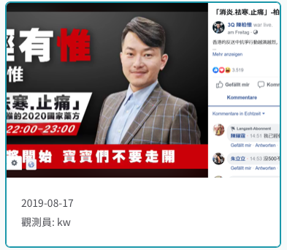
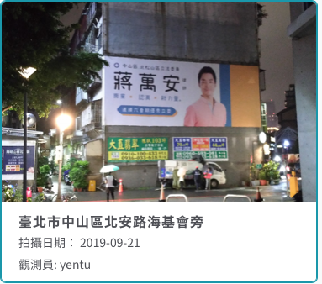
Campaign Activities

Slide 11
Why this Election Matters?
How will Taiwan people respond to China-US trade war and protests against the extradition bill in Hong Kong?
How much do China’s cyber troops and content farms influence Taiwan?
Will the DPP rebound from losing 7 out of 13 county/city that they controlled, including Kaohsiung and Taichung, in the 2018 mayor election?
How many minor parties (TPP, NPP, PFP, Green) will survive in Taiwan?

Slide 12
Diagram of Voting
Party Identification
Government performance
Economic perception
Vote
National Identity
Cross-Strait Relations

Slide 13
Taiwan’s Identity Politics
Taiwanese/Chinese identity characterizes Taiwan politics.
Kuomintang (KMT) and Democratic Progressive Party (DPP) promote Chinese and Taiwan identity respectively.
National identity is related to independence/unification issue; most people prefer the status quo of cross-Strait relations.

Slide 14
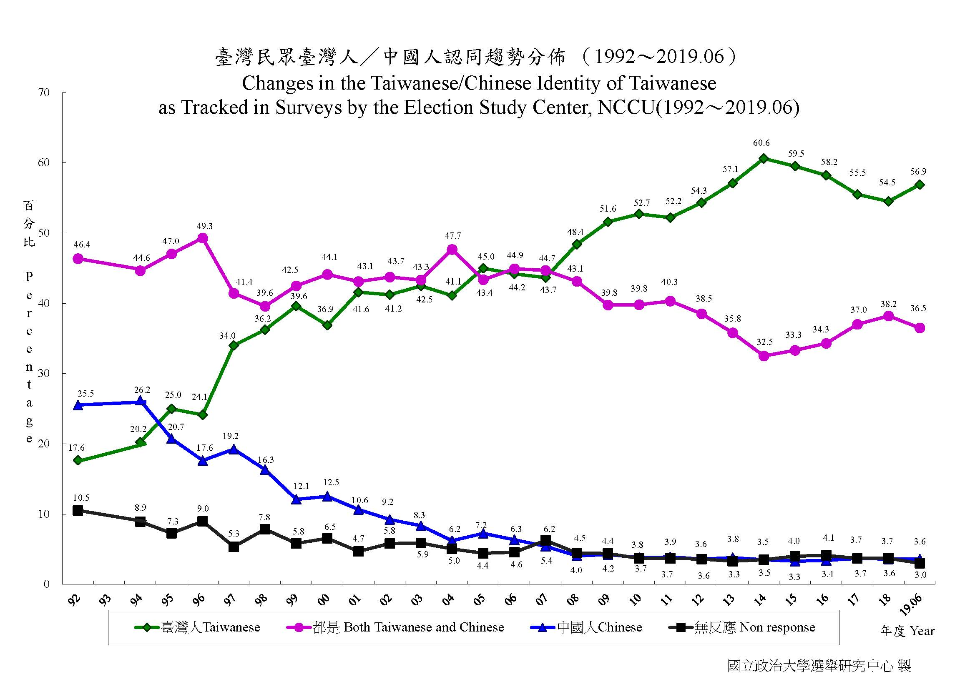
Longitudinal Core Attitudes
ESC has accumulated three longitudinal core attitudes since 1992.
They are partisanship, independence-unification, and Taiwanese identity.
Data are based on various polls for the past half or one year.

Slide 15
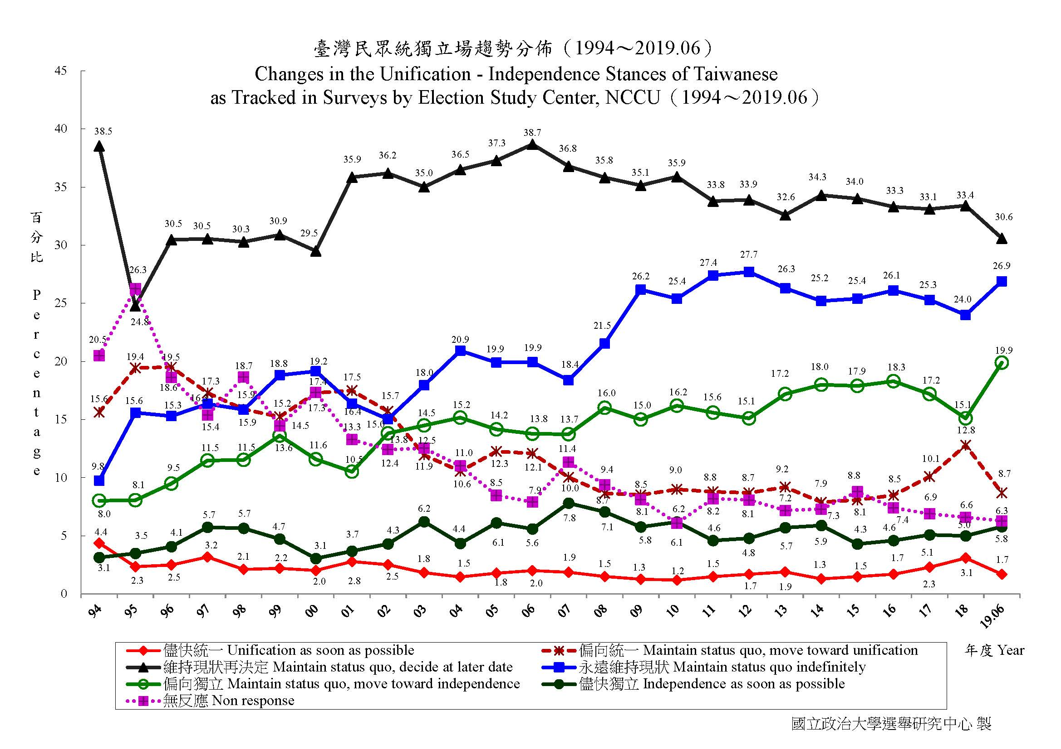

Slide 16
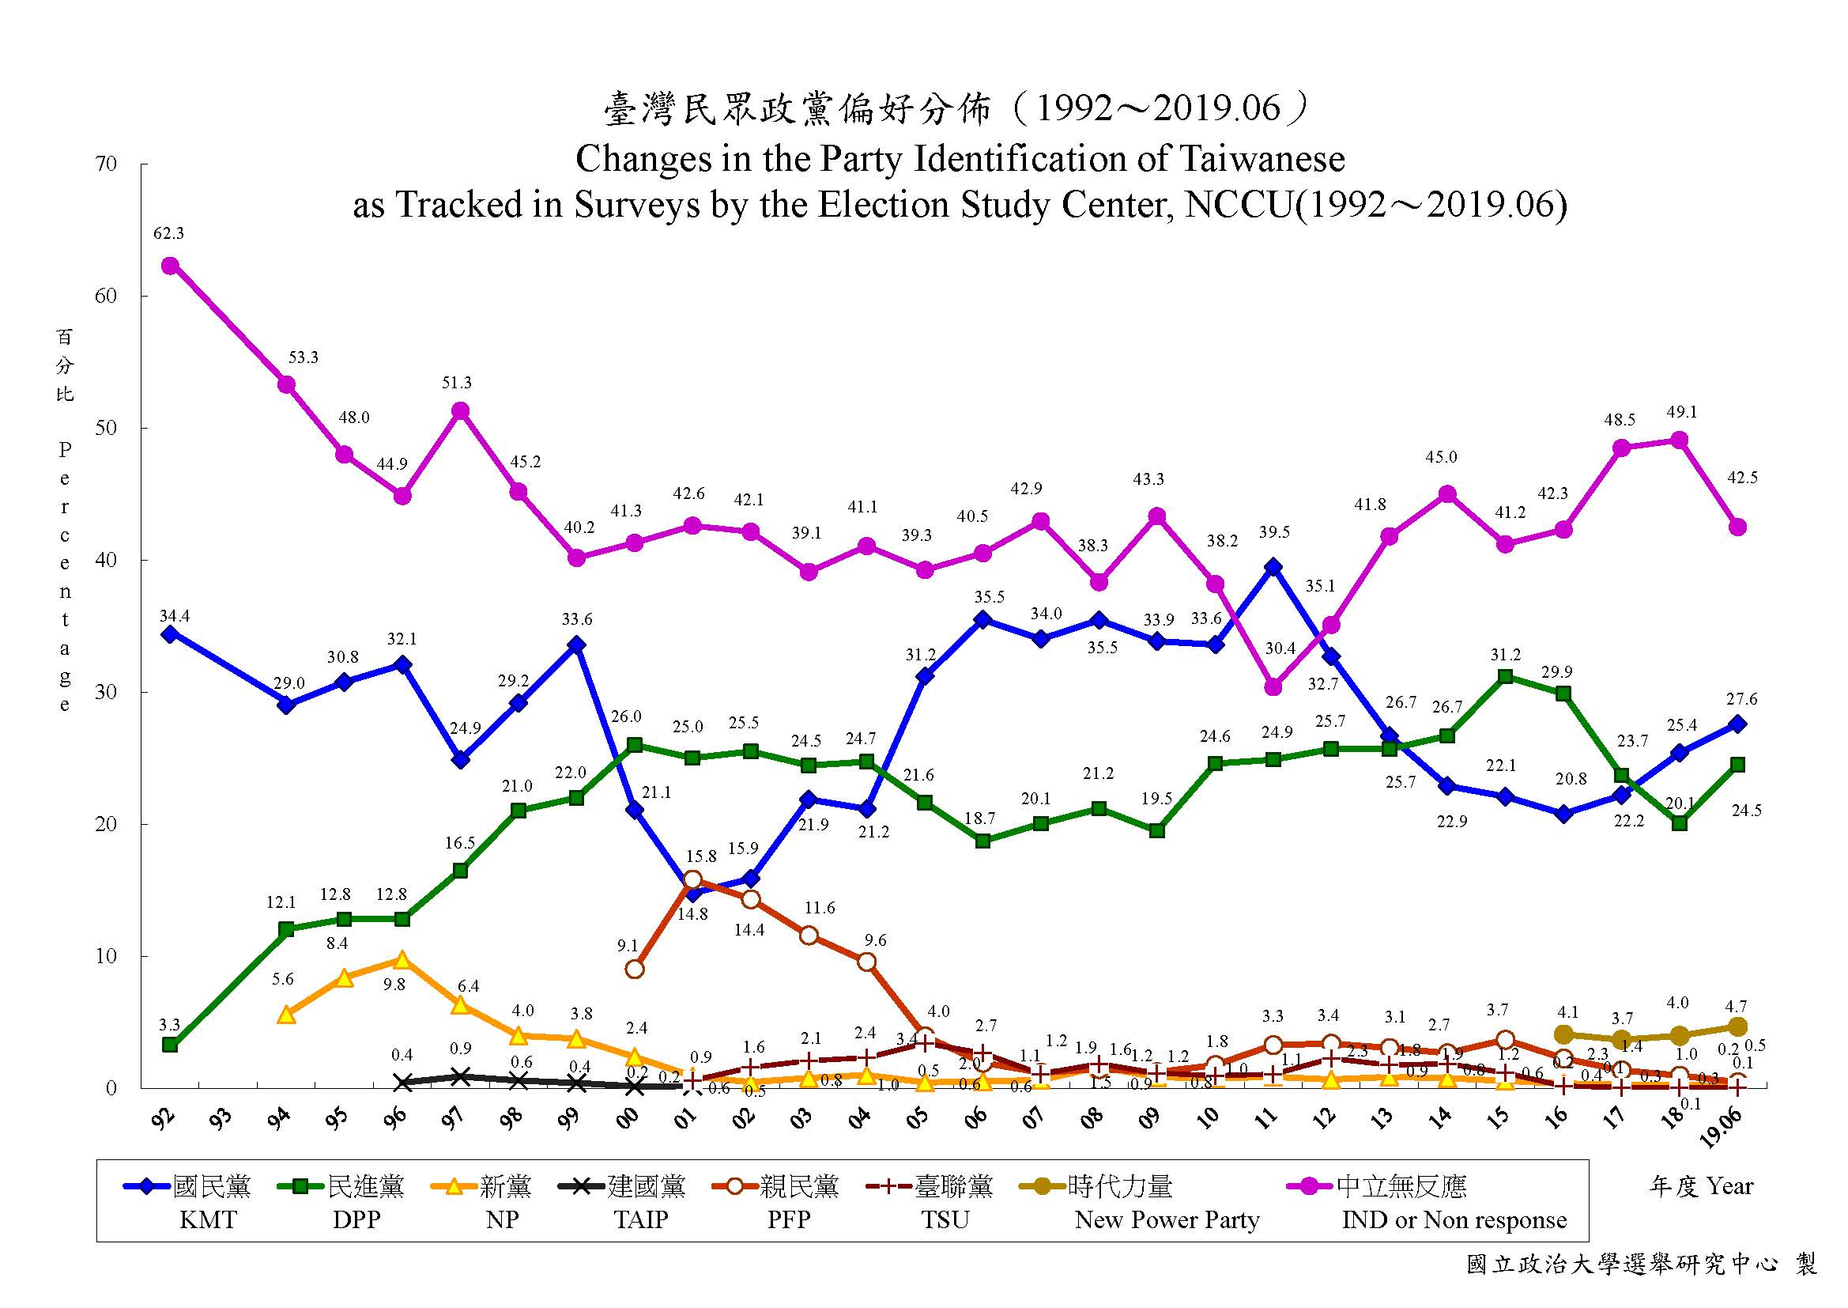

Slide 17
Big Picture
Pro-independence and Taiwanese identity have been growing since 2008, but KMT identification remains strong until 2011.
Since 2008, on average 55% Taiwanese identity and 22% pro-independence. Over 50% choose status quo.
DPP gained momentum in 2013 but has struggled since 2017.

Slide 18
China: Threats or Opportunities?
Taiwan has great trade surplus with China since 1980s. China also receives up to 80% of Taiwan’s foreign investment.
Since 2001, many Taiwanese companies manufacture goods in China, and then importing to US or selling to China.
It is estimated that 400,000 Taiwanese are working in China.

Slide 19
National Security
Xi Jinping, China’s president, re-urged Taiwanese to consider “one country two systems” in January, 2019.
Many international media and think tanks warn the world about China’s cyber attack and spreading misinformation in Taiwan.
China boycotted Taiwan in every international organization, such as United Nations, WHO, and INTERPOL. They also cut Taiwan’s diplomatic ties.

Slide 20
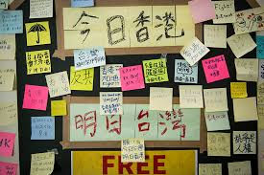
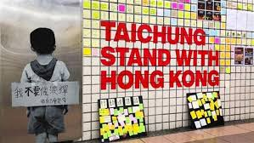
Influence of Protest in HK

Slide 21
So how Taiwan People Think about Politics Lately?
Mainland Affair Council (MAC) commissioned Election Study Center to do opinion polls three times a year. The latest poll was conducted in October.
Taiwan’s Election and Democratization Study (TEDS) conducts quarterly presidential popularity polls. The latest one released was in September.
ESC and Fairbank Center of Harvard University conducted a survey in mid-November.

Slide 22
Party Identification
Data: MAC (Oct.)

Slide 23
Taiwanese/Chinese identity
Data: MAC (Oct., 2019)

Slide 24
Unification-Independence Stances
Data: MAC (Oct. 2019)

Slide 25
Independence-Unification

Slide 26
Presidential Popularity

Slide 27
Distribution of Age
Data: MAC (Oct., 2019)

Slide 28
Age x Party ID
Data: MAC(Oct., 2019)

Slide 29
Age X Unification-Independence
Data: MAC (Oct., 2019)

Slide 30
Age X Tsai Ing-wen
Data: ESC-Harvard Survey (Nov. 2019)

Slide 31
Economic Retrospect
Compared to six months ago, do you think Taiwan’s economy becomes? (TEDS)

Slide 32
Election Forecast?
The coverage rate of telephone interview might be low (60%?). People who are not contacted may vote for either party or don’t turn out. We also need to know the preference of people who refuse to reveal their voting choices. So election forecast is complicated (Hung Yung-tai, 2014)
Some people watch the township or village that has previous election outcomes very close to the national ones.

Slide 33
Concluding Remarks
Young voters prefer independence and DPP. They are likely to support President Tsai.
President Tsai bounces back from the 2018 municipal election probably because President Xi of China mentioned ‘one country two systems’ and protest erupted in HK. However, very few people think economy is better.
Taiwan people are divided on identity, and governance remains vital to democracy.

Slide 34
Giving to ESC
http://donation.nccu.edu.tw/web/donate/donate.jsp

