Slide 1
Taiwan’s Elections and Democratization
Chia-hung Tsai
Election Study Center
March 26, 2026

Slide 2
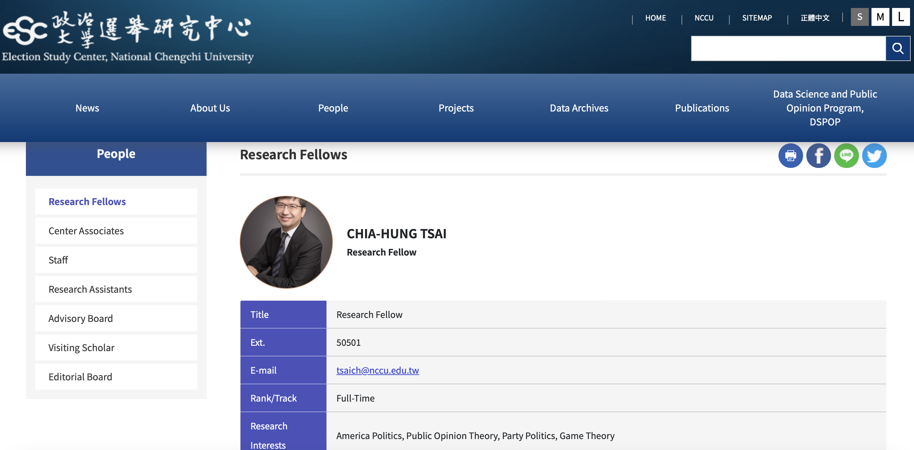

Slide 3
Why Taiwan’s Elections Matter
Taiwan is one of the most vibrant democracies in East Asia.
According to Huntington’s theory, Taiwan is the third-wave democracy with two party turnover
Elections ensure accountability and reflect identity politics.
Election plays an important role in Taiwan’s democratization.
Does election system or political culture shape voting behavior and party system?
Under external threat, will election help consolidate Taiwan democracy or shatter it?

Slide 4
Historical Roots
Elections existed during Japanese colonial rule and early KMT rule but mainly at local levels.
During Japanese colonization (1895–1945), Taiwan held its first local counselor elections in 1935, allowing male residents over 25 to vote for half of local assembly members in 9 cities.
The number of eligible Japanese and Taiwanese voters are 26,479 and 24,578, respectively.
The elections were held again in 1939, but the 1943 election was canceled due to the Second World War.

Slide 5
Election History
1935 – First local elections under Japanese rule Municipal and prefectural councils introduced; however, suffrage limited to male taxpayers, and many members were still appointed.
1947 – First national elections in the Republic of China Representatives elected to the Legislative Yuan and National Assembly before the KMT retreated to Taiwan.
1949–1987 – Martial law period National representatives elected in 1947 kept their seats indefinitely, creating the so-called “Ten-Thousand-Year Parliament.”
1950 – Regular local elections introduced in Taiwan Elections held for county magistrates, mayors, township chiefs, and local councils.
Opposition participation through local elections Non-KMT candidates (later called the Tangwai movement) began winning local offices in the 1960s–1980s.
By the 1980s: Taiwan had decades of electoral experience at the local level, which helped facilitate democratic transition after martial law ended in 1987.

Slide 6
Elections and Democratization
Local elections served as a safety valve allowing limited opposition competition.
Once elected, the opposition activists challenged the KMT’s authoritarian regime.
In 1960, the first non-KMT candidate, Yu Den-fa, was elected as the Kaohsiung County mayor. He was suspended and arrested later.
Many political movements drove reforms.

Slide 7
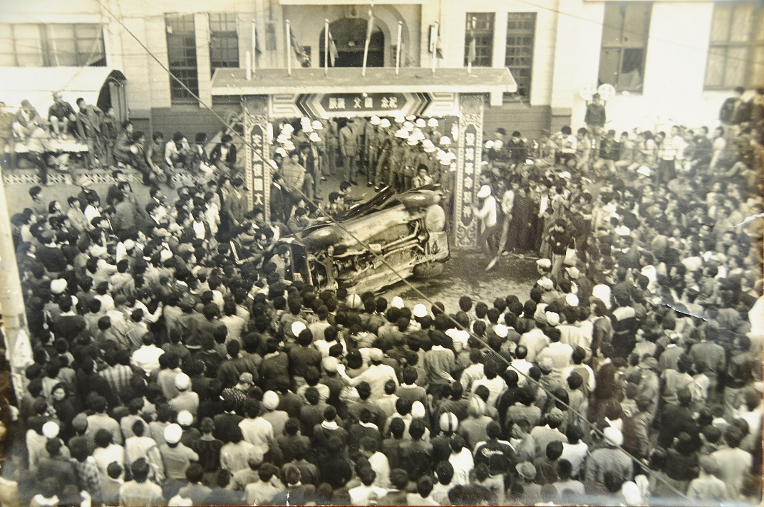
Chung-li Incident (1977)

Slide 8
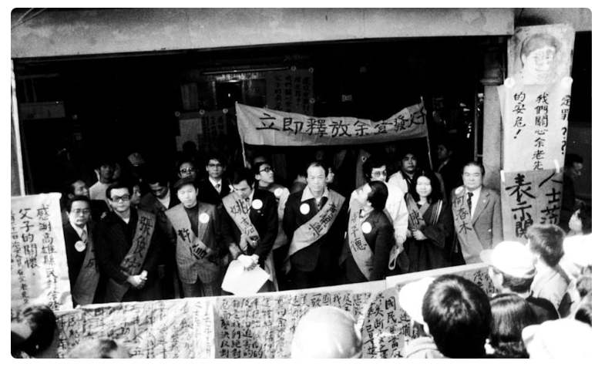
Ciaotao Rally (1979)

Slide 9
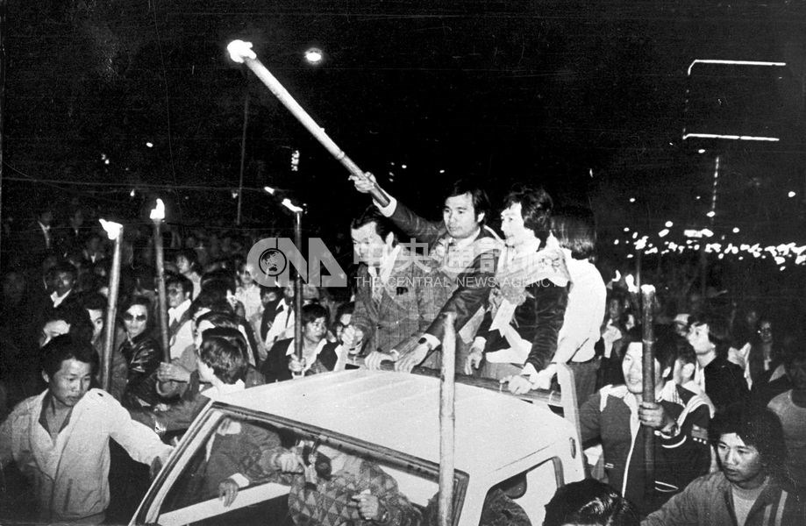
Formosa Incident (1979)

Slide 10
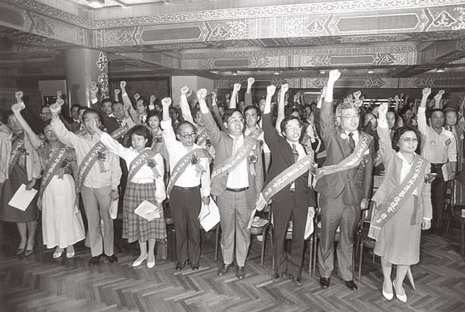
DPP founded (1986)

Slide 11
Turning Points
1992 Legislative Yuan reelection
Taiwan held the first full reelection of the Legislative Yuan, replacing mainland-elected representatives and defining the status quo of a democratic Taiwan, distinct from the PRC.
1996 first direct presidential election:
It symbolizes democratic sovereignty and presidential system.
2000 peaceful power transition
The victory of Chen Shui-bian (DPP) ended decades of Kuomintang rule and marked Taiwan’s first peaceful transfer of power between parties.

Slide 12
Election Issues
After DPP was established, democratization issue (reform vs. social order) was replaced by national identity (independence vs. unification).
The DPP promoted the idea of self-determination, claiming to represent the indigenous Taiwanese.
The KMT insisted on continuation of Republic of China, calling the DPP the separationists.
Environmental protection, labor, anti-nuclear power, woman rights, and unemployment issues were not prioritized.

Slide 13
Electoral Participation
Since Taiwan is young democracy, Taiwanese people are interested in politics.
Due to the high competitiveness, the turnout rates in the presidential election are around 70 percent. The lowest one occurred in 2016.
The turnout rates in the county/city mayoral elections are around 60 percent.
Because there is no absentee vote, many of young voters have to travel back to their hometown to vote.
Voting Day is scheduled on Saturday, but many people still work.

Slide 14
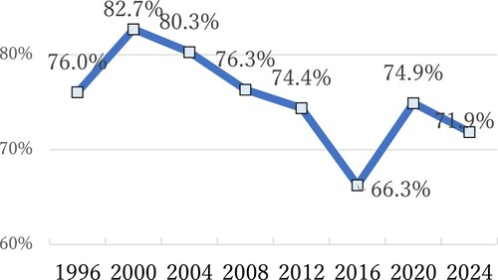
Turnout Rates in Presidential Elections

Slide 15
Party System
After a series of legislative and local elections, the DPP became the major party. The presidential system fosters Taiwan’s two-party system.
Some third parties like New Party, People’s First Party (PFP, James Soong) and New Power Party (NPP, Kuo-chang Huang) emerged, they cannot compete against DPP or KMT in the presidential election.
Taiwan People’s Party (TPP, Ko Wen-je) was founded in 2020. Ko almost won the second place in the 2024 presidential election.
People may sincerely vote, but the two major parties have much more resources.

Slide 16
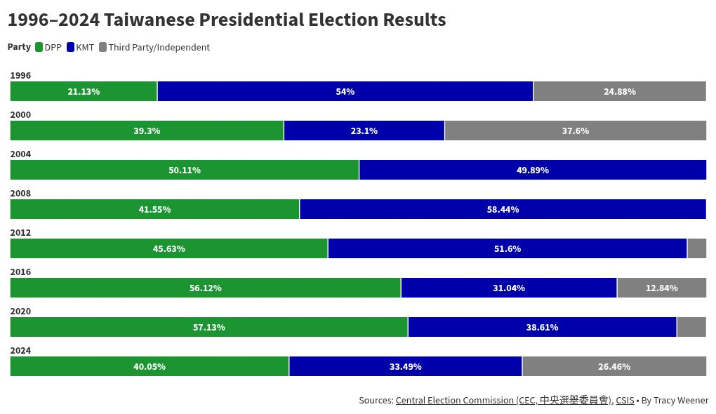

Slide 17
Local Factions (1)
When Taiwan transformed from agricultural to industrial society, political families and local factions still control farmer/fisher association, credit unions, chartered business, and social associations.
They accumulate social capital and wealth for elections.
Due to weak law enforcement and KMT’s tolerance, vote buying was common.
Therefore, local elites can mobilize voters through long‑term reciprocity networks.

Slide 18
Local Factions (2)
Because Taiwan used single non-transferrable voting system (SNTV) in the legislative and assembly elections, it only takes few thousand votes to get elected.
Therefore, partisanship may not be as important as in single-member district. Instead, people tend to choose candidates based on their visibility and constituent service.
Major political parties also like to cooperate with political dynasties as long as they share some points of view.
Although the legislative election changed to simple majority voting system in 2008, local factions remain influential in the elections.

Slide 19
Current Legislative Election System
Taiwan uses a parallel voting system, meaning the two types of votes (district and party) are calculated separately and do not influence each other’s seat allocation.
Total Seats: 113
Term Length: 4 years (concurrent with the Presidential term)
The "Three-Way" Split:
73 Seats: Regional District (First-Past-The-Post)
34 Seats: At-Large / Party-List (Proportional Representation)
6 Seats: Indigenous Representatives

Slide 20
Two-Ballot System
Ballot A: The District Vote (Person)
Mechanism: First-Past-The-Post (FPTP).
Geography: Taiwan is divided into 73 single-member districts.
Outcome: The candidate with the most votes in that specific district wins. This favors large parties with strong local machines (KMT/DPP).
Ballot B: The Party Vote (Political Party)
Mechanism: Proportional Representation (PR).
The 5% Threshold: Only parties that receive at least 5% of the total national party vote are eligible to receive any of the 34 "at-large" seats.
Gender Quota: By law, at least 50% of the legislators elected from each party’s list must be women.

Slide 21
The Indigenous Seats
Indigenous voters do not vote in geographical districts. Instead, they vote in two special nationwide constituencies:
Lowland Indigenous: 3 seats.
Highland Indigenous: 3 seats.
System: They use Single Non-Transferable Vote (SNTV), where multiple winners are elected from a single pool of candidates.
The "Plains" vs. "Mountain" distinction is not based on where the person lives today, but on where their ancestors were registered during the Japanese colonial period and the early KMT era.

Slide 22
Malapportionment
The Constitution guarantees at least one seat per county.
The population of every district must be over 300,000, except Kinmen and Matsu.
A legislative candidate in Lianjiang County (Matsu) only needs around 5,000 votes to get elected. In Kinmen, 22,000 votes are enough for a seat. But it takes about 160,000 votes to be elected in the first district of New Taipei City.
This has been challenged in the Constitutional Court (Interpretation No. 721), but the court ruled the current system is constitutional.

Slide 23
Parallel System
In the Mixed-Member Majoritarian or MMM system, major parties can win the majority of single-member districts while minor parties may receive seats in party-list tier (proportional representation).
Therefore, minor parties often concentrate on party-list. For example, all of TFP’s six seats are elected in party list.
Political parties tend to nominate the strongest candidates in single-member districts to boost their party-list vote shares.
However, major parties can win more seats disproportionally in single-member districts (e.g. 51% in every districts). MMM does not reflect current party support.

Slide 24
Voting Behavior
Partisanship anchors voting behavior. However, about 40% of people claim that they don’t identify with any party.
National identity and views on independence is the underlying cleavage. They are related to national security, economic development, and even pension reform.
Nuclear power and death penalty are the most prominent issues besides national identity. The DPP used to oppose nuclear power and death penalty, and the KMT and TPP are supporting both.

Slide 25
Election Body
Central Election Commission (CEC) is an independent institution. There are 11 commissioners, but only the President and Vice President are full-time. All of them have to be approved by the Legislative Yuan.
CEC is responsible for integrity and regularity of elections, but Ministry of Interior manages the voter registration.
Campaign finance is audited by the Control Yuan. Before a candidate or party can accept a single dollar, they must apply to the Control Yuan to open a dedicated campaign account
Election history can be found at CEC website: https://web.cec.gov.tw/english/article/24

Slide 26
Conclusion
Taiwan elections combine modern democratic institutions with deep political culture.
Historical legacy—local factions and identity--remains very influential, while two-ballot system, specified in the Constitution, structures party competition.
Taiwan’s democracy is not perfect, especially the division on identity and related issues.
But most people agree that elections can reflect people’s positions on the pressing issues, instead of emotions or opinion manipulated by politicians.

Slide 27
References
Rigger, Shelley. 1994. Machine Politics in the New Taiwan.
Chu, Yun-han and Lin, Jih-wen. 2001. Political Development in Taiwan.
Hsieh, John Fuh-sheng. 2005. Ethnicity, National Identity, and Domestic Politics in Taiwan.
Achen, Chris and TY Wang (eds). 2017. The Taiwan Voter.
Fell, Dafydd. 2018. Government and Politics in Taiwan.

