Slide 1
Welcome

Slide 2
Overview of Taiwan’s 2020 Presidential and Legislative Election
Election Study Center

Slide 3
Facts about the 2020 election
Voting Day: Jan. 11, 2020
Three Ballots: president, district-level legislator, and party list
President: first-past-the-position
District-level legislator (79 seats): 73 single-member districts and 6 seats for indigenous voters in 2 SNTV districts.
Party list (34 seats): 5% of votes allocated 2 seats.
Number of eligible voters (20+ years old): 19 million.

Slide 4
Previous Turnout Rates and Vote Shares

Slide 5
Current Seat Shares in LY

Slide 6
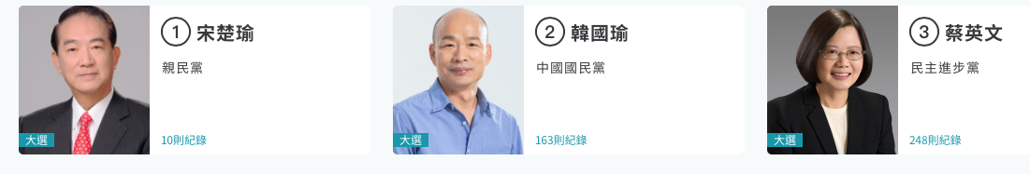
Presidential Candidates
For more campaign pictures, please see https://campaignwatch2020.nccu.edu.tw

Slide 7
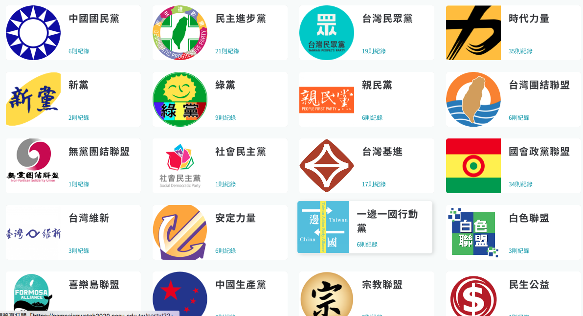




19 Party Lists

Slide 8
Party Nomination in LY Election
433 candidates register in the LY election.
43 parties nominate district candidates.
19 parties have party lists.
KMT nominates 76 district candidates and DPP nominates 69. TPP: 17, PFP: 10, NPP: 5, Green: 11.

Slide 9
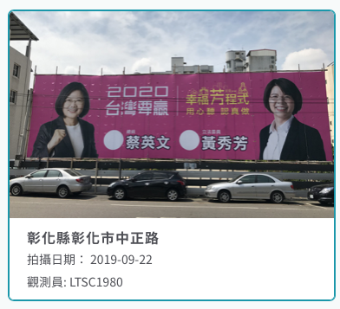
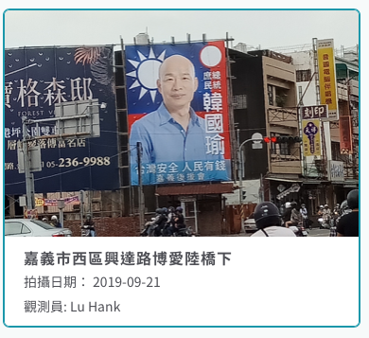
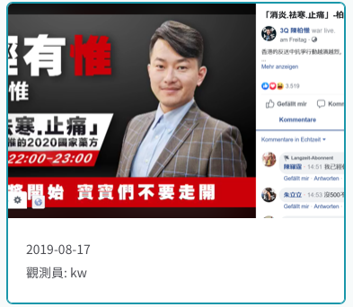
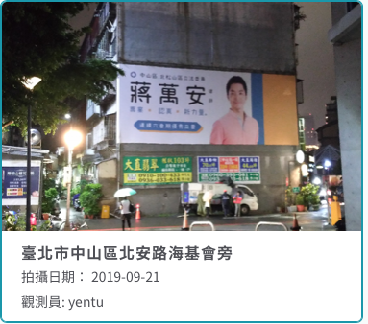
Campaign Activities

Slide 10
Why this Election Matters?
How will Taiwan people respond to China-US trade war and protests against the extradition bill in Hong Kong?
How much do China’s cyber troops and content farms influence Taiwan?
Will the DPP rebound from losing 7 out of 13 county/city that they controlled, including Kaohsiung, in the 2018 mayor election?
How many minor parties (TPP, NPP, PFP, Green) will survive in Taiwan?

Slide 11
Diagram of Voting
Party Identification
Government performance
Economic perception
Vote
National Identity
Cross-Strait Relations

Slide 12
Taiwan’s Identity Politics
Taiwanese/Chinese identity characterizes Taiwan politics.
Kuomintang (KMT) and Democratic Progressive Party (DPP) promote Chinese and Taiwan identity respectively.
National identity is related to independence/unification issue; most people prefer the status quo of cross-Strait relations.

Slide 13
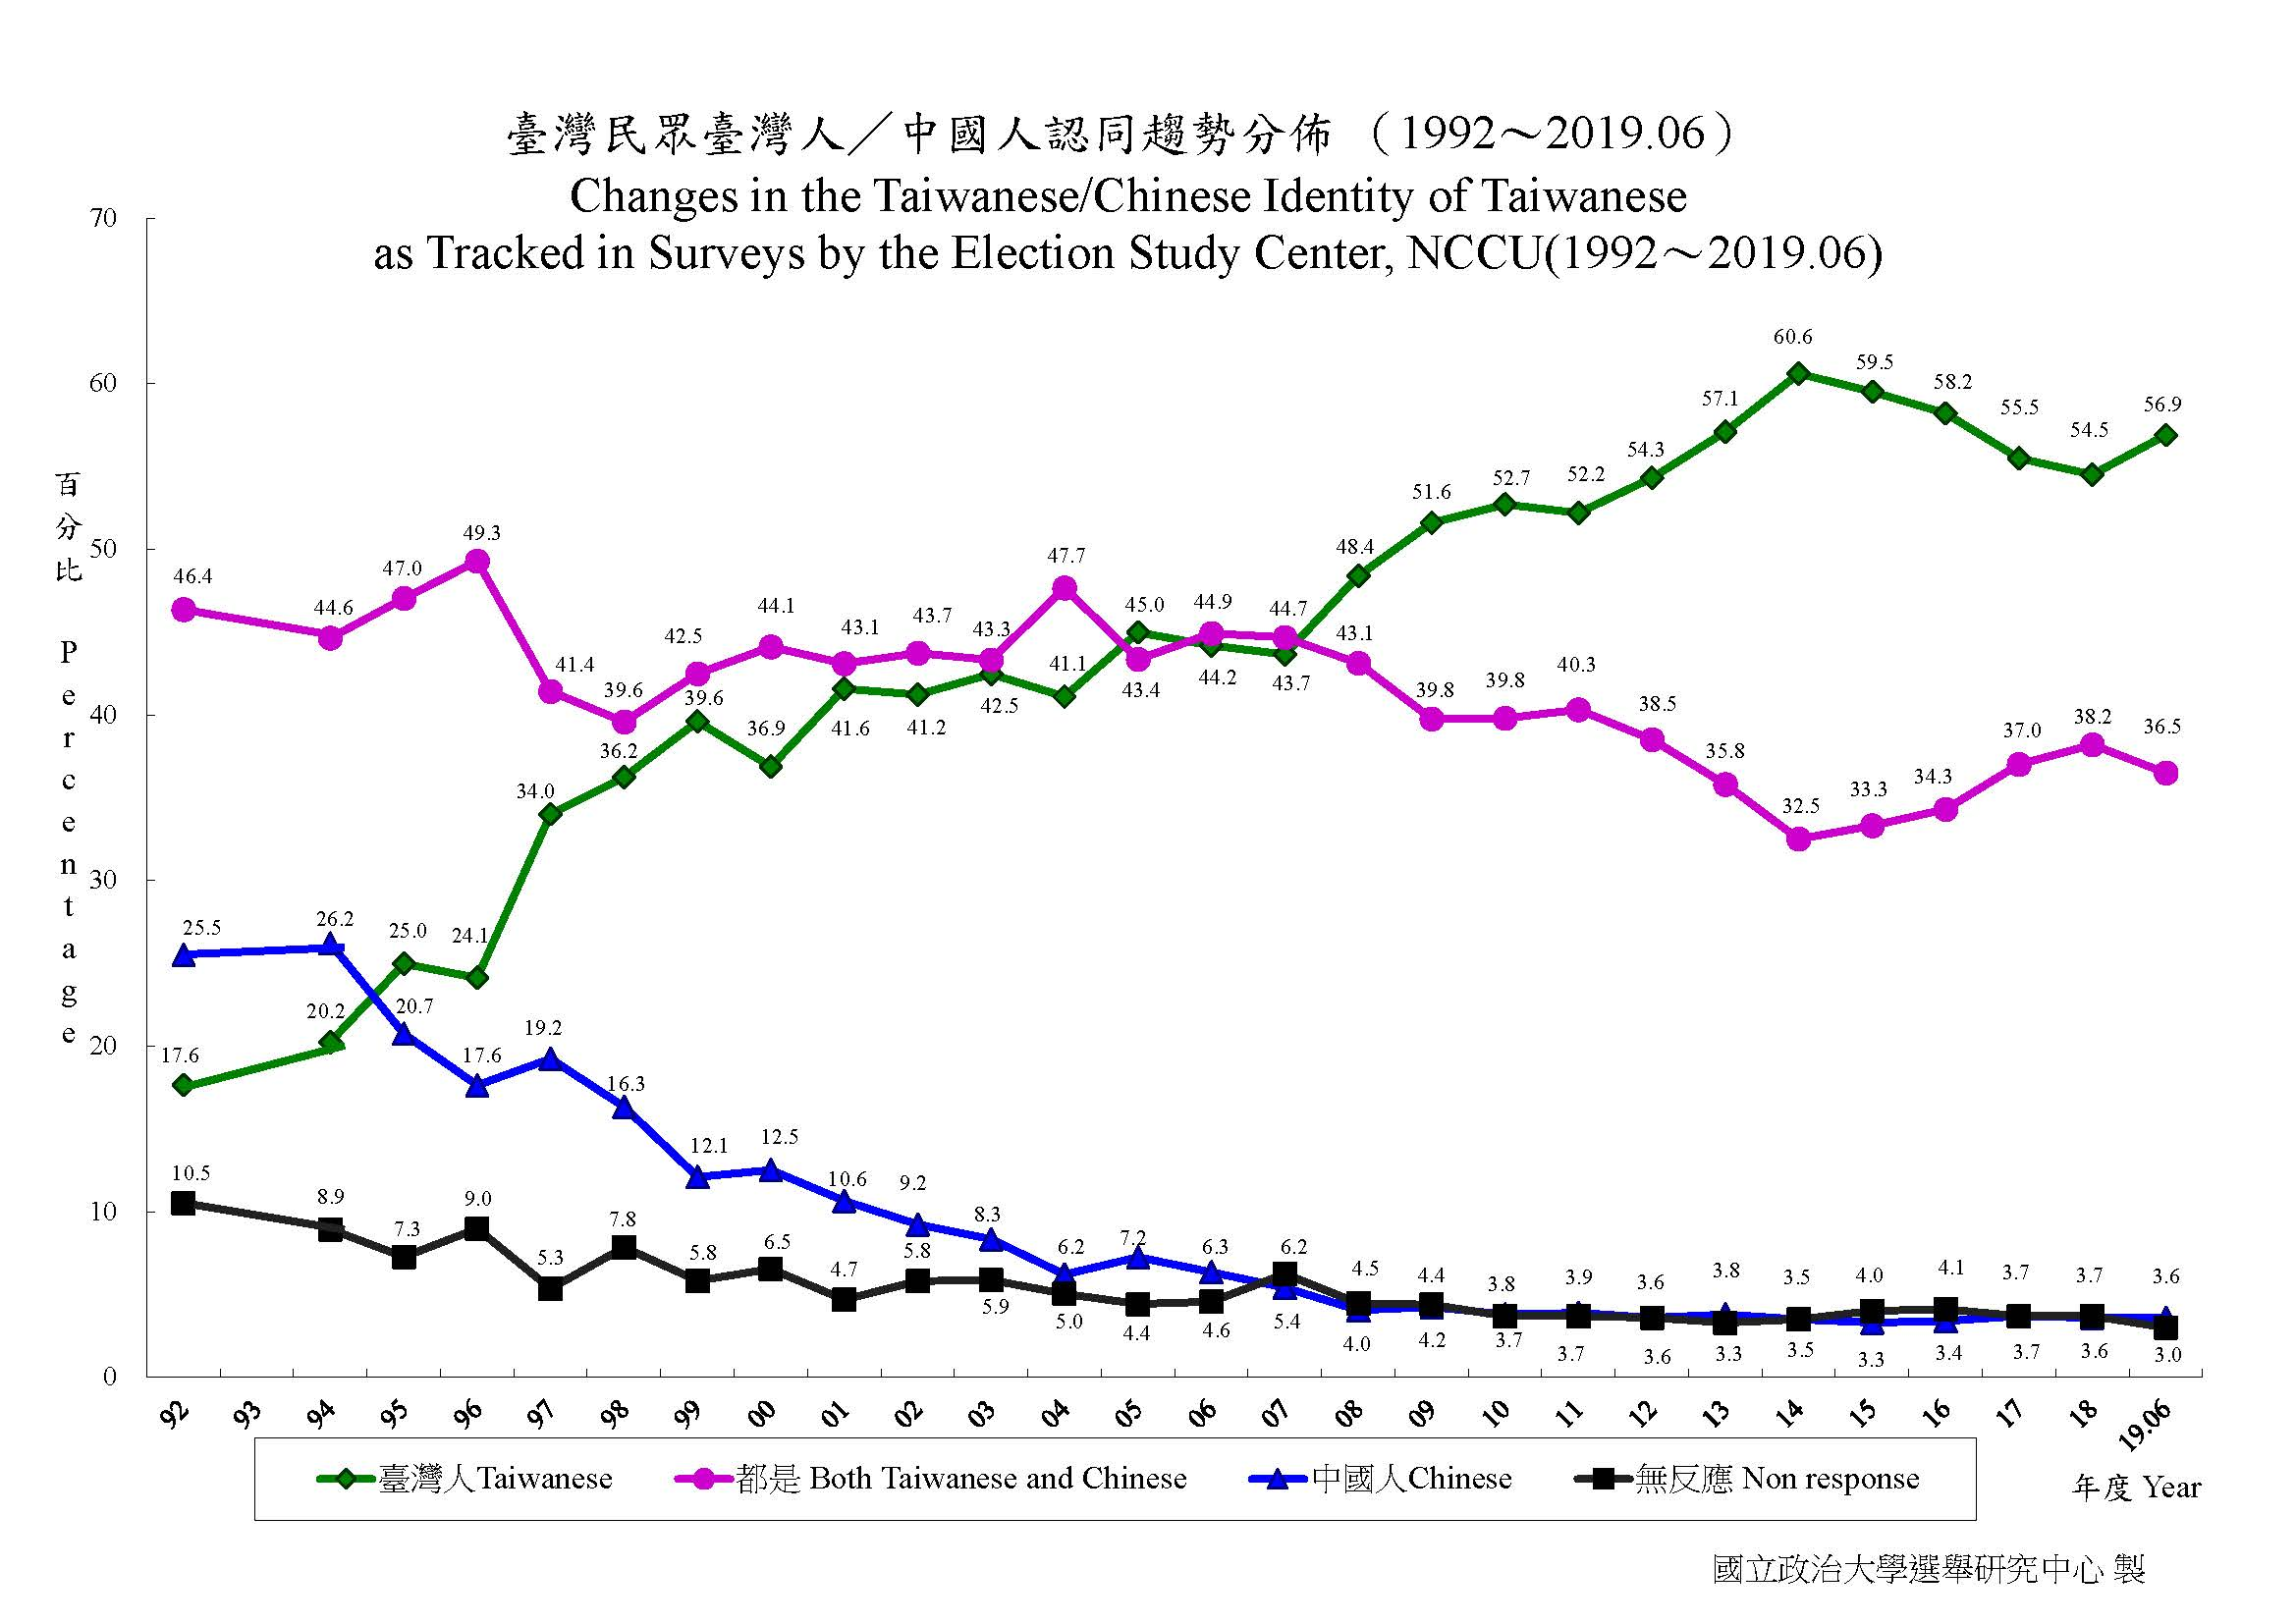
Longitudinal Core Attitudes
ESC has accumulated three longitudinal core attitudes since 1992.
They are partisanship, independence-unification, and Taiwanese identity.
Data are based on various polls for the past half or one year.

Slide 14
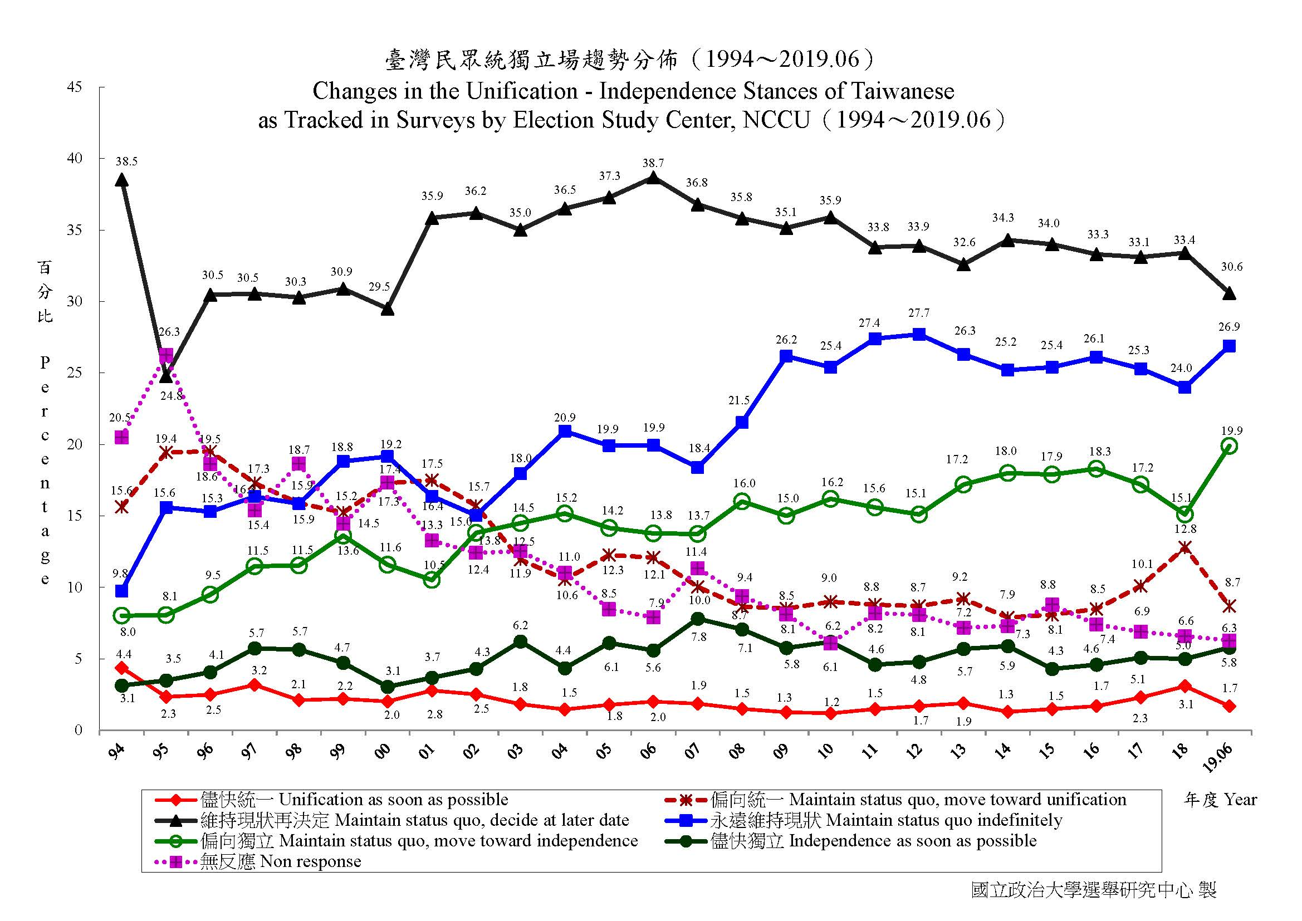

Slide 15
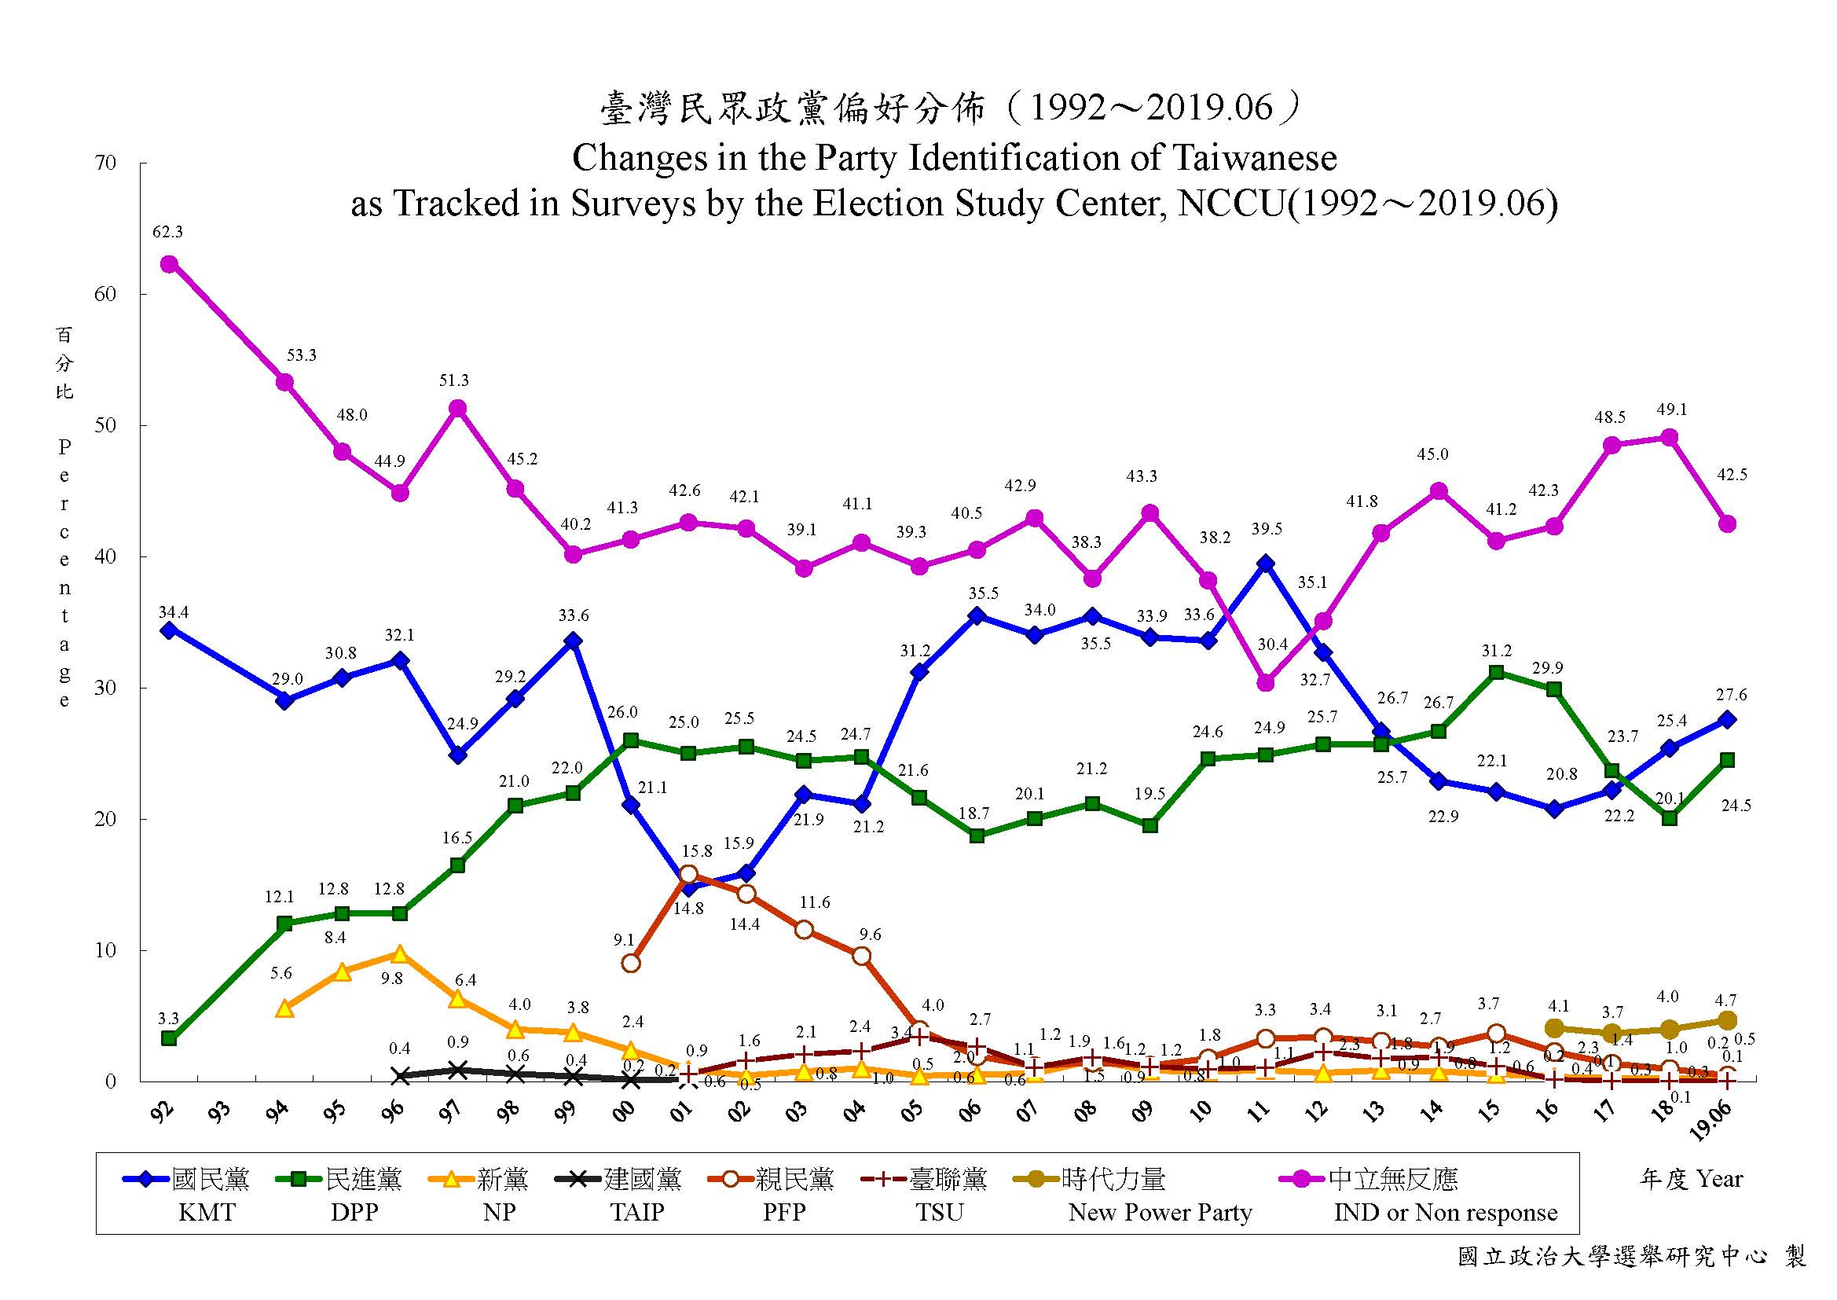

Slide 16
Big Picture
Pro-independence and Taiwanese identity have been growing since 2008, but KMT identification remains strong until 2011.
Since 2008, on average 55% Taiwanese identity and 22% pro-independence. Over 50% choose status quo.
DPP gained momentum in 2013 but has struggled since 2017.

Slide 17
China: Threats or Opportunities?
Taiwan has great trade surplus with China since 1980s. China also receives up to 80% of Taiwan’s foreign investment.
Since 2001, many Taiwanese companies manufacture goods in China, and then importing to US or selling to China.
It is estimated that 400,000 Taiwanese are working in China.

Slide 18
National Security
Xi Jinping, China’s president, urged Taiwanese to consider “one country two systems” in January, 2019.
Many international media and think tanks warn the world about China’s cyber attack and spreading misinformation in Taiwan.
China boycotted Taiwan in every international organization, such as United Nations, WHO, and INTERPOL. They also cut Taiwan’s diplomatic ties.

Slide 19
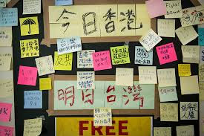
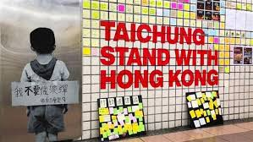
Influence of Protest in HK

Slide 20
So how Taiwan People Think about Politics Lately?
Mainland Affair Council (MAC) commissioned Election Study Center to do opinion polls three times a year. The latest poll was conducted in October.
Taiwan’s Election and Democratization Study (TEDS) conducts quarterly presidential popularity polls. The latest one released was in September.
ESC and Fairbank Center of Harvard University conducted a survey in mid-November.

Slide 21
Party Identification
Data: MAC (Oct.)

Slide 22
Taiwanese/Chinese identity
Data: MAC (Oct.

Slide 23
Unification-Independence Stances
Data: MAC (Oct.)

Slide 24
Independence-Unification

Slide 25
Presidential Popularity

Slide 26
Distribution of Age
Data: MAC (Oct.)

Slide 27
Age x Party ID
Data: MAC

Slide 28
Age X Unification-Independence
Data: MAC (Oct.)

Slide 29
Age X Tsai Ing-wen
Data: ESC-Harvard Survey (Nov. 2019)

Slide 30
Economic Retrospect
Compared to six months ago, do you think Taiwan’s economy becomes? (TEDS)

Slide 31
Election Forecast?
The coverage rate of telephone interview might be low (60%?). People who are not contacted may vote for either party or don’t turn out. We also need to know the preference of people who refuse to reveal their voting choices. So election forecast is complicated (Hung Yung-tai, 2014)
Some people watch the township or village that has previous election outcomes very close to the national ones.

Slide 32
Concluding Remarks
Young voters prefer independence and DPP. They are likely to support President Tsai.
President Tsai bounces back from the 2018 municipal election probably because President Xi of China mentioned ‘one country two systems’ and protest erupted in HK. However, very few people think economy is better.
Taiwan people are divided on identity, and governance remains vital to democracy.

Slide 33
Giving to ESC
http://donation.nccu.edu.tw/web/donate/donate.jsp

