Slide 1

Git Version Control System

Slide 2
大綱
What Is Version Control System?
Git Basic and Git Hosting Service
Git Workflow
From Git to Product Release

Slide 3
What Is Version Control System?

Slide 4

Bad Version Management
If develop in local environment
How to compare the different between each version?
Is good for team members collaborate?
Alice’s Code
Bob’s Code
What is the different?
V1.0.0
V1.0.0
V1.0.1
V1.0.1
How to merge these two version of project
V1.0.2
V1.0.2

Slide 5



Version Control System (VCS)
Records the changes made to our code over time in a special database called Repository
We can track when, who, what, and why to change in the project
Easy to revert the project to earlier status
VCS will detect code conflict automatically to ensure there are no code conflicts between the developers
Makes collaboration easier, allowing changes by multiple people to all to be merged into one repository
Remote Repository
Alice’s Code
Repository
History
Bob’s Code

Slide 6


Centralize vs. Distributed
Two Categories to implement the VCS
Centralize: Team members connect to a central server to get the latest copy of the code and to share their changes, e.g. change the code on same computer
Distributed: Every members has a copy of the project with its history on their machine, so can save snapshots of project locally on our machine and synchronize the project with others, e.g. Git
Centralize
Distributed
Central Server

Slide 7
Git Basic and Git Hosting Service

Slide 8
Git Introduction
Popular and free open-source VCS
Support for non-linear development (thousands of parallel branches)
Fully distributed and able to handle large projects efficiently
Cheap Branching and Merging
Git is a software system and Github/Gitlab is a host service for git repositories. Therefore, Git is not equals to Github/Gitlab!!!
Notes:
大家可同步進行
分散事
有效率

Slide 9


Build Git enviroment
This link has details on how to install Git in the difference OS https://git-scm.com/book/en/v2/Getting-Started-Installing-Git
Verify if Git is installed by using the following command in the command prompt:
Set your user name and email address at first. Git commit uses this information, and it’s immutably baked into the commits you start creating
Notes:
安裝 Git 後首先應該做的事是設定使用者名稱及電子郵件。 這一點非常重要，因為每次 Git 的提交會使用這些資訊，而且提交後不能再被修改
再次提醒，若你有傳遞 --global 參數，只需要做這工作一次，因為在此系統，不論 Git 做任何事都會採用此資訊。 若你想指定不同的名字或電子郵件給特定的專案，只需要在該專案目錄內執行此命令，並確定未加上 --global 參數。

Slide 10
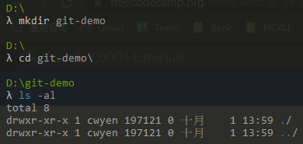
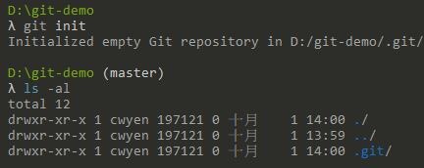
Build Git enviroment
Create a folder for your project
Add a local Git repository to the project

Slide 11
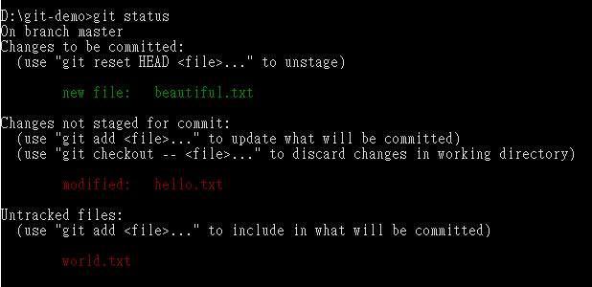
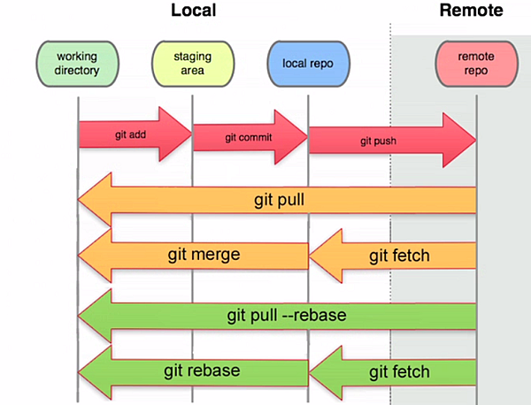
Working , Staging and Local Repo
Staging
Area
Working
Directory
Working
Directory
(Untracked)

Slide 12
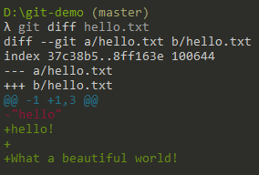
Different in files
“git diff” will display the diffrence code in files.
This line has been edited

Slide 13
Commit the Changes
“git commit”: Create a new commit containing the current contents of the index and the given log message describing the changes.
The commit message for the person to know what had been changed

Slide 14
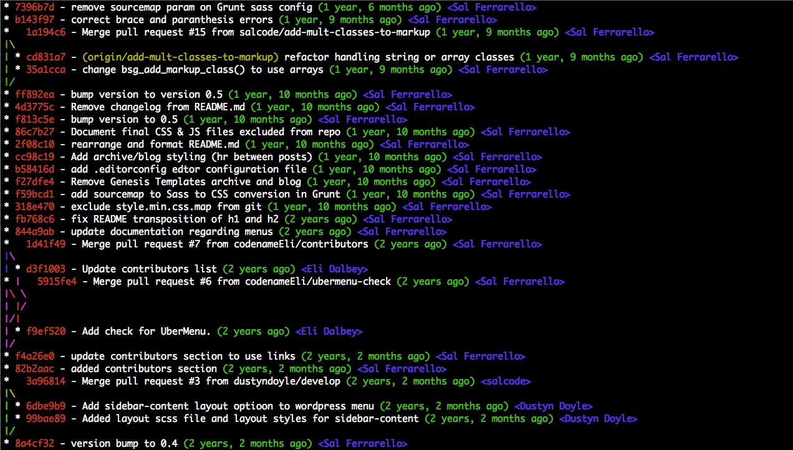
Git snapshot
Git will create a snapshot when commit files to local repository
Snapshot has unique SHA1 hash code
We can use the specific hash to revert to the previous version
SHA1 Hash code
Commit message
Commit time
Who create this commit

Slide 15
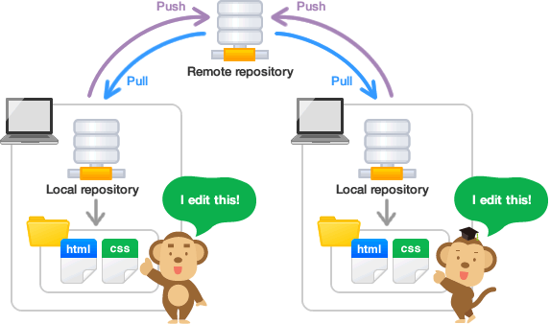
Collaborative Development
Need a Git hosting service to track the changes from all developers
Github
GitLab
Gitee
Bitbucket
Setting up github remote repository https://guides.github.com/activities/hello-world/

Slide 16
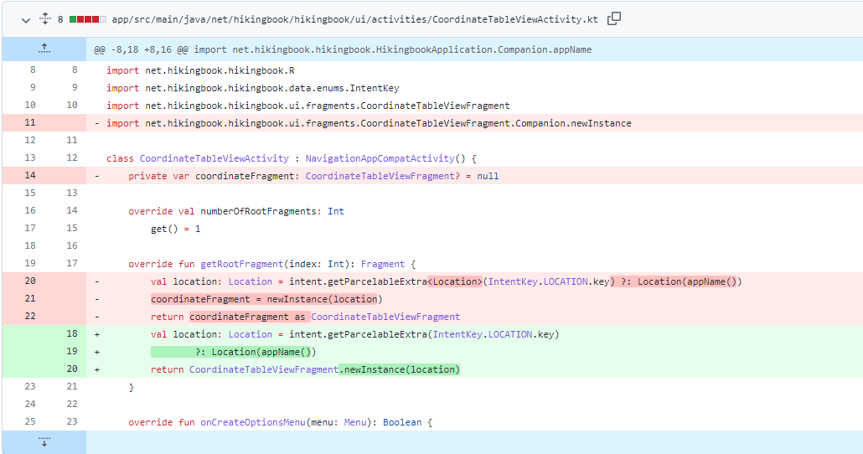
Collaborative Development
Git hosting service will mark the lines which was cheaged
This is good for “Code Review”
Removed
Edited line is 20, 21, 22 to 18, 19, 20

Slide 17
Collaborative Development
Pull the remote repository to local repository
Git will merge the change on the remote repo with the local repository
Conflict when merging https://gitbook.tw/chapters/branch/fix-conflict.html
Fix conflict

Slide 18
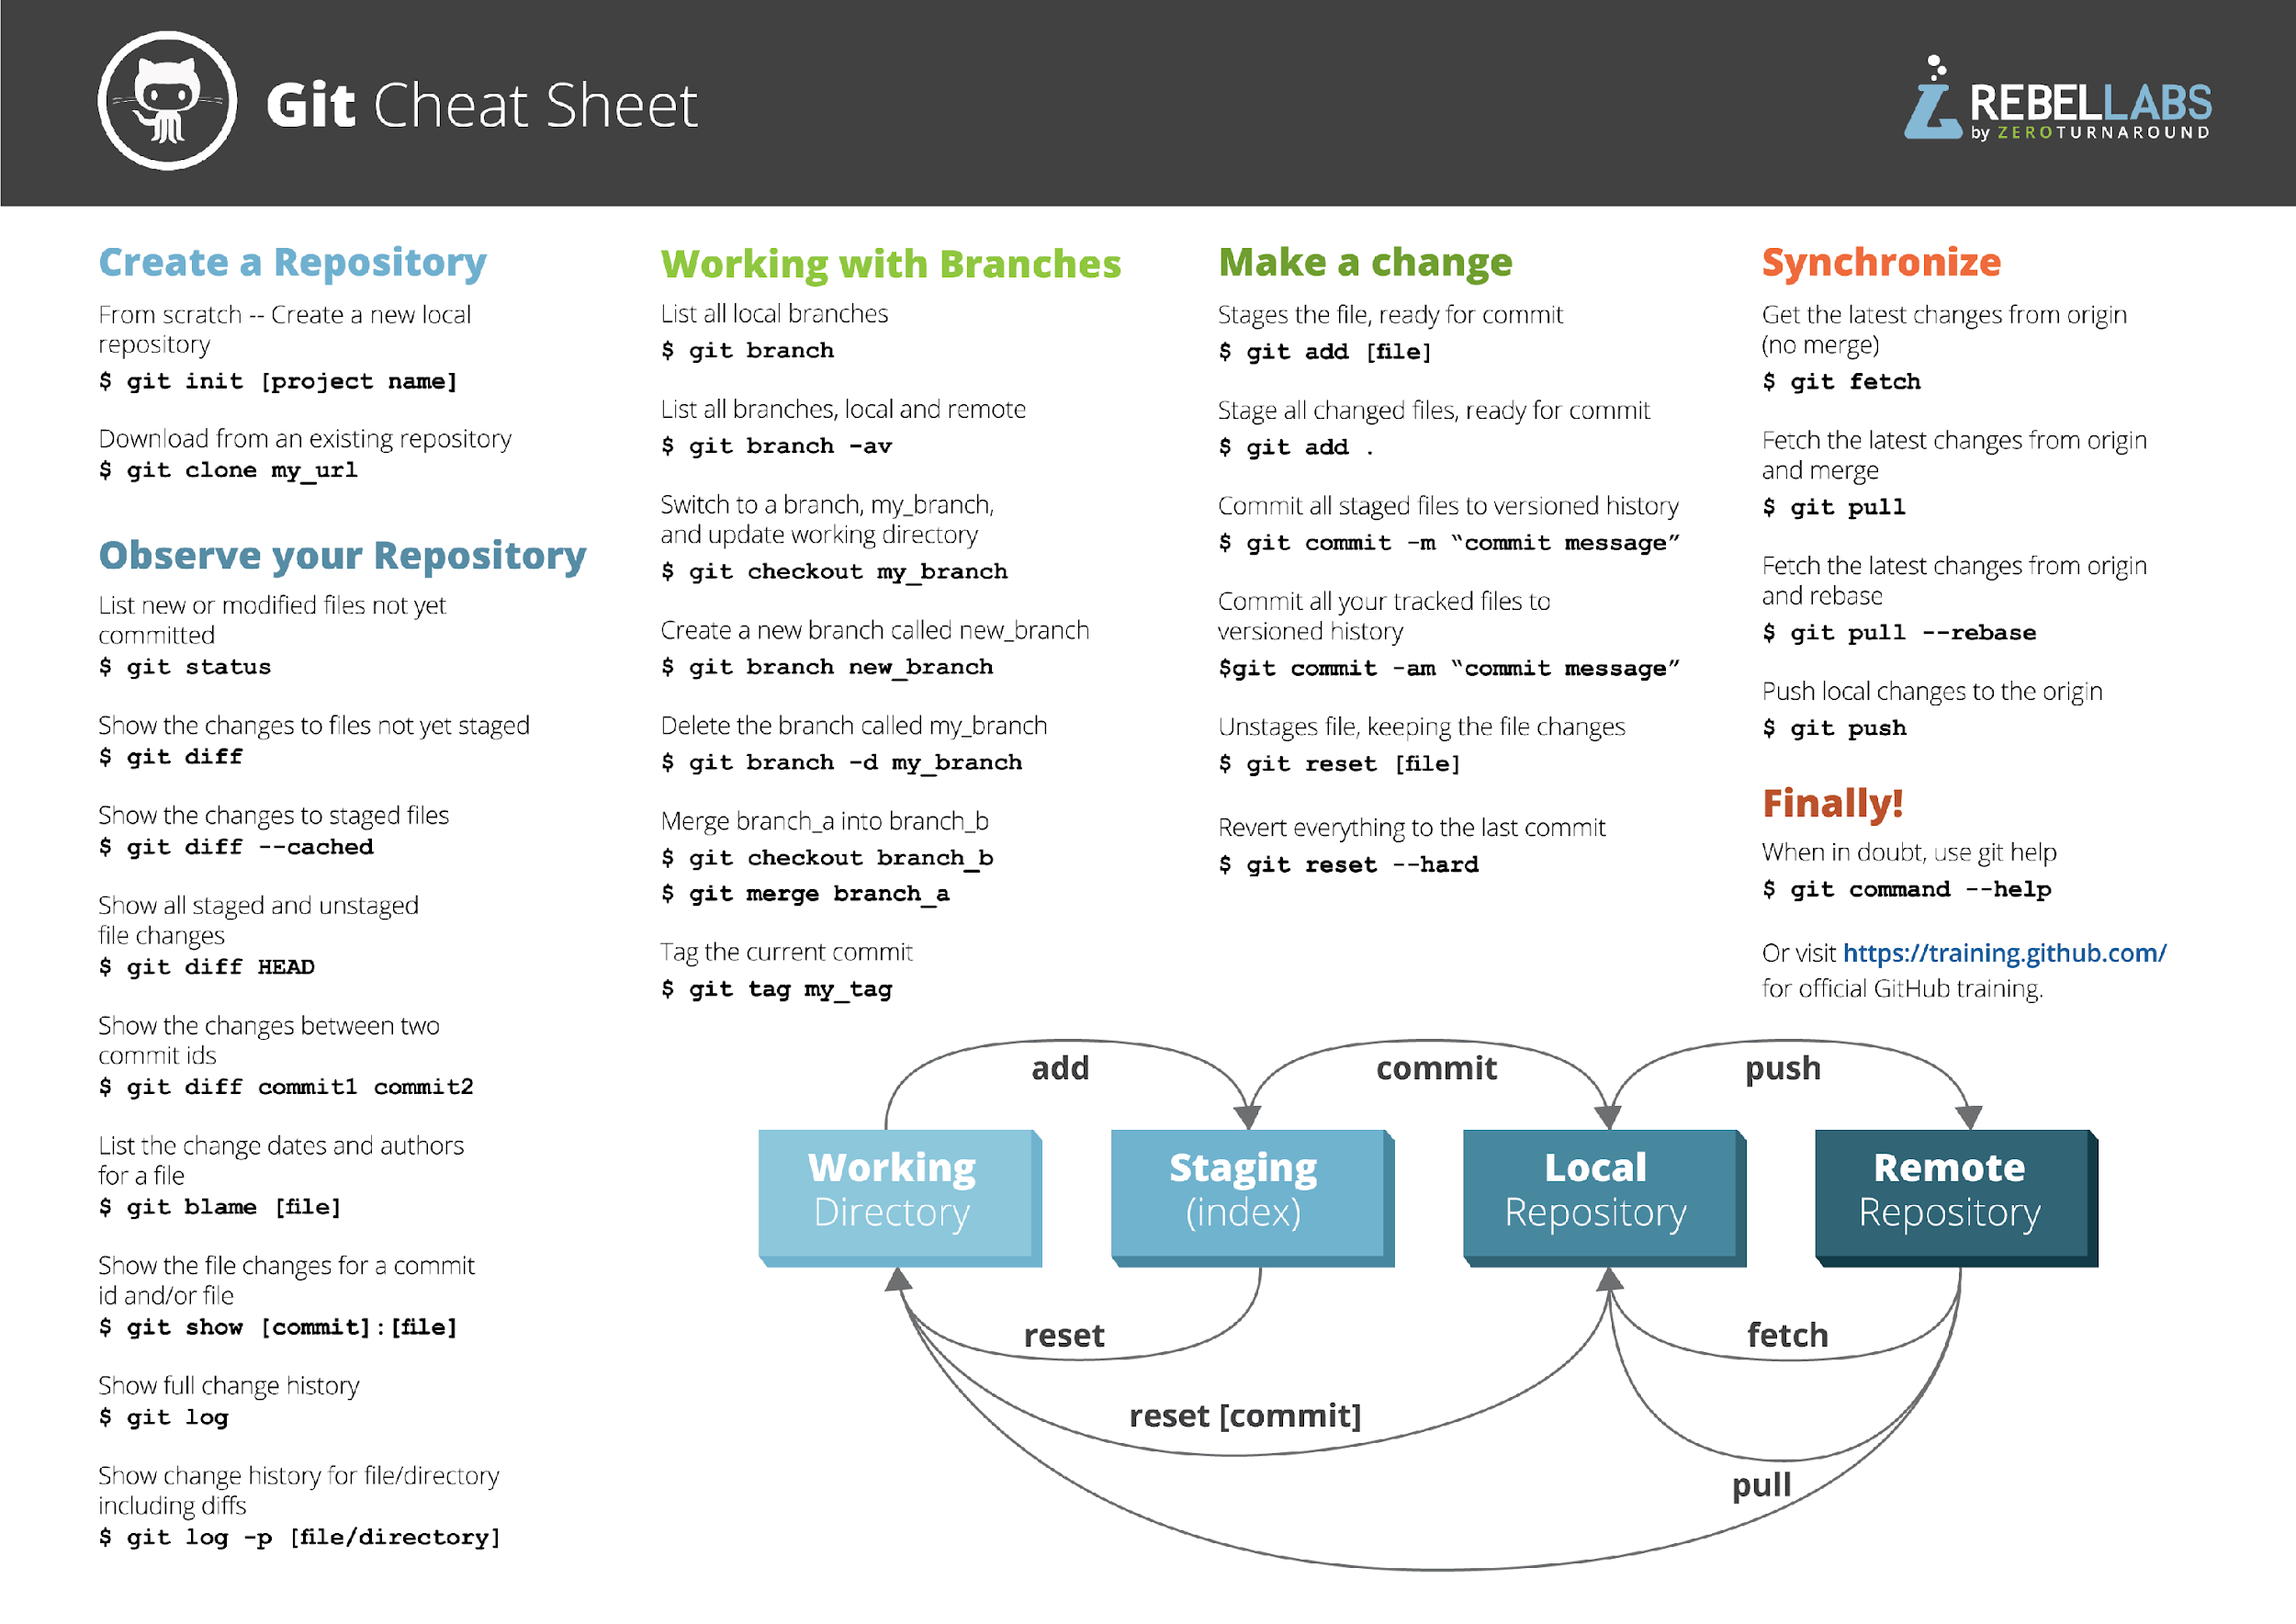
Git Commands And GUI
Git cheat sheet
Git GUI can instead of execute commands in the terminal
Sourcetree https://www.sourcetreeapp.com/

Slide 19
Git Workflow

Slide 20
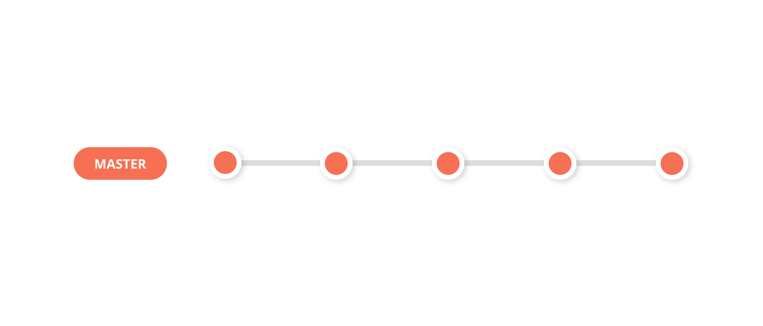
Git workflow
Collaboration between departments
Dev team
QA team
Ops team
Ops team
Dev team
Dev team
V1.0
V1.1
V1.2
V5.0
QA team
Which version should be test and which version should be release?
How to fix bugs?
Notes:
如果Dev team 開發很快，那 QA team 和 Ops team 要怎麼知道哪個版本要測試，哪個版本要 Release?
又或者說如果 QA team 測試到 bug 而 Dev team 要怎麼跳進來修
如果 Dev team 修再 master 上，那 QA team 就要測到還沒有要上的新功能，而新功能可能Dev team 還沒做完，就又會碰到其他的 bug，那 qa team 是否還要再等待 dev team 完成新功能才能再做測試?

Slide 21
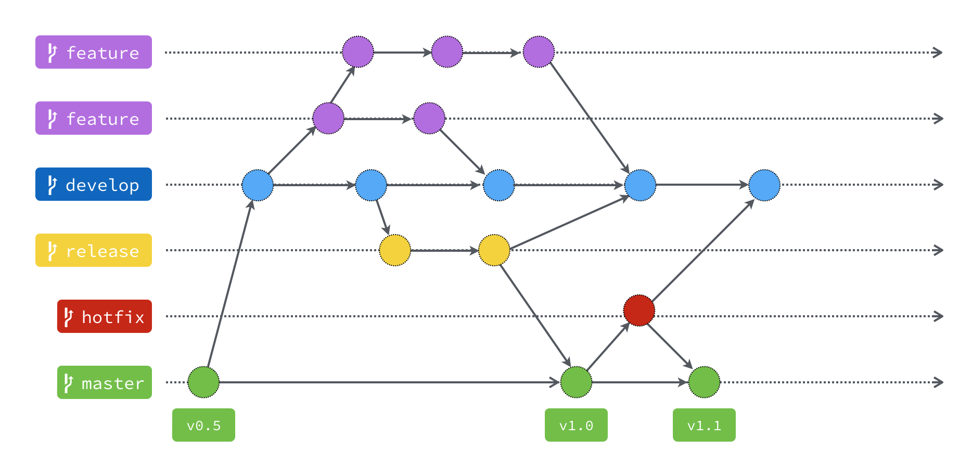
Git Flow
Branch is very important in git world
Every branch have specific purpose
Master: Stable and can release in anytime
Develop: The base brach of all features and the finished featrue will merge to here
Hotfix: Used to quickly patch production releases
Release: This branch is for product testing (For QA team)
Notes:
Master 分支
主要是用來放穩定、隨時可上線的版本。這個分支的來源只能從別的分支合併過來，開發者不會直接 Commit 到這個分支。因為是穩定版本，所以通常也會在這個分支上的 Commit 上打上版本號標籤。
Develop 分支
這個分支主要是所有開發的基礎分支，當要新增功能的時候，所有的 Feature 分支都是從這個分支切出去的。而 Feature 分支的功能完成後，也都會合併回來這個分支。
Hotfix 分支
當線上產品發生緊急問題的時候，會從 Master 分支開一個 Hotfix 分支出來進行修復，Hotfix 分支修復完成之後，會合併回 Master 分支，也同時會合併一份到 Develop 分支。
為什麼要合併回 Develop 分支？如果不這麼做，等到時候 Develop 分支完成並且合併回 Master 分支的時候，那個問題就又再次出現了。
那為什麼一開始不從 Develop 分支切出來修？因為 Develop 分支的功能可能尚在開發中，這時候硬是要從這裡切出去修再合併回 Master 分支，只會造成更大的災難。
Release 分支
當認為 Develop 分支夠成熟了，就可以把 Develop 分支合併到 Release 分支，在這邊進行算是上線前的最後測試。測試完成後，Release 分支將會同時合併到 Master 以及 Develop 這兩個分支上。Master 分支是上線版本，而合併回 Develop 分支的目的，是因為可能在 Release 分支上還會測到並修正一些問題，所以需要跟 Develop 分支同步，免得之後的版本又再度出現同樣的問題。

Slide 22
From Git to Product Release

Slide 23


Slide 24
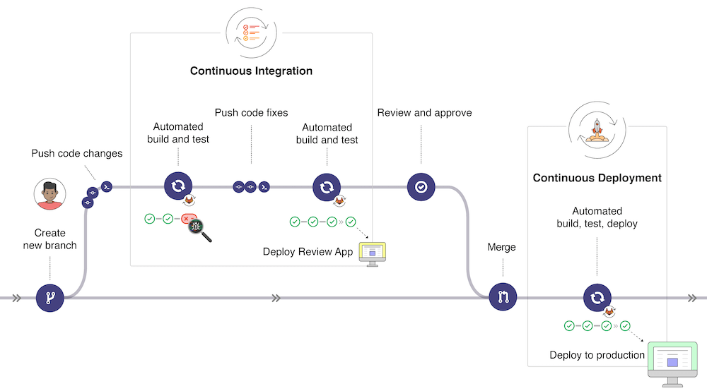
Git to CI/CD
CI/CD
Automated build staging enviroment
Automated testing on staging enviroment
Automated build, test and deploy to production enviroment

Slide 25
Time to Practice
Install git and setup environment
https://git-scm.com/book/en/v2/Getting-Started-Installing-Git
https://git-scm.com/book/en/v2/Getting-Started-First-Time-Git-Setup
Signup github and fork the remote repo
Fork this repo the your github https://github.com/RobinChien/Backend_Swagger_Demo
Clone the remote repo to local repo
$ git clone “the ssh path of your remote repo”
Create the new brance and edit the README.md
$ git checkout -b dev *Create new branch and change to this branch
$ git branch
Edit the README.md
$ git status
Add the edit to history
$ git add README.md
$ git commit -m “the commit message”
Push to remote repo
$ git push origin dev

Slide 26
Homework - Create a PR
Read this first: https://gitbook.tw/chapters/github/pull-request
Fork (https://github.com/RobinChien/Backend_Swagger_Demo) and create a new branch call “[your_name]_dev”.
Then create a new file call “try_for_git.txt” and add to git repo
Create a PR to this repo (https://github.com/RobinChien/Backend_Swagger_Demo) and ask to merge in dev branch. * The title and the description of PR is not acceptable.

Slide 27
Thank You!
Q
A
&
27

Slide 28
Q1. What is the difference between with Git and Github/Gitlab?
Git is a software for version history control
Github is the repository hosting service, is a online platform

Slide 29
Q2. Which two categories can implement the VCS?
Centralize: Team members connect to a central server to get the latest copy of the code and to share their changes, e.g. change the code on same computer
Distributed: Every members has a copy of the project with its history on their machine, so can save snapshots of project locally on our machine and synchronize the project with others, e.g. Git

Slide 30
Q3. The steps of push the local repo to remote repo?
$ git commit
$ git push
$ git add
Fix conflict

Slide 31
Backup Material
為你自己學 Git https://gitbook.tw/

