Slide 1
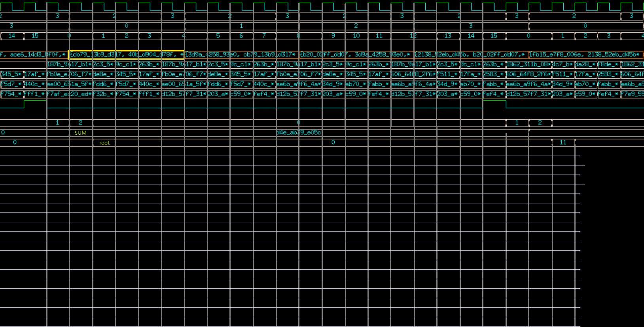
h1 ready
1 2
1 2
1 2
h1 ready
SUM
Div-1 Div-2
R12 R13 R14
h2 h3 h4
SUM
root
Div-1 Div-2
State == 2
div_en<=1
State == 1
Deviend<=column
R23 R24
h3 h4
SUM
root
Div-1 Div-2
R34
h4
SUM
root
Div-1 Div-2
H_reg[0] - h1 h1 h2 h3 h4 h4 h2 h3 h4 h4 h4 h4 h3 h4 h4 h4 h4 h4 h4 - h1
H_reg[1] - - h1 h1 h2 h3 h4 h4 h2 h3 h3 h4 - - h3 h4 h4 h4 h4 h4 h4
0 1 2 3 4 5 6 7 8 9 10 11 12 13 14 15 16 17 18 19 0

Slide 2
