Slide 1
BAN6440: Applied machine learning for analytics
Milestone 1: Spam Filtering Email System Using Machine Learning Algorithm
Tuyishime Sandrine

Slide 2

Introduction
Objective: Build a machine learning model to classify emails as spam or not spam.
Dataset: Email spam dataset containing text content and labels.
Importance: Helps automate email filtering and reduce user exposure to unwanted content.

Slide 3
Thought Process
Understand the dataset .
Preprocess data: clean text, lemmatize.
Balance the dataset to handle class imbalance.
Vectorize text using TF-IDF.
Split data into training and test sets.
Train multiple machine learning models.
Evaluate models and visualize results.

Slide 4
Challenges Encountered
Solution Implemented
Class Balancing: Used downsampling to equalize spam and not-spam counts.
Text Cleaning: Removed 'Subject' line, punctuation, stopwords.
Lemmatization: Applied WordNet lemmatizer to reduce words to base form.
TF-IDF Vectorization: Transformed text to numerical format with max_features=2000, ngram_range=(1,2).
Model Tuning: Used Logistic Regression with penalty='l2' and solver='liblinear'.
Class Imbalance: Original data had more non-spam emails.
Text Noise: Raw emails had inconsistent formatting and unnecessary tokens.
Model Accuracy: Some models underperformed

Slide 5
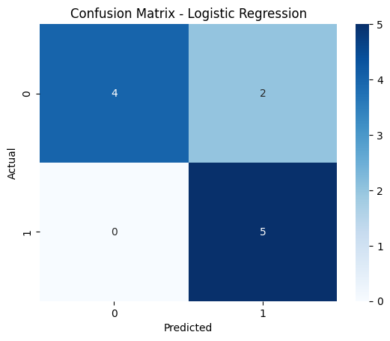

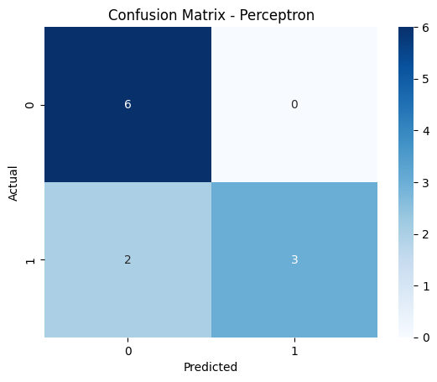
Results
Confusion Matrix
Logistic Regression: 0.81
Linear Regression : 0.81
Perceptron : 0.81
NB: Logistic Regression with TF-IDF and lemmatization performed best.

Slide 6
Conclusion
Successful spam classification using machine learning.
Improved accuracy with preprocessing and model tuning.
The project successfully demonstrated that machine learning models can effectively classify spam emails when combined with thoughtful data preprocessing and model selection.
Logistic Regression exceeded the accuracy benchmark of 0.75, confirming its robustness.

