Slide 1


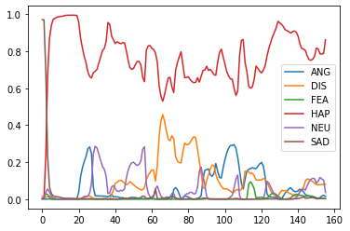


AIoT Coding, Engineering and Entrepreneurial Skills Education for Gifted Students
Trusted Friend
Student(s): 34 Tsang Siu Yin Project ID: P28
Abstract
Results/Application
There is a lack of social workers to deal with the increasing cases of mental disorders. This AI can detect emotions which can be useful to mimic a social worker when combined with a linguistic model.
The results shows that there wasn’t sufficient data to properly recognize different emotions.
Objective/Background/Motivation
However, it was able to recognize happiness with relative ease.
Mental troubles are one of the prominent problems that people from all age groups have to deal with.
Usually people needed someone to talk to just to release their stress and fear, but it is often difficult to find those people.
Social workers can achieve that goal, but as a mostly volunteer job, there too few.
This AI is intended to be able filter people with light mental disorder and severe mental disorder.
The AI should be able to deal with light mental disorder while redirecting people who have severe mental disorder to professional social workers.
QR Code for GitHub Page
QR Code for Video Demo
GitHub Link
YouTube Link
Discussion/Conclusion
The results aren’t very satisfactory, the major reason is due to the lack of labelled data processed, more data should be processed to improve the ability of the AI.
An RNN should also be implemented to better get a time varying data for emotions which can better reflex multi-emotional conversations and allow for real time capabilities.
A linguistic AI can be trained based on the data provided by the emotion-detection AI.
Methodology
The first step is to turn the audio from the dataset to a mel-spectrogram, which is a spectrogram with logarithmic frequency that mimics hearing of a person.
Then the spectrogram is processed by a CNN model, similar to regular image recognition.

