Slide 1
Road accident project
WEAPON OF CHOICE
Excel

Slide 2
About the raw data
Demo data downloaded from Kaggle website
Data about road accidents happening in London during 2021 and 2022
21 columns and 308 180 rows
Concepts I covered in this project
Cleaning and Processing the data to apply some formulas, building customized columns to be used for visualization
During the data analysis, I used aggregation data and built different view
For data visualization I then built custom charts that are dynamic and used formatting
For the dashboard/DA report, presents the dynamic charts to show the relationship between different charts

Slide 3
Requirements I had for the data
Client wants us to create a Road Accident Dashboard for the years 2021 and 2022 so they have insights on the following:
1. Total casualties and type of accident severity (serious/minimal severity)
2. Total Casualties taken place after the accidents (Primary KPI)
3.Total casualties with respect to vehicle type (Secondary KPI)
4.Monthly trend showing comparison of casualties for the Year 2022 and Previous Year 2021
5.Maximum casualties by Road Type
6.Distribution of total casualties by Road Surface
7.Relation between Casualties by Area/Location and by Day/Night.

Slide 4
Above shows the various sheets I created to aide me in creating custom charts to be used in the visualization report (DASHBOARD SHEET). Sheet 1 had included data that was raw but has since been transformed and cleaned into usable data that is used in the subsequent sheets. Which are then used to create custom charts and further breaking down the data that is used in the dashboard sheet which is the report to be used to present the findings of the data

Slide 5
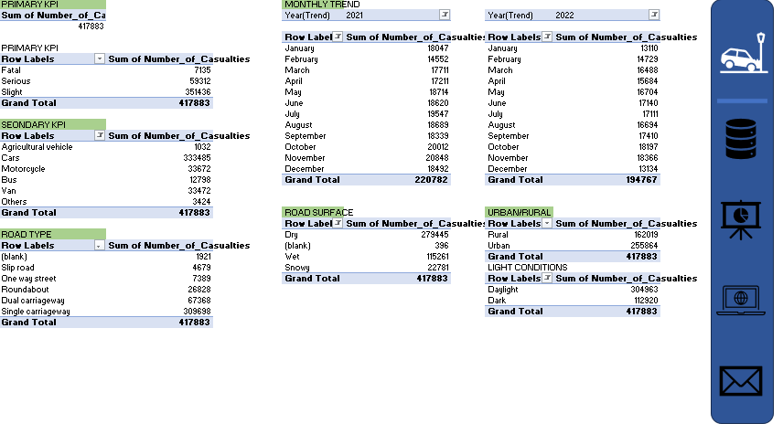
Custom tables to be utilized

Slide 6
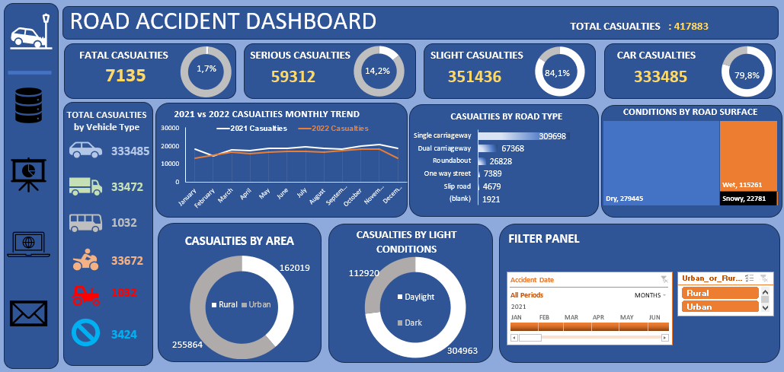
Final Report

