Slide 1
Human Pose Estimation and K-Mean Clustering
By cheuk-hang Tse

Slide 2
Objective
Perform single person Human Pose Estimation on an image using Deep Neural Network
Use K-mean clustering to find similar human pose
Save image joint position for future clustering uses

Slide 3

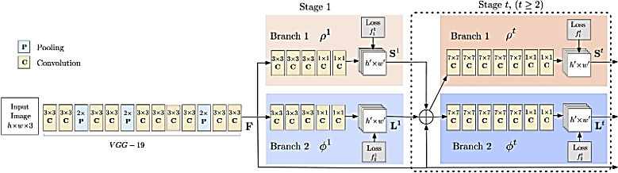
What does the Deep Neural Network do?
By the Perceptual Computing Lab at Carnegie Mellon University
Use 10 layer of VGGNet to create a feature map for the input image
A 2-branch multistage CNN is used to predict a set of confidence map of body parts location
The confidence and affinity maps are parsed by a greedy algorithm to produce the key points location
Source: https://arxiv.org/pdf/1611.08050.pdf
Notes:
VGGNet: Very Deep Convolutional Networks (specifically design for classification and localization)
CNN: Convolution Neural Network (concept of neural network, consists of convolution layers, pooling layers, activation layers)

Slide 4
K-Mean Clustering
Keypoint Name | Index
Head | 0
Neck | 1
Right Shoulder | 2
Right Elbow | 3
Right Wrist | 4
Left Shoulder | 5
Left Elbow | 6
Left Wrist | 7
Right hip | 8
Right Knee | 9
Right Ankle | 10
Left Hip | 11
Left Knee | 12
Left Ankle | 13
Chest | 14
Each keypoint will have x and y pixel location
Normalize the x and y using min-max normalization
Use inputted k on k-mean clustering to find similar image
Save the new normalized keypoint in a dataset for future use

Slide 5
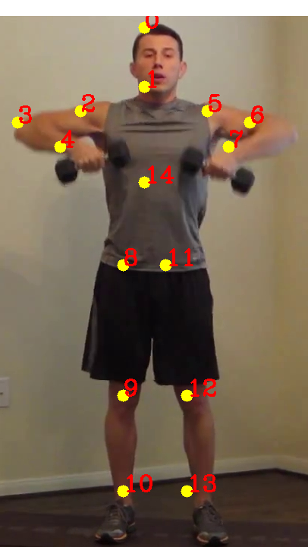
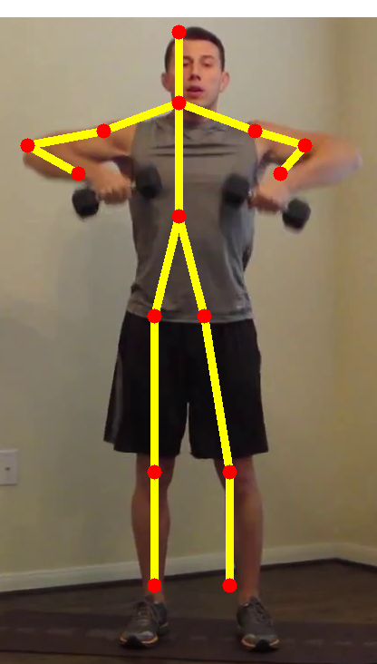
Result Demo
Input parameters:
Device: should be either “gpu” or “cpu”
inputFile: image file name, should use opencv readable file type
K: number of cluster in k-mean clustering
Use Opencv to read the model and preprocess the image to fit the model requirement

Slide 6
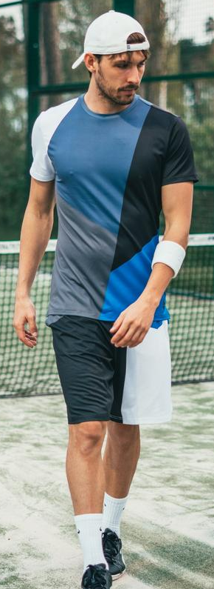
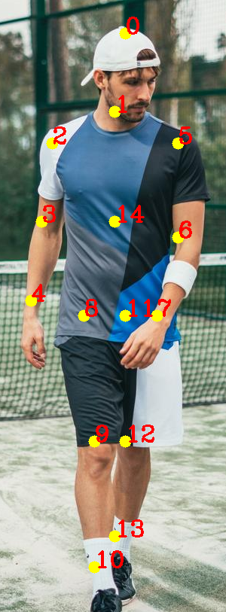
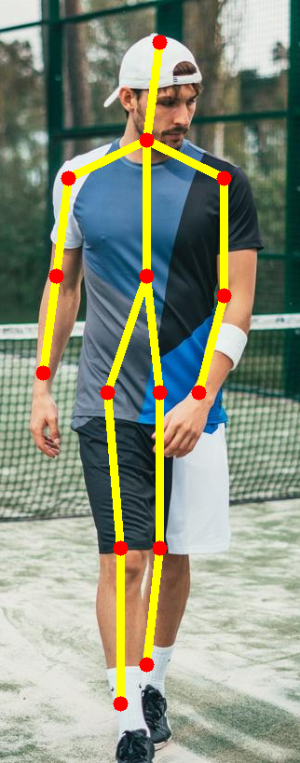
K-mean result
The demo is run using 15 clusters
9 similar image is displayed

Slide 7
Accomplishment
Utilized Deep Neural Network to locate human pose keypoints
Created a K-mean clustering class
Clustered keypoints location to find similar images
Implemented a continuous way to update and save keypoints by reading and saving into a dataset

Slide 8
Future Accomplishment
Use cosine similarity to pin-point top x similar images
Find ways to allow multi-human pose

Slide 9
Question?

