Slide 1
ITP4514 Artificial Intelligence and Machine Learning
Project
Name: Tse Man Fung
Student ID: 230026964
Class: SE-2A

Slide 2
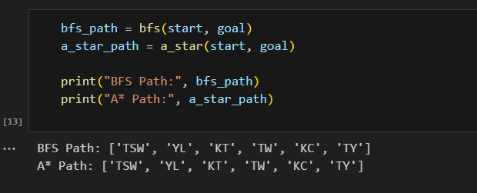
A1

Slide 3
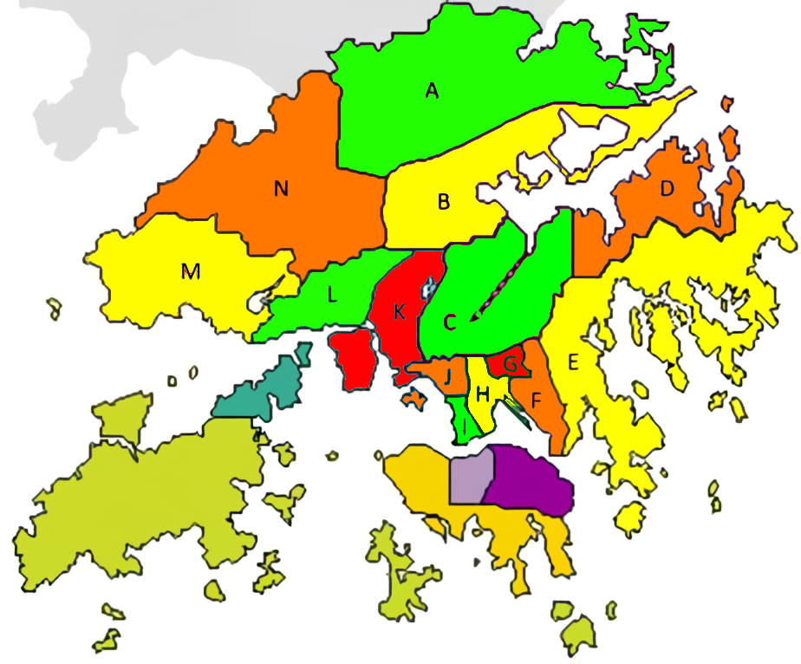
A2

Slide 4
B: Use genetic algorithm to find out the best keyboard for Cangjie Input Method
Genetic algorithms (GAs) are inspired by the principles of natural selection and evolution. They offer a robust framework for solving complex optimization problems by iteratively improving candidate solutions based on defined criteria. By applying GAs to keyboard design, we can systematically evaluate various configurations to determine the most effective layout that enhances typing efficiency and minimizes user fatigue.

Slide 5
Dataset
Novel
● Development of web scraper (getArticle.py) ● Purpose: Extract coherent sentences from novel websites ● Methodology: Crawling online literary resources ● Outcome: Creation of a robust text corpus for analysis
Cangjie File
● Development of script (makeDataset.py) for data standardization ● Consolidation of Cangjie files into a unified JSON format (unicode2cangjie.json) ● Example of JSON structure linking Chinese characters, Unicode values, and Cangjie keys

Slide 6
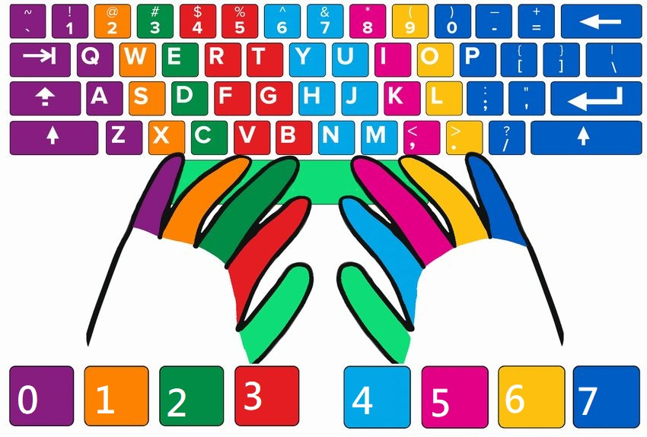
Define Keyboard

Slide 7
Train Method
Initialization
Population generation (random or predefined)
Evaluation
Assessment of keyboard layouts based on total finger travel distance
Selection
Process for selecting top-performing layouts for next generation
Crossover and Mutation
Mechanisms for combining features and maintaining diversity
Iteration
Repetition of the process over multiple generations
Results
Documentation of the best keyboard layout and performance metrics

Slide 8
Coding
Genetic Algorithm Implementation
Methods for managing populations and computations
Keyboard Class Functionality
Details on layout representation and distance calculations
Data Handling
Methods for JSON file interactions
User Interaction
Options for configuring parameters in the main script
Visualization
Use of Matplotlib for performance visualization

Slide 9
Result
Parameter
Definitions and implications of key parameters: population size, generations, text lines, random text, mutation rate
Label
Descriptions of performance metrics: distances for fastest, average, and control keyboards
Chart
Explanation of chart elements: X-axis (iterations) and Y-axis (distance increase rate)
Result Examples
Summary of multiple parameter sets and their outcomes

Slide 10
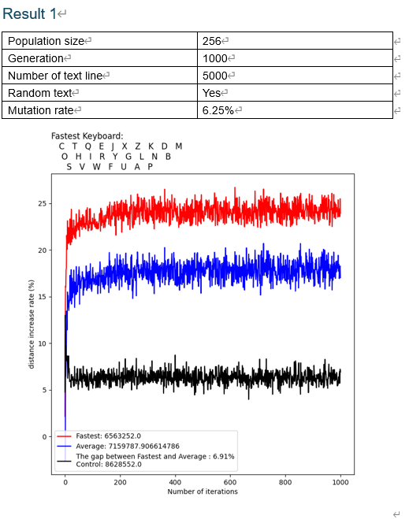
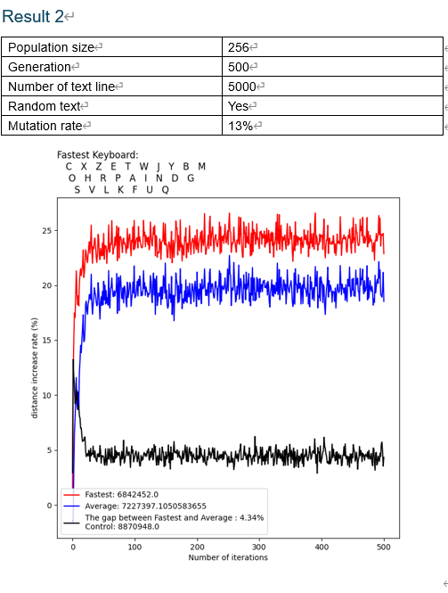

Slide 11
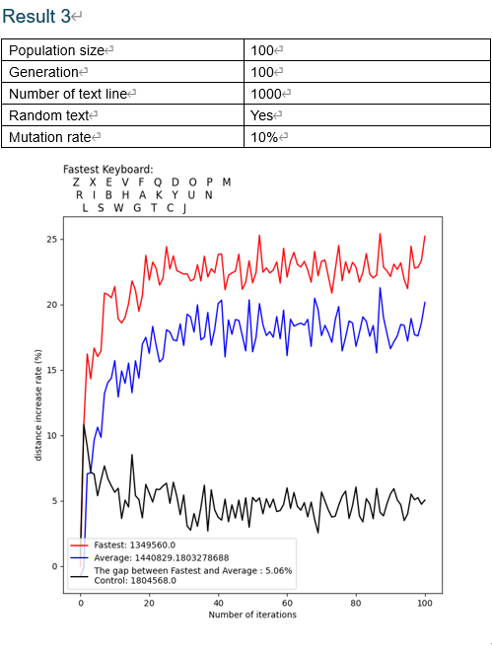
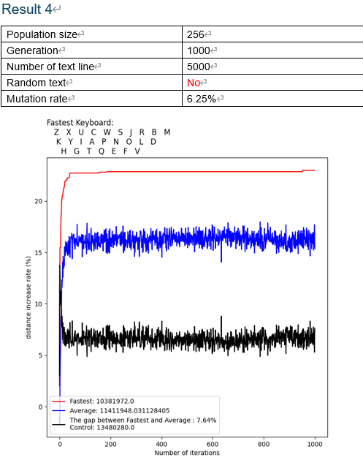

Slide 12

Conclusion
Key characteristics of the best keyboard for
Cangjie Input MethodInsights on layout design based on frequency and positioning of keys (color-coded analysis)

