Slide 1

GROUP 2 : THE DATA NINJAS EVALUATING COST OF LIVING IN THE US CITIES
Faiza Ahmad,
Nicole Harris,
Tsebaot Kebede,
Cynethia Martinez,
Libby Berter
Feb, 2023

Slide 2

Cost of Living in US Cities
Introduction:
Welcome to this presentation on the cost of living in US cities.
Importance of considering cost of living when relocating for job opportunities.
Determine the lowest cost of living cities (or states) in the US based on
transportation
food
housing expenses
Goal: understand cost of living and make informed decision on relocation.

Slide 3
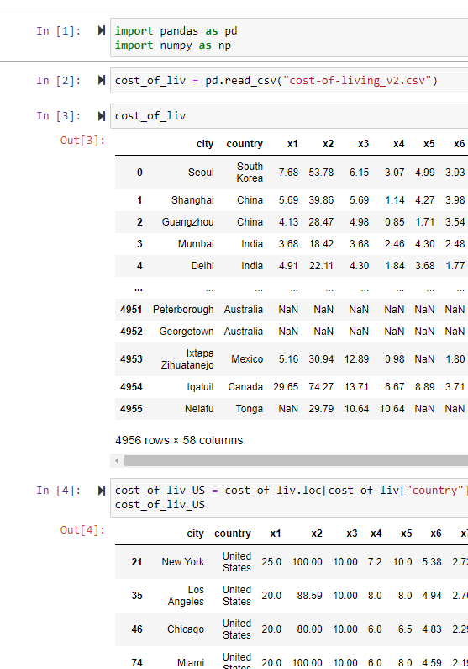
Cost of Living in US Cities
Introduction:
Welcome to this presentation on the cost of living in US cities.
Importance of considering cost of living when relocating for job opportunities.
Determine the lowest cost of living cities (or states) in the US based on
transportation
food
housing expenses
Goal: understand cost of living and make informed decision on relocation.

Slide 4
The data and collection:
Sources:
"Global Cost of Living" dataset on Kaggle.
Open Weather API
Extracted the US data, dropping the data from around 5,000 rows to 1073
Data Cleaning eliminated the empty rows dropping the rows from 1073 to 313.
Data Analysis techniques
Sorted
Adding relevant columns to simplify
Renaming the columns to make is more intuitive
Limitation: no State information from the main Data source.
Open Weather API used to add State information

Slide 5
Cost of Living in US Cities
Cost of Living Comparison:
Top 50 most expensive cities primarily in California and Florida.
Housing drives cost of living and geography is key factor.
Most expensive states: Hawaii, California, Washington, New York, Massachusetts.
Most expensive cities: Key West, Boca Raton, Red Wood City, New York, Mountain View.
Least expensive states: West Virginia, Mississippi, Arkansas, North Dakota, Missouri.
Least expensive cities: Shreveport, Dubuque, Sumter, Suffolk, Russellville.
Trending expenses by state:

Slide 6
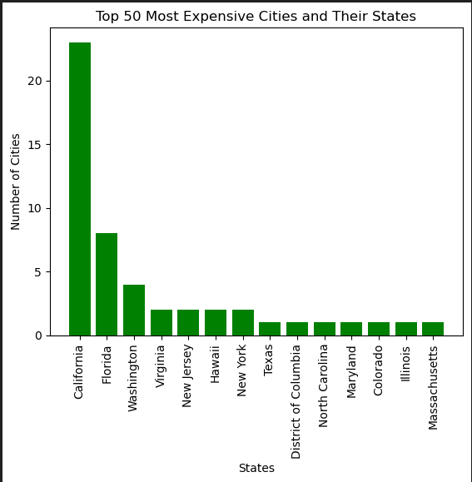
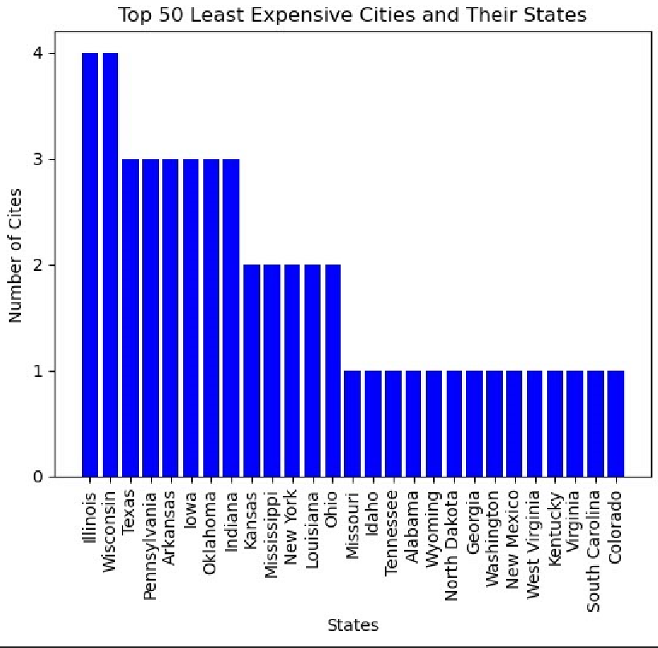
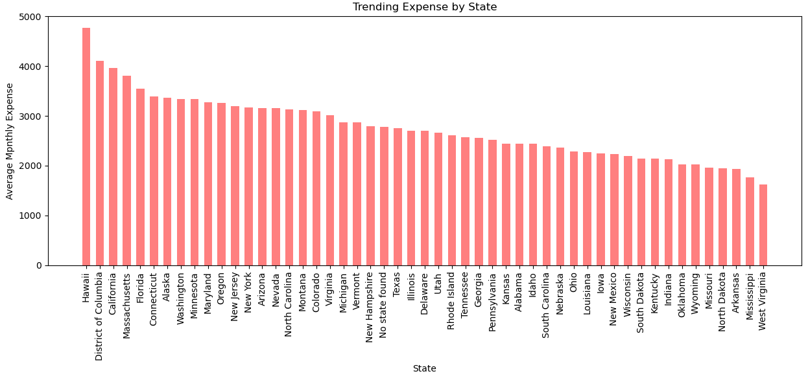
Top 50 most expensive cities and their state
23 of the most expensive cities are in California
8 of the most expensive cities are in Florida
Trending expense by state. Hawaii being the most expensive

Slide 7
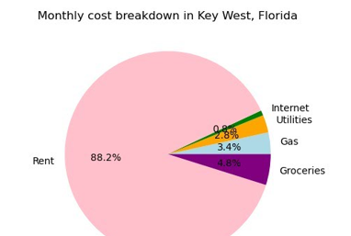
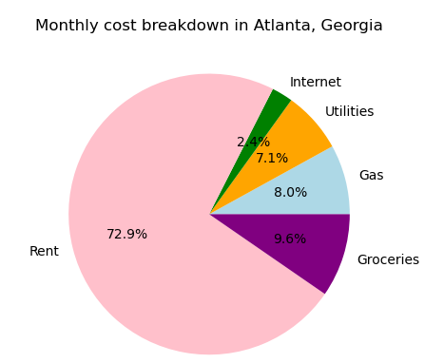
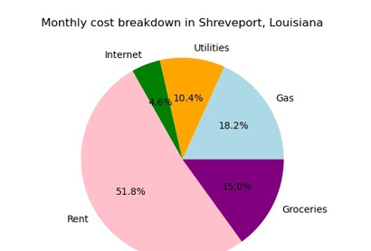

Slide 8
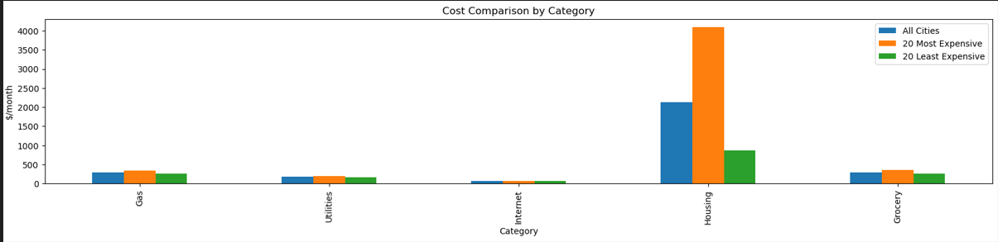
Outside the City Center living expensive
Utilities and internet costs consistent across cities.
Housing drives cost of living.
Housing drives cost of living

Slide 9
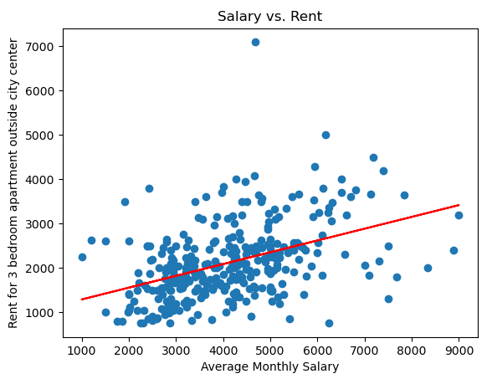
Data Analysis:
Using Python, Pandas, JSON, and Matplotlib.
Median salary important to consider.

Slide 10
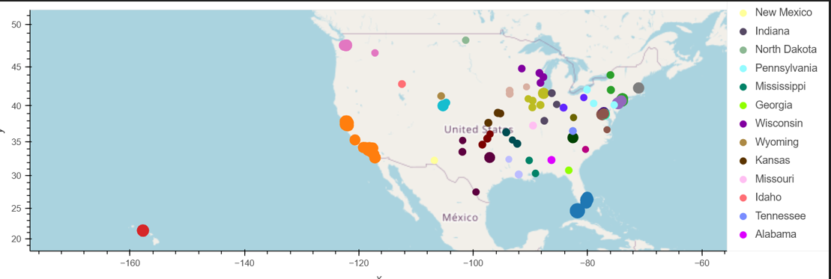
Cost of Living in US Cities

Slide 11
Cost of Living in US Cities
Conclusion:
Importance of considering public transportation.
Checking multiple cities and reformatting data can improve accuracy.
California noted to be above national cost of living and not ideal for computer data programmers.

