Slide 1

GROUP 2 : THE DATA NINJAS EVALUATING COST OF LIVING IN THE US CITIES
Cynethia Martinez,
Faiza Ahmad,
Libby Berter
Nicole Harris,
Tsebaot Kebede,
February 2023

Slide 2
Cost of Living in US Cities
Introduction:
Welcome to this presentation on the cost of living in US cities.
Importance of considering cost of living when relocating for job opportunities.
Determine the lowest cost of living cities (or states) in the US based on
transportation
food
housing expenses
Goal: understand cost of living and make informed decision on relocation.

Slide 3
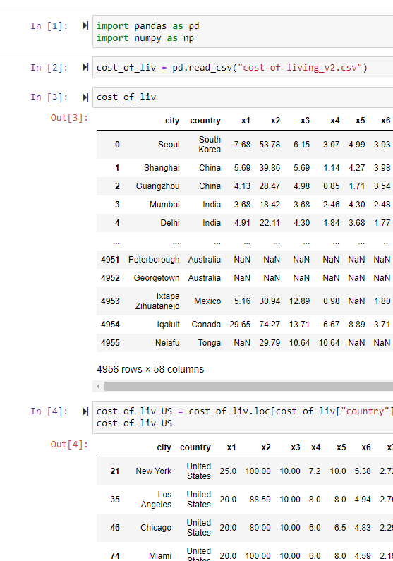
Data collection:
Sources:
"Global Cost of Living" dataset on Kaggle.
Open Weather API
Initial Steps
Read data from the source files
Extracted the US data, dropping the data from 4,956 rows to 1073
Cleaned the data dropping the empty rows, and decreased the number of rows from 1073 to 313.
Data Analysis
Using Python, Pandas, JSON, and Matplotlib.
Merged Columns
Added relevant columns
Renamed columns
Sorted & Plotted the data

Slide 4
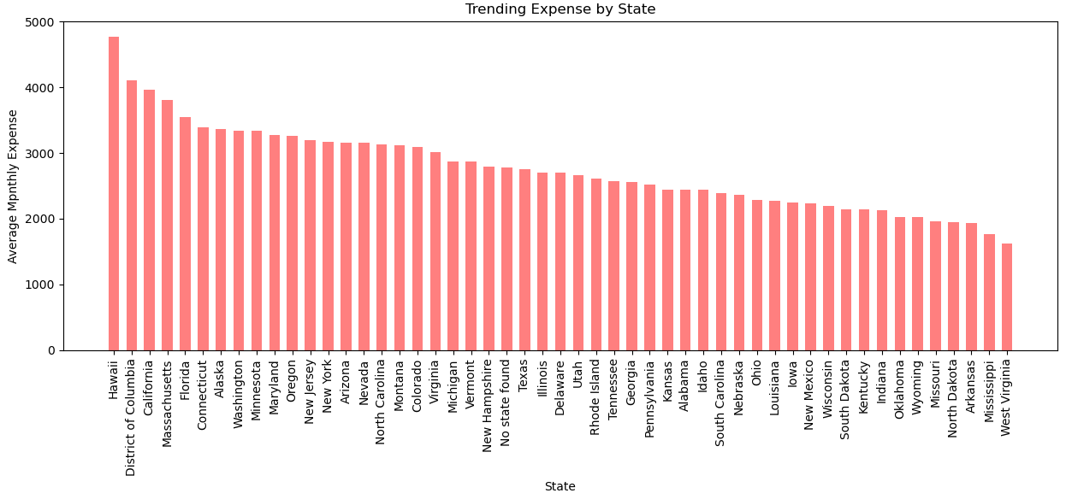
Cost of Living Comparison:
Most expensive states: Hawaii, DC, California, Massachusetts, Florida, Connecticut.
Most expensive cities: Key West, Boca Raton, Red Wood City, New York, Mountain View.
Top 50 most expensive cities primarily in California and Florida.
Least expensive states: West Virginia, Mississippi, Arkansas, North Dakota, Missouri.
Least expensive cities: Shreveport, Dubuque, Sumter, Suffolk, Russellville.
Trending expense by state. Hawaii being the most expensive

Slide 5
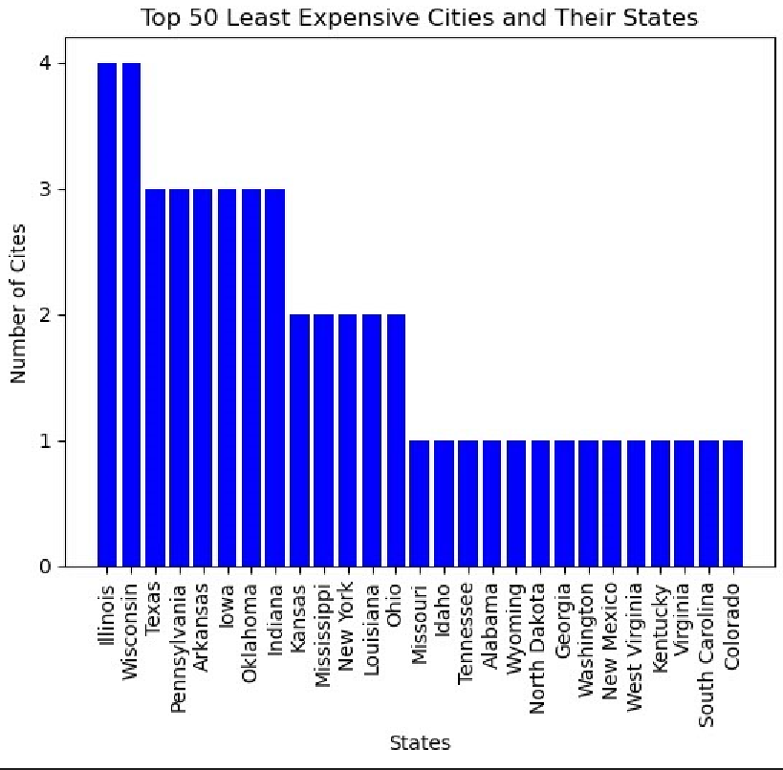
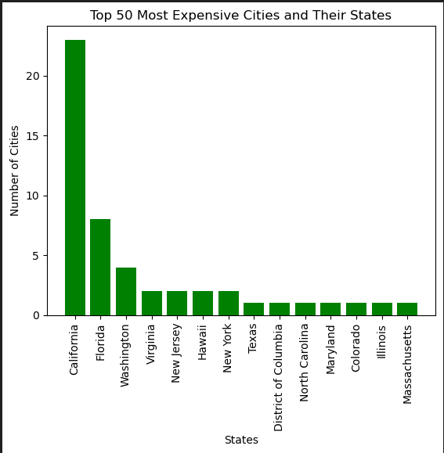
50 least expensive cities and their state
23 of the most expensive cities are in California
8 of the most expensive cities are in Florida

Slide 6
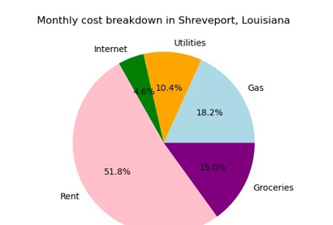
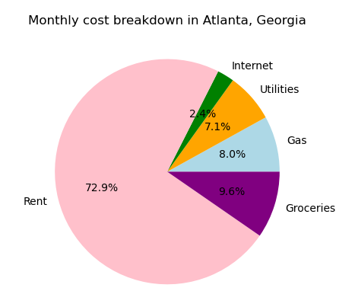
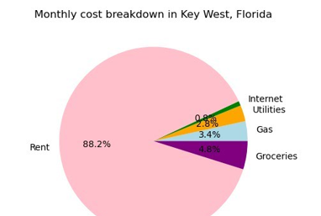

Slide 7
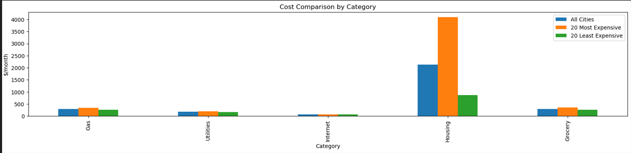
Outside the City Center living expensive
Utilities and internet costs consistent across cities.
Housing drives cost of living.
Housing drives cost of living

Slide 8
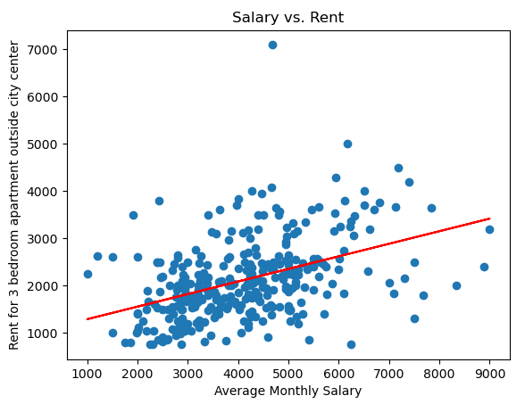
Data Analysis:

Slide 9
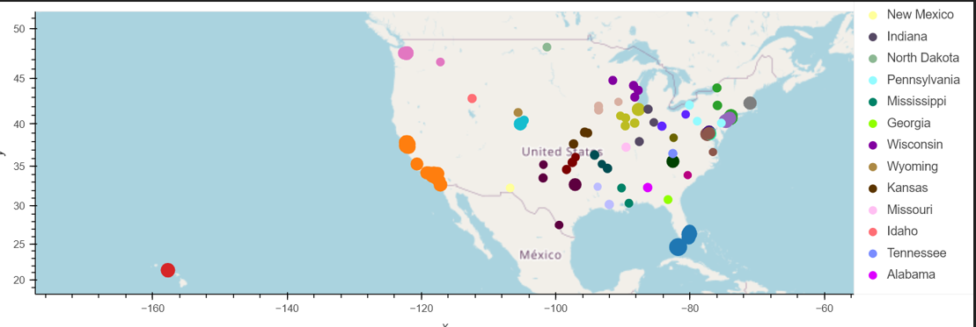
Cost of Living in US Cities

Slide 10
Conclusion:
Importance of considering public transportation.
Checking multiple cities and reformatting data can improve accuracy.
California noted to be above national cost of living and may not ideal for computer data programmers.
Limitation:
no State information from the Primary Data source.
Open Weather API used to add State information

