Slide 1

GROUP 2 : THE DATA NINJAS EVALUATING COST OF LIVING IN THE US CITIES
Cynethia Martinez,
Faiza Ahmad,
Libby Berter
Nicole Harris,
Tsebaot Kebede,
February 2023

Slide 2
Cost of Living in US Cities
Introduction:
Welcome to this presentation on the cost of living in US cities.
Importance of considering cost of living when relocating for job opportunities.
Determine the lowest cost of living cities (or states) in the US based on
Utility
food
housing expenses
Goal: understand cost of living and make informed decision on relocation.

Slide 3
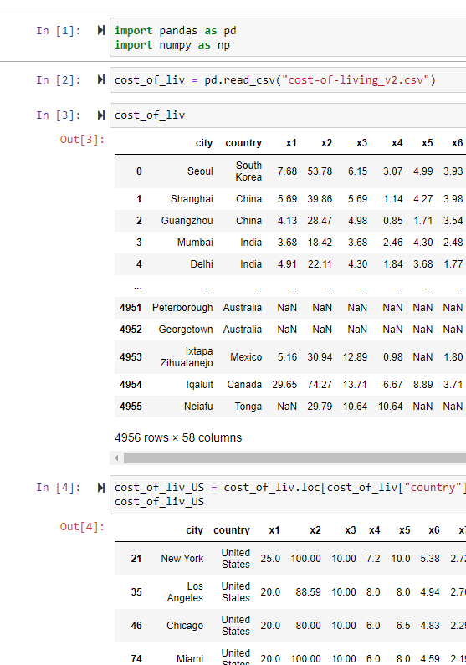
Data collection:
Sources:
"Global Cost of Living" dataset on Kaggle.
Open Weather API
Initial Steps
Read data from the source files
Extracted the US data, dropping the data from 4,956 rows to 1073
Cleaned the data dropping the empty rows, and decreased the number of rows from 1073 to 313.
Data Analysis
Using Python, Pandas, JSON, and Matplotlib.
Merged Columns
Added relevant columns
Renamed columns
Sorted & Plotted the data

Slide 4
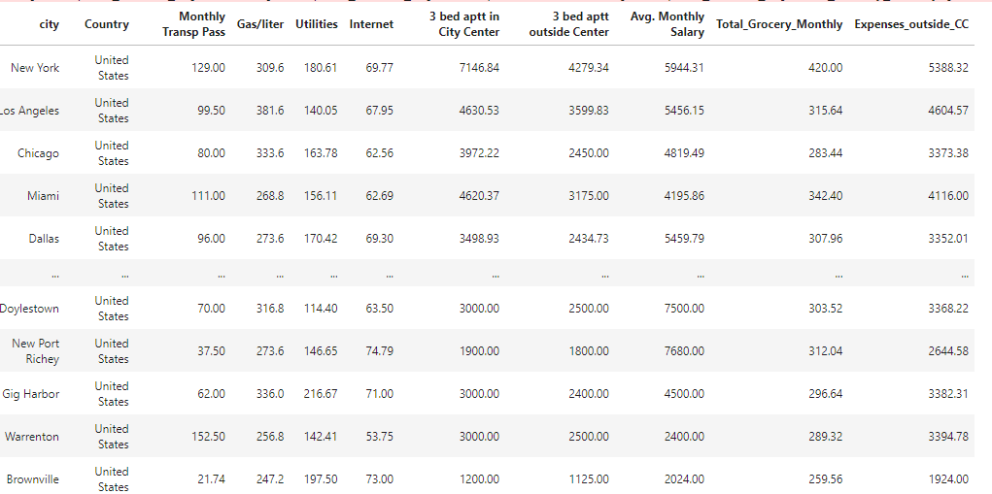
Monthly Expenses & Incomes:
Assuming expense for a Family
Expenses
Monthly transportation
Gas per liter
Utilities
Internet
3 bed apartment outside City Center
Total Grocery
Income
Average Salary

Slide 5
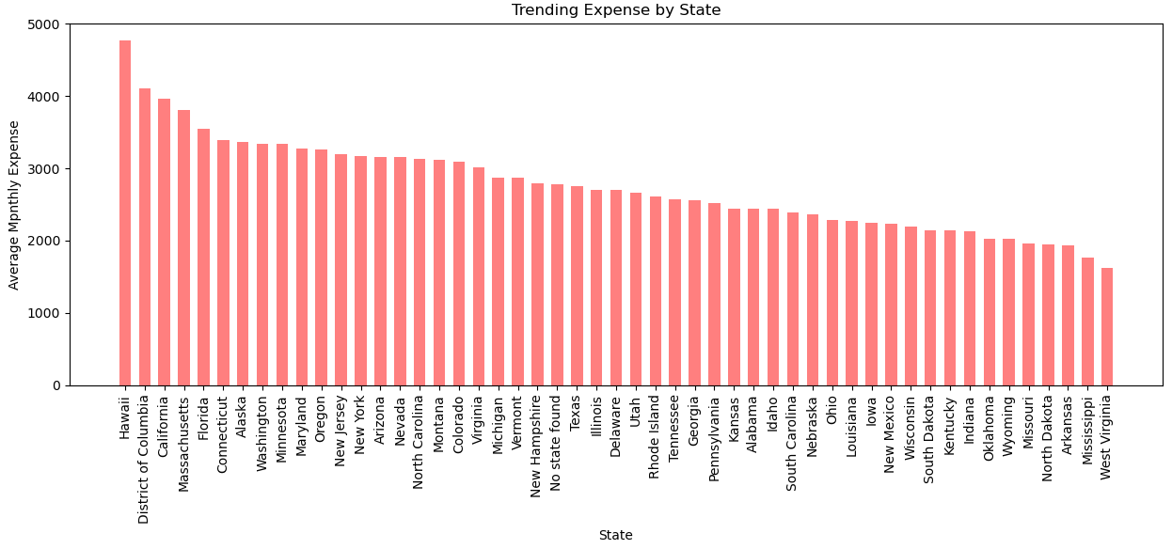
How does Cost of Living vary by State?
Most expensive states: Hawaii, DC, California, Massachusetts, Florida, Connecticut.
Most expensive cities: Key West (FL), Boca Raton(FL), Red Wood City(CA), New York(NY), Mountain View(CA).
Least expensive states: West Virginia, Mississippi, Arkansas, North Dakota, Missouri.
Least expensive cities: Shreveport(LA), Dubuque(IA), Sumter(SC), Suffolk(VA), Russellville(AR).
Trending expense by state. Hawaii being the most expensive

Slide 6
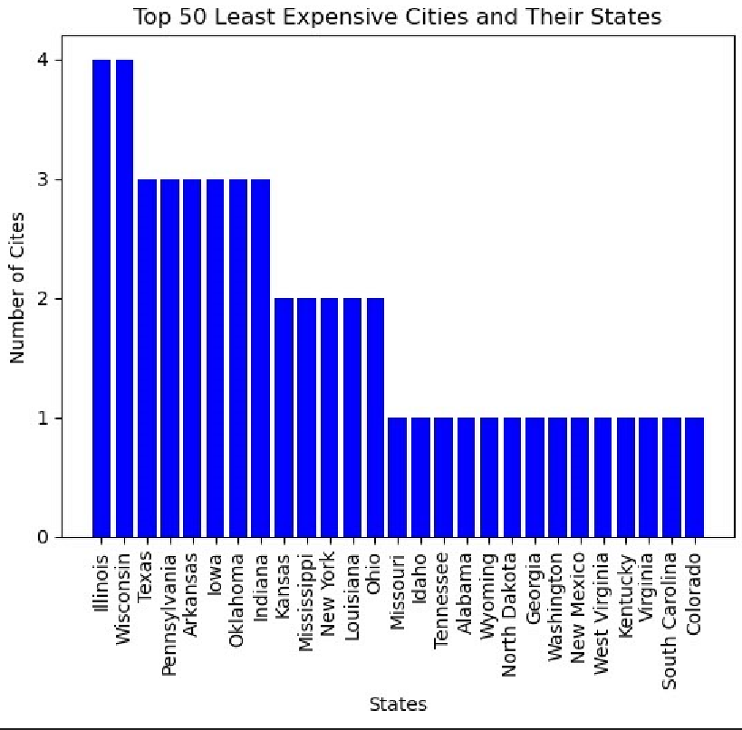
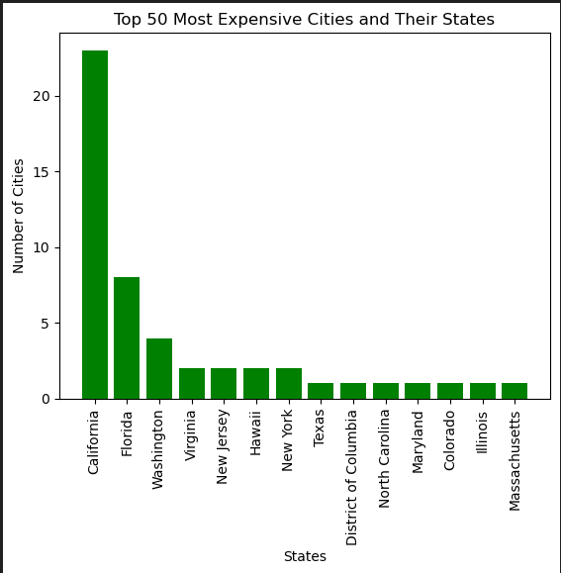
50 least expensive cities and their state
23 of the most expensive cities are in California
8 of the most expensive cities are in Florida

Slide 7
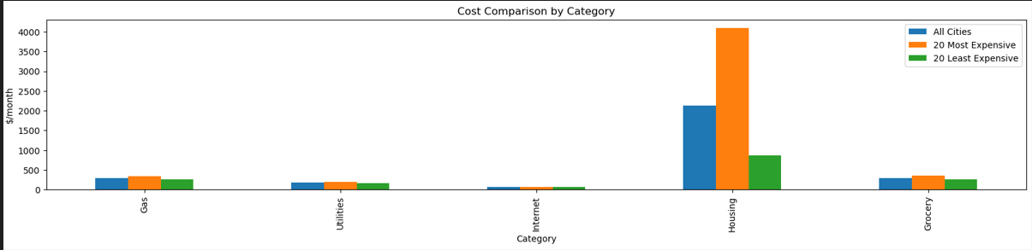
What drives living cost?
Utilities and internet costs consistent across cities.
Housing drives cost of living.
Housing drives cost of living

Slide 8
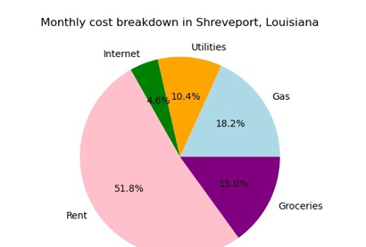
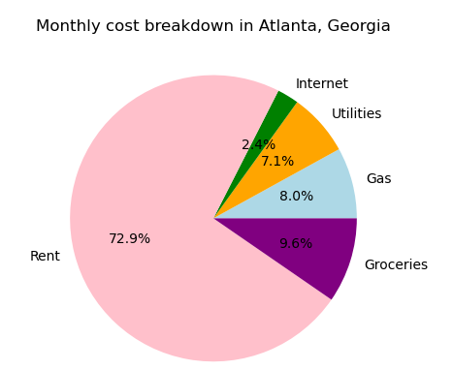
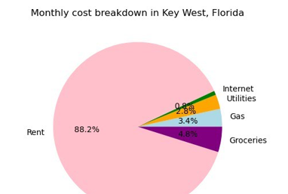

Slide 9
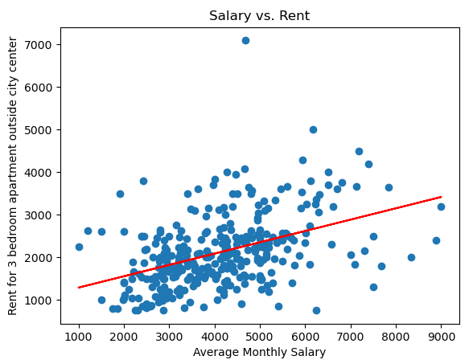
Data Analysis:
The plot shows that there is a positive correlation between monthly salary and the rent.

Slide 10
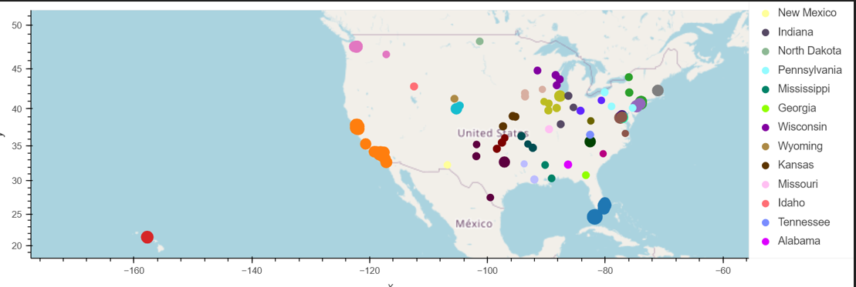
Cost of Living vary geographically?
Size by average Monthly expense

Slide 11
Conclusion:
Based on the data
Housing was the main driver of cost of living.
For family with average monthly salary income, it is more appropriate to live outside the city center than in the city center
If there is the option to work remotely, the least expensive states will be ideal for living: Mississippi, Arkansas, North Dakota, Missouri.
Geographical location is turned out to be one of the significant factors, with cities on the North East and Western Coast being the most expensive.
If additional time allowed, others important factors like weather, hobby, education, crimes etc. should be considered.

Slide 12

Thank you

