Slide 1
Large-Scale and Multi-Structured Databases ApparelSpotter
Tesgay Gebrelibanos
Olani Gerba

Slide 2
Application Highlights
Apparel Spotter is a web application designed to connect fashion enthusiasts with nearby clothing options tailored to their tastes.
The application is designed for:
Customers:
To find nearby apparel shops
To get clothing suggestions based on their style preference
Retailers:
To publish new clothing collections and gather user feedback
To get trend analysis data

Slide 3
Dataset Description
The data set for Apparel Spotter is a comprehensive compilation of review, customer, and retailer details obtained from Kaggle, combined with clothing specifics gathered through web scraping from eBay.
The dataset consists of:
10.8k Cloth items
100 numbers of Retailers
1000 number of Customers
301.6k Review items

Slide 4
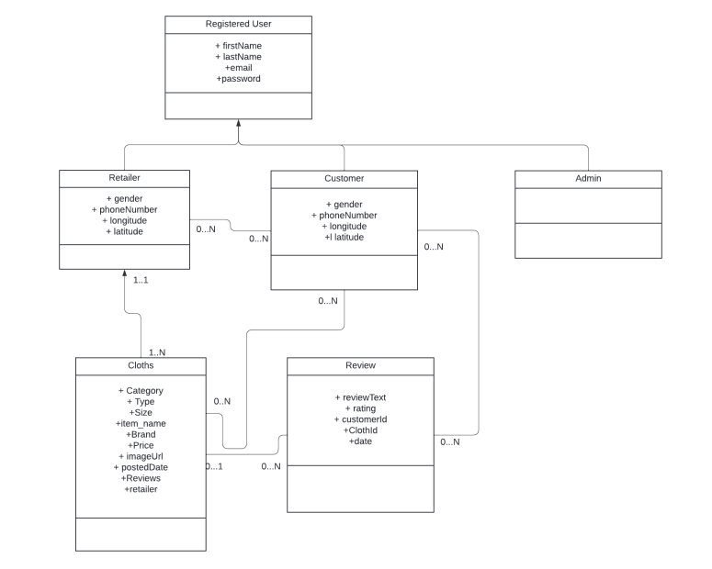
Preliminary UML Class Diagram

Slide 5
Non – Functional Requirement
The application must be fast and return quick responses to its users
The application must be able to support a high number of concurrent users
The application must work on web platforms
The application must be user-friendly for all its users
The application must be able to serve users 24/7
The application should be able to handle an increasing number of users and data without a decrease in performance.
The application allows for the easy addition and modification of data structures as the application evolves and user needs change.

Slide 6
CAP Theorem Consideration
According to the non-functional requirements, our system must provide high availability, Partition tolerance while trading off strict consistency. We orient our application on the A (Availability), P (Partition Tolerance) edge of the CAP triangle ensuring eventual consistency.

Slide 7
Document DB Design
Browse for a cloth
Post cloth items
Find cloth by preference
Browse apparel shops
Show popular Brands and retailers
Show retailer’s statistics based on based on category
Recommendation based on top – rated by review and average ratings

Slide 8
Graph DB Design
Follow a retailer
Like a clothing
Recommendation based on top – liked clothing
Recommendation based on like/follow
Find nearby apparel shops
Show retailer’s statics based on their number of likes and follower

Slide 9
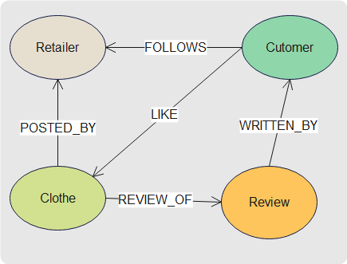
Cont…

Slide 10
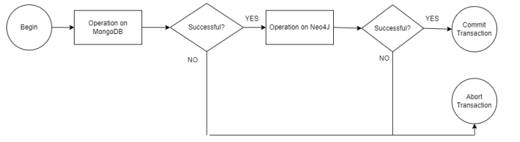
Consistency Between MongoDB and Neo4J
The operations that require cross database consistency include adding/removing a user, adding/removing a clothing item and reviewing/liking/following a clothing or a retailer. To achieve this, we utilize MongoDB’s transactions.

Slide 11
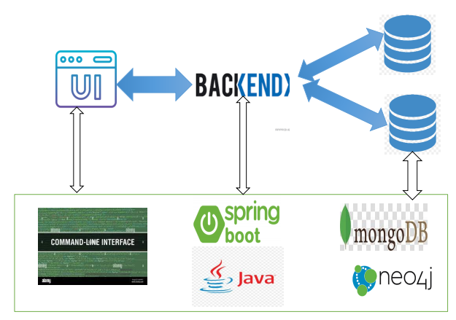


Software Architecture Preliminary Idea

Slide 12
Sharding
The sharding should be implemented by selecting one sharding key for each collection of the document database.
For the Cloth collection, the attribute Category is used as a sharding key.
For the Retailer collection, the attribute Location is used as a sharding key.
For the Customer collection, the attribute Location is used as a sharding key.
For the Review collection, the attribute Cloth_id is used as a sharding key.

