Slide 1
Bring Your Presentations to Life with 3D
How to get started with 3D in PowerPoint
About this deck
Office 365 subscribers can add 3D models to documents and rotate the angle to show the right view. If you don’t have a subscription, the deck simply shows a single view.

Slide 2

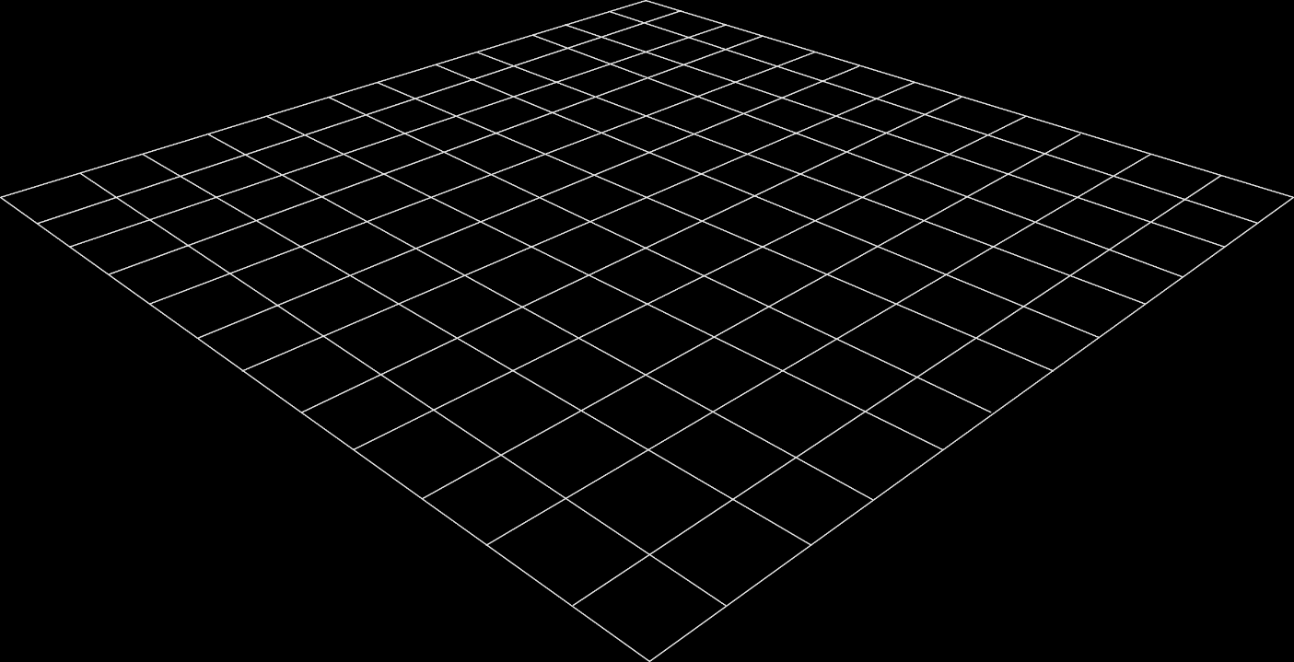
Why Use 3D?
2D Slides
3D Models
Slides are a static portrait.
3D helps foster conceptual understanding and visual and spatial thinking.
Audience is passive and cannot interact.
Animated 3D models display objects within space in ways text and images cannot.

Slide 3
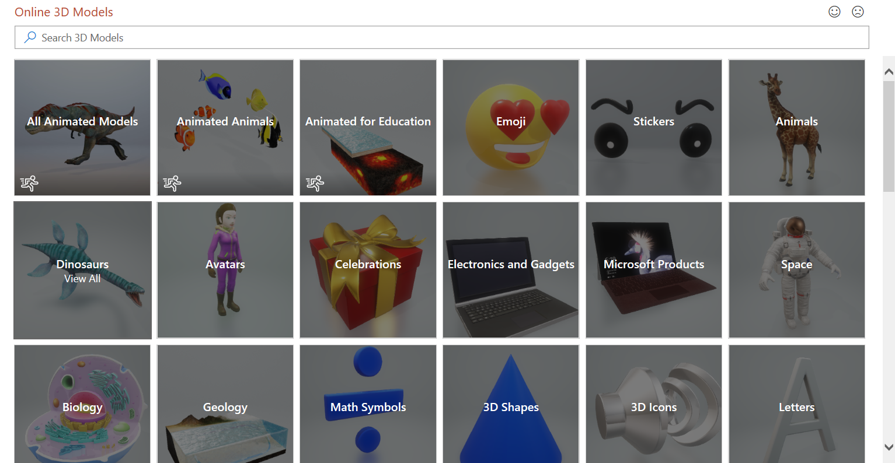
No 3D Model? No Problem!
Microsoft makes it easy to insert a 3D Model! Simply go to the Insert Ribbon and click on the 3D Models option. Choose the option for online sources gallery (shown at the right). Select the model you wish to insert.
3D Models is a subscription-only feature. If you have an Office 365 subscription, the next slide shows you how it works in a new presentation.

Slide 4
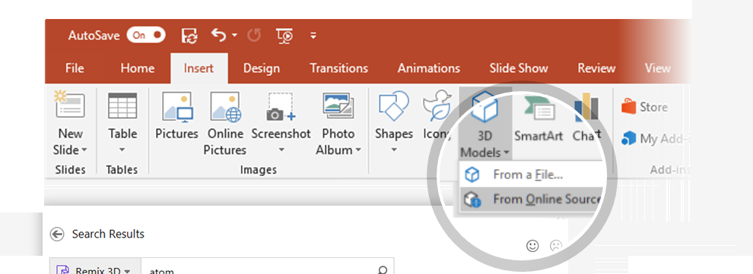
How to Insert a 3D Model
To Insert a 3D Model:
  From the Ribbon, go to
  Insert > 3D Models
  -or-
  Insert > 3D Models from Online Sources
  That will open the Online 3D Models Window where you can search or browse categories of various 3D models, right from within PowerPoint.
  Hint: You need to be online when you add the model.
  To search for a keyword, type a word or phrase into the search box at the top of the window and press enter.
  To insert a 3D Model, click or tap on the model > Insert.
  The 3D Model will now be downloaded and placed onto your PowerPoint slide.
1
2
3

Slide 5

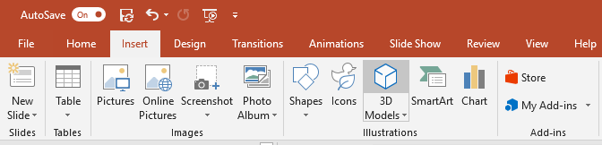
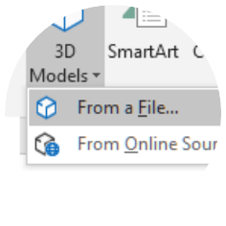

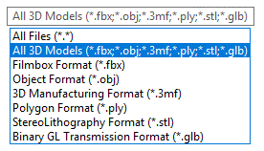
Have Your Own 3D Model? You Can Import It!
PowerPoint allows you to import a variety of popular 3D model formats.
So no matter your workflows outside of PowerPoint, you should be able to find a suitable solution to make your 3D models portable and presentable to virtually anyone, anywhere and on any device (with just a few quick modifications)
To Insert a 3D Model:
1
Go to Insert > 3D Models from a File…
This will open the Insert 3D Model Window where you can search your computer, network or cloud drive for any saved 3D models.
2
Insert the 3D model by selecting the file and clicking on Insert.
The 3D Model will now be placed onto your PowerPoint slide

